Slide 1
The Black Death, 100 Years’ War, Church Breakdown, and Medieval Russia
8/26/11

Slide 2
Black Death
What was it?
How was it caused?
What were the symptoms?
What were some “remedies”?
What were the believed causes?
What were social and economic consequences?

Slide 3
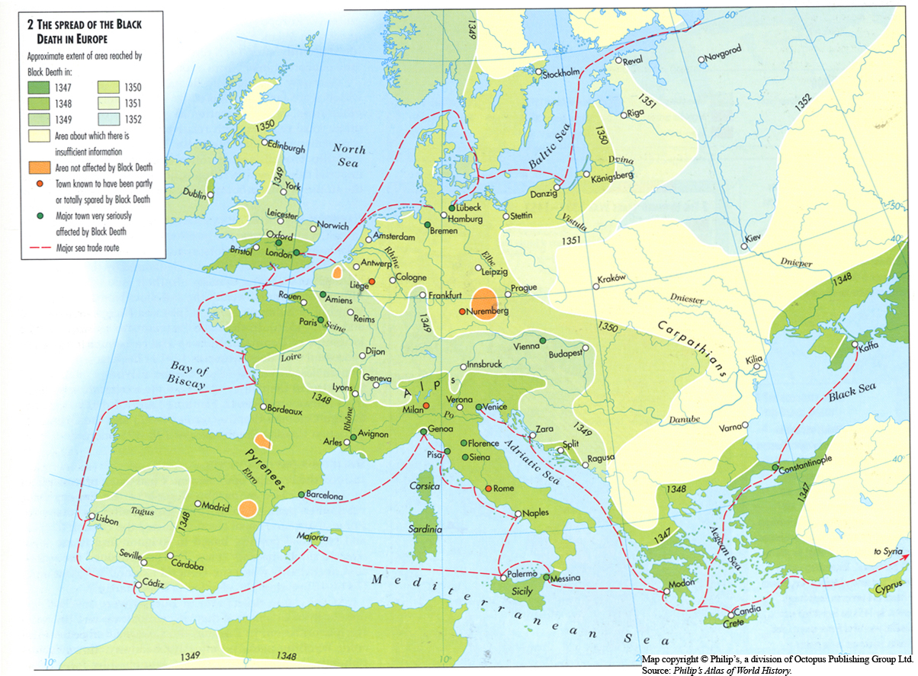

Slide 4
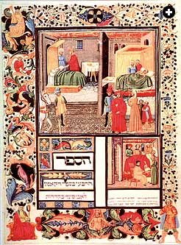

Slide 5
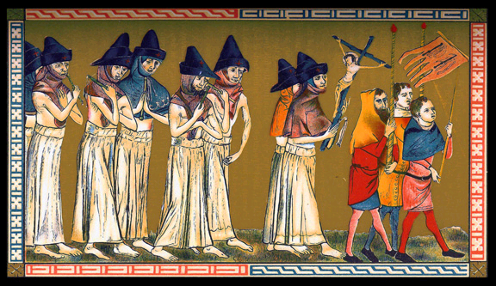

Slide 6
100 Years’ War
Causes
Progress of the War
Conflict during Reign of Ed III
French Defeat and Treaty of Troyes
Joan of Arc and the War’s Conclusion

Slide 7
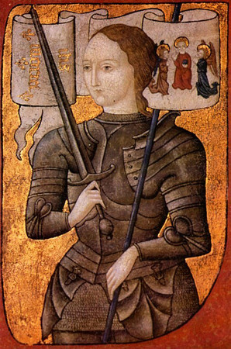

Slide 8
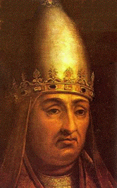
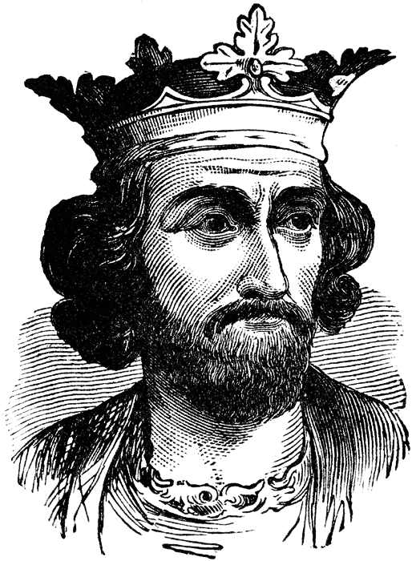
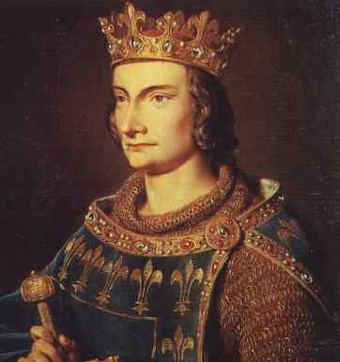
Church Politics
Plentitude of Power
Benefices
Political power of the church
Sequestering of bishops
Boniface vs. Phil and Ed
Clerical Laicos
No court hearing or money exportation
Unam Sanctam
Death of Boniface

Slide 9
Avignon
Moving the papacy to Avignon (Fr.)
Annates and indulgences
Opposition to Avignon

Slide 10
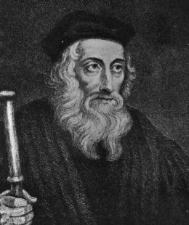
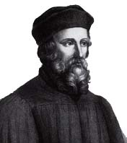
Wycliffe and Huss
Wycliffe/Lollards
Donatism
Vernacular, Eucharist
Huss

Slide 11
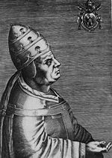
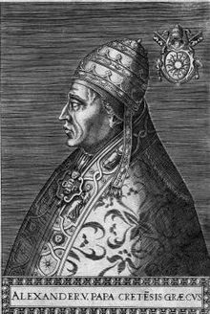
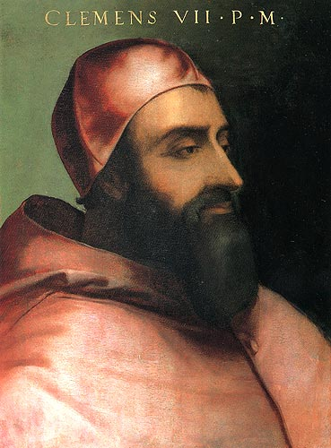
The Great Schism/Conciliar Movement
“Babylonian Captivity”
Urban VI (It.) and Clement VII (Fr.)
Solutions
Cession of both
Resignation of one
Conciliar Theory
Council of Pisa
Alex V
Council of Constance
Sacrosancta and Martin V

Slide 12
Council of Basel
Four Articles of Prague (Hussites)
Eucharist for laity
Free preaching
No clergy in secular offices/holding property
Punishment for sinful clergy
Results
Consequences

Slide 13
Medieval Russia
Choice of state religion
Greek Orthodoxy
Kiev as a center of politics and culture
Rivalry of three cultures
Great, White, Little (Uk.)
Russian gov’t
Mon., Aris., Dem.
Social divisions
Free (clergy, officers, boyars, townspeople, peasants) vs. slave (POW)
Semi-free (debtors)

Slide 14
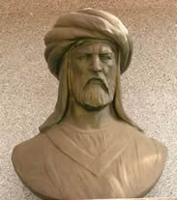
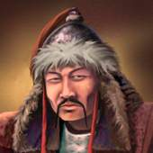
Mongolian BBQ
Tatar/Mongols
Ghengis Khan and Batu Khan
Golden Horde
Slavery and harems
Cultural diffusion
Dimitri defeats

