Slide 1
The Causes of WWI

Slide 2
Nationalism
Growth of nationalism, deep devotion to one’s nation
Competition between nations to overpower one another
Rivalry among Europe’s great powers (Germany, Austria-Hungary, Great Britain, Russia, Italy, France)
Sources of rivalry:
Competition for materials and markets
Territorial disputes
Calls for independence

Slide 3
Imperialism and Militarism
Competition for colonies in Africa and Asia
To be great, a nation must have a powerful military
All nations except Britain have standing armies by 1914
Nations should be able to mobilize quickly
Militarism: policy of glorifying military power and keeping an army prepared for war
Leads to sense of patriotism
Some are frightened

Slide 4
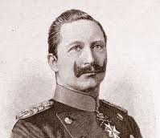
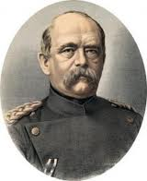
Alliances
Alliances created to keep peace, but eventually lead to war
Otto von Bismarck (Prime Minister, Prussia) wants to keep peace in Europe
Wants to isolate France to keep it from gaining power
Forms dual alliance with Germany and Austria-Hungary (Triple Alliance)
Allows Russia to join alliance
Kaiser Wilhelm II (Germany) forces Bismarck to resign
Ignores Russia, who signs treaty with France in 1892-94
Wilhelm begins building navy of Germany to rival Britain
Fearing growing power of Germany, Britain forms alliance with France and Russia (Triple Entente)

Slide 5
The Balkans Lead to War
Home to many ethnic groups in E. Europe
Nations break away from Ottoman Empire and create new nations
Bulgaria, Greece, Montenegro, Romania, Serbia
Each new nation has a strong sense of nationalism and wants to extend borders
Serbia wants to absorb all of E. European Slavic population, Austria-Hungary fears rebellions inside its borders
In response to Serbia, Austria annexes Bosnia and Herzegovina (Slavic nations)
Angers Serbians, who try to take Bosnia and Herzegovina away
Austria-Hungary vows to fight against Serbia

Slide 6
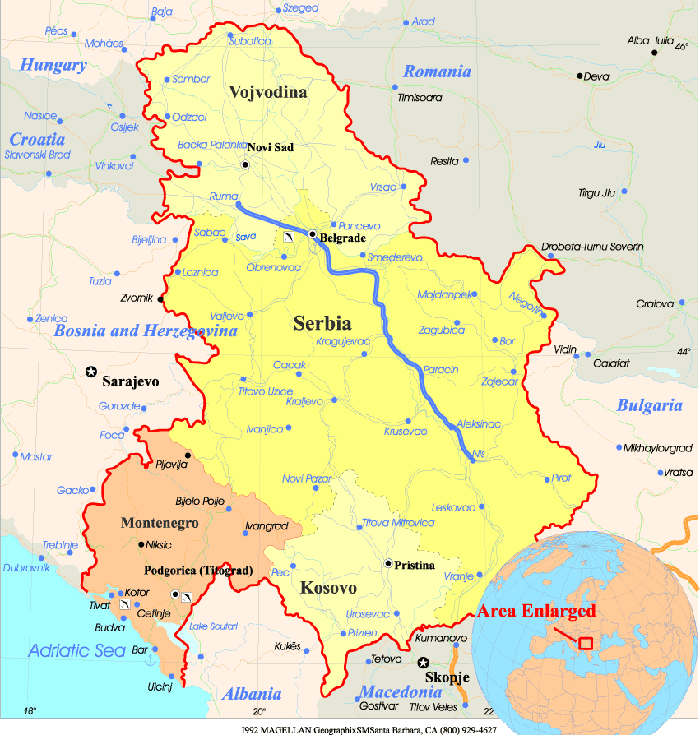

Slide 7
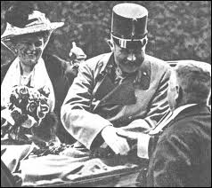
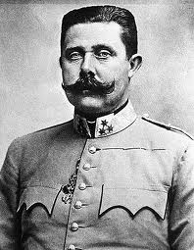
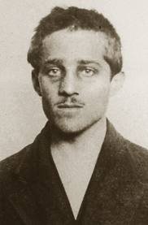
The First Shot of WWI
June 28, 1914: Archduke Franz Ferdinand (heir to throne of Austria-Hungary) and his wife visit Sarajevo, Bosnia
While riding in their car through Sarajevo, they are shot by a Serbian, Gavrilo Princip
Princip is member of Black Hand, a group wanting to rid Bosnia of Austrian rule
Austria-Hungary decides to punish Serbia
Declaration of war on July 28

Slide 8
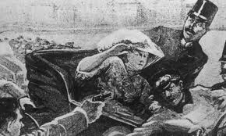

Slide 9
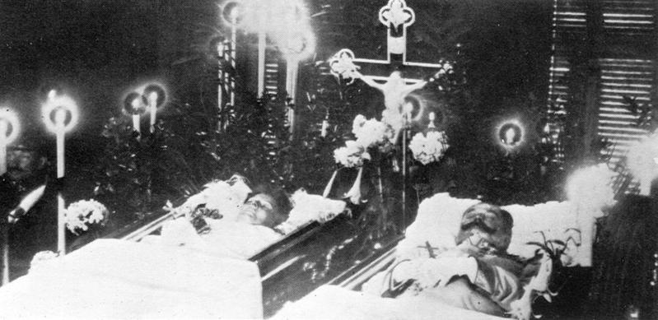

Slide 10
Alliances Drawn Into War
Austria declares war on Serbia
Russia (Austrian ally) enters war by settling on Russian and German borders
Germany takes this as threat, declares war on Russia and France
Russia asks France for help, Britain steps in

Slide 11
Settled Alliances
Central Powers
Austria-Hungary, Germany, Bulgaria, Ottoman Empire
Allies/Allied Powers
Great Britain, France, Russia, Japan, Italy (switches sides from CP)
Young men march off to war, believe the war will be short (over by Christmas)

Slide 12
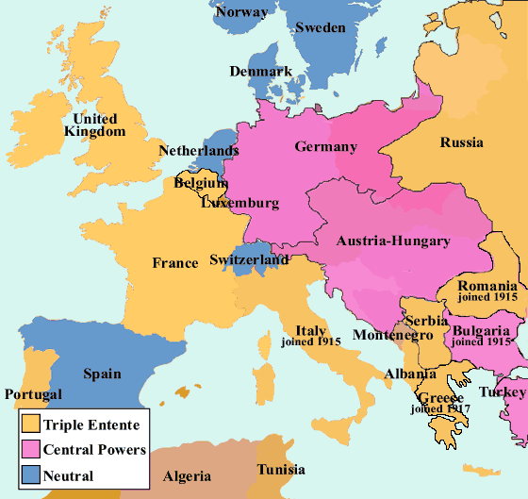
N
W
E
S
Triple Entente
Triple Alliance
1”=500 mi.

