Slide 1
Causes of the Cold War

Slide 2
Allies become Enemies
US upset that Stalin signed nonaggression pact with Hitler in 1939
Stalin blames Allies for not invading Germany pre-1944
Yalta Conference (2/1945)
Divide Germany into zones of occupation controlled by Allied military forces
W. Germany controlled by US/W. Europe, E. Germany controlled by USSR (as is W and E Berlin within E. Germany)
United Nations (6/1945): international organization made up of 50 nations to protect members against aggression

Slide 3
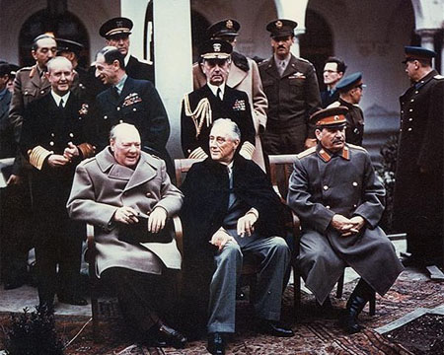

Slide 4
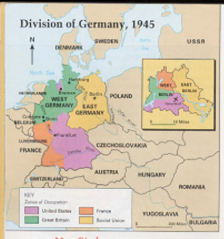

Slide 5
Superpower Aims in Europe, post-WWII
The US
The USSR
Encourage democracy to prevent rise of communist governments
Gain access to raw materials and markets to fuel booming industries to help Europe
Rebuild European governments to promote stability
Reunite Germany to stabilize it and increase security of Europe
Encourage communism as part of a worldwide workers’ revolution
Rebuild own war-ravaged economy using E. Europe’s industrial equipment and raw materials
Control E. Europe to protect Soviet borders
Keep Germany divided to prevent its waging war again

Slide 6
The Iron Curtain
The Soviet Union fears invasion
No natural boundaries
Nations along USSR’s western border act as buffer of protection (Iron Curtain)
Stalin ignores Yalta and installs Communist governments in Albania, Bulgaria, Hungary, Czechoslovakia, Romania, Poland, Yugoslavia
Truman, Stalin, Churchill meet in Potsdam
Truman asks Stalin to allow free elections, Stalin refuses
States that communism and capitalism could not coexist in the same world

Slide 7
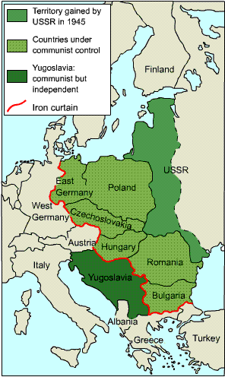

Slide 8
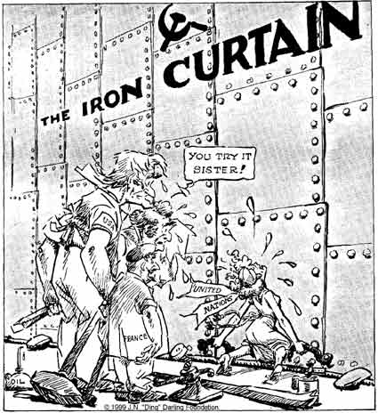

Slide 9
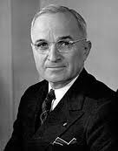
Containment
Containment: policy directed at blocking Soviet influence and stopping the expansion of communism
Forming alliances, helping weak countries resist Soviet advances
Truman Doctrine: support of the US for nations that rejected communism

Slide 10
The Marshall Plan
Give aid to needy European nations
Food, machinery, other materials
Provide machinery to stimulate jobs, money for nations to dole out on their own
Communists take over Czechoslovakia in 1948
Congress approves Marshall Plan ($12.5 billion)
Rather than ruling West Germany to be divided amongst Britain, France, and US, the allies allow it to create a unified nation
USSR decides to hold W. Berlin hostage by cutting off highways, water, and rail traffic
Leads to starvation
The US flies food and supplies into W. Berlin (Berlin Airlift) for almost a year

Slide 11
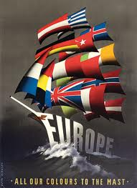

Slide 12
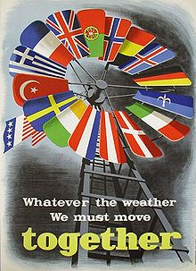

Slide 13
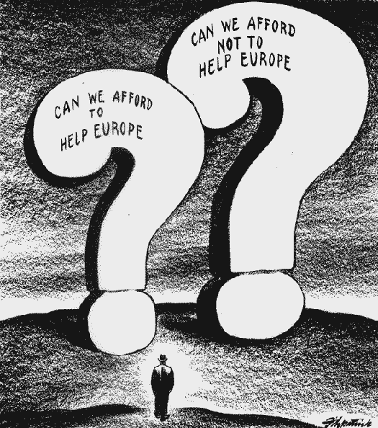

Slide 14
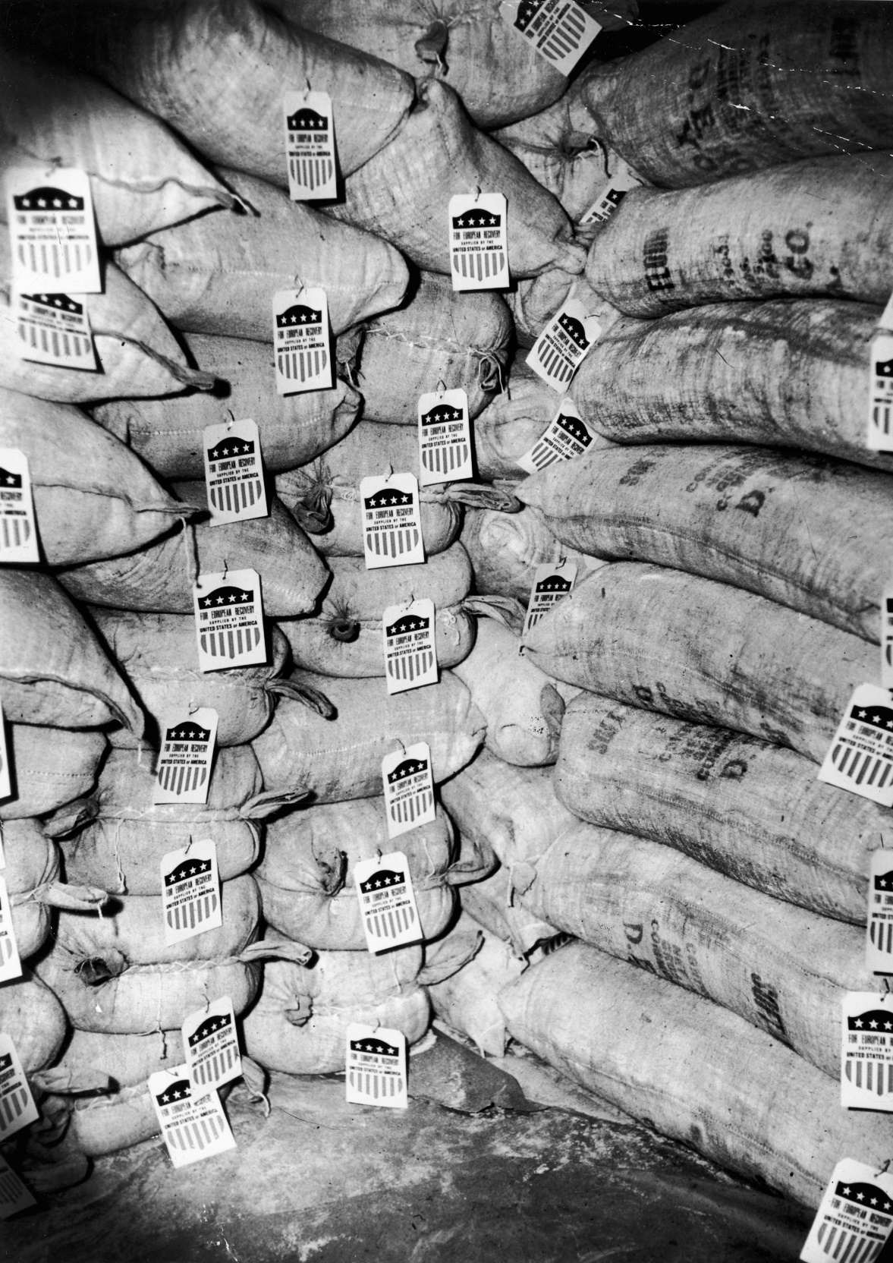

Slide 15
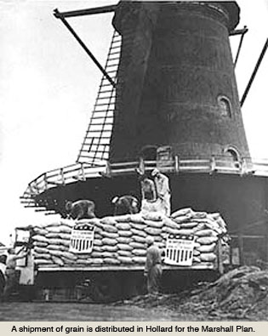

Slide 16
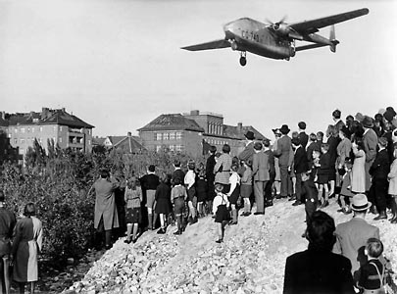

Slide 17
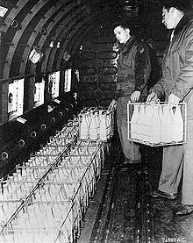

Slide 18
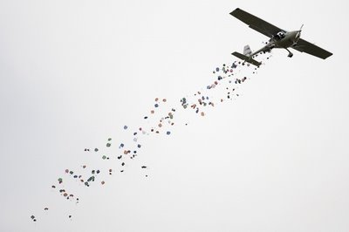

Slide 19
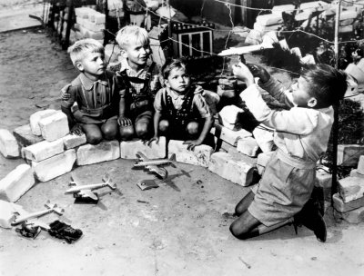

Slide 20
The Cold War
Cold War: struggle over political differences carried on by means of short military action/war
Spying, propaganda, diplomacy, secret operations
NATO (North Atlantic Treaty Organization)
Ten w. European nations join the US and Canada
Defensive alliance to protect involved nations
Warsaw Pact
Alliance of USSR, E. Germany, Czechoslovakia, Poland, Hungary, Romania, Bulgaria, Albania against capitalism
E. Germans build wall separating E & W Berlin (1961)

Slide 21
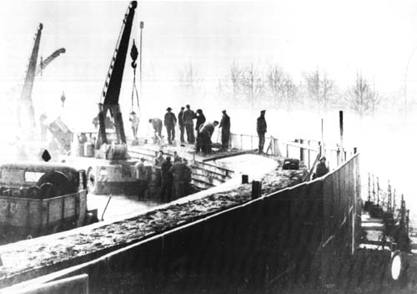

Slide 22
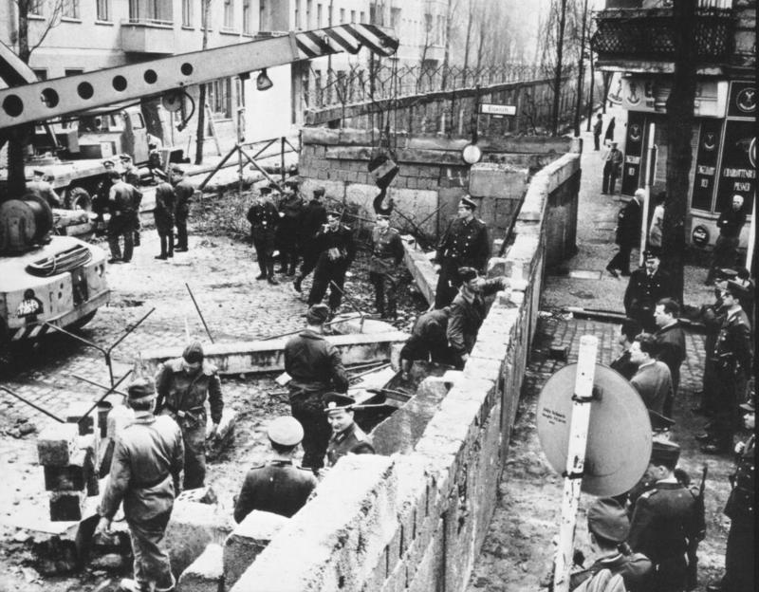

Slide 23
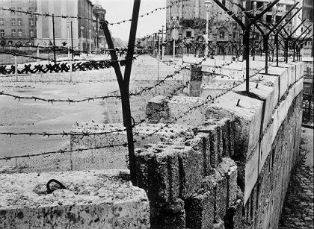

Slide 24
Nuclear War?
USSR begins building nuclear atomic weapons
US already has nuclear weapons from WWII
Begins developing hydrogen (H) bomb
Countered by USSR
Brinkmanship: willingness to go to the brink (edge) of war
Required reliable source of nuclear weapons and airplanes
Stockpiling of weapons and airplanes (arms race)
MAD (Mutually Assured Destruction)

Slide 25
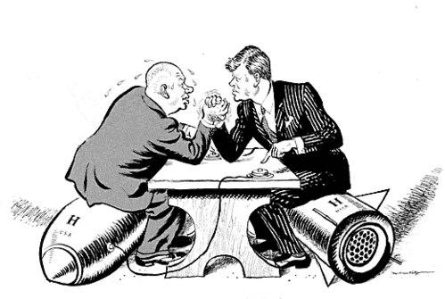

Slide 26
Sputnik
Intercontinental Ballistic Missile (ICBM) developed by Soviets
ICBM pushes Sputnik (first space satellite) into space (1957)
Sputnik causes the US to pour money into math and science education
US launches own space satellite in 1958
USSR refuses to allow the US to fly over USSR
US sends spy planes (U-2) over, shot down

Slide 27
