Slide 1
Conquest and Colonization in Latin America

Slide 2
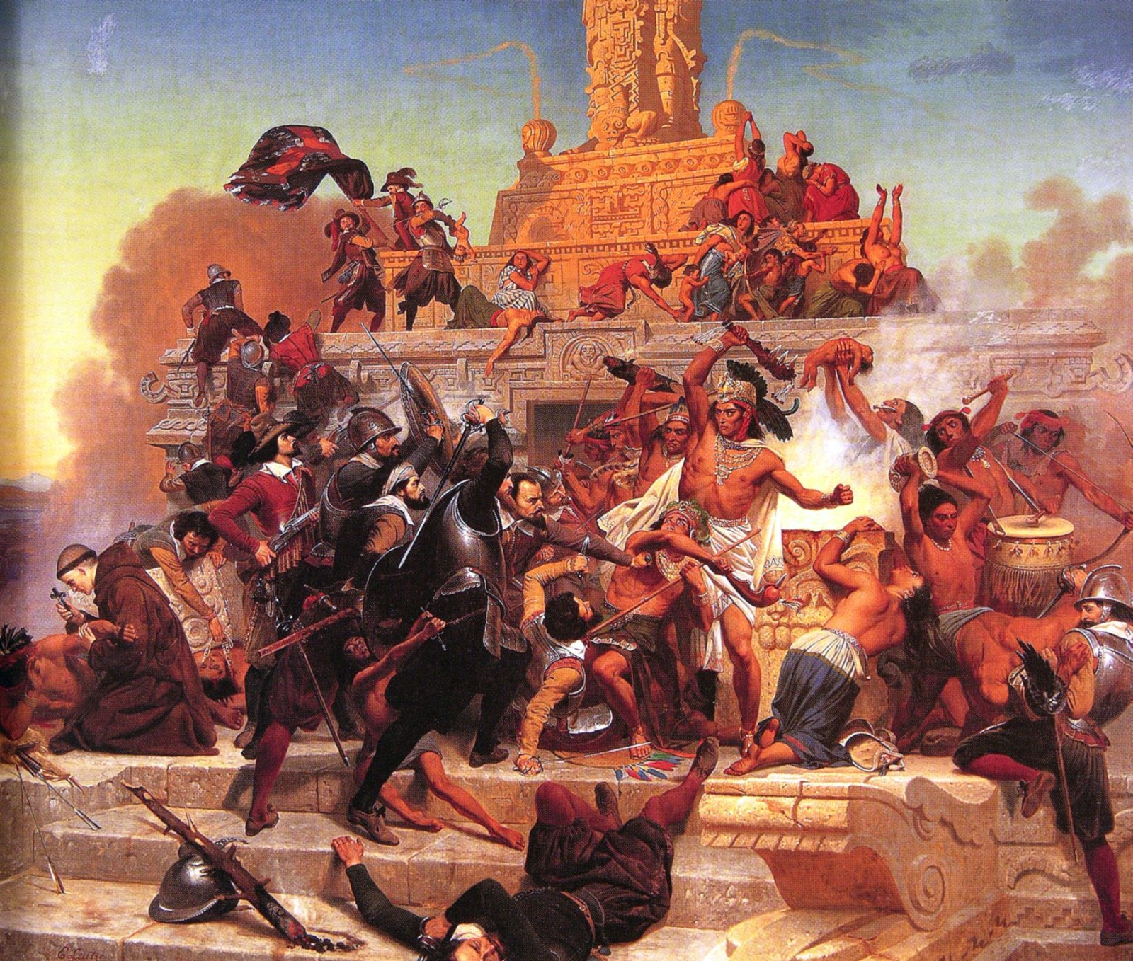
Module 1: Spanish Conquest

Slide 3
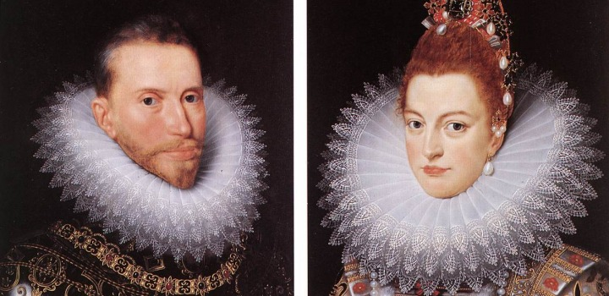
Iberian Europe
Frontier between Christianity and Islam
Creates strong tradition of military and ability to rule people of other belief systems
Emergence of Christian kingdoms
Portugal, Aragon, Castile
Unification of Aragon and Castile
Marriage of Ferdinand and Isabella
Seeks to eliminate religious and ethnic divisions
Expulsion of heretics and Jews
Heavily urban region
Majority peasants living in suburbs and towns
Want to make themselves a “new nobility,” participate in colonial conquests
Patriarchal society easily adapted through encomienda system
Bureaucratic administration of kingdom, empire, colonies
Church as a part of politics, royal nomination of clergy
Agricultural economy based on sugar and slave trade

Slide 4
Chronology of Expansion
Three periods:
Conquest, 1492-1570
Consolidation, 1570-1700
Reform and reorganization, 1700-1800s

Slide 5
Caribbean Colonialism
Early focus on the Caribbean
Return voyage to Hispanola (1493)
Columbus sets up government under his son
Colonial Santo Domingo images
Other colonies include Puerto Rico, Cuba, eventually moving to Panama and South America
Use of Taino as laborers under encomienda
Taxation of labor using natives, similar to serfdom
Set up colonial cities similar to Spanish layout
Grid plan with town hall, church, and governor’s palace in central plaza
Surrounded by fortifications for protection against natives, other European navies
Administrative bureaucracy
Governorship, treasury, court of appeals, notaries, law body, church, university
Importation of African slaves for new sugar industry
Lucrative nature of colonies leads to new immigrants (including women)
Begins early settlement of Caribbean
Depopulation of natives
Support by clerics (Bartolome de Las Casas)
Suspension of encomienda by crown, not heeded by plantation owners
Importation of African slaves

Slide 6
Conquest
Conquistadors
Groups of 50-500
Led the charge, followed later by priests, women, merchants who begin civil society
Two pronged conquest:
Mexico (1519-21)
Hernan(do) Cortes(z)
600 men into central Mexico (mythical treasures)
Dominate tribes surrounding Aztecs, using them against Aztecs
Capture and kill Moctezuma/Montezuma II
Remaining Aztecs die of starvation, slaughter, disease
Establishment of New Spain
South America
Francisco Pizarro (1533-40)
200 men begin in Panama, stretch down into South America
Meet Incas who are weakened by civil war, utilizing native enemies of Inca
Coronado and Valdivia explore and conquer SW North America and central Chile, Amazon

Slide 8
Conquest of the Mainland
Searching for treasures
Conquerors=80%, crown=20%
Treasure split on shares basis
Conquerors get more shares based on importance, sometimes reward friends and families with treasure
Conquerors a smattering of social groups
Clergy, gentlemen, peasants
Hoping to better themselves by conversion, become a “new nobility”
Bureaucratic administration develops
Merchants, colonists, law courts, bureaucrats, viceroys

Slide 9
The Morality of Conquest
Moral and philosophical questioning of conquest
Who were the Indians?
Are they fully human?
Is it proper to convert them to Christianity?
Is conquest of their land justified?
Conquest is necessary to spread the gospel
Spain freed natives from unjust lords to bring salvation
Control of Indian labor essential for Spanish rule
Natives not fully human and “born to serve”
King suspends encomienda system in 1550 to hold arguments on humanity of natives
Natives are rational people who never harmed Christendom
Conquest as unjustified, conquest only through peaceful means
Many farmers ignore king’s dictate and continue encomienda system

Slide 10
Reflection Questions
How were the Spanish colonies a reflection of political and cultural life of those living on the Iberian peninsula?
Explain the economies and politics of Spanish colonies.
Do you think that Spain’s method of taking land in the Americas and Caribbean was justified? Why or why not? If disagree, explain a different way of taking this land for Spain.
Why was Spain so successful in taking land in the Americas and Caribbean?
How did Spain justify the conquering of land?
Do you think the use of natives or Africans as laborers was a better system? Why?

Slide 11
Module 2: Effects on Indian Societies

Slide 12
Native Exploitation
Native religion and priestly class eliminated
Local native nobility kept in place
Rule for Spanish, acting as middlemen for taxes and labor
Slavery of natives forbidden in 1500s
Mita: labor tax by Spanish lords
State labor projects, church construction, road building, mining, agriculture
Paid wage, endured abuses
Many natives flee to avoid the mita, leading to a wage labor system
Natives adapt in some ways while still trying to maintain traditions

Slide 13
Multiracial Societies
Miscegenation
Mixed backgrounds
Mestizos
Mulattos
Hierarchy based on race (castas)
Peninsulares
Creoles
Mestizos (shopkeepers, small farmers)
Indians
Mulattos
Slaves
Patriarchal
Father with legal authority over children until 25
Women subordinate
Arranged marriages with dowry
Upper class women not getting married sent to convents

Slide 14
Reflection Questions
Compare and contrast castas in Latin America with the caste system in India.
Why do you think Mestizos were higher than Mulattos?
What were the benefits and disadvantages for people of mixed races?

Slide 15
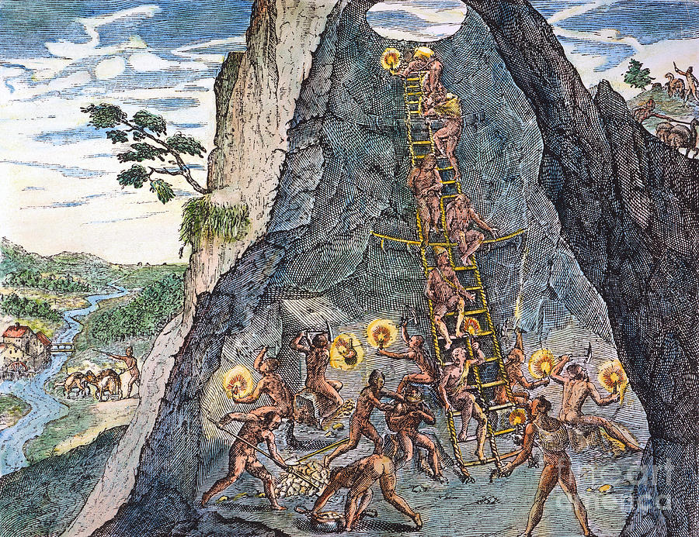
Module 3: Colonial Economies and Governments

Slide 16
Economic Foundations of Spanish Colonies
80% population of Spanish colonists (natives, Europeans, slaves, etc) live in agrarian society
Mining is main basis of Spain’s rule in West Indies
Some gold, mainly silver as Spain’s source of wealth
Silver discovered in Mexico and Peru (1545-65)
Petosi produces 80% Spanish silver, employing 160,000
Early use of encomienda slowly replaced by labor drafts under the mita
Leads to other economic boosts in the area
Huancavelica mercury mining
Infrastructure supporting mining towns
Subsoil rights to silver owned by crown
Mines and plants owned by individuals, owe 20% production to monarchy

Slide 17
Haciendas: Spanish Plantations
Americas predominantly agrarian
Ranches and farms
Land ownership becomes attractive with declining native populations
Creation of large estates producing grain, grapes, livestock (haciendas)
Labor held by natives and mixed
Produced primarily for American consumers, not Spain
Basis for wealth of local aristocracy
Some crops (sugar, cacao) exported to Europe, not comparable to silver

Slide 18
Industry and Commerce
Raising of sheep begins textile industry
Americas become self-sufficient with foods and goods
Europe only provides luxury items for nobility
Trading monopoly: Americans can only trade with Spain, conducted through Seville
Consulado: merchant guild controlling trade
Keeps prices high in the colonies
Trade through convoys using galleons
Multiple ships split treasure and follow each other for extra protection against pirates and other nations
Silver trade to Spain continuous
>50% silver remains in Spain (going to China, other places)
Leads to inflation, rise in prices
Wealth in Spain more dependent on taxes collected

Slide 19
Church and State
Governing colonies bureaucratically
Sovereignty through papal grant, not the crown
Treaty of Tordesillas provides land grants to Castile in return for conversion of natives
Letrados (lawyers) serve in legislative, judicial, and executive roles
Codification of laws under the Recopilacion (1681)
Viceroyalties (governorships) of New Spain and Peru
Two, Mexico City and Lima
High ranking nobles directly representing the king
Held broad military, legislative, judicial powers
Divided into 10 judicial divisions
Controlled by audiencias (superior courts) that make and applied law
Clergy focuses on conversion of natives
Also defend Indian rights (de Las Casas, Sahagun)
Supportive of state policy (appointed bythe state)
Churches designed in European baroque (cathedral) style
Run schools and university to teach law and theology
Hold the Inquisition to enforce morality and orthodoxy

Slide 20
Dissent
High taxes
Government control of tobacco and alcohol consumption
Exposure of Creoles to reform, revolutions, and political ideas in Europe
Sub-ordinance of Creoles to Peninsulares

Slide 21
Reflection Questions
What was Spain’s most lucrative import from the colonies in the New World?
How did this affect Spain’s economy?
Explain the mita system.
Explain why Spain used the convoy system to return goods back to Europe. Why do you think this was successful?
Explain the role of the church in Spain and its colonies.
Explain the bureaucratic system of government in Spanish colonies.

Slide 22
Module 4: Portuguese Brazil

Slide 23
Establishing a Plantation System
Portuguese first arrive in 1500
Pedro Alvares Cabral stops in Brazil on the way to India
Discovers dye wood, granting licenses to merchants
Settlement begins in 1532 (captaincies)
Granted to nobles given strips of land to colonize
Feudal powers
Beginning of sugar cane plantations
Worked by African slaves
King sends governor to create capital at Salvador
Accompanied by missionaries to convert natives
Establishment of port city, Rio de Janeiro, to ship sugar

Slide 24
Brazilian Sugar
Brazil as leader of sugar production throughout 1600s
Plantation hierarchy
Planters and families=aristocracy
Merchants/bureaucrats/officials
Mixed persons (miscegenation)
Artisans, farmers, herders, laborers
Indians
Slaves
Bureaucracy similar to Spain
No education system, so wealthy had to be sent to Portugal for university and printed word

Slide 25
Brazilian Gold
Habsburg kings rule Spain and Portugal (1580-1640)
Habsburgs=Prussia, C. Europe
As Dutch gain independence from Spain, seize part of NE Brazil for sugar production
By 1680s, France, Dutch, English held sugar colonies in Caribbean
Lowers value of sugar and rising prices for slaves
Portugal sends Paulistas (lumberjacks) into Brazilian interior looking for gold
Discovered in 1695, establishing Minas Gerais
Slaves provide labor in mines during gold rush (50% regional population)
Government becomes more strong-fisted to collect taxes
Causes Brazil to become largest producer of gold in “the west”
Effects
Opens interior of Brazil to settlement
Depletes natives, increases slavery
Causes Rio to grow (closest port to mines), becomes capital in 1763
Wealth used to build churches, infrastructure, stimulating cultural advances
Gold used to buy manufactured goods needed for colonies from England, compensating for trade imbalance
Becomes an economic dependency of England

Slide 26
Reflection Question
Putting aside our perception of the values of gold and silver, which precious metal do you think was more lucrative and beneficial to colonial and European societies? Why?
Trace/Explain the growth of Brazil in terms of economics and settlement.
Compare and contrast the colonies of New Spain and Brazil.
How can you predict social hierarchies of colonies to develop based on settlement and relationships of colonists, natives, and African slaves in the Portuguese and Spanish colonies? Explain.

