Slide 1
Columbian Exchange and the Triangular Trade

Slide 2
Essential Questions
How did the Columbian Exchange affect the daily lives of people in the New World and Europe?
How did the Columbian Exchange change the face of Latin America?
What are some of the pieces of evidence from the Columbian Exchange that we can see today?
What are some examples of the cultural impact of the Columbian Exchange?

Slide 3
Causes of African Slavery
Muslims in Africa enslave non-Muslim Africans
Portugal arrives in Africa, 1400s
Native Americans die from European disease
Africans are healthier, have experience in farming
Between 1500 and 1600, 300,000 Africans sent to Americas
1.3 million by 1700
9.5 million by 1870

Slide 4
African Cooperation to Slavery
African rulers and merchants capture prisoners of war, sell as slaves in exchange for weapons (guns, etc)
Breakdown of slaves:
33% captured in war and raids
33% kidnapped
15% condemned into slavery due to crime
10% sold
10% sold to pay debt

Slide 5
Slavery in Spanish and Portuguese Colonies
Spanish colonies
Caribbean and American mainland
Plantations, gold/silver mines
Portuguese colonies
Brazilian sugar canes

Slide 6
Triangular Trade
Europe sends manufactured goods to Africa, Africa sends slaves to Americas, Americas send sugar/coffee/tobacco to Europe
New England sends goods to Africa, Africa sends slaves to West Indies, West Indies send sugar and molasses to New England

Slide 7
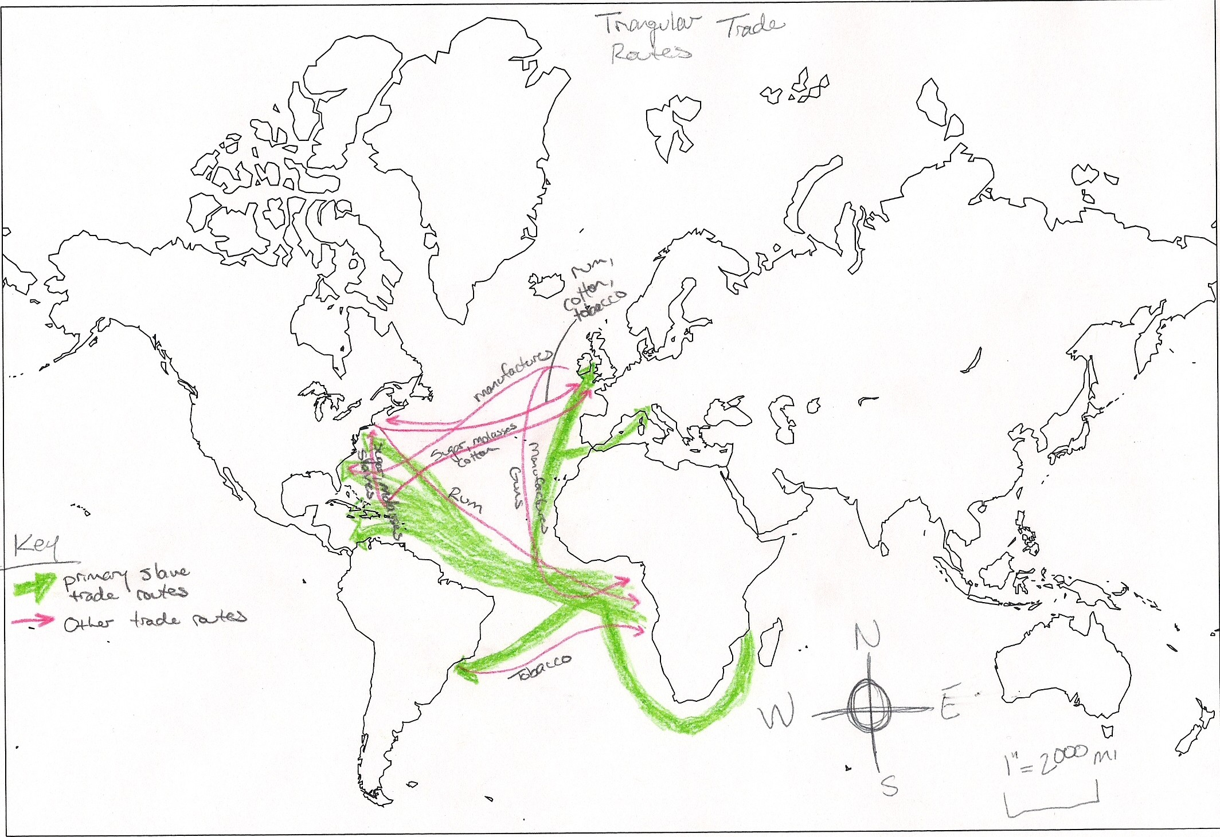

Slide 8
Middle Passage
“Middle Leg” of transatlantic triangle
Many Africans packed into bottoms of ships for long journeys
Whippings, beatings, diseases
Suicide by drowning
20% die each trip
“Loosepackers” (healthier) vs. “tightpackers” (more slaves)
Chained with shacklemate
6’(L)x18”(H)x30”(W) space
Better fed closer to America to “improve merchandise”

Slide 9
Slavery in the Americas
Slaves sold to highest bidder
Mines, fields, domestics
Cultural heritage (music, stories, etc)
Resistance
Quota system
3 types of slavery (and a side-type)
Master provides ALL food
Master provides portion of food, letting slaves keep garden
Master requires slaves to provide own food
“Peasant Breach” (or an inner-economy by selling garden goods)

Slide 10
Consequences of Slavery
Cultures in Africa lose millions of people
Families destroyed
Guns in Africa
New ideas of agriculture in New World
Culture/art/music/religion/food
Large African-American populations in South, Latin America, American south, Caribbean
Mixed race populations

Slide 11
Columbian Exchange
Columbian Exchange: global transfer of foods, plants, animals during the colonization of Americas
From New World: Tomatoes, squash, pineapples, tobacco, cacao beans, turkey, corn, potatoes
From Europe: horses, cattle, sheep, pigs, wheat, barley, rice, oats
From Africa: bananas, black-eyed peas, yams
Diseases: smallpox, measles, influenza, typhus, malaria, diphtheria

Slide 12
Global Trade
Rise of capitalism (economic system based on private ownership and investment of resources like money for profit)
Leads to more private businesses
Increase in money supply=inflation
Joint-stock companies (investors buy shares of stock in company)
American colonization
Great wealth=great risks

Slide 13
Mercantilism (p. 574)
Mercantilism: country’s power depends on wealth
Two ways to increase power and wealth:
Obtain as much gold/silver as possible
Establish favorable balance of trade, sell more goods than bought
Goal is to become self-sufficient, not dependent on others’ goods
Use goods found in colonies to supplement what nation doesn’t have
Colonies purchase goods from mother country

