Slide 1
Eastern Europe
Ch. 9

Slide 2
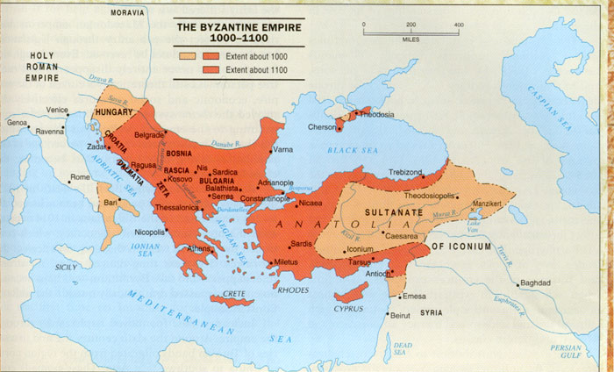
Module 1: The Byzantine Empire

Slide 3
Origins of Byzantine Empire
Begins in 4th century
Rome set up eastern capital in Constantinople
Constantine sets up elegant buildings, churches
Founded on city of Byzantium
Separate emperors ruling eastern part for Caesars
Successful in warding off Germanic Huns
Stretched across Balkan peninsula, northern Middle East, Mediterranean coast, north Africa

Slide 4
Growth of the Byzantine Empire
Solid tax base with strong agricultural peasants
Greek as common language
Becomes official language under Justinian (6th c.)
Replaces Latin, which is seen as barbaric and inferior
Allows scholars to read ancient Greek texts
Participates in high levels of trade
Use of Egyptians and Syrians in bureaucracy
Previously excluded by Roman empire
Successful in holding back enemies and invaders
Recruit armies from Middle East
Repels Sassanians and Germanic invaders
Administration centered around remote emperor surrounded by elaborate ceremony

Slide 5
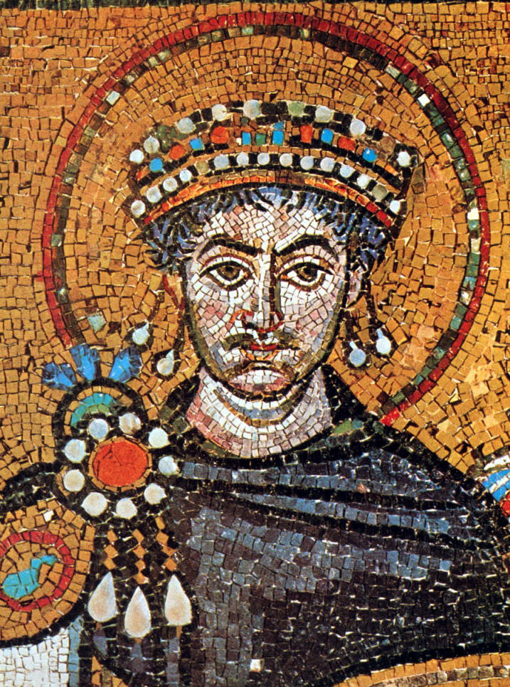
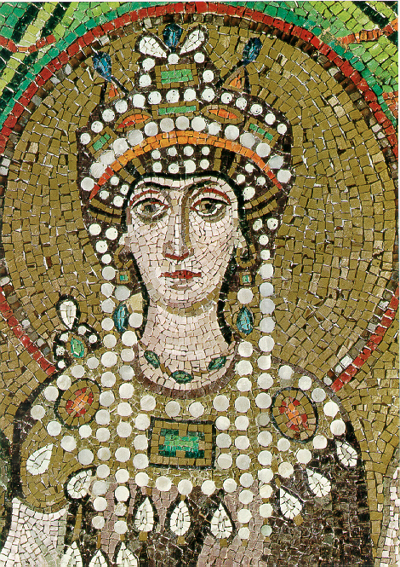
Justinian
Tries to reconquer western territory to restore empire to Rome (r. 533-565)
Autocratic and grandiose
Influenced by wife, Theodora
Attempts to rebuild Constantinople

Slide 6
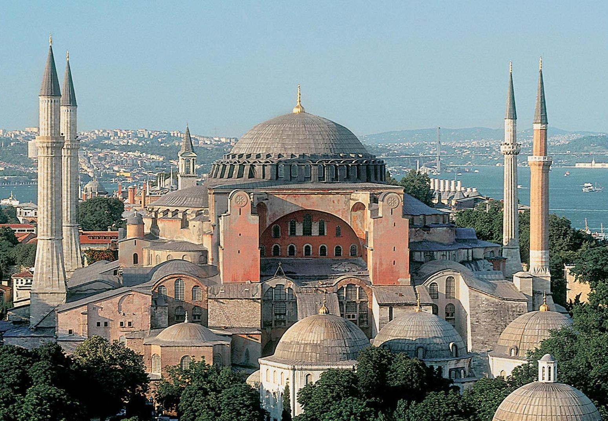
Justinian’s Accomplishments
Creates systematic legal code (Justinian’s)
Sums up and reconciles prior edicts and decisions
Reduced confusion
United and organized empire, paralleling bureaucracy
Spreads Roman principles to Europe
Architecture
Domed buildings
Hagia Sophia
Attempts to create “Second Rome”
Gains in north Africa, Italy
Soon retaken by invaders
Persians, Slavs
Wars create new tax pressures on government

Slide 7
Byzantine Empire and the Arabs
Arabs challenge around 7th c.
Arabs build naval fleet to challenge Byzantine in e. Mediterranean
Repeatedly attacks Constantinople
Defeat provinces on eastern seaboard
Causes Byzantine empire to shrink by half
Siege on Constantinople (717-18)
Due to Greek Fire (napalm) devastating Arab ships

Slide 8
Byzantines and Bulgaria
Bulgaria pressed territory in Balkans
Military success and marriage alliance gives Byzantine control over Bulgarians
Bulgarian ruler=tsar
Basil II (11th c.) uses empire’s wealth to bribe Bulgarians
Defeats Bulgarian army in 1014
Becomes part of Byzantine empire
Aristocrats settled in Constantinople, merges with Greek families

Slide 9
Society and Politics
Emperor ordained by God
Head of church and state
Appointed bishops
Passed religious and secular laws
Divinely inspired, all-powerful ruler
Elaborate court rituals

Slide 10
Theodora the Empress
Strong and austere
Refused to marry imperial heir
Prince instead marries her sister Zoe
Rebellion against emperor installs Theodora and Zoe as joint empresses
Checks power of nobles and limits corruption in bureaucracy

Slide 11
Byzantine Bureaucracy
Elaborate bureaucracy
Studied Greek classics, philosophy, science
Bureaucrats recruited from all social classes
Aristocrats dominated, but all talent accepted
Specialized into various offices
Provincial governors appointed and keep tabs on military
State control of the church, appointment of church officials
Recruited local troops
Rewarded with land
Could be passed hereditarily

Slide 12
Economics
Bureaucracy controlled trade and food prices in countryside
Peasants carry most production of goods and tax revenues
Food prices kept purposely low
Cities begin to fall apart (Athens) to focus instead on building up Constantinople
Trade with Asia, Russia, Scandinavia, India, Arabs
Silk (worms imported), luxury products
Large merchant class never gains political power due to government controls

Slide 13
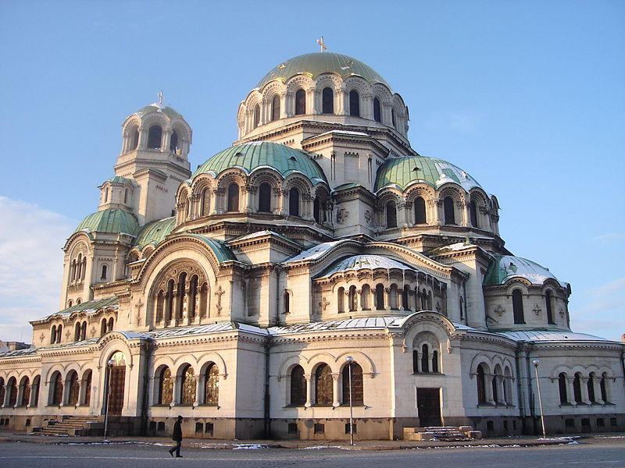
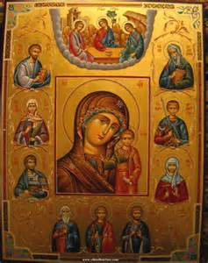
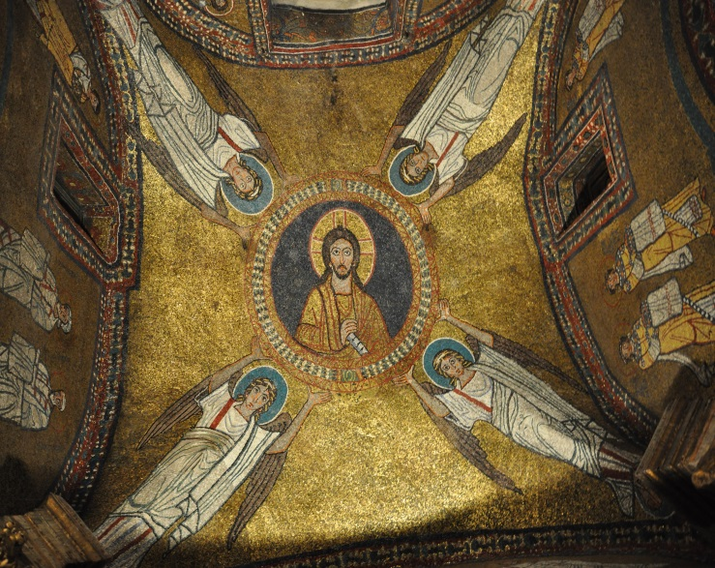
Culture
Secular traditions of Hellenism
Preserve and comment on past forms more than developing new ones
Ancient Greeks
Art and architecture
Domed buildings
Colored mosaics
Icon paintings
Art focuses on religious ideas

Slide 14
Roman vs. Orthodox
Background of the split
Read through pages 201-02 to identify reasons for the split between Eastern Orthodox and Roman Catholicism
Ritualistic differences
Latin vs. Greek Bibles
Byzantine resentment of papal state control
Artistic differences
Type of bread for communion (yeast or not?)
Clerical celibacy
Excommunication of each leader and his followers

Slide 15
Weakening Byzantines
Wars add economic burdens
Weakens position of small farmers
Larger aristocratic estates to which peasant farmers forced into dependence (can’t pay taxes)
Weak and strong emperors
Arabs harass shipping on Crete (9th c.)
Turkish Seljuks seize most Asiatic provinces (11th c.)
Cuts off most prosperous sources of tax revenue and food production
Byzantines lost Battle of Manzikert (1071), never recovers
Creation of new Slavic kingdoms in Balkans (Serbia)
Italian cities with powerful navies gain advantages in Constantinople
Crusaders turn against Constantinople from the west (1204)
Turkish sultan and army attack Constantinople in 1453, which falls after 2 months
Fully conquered by Turks by 1461

Slide 16
Reflection Questions
What do you consider to be the biggest accomplishments of the Byzantine empire? Why?
Compare/contrast the Byzantine Empire and China.
How successful was the Byzantine Empire in becoming a “Third Rome”? Why?
How do you think the split between eastern and western Christianity may facilitate the further fracturing of Christianity?
Compare and contrast the fall of the Byzantine Empire to the fall of China, Rome, the Umayyads, the Abbasids, or India.

Slide 17
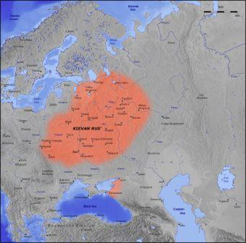
Module 2: Civilization in Eastern Europe

Slide 18
Advent of “Civilization” in Eastern Europe
Missionaries sent by Byzantine Empire into Eastern Europe
Cyril and Methodius (864) into Czech and Slovak republics
Failed mission; Catholics more successful
Move into Balkans and s. Russia
More successful due to being able to speak Slavic language
Create Cyrillic written language to aid conversions
Begins literate culture
Allows for local languages in church services rather than Latin (vernacular)

Slide 19
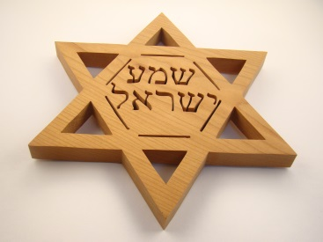
Border of the East and West
Roman Catholicism and Latin in Czech, Hungary (Magyars), and Poland
Organized into regional monarchies owned by landowning aristocracies
Emerges as a center for trade and industry (iron)
Massive influx of Jews
Migrating from Middle East
Flee intolerance in western Europe
Largest concentration: Poland
Barred from agriculture, resented by Christian majority
Gets involved in local commerce
Maintains religious and cultural traditions
Extensive education and literacy, primarily males

Slide 20
Origins of the Kievan Rus’
Slavs move into Russian plains and e. Europe from Asia during Roman Empire
Mix and incorporate earlier inhabitants and other invaders (Bulgarians) who adopt Slavic language and customs
Use of iron and extended agriculture
Practice of animist religion, folk music, oral legends
Loose regional kingdoms

Slide 21
Development of the Kievan Rus’
6th-7th c: traders from Scandinavia and Norselands work through Slavic lands to get to Byzantine Empire
Set up governments along trade routes
Establish city of Kiev
First prince, Rurik, 855
Loosely organized by alliances, regional landed aristocrats (12th c)
Becomes prosperous trading center
12th c: region given name Russia (Greek “red” for beard color of Norse traders?)
Prince Vladimir I (980-1015) converts to Christianity
Mass baptisms, forced conversions by military
King controls all church appointments
Development of Russian Orthodox Church
Kievan Rus’ as largest single state in Europe
Highly decentralized
Development of formal law code
Reduced severity of punishments, state-run courts
Legal codification of laws under Yaroslav

Slide 22
Institutions
Adopt some governmental ideas from Byzantine Empire
Ceremonials and luxury of ruling elites
Central ruler having wide powers
Orthodox Christianity
Devotion to power of God
Eastern saints
Ornate churches with icons and incense
Monasticism, prayer and charity
Polygamy>>monogamy

Slide 23
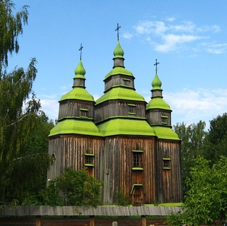
Culture
Literature
Use of Cyrillic alphabet
Mixture of religious and royal events
Praises on saints and power of God
Disasters: wrath of God against human wickedness; success in war: aid from God and saints
Lack of philosophy and science
Art (religious)
Icon painting, religious manuscripts
Churches built in form of cross topped by domes
Oral art by music, street performance, theater

Slide 24
Economics
Peasants
Free farmers
Aristocratic landlords
Boyars
Less political power than in w. Europe

Slide 25
Decline of Kiev (12th-13th c.)
Use p. 206-207 to identify the factors that led to the fall of Kiev
Rival princes set up regional governments
Succession questions
Decline of Byzantine empire reduces trade and wealth
Invasions of Mongols (Tatars, 1237-38 and 1240-41)
Under control for 200 years
Decline of literature and trade with w. Europe
Continuity of Christianity and aristocratic class
Payment of tribute ensures autonomy
After fall of Tatars, Russia emerges as “Third Rome”
As a result of Mongol/Tatar rule and collapse of Byzantine empire, e. Europe falls behind the west culturally, politically, and economically

Slide 26
Reflection Questions
Why do you think so many Jews fled to Eastern Europe? How might this affect their “plight” in Europe’s future?
How/why does Kievan Rus’ develop? Are there any other civilizations we have discussed that compare to the development of Kievan Rus’? How does the development of Kievan Rus’ differ from the development of other civilizations we’ve discussed?
Why do you think western Europe excelled in the late middle ages, whereas eastern Europe fell behind? Give examples.

