Slide 1
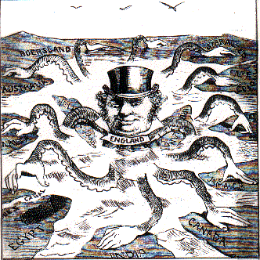
Imperialism

Slide 2
Imperialism
Imperialism: seizure of a country or territory by a stronger country dominating the political, economic, and social life of weaker countries
Forms of imperial control:
Colony: country or territory governed internally by a foreign power
Protectorate: country or territory with own internal government but under the control of outside power
Sphere of influence: area where outside power claims exclusive investment or trading privileges
Economic imperialism: independent but less-developed nation controlled by private business interests rather than other governments

Slide 3
Imperialism
Methods of management:
Indirect Control: relied on existing political rulers, asking ruler to accept British authority
Legislative councils set up by crown would train leaders in colonizer’s method of government
Direct control: colonists unable to handle complex business of running a country
Paternalism: governing people in parental way, providing for needs but giving no rights, ruling by own bureaucrats
Assimilation: in time, local populations would adopt colonizers culture and become like them (schools, courts, business, language, religion, etc)

Slide 4
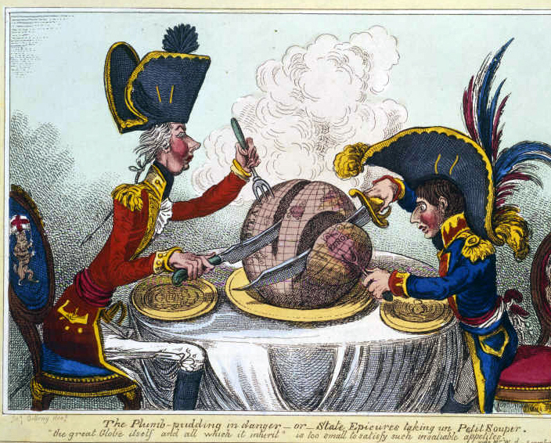

Slide 5
Africa Before Europe
Divided into hundreds of ethnic and linguistic groups
Traditional religion, some Islam and Christianity
Almost impossible for Europeans to get to African interior
Difficult to navigate rivers
Disease (malaria, etc)
Africans control own specialized trade networks

Slide 6
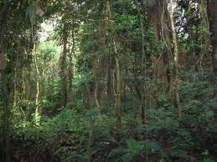

Slide 7
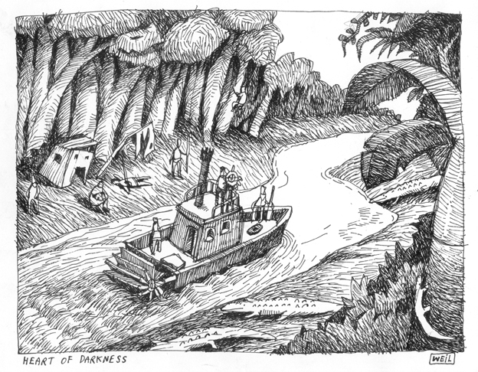

Slide 8
Reasons for African Imperialism
Explorers, missionaries
Humanitarians opposing slave trade
Africa as adventure, mystery, excitement
Industrialization allows for new markets and raw materials (weapons, transportation, medicine)
Empire seen as measure of national greatness
Europeans “better than others” (racism)
Social Darwinism: fittest for survival enjoy wealth and success and are superior than others
Europe has right and duty to bring results of progress to other nations
European rule is best way to end slave trade
“Civilize and Christianize”

Slide 9
Dr. Livingstone, I Presume…
David Livingstone (missionary) travels into central Africa to promote Christianity (1860s)
Many years go by without word from Livingstone
Newspaper reporter Henry Stanley explorers Africa looking for Livingstone (1871)
Stanley explores Congo River
Obtains land in Congo region for Leopold II of Belgium
Leo claims motives for establishing colony is to abolish slave trade and promote Christianity
Companies sent to exploit Africans, forcing them to collect sap from rubber plants (kills many Africans)
Belgium’s holding of Congo frightens other European countries, who begin claiming parts of Africa

Slide 10
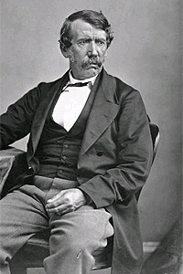
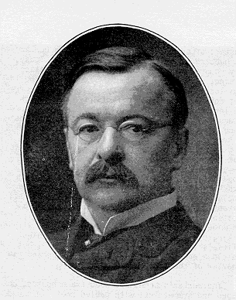

Slide 11
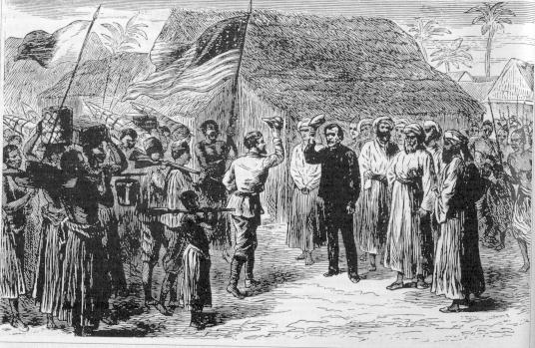

Slide 12
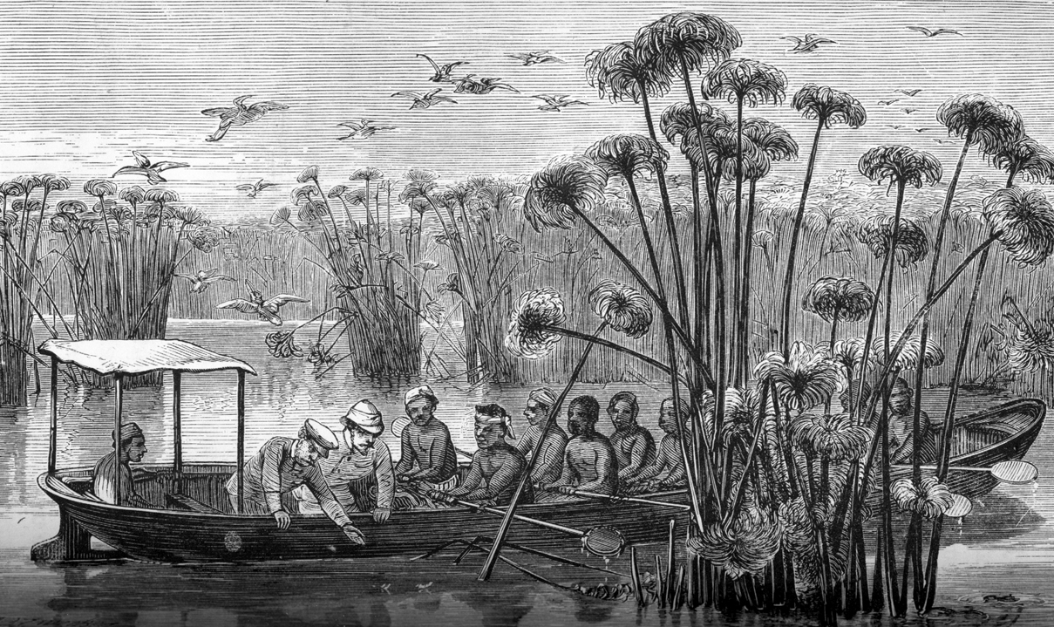

Slide 13
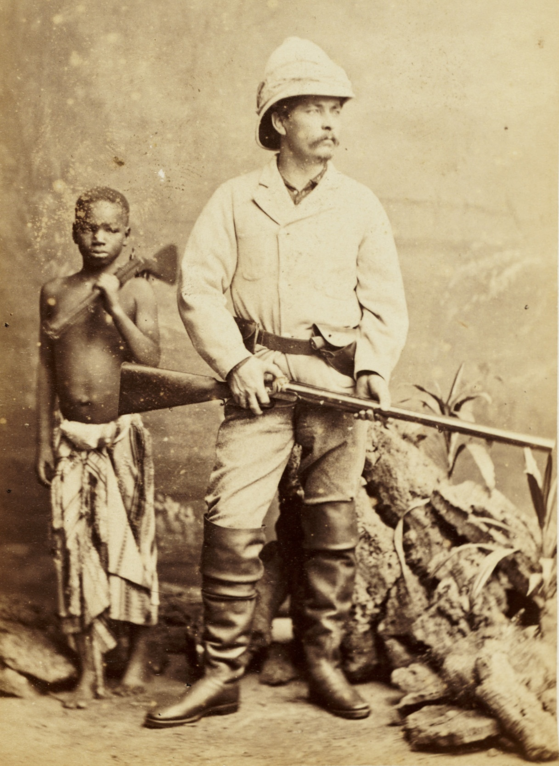

Slide 14
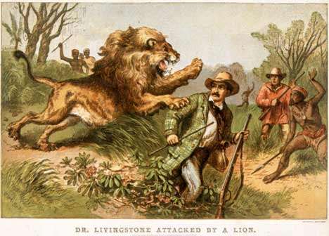

Slide 15
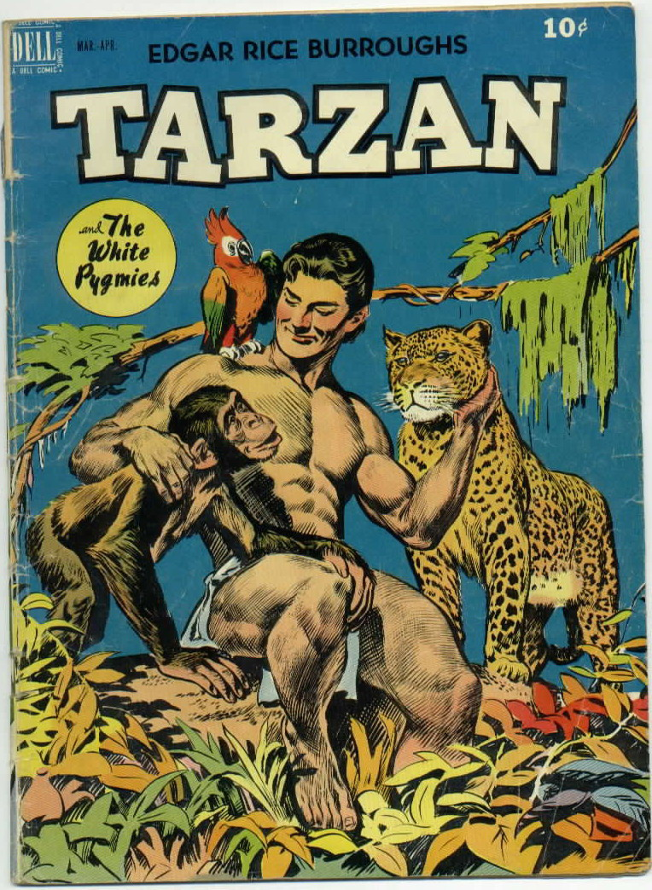

Slide 16
Division of Africa
Discovery of diamonds (1867) and gold (1886) drives colonization
Drive to colonize is so fierce that Europe fears war
Berlin Conference (1884-85): to prevent conflict, 14 European nations meet to lay down rules for division of Africa
Any nation should claim land in Africa by notifying other nations of its claims and showing it could control area
Africa is divided with no thought about how ethnic or linguistic groups are distributed
Europeans hope Africans will buy European goods
Rather than buy goods, Africans provide raw materials (minerals, copper, tin, gold, diamonds, peanuts, palm oil, cocoa, rubber)

Slide 17
Conflict in South Africa
Zulu nation led by Shaka organizes strong centralized state with disciplined warriors and military
British invaders have superior weapons and invade
Dutch take over land in Cape of Good Hope as a station for ships heading to India (Boers, Afrikaners)
Push Africans off their land and begin to farm
British move in and settle on Cape as well
Boers move north to escape British in 1830s (Great Trek) and fight African tribes of land they are taking
Boer War
Gold and diamonds discovered in S. Africa
Boers try to keep “outsiders” from gaining political rights
Boers launch commando raids and guerilla tactics against British, who burn Boer farms, imprison women and children
Britain wins, takes control of Boer Republics

Slide 18
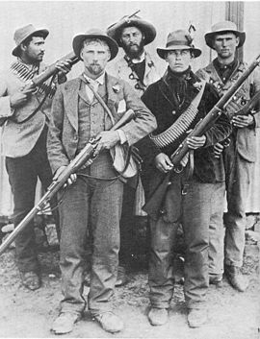

Slide 19
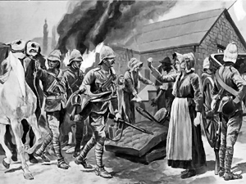

Slide 20
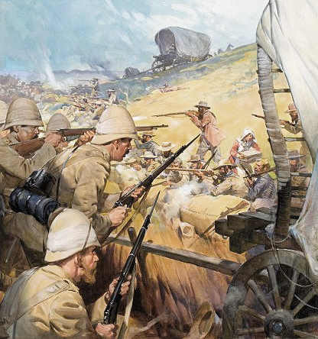

Slide 21
Legacy of Imperialism in Africa
Negative effects
Africans lose control of land and independence
Die of diseases brought from Europe (smallpox)
Famines
Breakdown of traditional cultures
Division of African continent (not by tribes but land)
Positive effects
Reduced local warfare
Provided hospitals, schools, sanitation
Increased lifespans and literacy rates
Economic expansion
Industrial expansion (railroads, dams, telephone/graph)

Slide 22
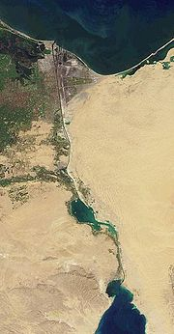
Europeans in Muslim Lands
Russians try to gain land on Black Sea and wage war (Crimean War) against Ottoman Empire
Opposed by France and Britain, Russia loses
Ottoman Empire continues to lose land
Ottoman Empire sends Muhammad Ali to rule Egypt
Fosters growth of cotton farms
Ali’s grandson Isma’il constructs Suez Canal connecting Red Sea to the Mediterranean
Financed by Britain, who then occupies Egypt

Slide 23
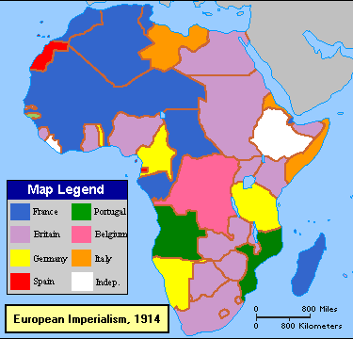

Slide 24
British Imperialism in India
British East Indian Trading Company
Has its own military (British officers, Sepoys or Indian soldiers)
Britain sees India as colony with most potential and most valuable, its “Jewel in the Crown”
India produces raw materials for Britain and India to purchase British goods
Indian competition with British goods prohibited
Railroad network transports raw products to ports, manufactured goods to the interior
Raw materials (tea, indigo, coffee, cotton, opium)
Impact of colonialism
Britain restricts Indian-owned industries, lack of Indian self-sufficiency
Pressure for Indians to assimilate
Third-largest railroad network in India
Modernization (railroads, telephone/graph, dams, canals)
Sanitation and public health, schools, crime decreased

Slide 25
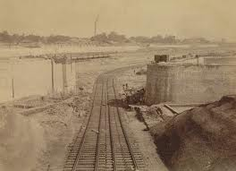

Slide 26
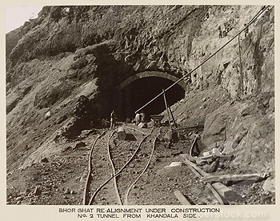

Slide 27
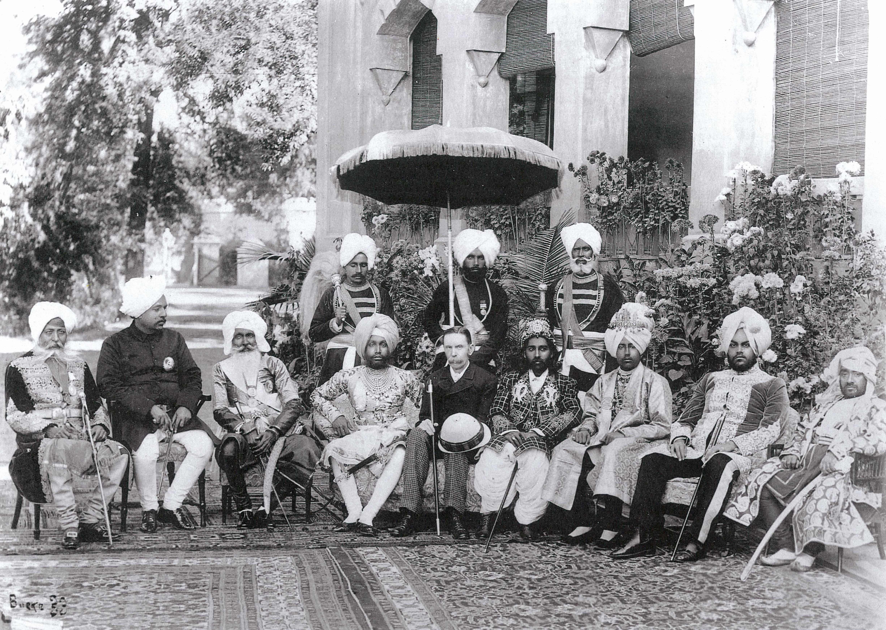

Slide 28
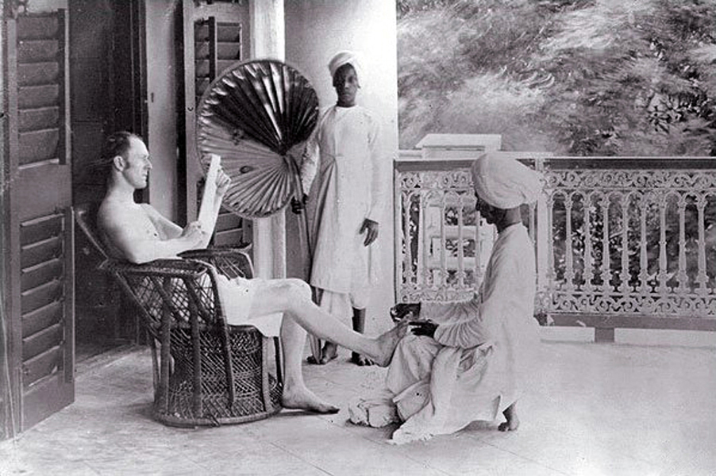

Slide 29
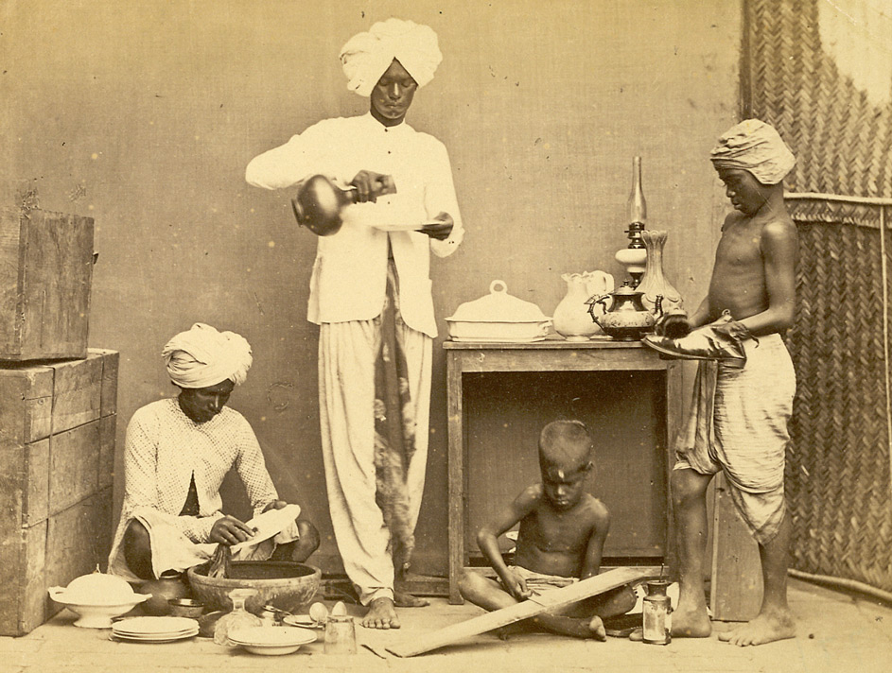

Slide 30
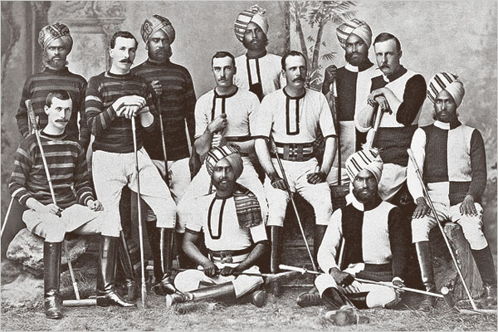

Slide 31
Sepoy Mutiny
Indians upset about racism and British trying to convert them to Christianity
Rumors that cartridges of rifles covered in beef and pork fat grease (why is this an issue?)
All but five sepoys refuse to accept cartridges
Sepoys are jailed, rebellion ensues (Sepoy Mutiny)
Indians can’t unite against Britain
Weak leadership
Splits between Hindus and Muslims
Some still have allegiance to Britain
Britain takes direct command of India (Raj)
Racism continues, control over India is tightened

Slide 32
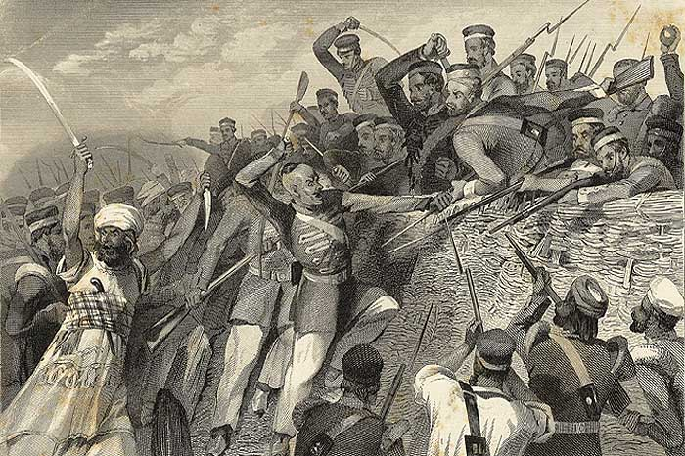

Slide 33
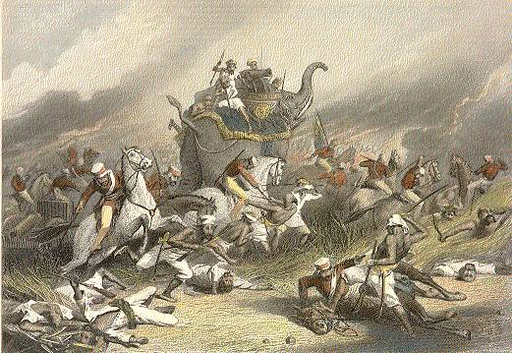

Slide 34
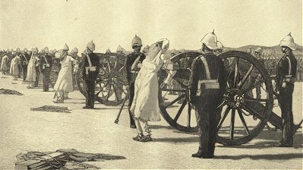

Slide 35
Indian Nationalism
In early 1800s, some Indians demand modernization and freedom
Ram Mohun Roy calls for change in Indian society
Step away from arranged marriage, caste system
Only way to escape control of England
Others follow Roy’s example, call for westernization
Nationalism surfaces
Indians treated as second-class citizens
Can’t have top-tier jobs, get paid less
Two nationalist groups emerge
Indian National Congress (1885)
Muslim League (1906)
Britain divides Bengal into Hindu and Muslim sections
Difficult to unite against British

Slide 36
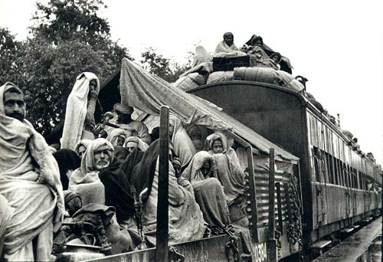

Slide 37
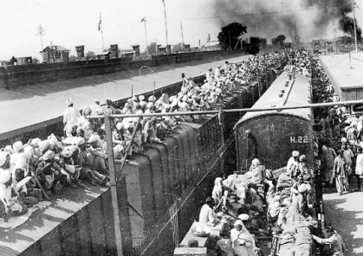

Slide 38
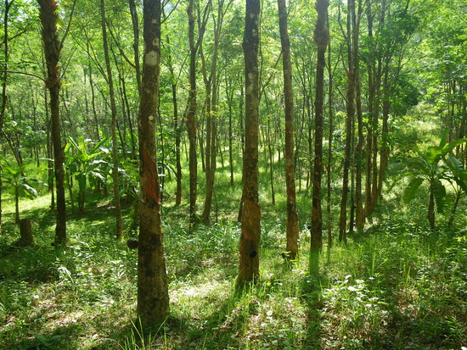
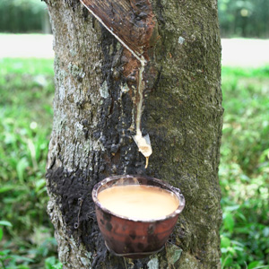
Imperialism in Southeast Asia
Europe wants parts of Pacific Rim (nations bordering Pacific Ocean) for strategic location along sea route to China, tropical agriculture, minerals, and oil
Islands perfect for agriculture (sugar cane, coffee, cocoa, rubber, coconuts, bananas, pineapple)

Slide 39
The Dutch in Indonesia
Dutch East India Company
Expands by seizing islands from Portugal and Britain
Discovery of oil, tin and want for more rubber plantations lead to expansion to new islands
Move to Indonesia
Create social class system
Dutch>>wealthy educated Indonesians>>plantation workers

Slide 40
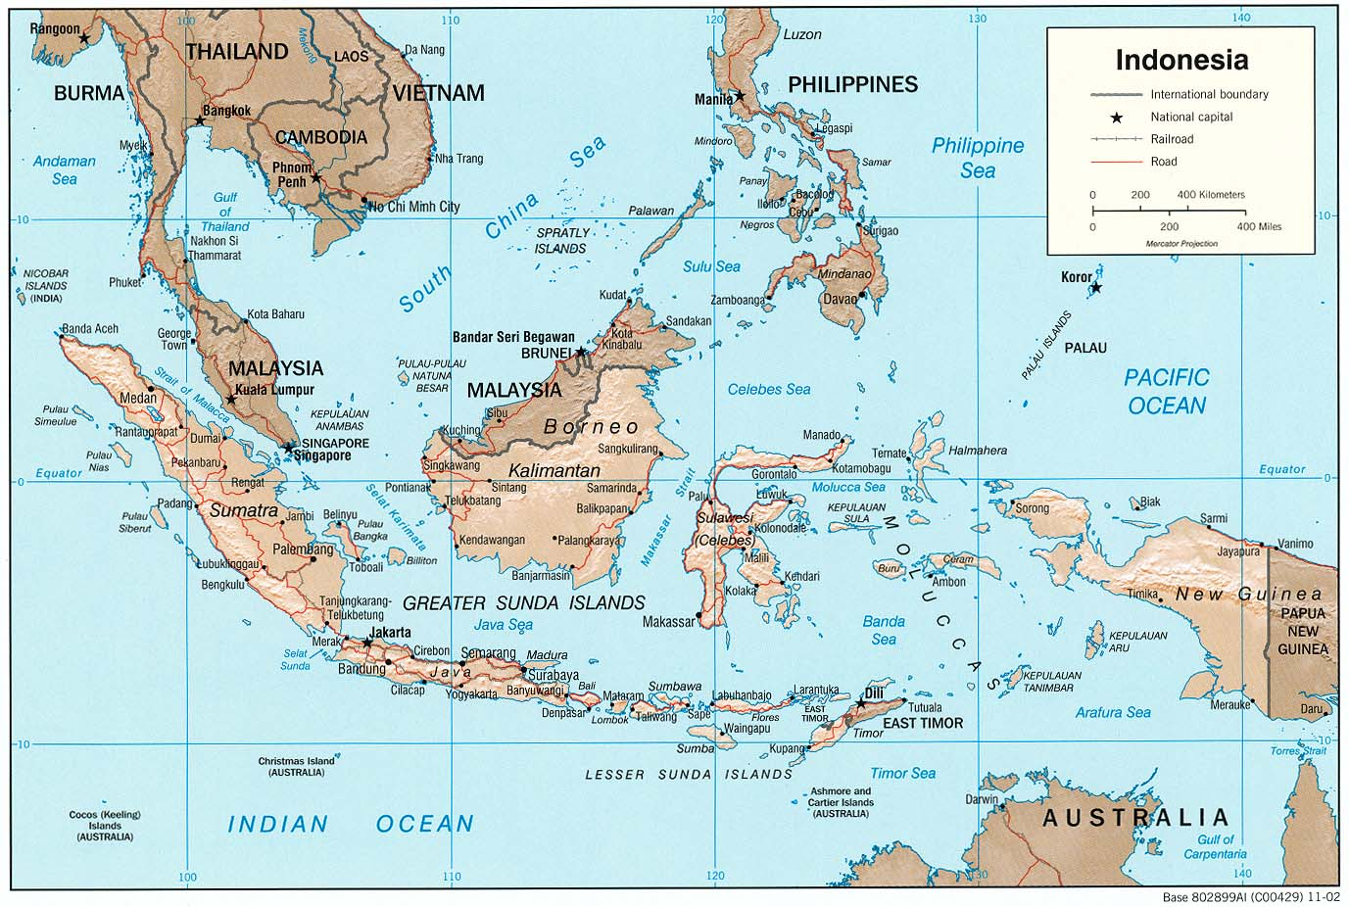

Slide 41
The British in Singapore
Want a stop along India-China routes
Gain colonies in Malaysia and Burma (Myanmar)
Tin, rubber
British encourage Chinese to migrate to Malaysia to mine tin and tap rubber trees
Conflict between Chinese and Malays continues today

Slide 42
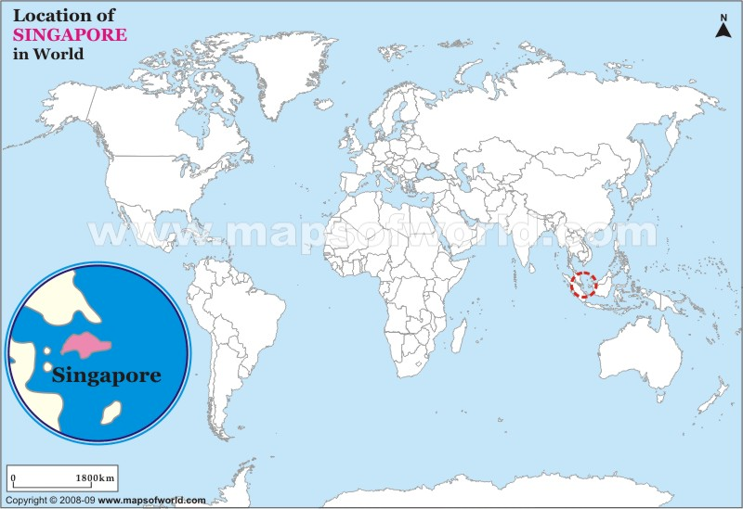

Slide 43
The French in Indochina
When French missionaries are killed in Vietnam, Napoleon III orders soldiers to invade S. Vietnam
Laos, Cambodia, N. Vietnam added creating French Indochina
Direct management
French fulfill government positions
Force Vietnamese to harvest rice and export it all
Creates resistence

Slide 44
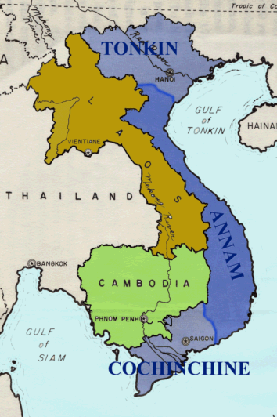

Slide 45
Siam
Present-day Thailand
Between British Burma and French Indochina
Britain and France try to prevent the other from gaining control of Siam
Siamese kings promote it as neutral
Pushes for progress
Opens schools, creates government and law
Industrializes (railroads, telegraphs)
Ends slavery

Slide 46
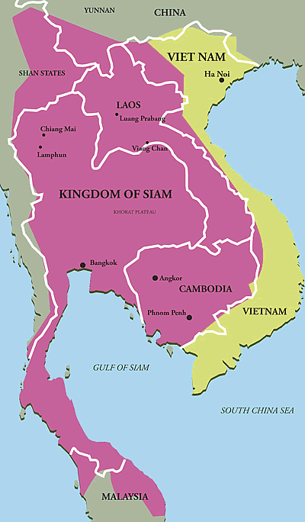

Slide 47
American Expansion
Louisiana Purchase (1803)
Manifest Destiny
The US has right and duty to rule North America from Atlantic to Pacific Oceans
Justifies evicting Natives from tribal lands
Indian Removal Act of 1830
Moves Cherokee from Georgia to Oklahoma (800 miles) called Trail of Tears
The Alamo (1836)
Texans revolt against Mexico, win independence
US annexes Texas in 1845
Mexican-American War (1848)
US gains Gadsden Purchase, SW US (CA, NV, CO, NM)

Slide 48
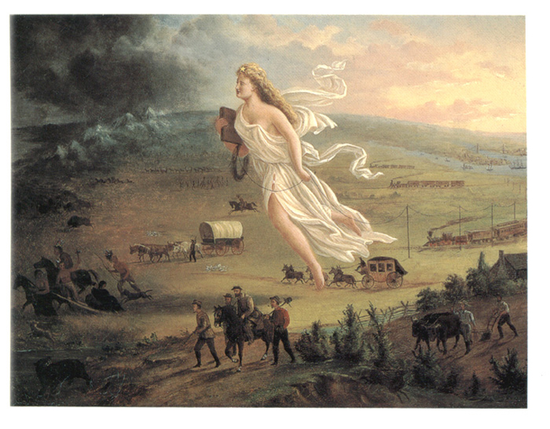

Slide 49
US Imperialism in the Pacific
Spanish-American War (1898)
US acquires Philippines, Puerto Rico, Guam
McKinley wants to “civilize and Christianize” Filipinos
Emilio Aguinaldo declares independence for Philippines
America beats Filipinos, promises to prepare for independence
Modernizes, takes advantage of cash crops
Hawaii as port on the way to China and India
Sugar plantations
Annexation of Hawaii (1898)
Not a state until 1950s

Slide 50
The US and Latin America
Monroe Doctrine
Fearing that Europe would try to conquer freed Latin American nations, James Monroe issues Monroe Doctrine
“the American continents…are henceforth not to be considered as subjects for future colonization by any European powers”
Cuba declares independence from Spain (1868)
Jose Marti fights for freedom
Because the US has business interests in Cuba and Spain is treating Cubans brutally, US intervenes
Spanish-American War
Cuba becomes free in 1901, US exerts control

Slide 51
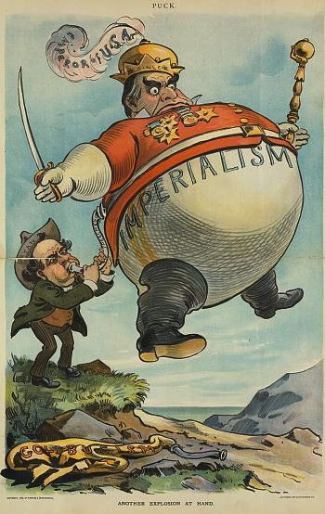

Slide 52
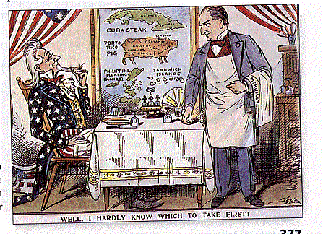

Slide 53
The US and Latin America
The US wants to connect Pacific and Atlantic
Shorten the trip of 13,000 miles sailing around S. America
T. Roosevelt offers Panama $10 million/year to build canal
Canal opens in 1914
Roosevelt Corollary as extension to Monroe Doctrine
Gave US the right to be “an international police power” in the W. Hemisphere
“Talk loud and carry a big stick”~ T. Roosevelt
Justifies American intervention in Latin America

Slide 54
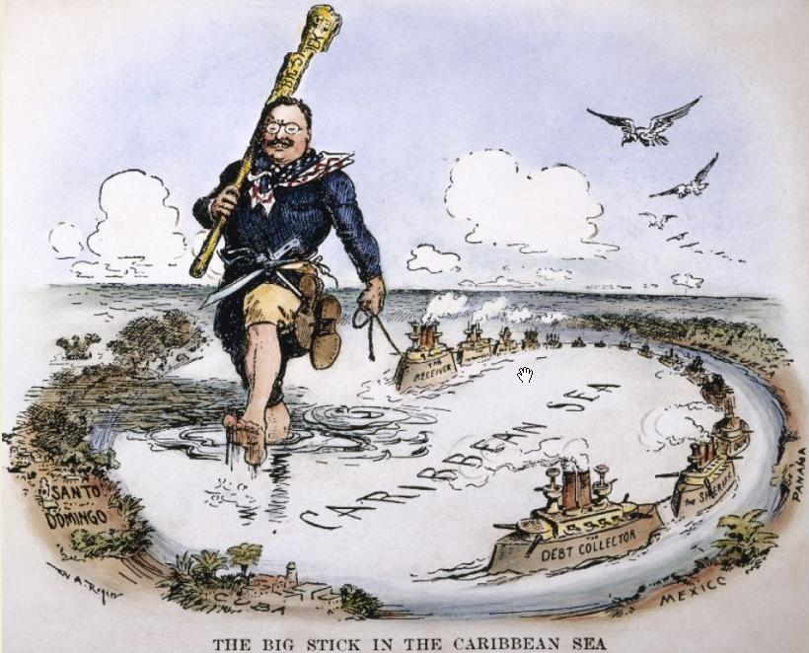

Slide 55
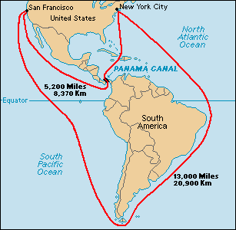

Slide 56
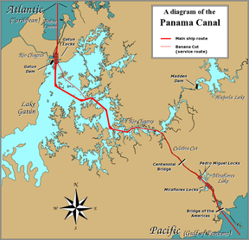

Slide 57
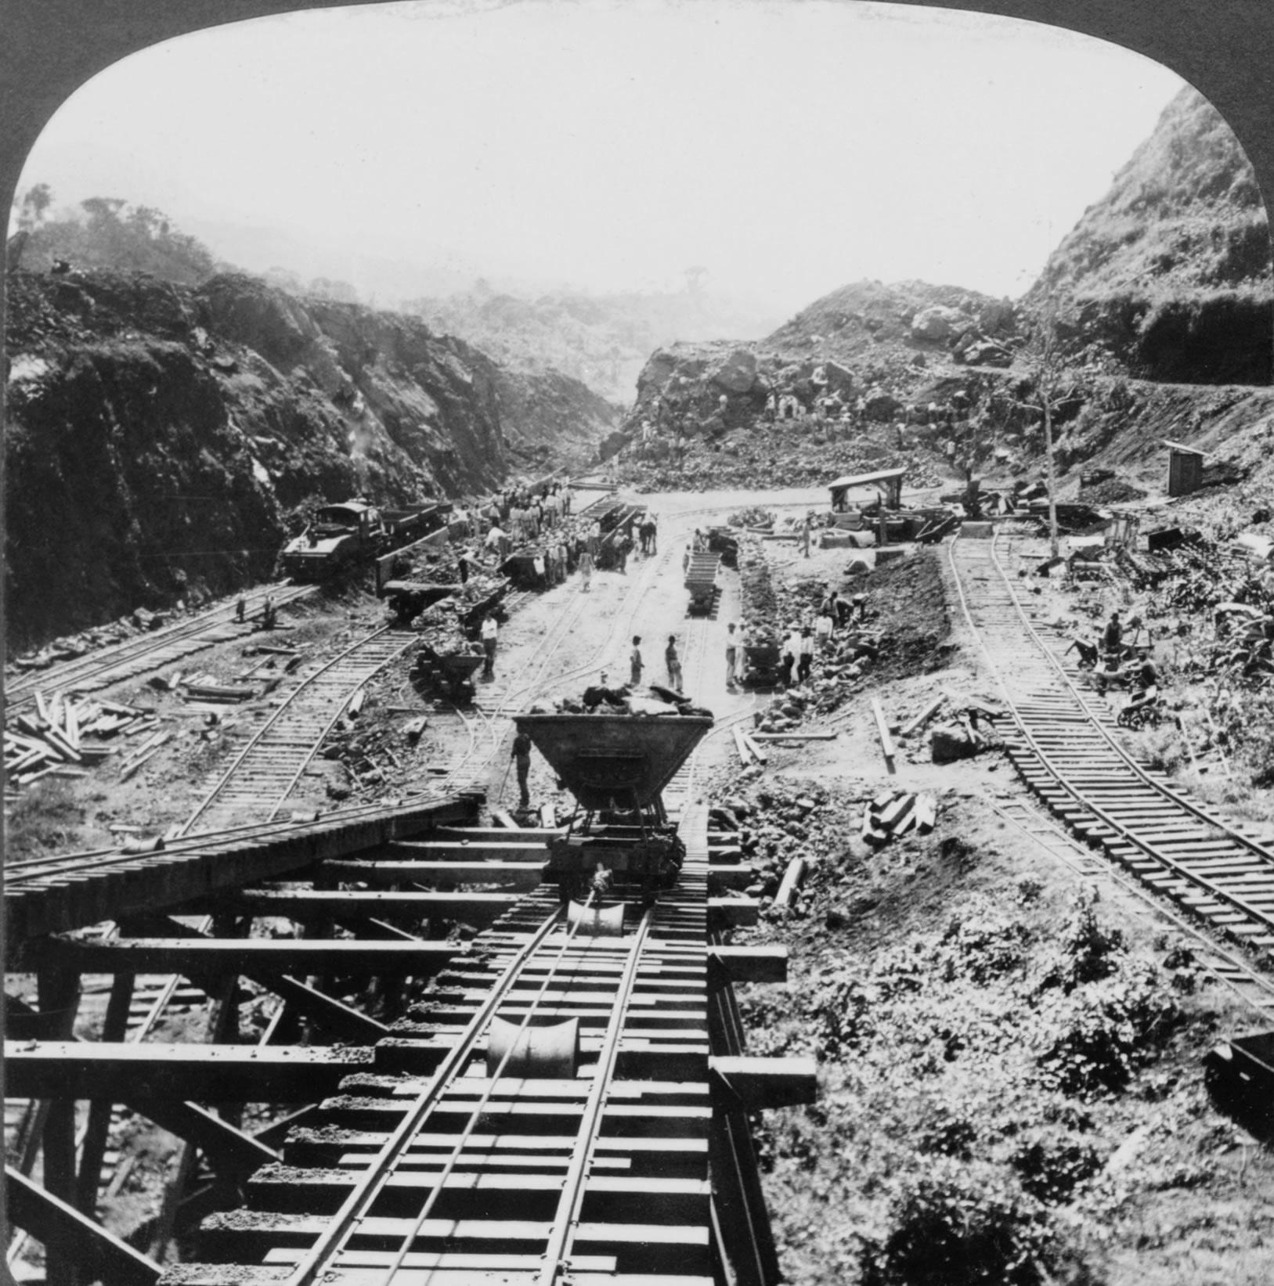

Slide 58
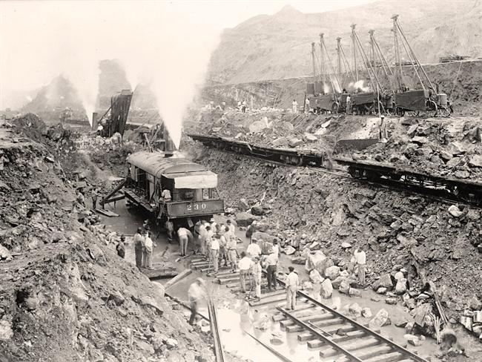

Slide 59
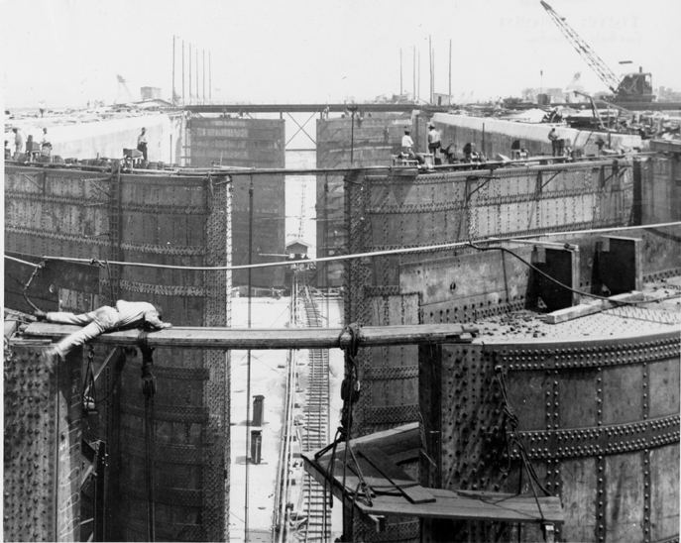

Slide 60
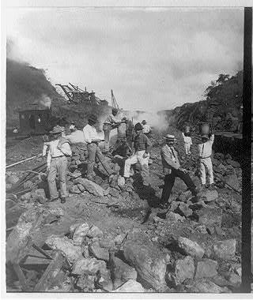

Slide 61
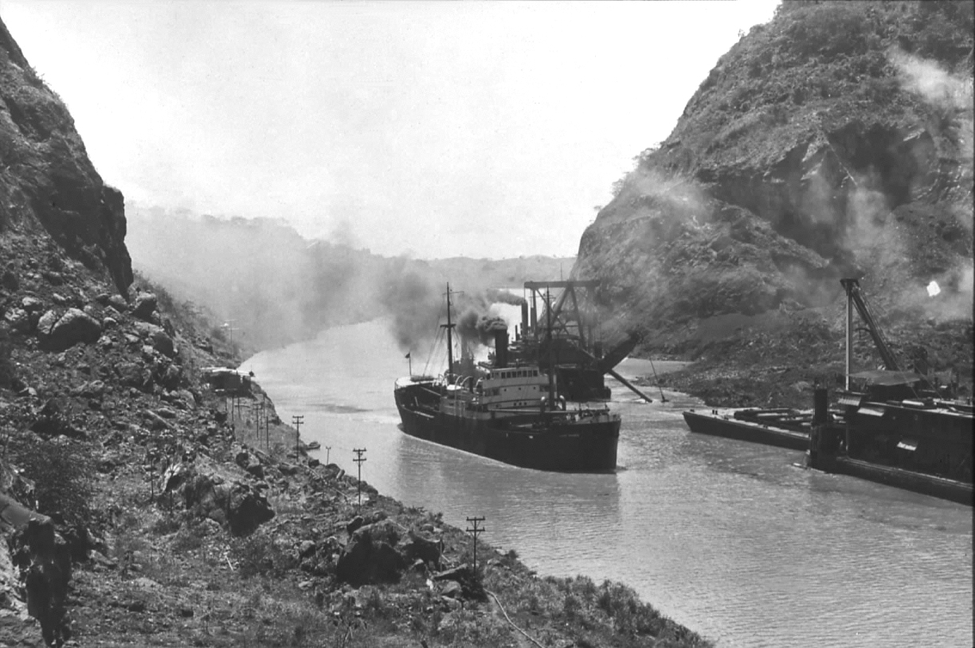

Slide 62
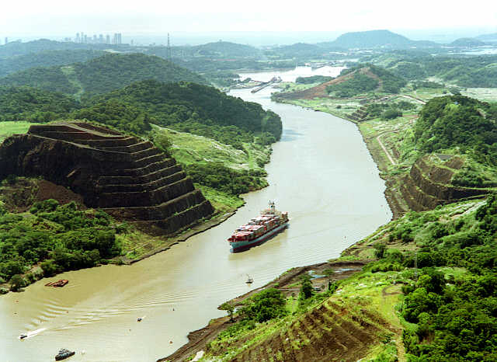

Slide 63
