Slide 1
Islam in Southeast Asia
Stearns Ch. 7

Slide 2
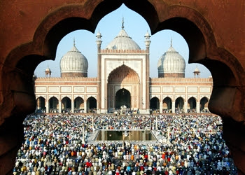
Module 1: Islam’s Arrival in South Asia

Slide 3
India and Invaders
Generally when invaded, Indian culture remained intact
Invaders usually assimilated
Converted to Hinduism or Buddhism
Fit into castes
Adopted food, dress, culture
Rivalry between regional kingdoms in India made them more vulnerable to outside invasions

Slide 4
The Arrival of Islam in India
Islam vs. India
Islam was as sophisticated and ancient as India
Islam was opposite of Hindu/Buddhism
Hinduism: open, tolerant, inclusive of worship types, stratified
Islam: doctrinaire, proselytizing, committed to exclusive worship, egalitarian
Islam fit well in India, however
Peaceful trade and religious interchange
Localized rioting between Hindu peasants and Muslim lords

Slide 5
Political Divisions and Muslim Invasions
First invasion (711)
Resulted from trading contacts
Attack by pirates from Sind (w. India) on ships owned by Arab traders
Umayyad viceroy launches expedition against king of Sind
General (Muhammad ibn Qasim) declares region part of Umayyad Empire (Indus Valley>northeast)
Local leaders surrender to Islamic rule

Slide 6
Indian Influences on the Islamic Empire
Science and mathematics
Astronomy
Algebra, geometry
“Arabic” numerals
Medicine, palmistry, alchemy
Music, chess
Architecture, motifs, dress, hairstyles, foods

Slide 7
Second Invasions
962-1100s: Turkish slaves send expeditions to India
Mahmud of Ghazni
Drawn by legendary wealth and zeal to spread Islam
Arabs begin to take political control
Qutb-ud-din Aibak (slave) seizes power in 1206
Makes Delhi capital of Muslim rule in India
Delhi Sultanate

Slide 8
Conversion
Few converts were forced
Carriers of Islam: merchants and Sufis
Sufis had
much in common with Buddhist monks
Wandering ascetics
carried power of healing and magic
Established schools and mosques
Organized disciples into militias
Cleared land for farming and settlements
Welcomed low-caste and outcastes
Converts included low and outcastes and Buddhists

Slide 9
Relationships between Invaders and Invaded
Hindus don’t take Islam seriously
Previous invaders had been quickly absorbed by Hinduism
Most Hindus (especially high caste) separate themselves from Muslims
Go so far as to have separate living areas
Muslim rulers begin to adopt some Hindu practices and claim divine kingship
Continue Hindu practices (marrying girls at age 9, sati, forbidding remarriage of widows)
Use p. 165 to describe the new caste system under Muslim rule
Muslims (divided based on ethnicity, Arab>Turk>Persian)>>high caste Hindu converts>>”clean” artisan and merchant groups>>lower caste>>untouchables

Slide 10
Hindu Revival
Beginning of devotional (bhaktic) cults
Open to all including women and untouchables
Saints of low caste origins venerated
Allow for spiritual fulfillment of all, not just high castes
Try to create a more egalitarian religious experience
Hindu religious texts and poems composed in vernacular languages (Bengali, Tamil, etc)

Slide 11
Reflection Questions
Why do you think Islam appealed to the people of India when the Muslims invaded?
Who did Islam appeal most to? Why?
How/why do you think the Islamic empire transmitted Indian culture to Europe?
Why were Hindus hesitant about Islam?
How did Hinduism respond to Islam?
How did the bhaktic cults try to compete with Islam?

Slide 12
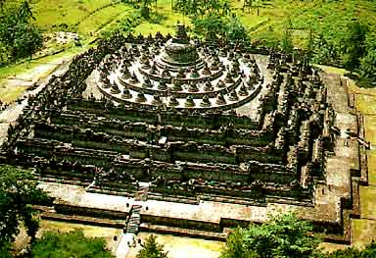
Module 2: Spread into SE Asia

Slide 13
Trading Contacts and Conversion in SE Asia
Traders and Sufis convince islanders how much of world has already converted
Islam spread to city of Malacca, Malaya, Sumatra, Java
Once Islam spreads to key cities, best interest of other cities to convert to enhance personal ties and provide common business practices
Also links SE Asian markets to Indian markets
Islam does not convert all islands
Some islands are staunch Buddhists, who contest Islam due to Buddhism securing leadership

Slide 14
How Islam Looked in SE Asia
Sufis allow inhabitants to keep beliefs and practices
Women keep stronger position
Trade and markets dominated by women
Lineage, inheritance traced by matrilineal

