Slide 1
Major Events During the Cold War

Slide 2
The Korean War
Communist North Korea, Democratic South Korea
Split at 38th Parallel (latitude)
North Koreans invade S. Korea on 6/25/50
Truman wants to help S. Koreans resist/contain communism
United Nations (UN) decides to help S. Korea
Elect General Douglas MacArthur to lead
UN troops push N. Koreans over 38th Parallel to Chinese border
China sends 300,000 troops to assist N. Korea
N. Koreans and China capture S. Korean city Seoul
Truman wants to use atomic weapons against N. Korea
MacArthur goes over Truman’s head and says no, he is fired
UN and N. Korea reach cease-fire in 7/1953, set border at 38th Parallel (4 million soldiers and civilians killed)

Slide 3
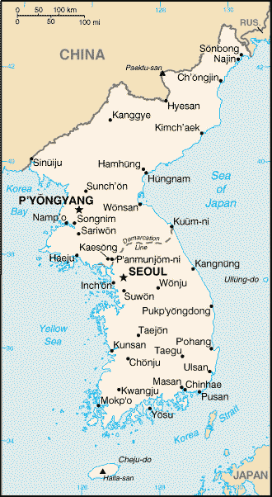

Slide 4
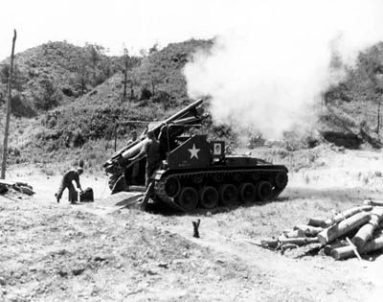

Slide 5
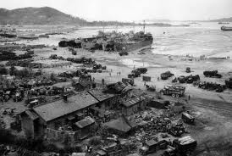

Slide 6
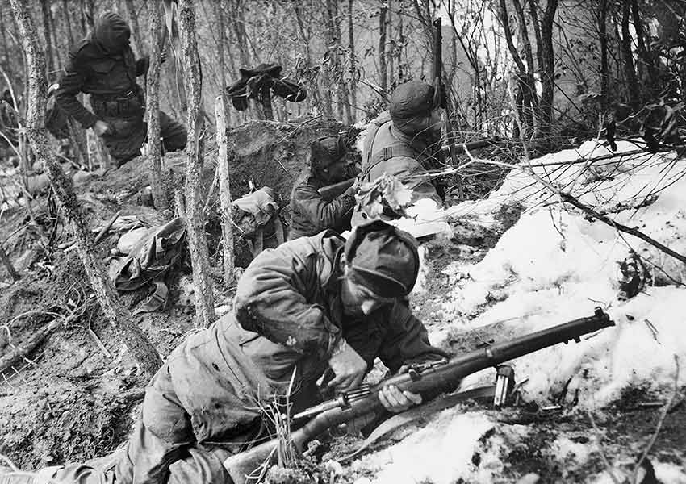

Slide 7
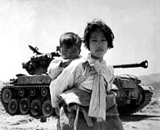

Slide 8
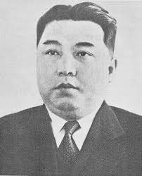
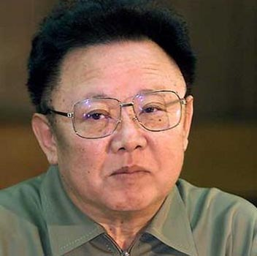
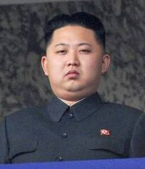
Effects of the Korean War
Korea remains divided
Demilitarized Zone (DMZ)
N. Korea led by Communist dictator, Kim Il Sung
Revered as a god
Collective farms, heavy industry, built up military
After Sung’s death, replaced by Kim Jung Il (son)
Develops nuclear weapons
Kim Jung Il died on 12/18/11
Replaced by his son, Kim Jung Un
May not be able to rule and fix economy
Food shortages, bad industry, etc (reliant on China)
May lead to shying away from conflict w/ US
S. Korea prospered from US aid
Becomes democratic in 1987
Highest economy worldwide in 1980s and 90s
Still US troops in S. Korea

Slide 9
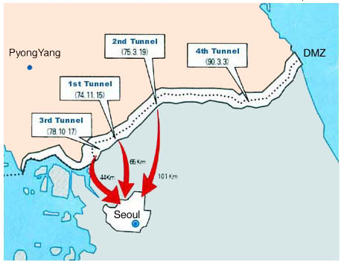

Slide 10
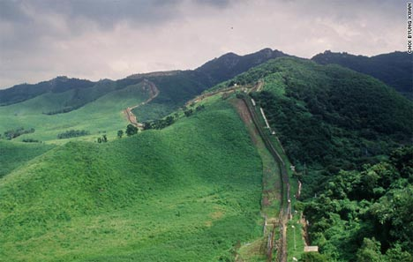

Slide 11
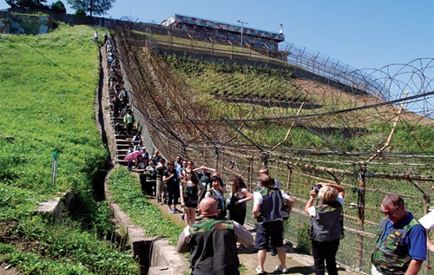

Slide 12
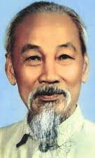
The Vietnam War
In resistance to France, nationalists turn to communists to gain independence
Led by Ho Chi Minh, who flees to exile, returns in 1941
Creates Vietminh (Independence)
Japan takes French Indochina (Vietnam) in 1941
When Japan loses control in 1945, Minh believes they will get independence, France tries to regain control
Vietminh spread resistance across countryside
Hit-and-run guerrilla tactics
Major French defeat at Dien Bien Phu (1954) leading to surrender
Vietnam seen as a threat to capitalist world
Domino theory: once one nation falls to communism, the rest will fall as well

Slide 13
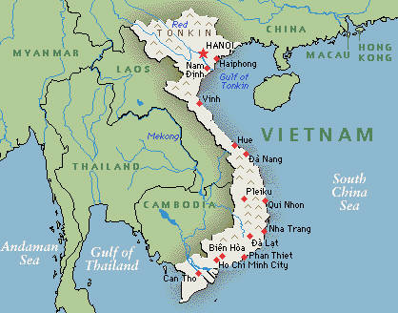

Slide 14
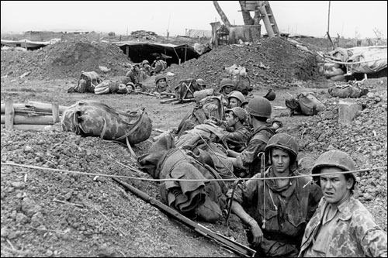

Slide 15
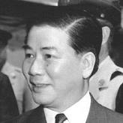
The Vietnam War
Vietnam divided at 17º latitude by Geneva Conference
Communism (Ho Chi Minh) rules N. Vietnam
S. Vietnam ruled by anti-communist gov’t under dictator Ngo Dinh Diem
Communist guerrillas (Vietcong) gain strength and oppose Diem
Vietcong gain control of S. Vietnam, assassinate Diem, supported by N. Vietnamese communists

Slide 16
The US Gets Involved in Vietnam
US wants to contain communism
Gulf of Tonkin (1964)
N. Vietnamese attacked US ships anchored in Gulf
Congress sends troops to Vietnam (1/2 million)
Unfamiliar terrain, guerrilla warfare
S. Vietnamese government was unpopular
Support for Vietcong grew, supplies from Ho Chi Minh, USSR, Communist China
US turns to bombing farmland and forests to destroy hideouts
Strengthens peasant opposition to S. Vietnamese gov’t
Vietnam War unpopular in the US
Vietnamization: US troops pull out, giving power to S. Vietnam (ends in 1973)
Bombing N. Vietnam and supply routes, Vietcong hideouts

Slide 17
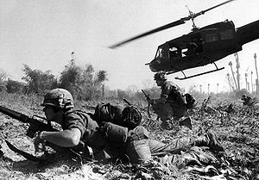

Slide 18
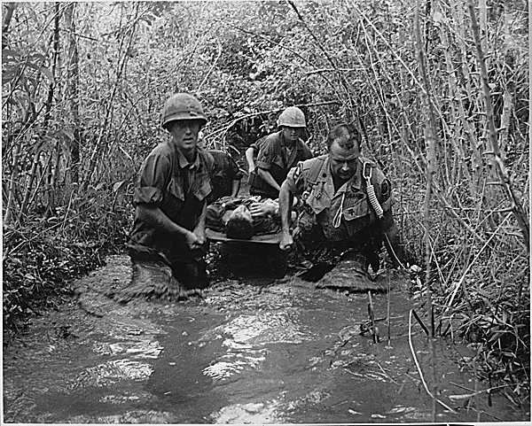

Slide 19
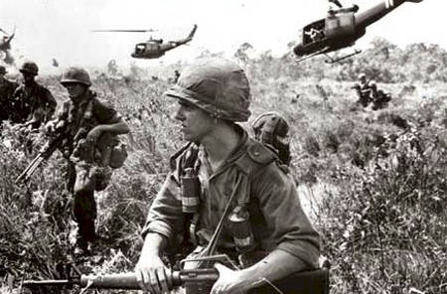

Slide 20
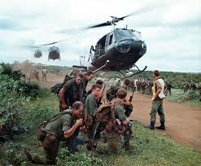

Slide 21
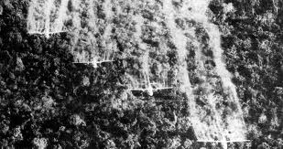
Agent Orange

Slide 22
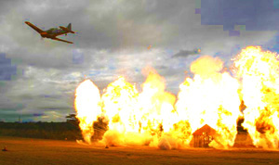
Napalm

Slide 23
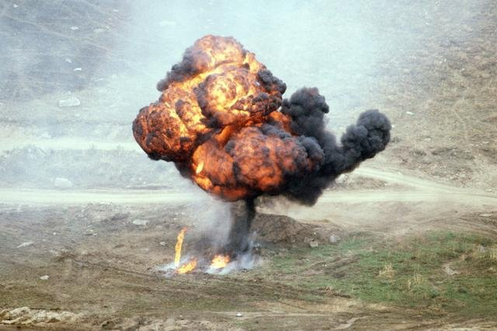

Slide 24
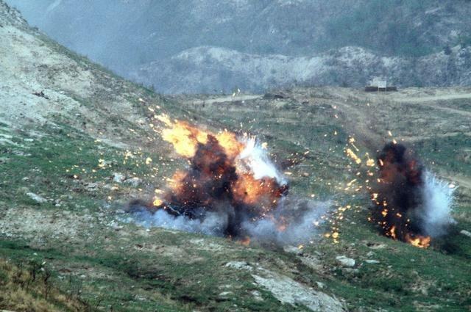

Slide 25
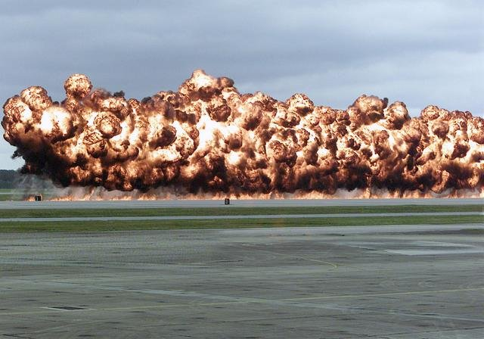

Slide 26
Effects of Vietnam War
N. Vietnam takes over S. Vietnam
Sends thousands to “reeducation camps” for training in Communist thought
Nationalization of industry, control of business
Renamed Saigon (S. Vietnam capital) Ho Chi Minh City
Many S. Vietnamese flee, die
US and Vietnam made peace in 1995

Slide 27
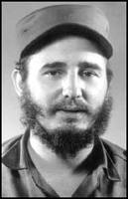
Cuba
After WWII, third-world nations seek aid from superpowers
Revolutions find communist support
In Cuba, US backs dictator Fulgencio Batista
Cubans resent leader, leads to revolution under Fidel Castro, supported by USSR (1959)
Castro is harsh dictator
Suspended elections, jailed/executed opponents, controlled press
Takes over US-controlled sugar mills and refineries
Eisenhower orders halt of all trade with Cuba
Castro asks Soviets for economic/military aid
US invades Cuba with anti-Castro Cubans at Bay of Pigs
Cuba defeats invaders

Slide 28
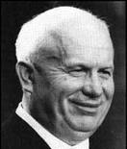
The Cuban Missile Crisis
July 1962: Nikita Khrushchev (USSR leader) begins building 42 nuclear missile sites in Cuba
US spy plane discovers sites
JFK sees missile sites as threat, demands removal and blockade
Tension believed to lead to brinkmanship
Khrushchev agrees to remove missiles if US won’t invade Cuba
Soviet aid ends in 1991, hurting Cuba
Castro ruled until 4/19/11, followed by son Raul
Cuba still under Communism

Slide 29
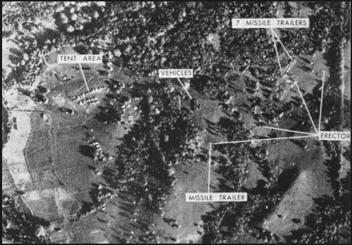
Launchpad

Slide 30
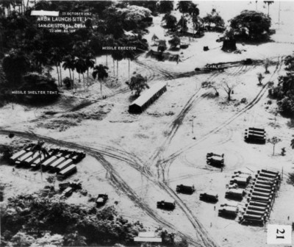

Slide 31
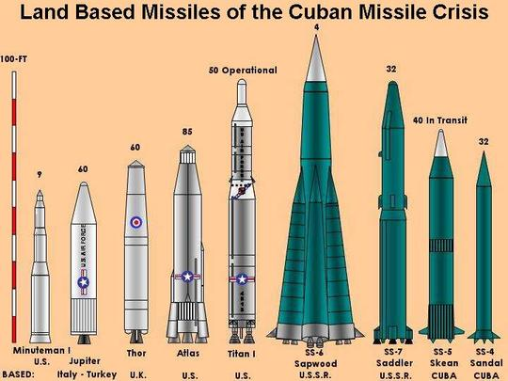

Slide 32
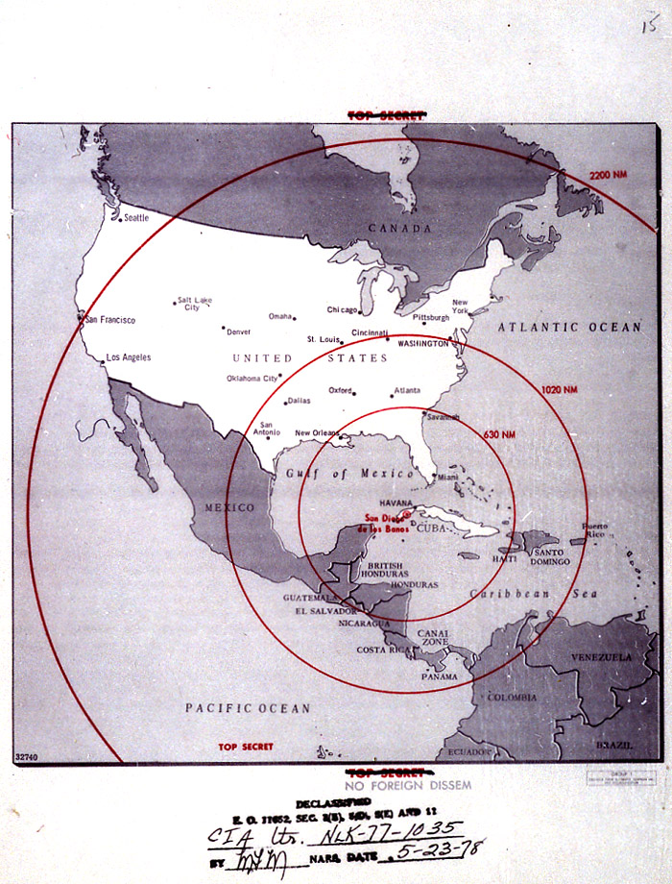

Slide 33
Tensions in the Middle East
Middle East is oil-rich
USSR and US want wealth associated with oil
Post-WWII, Iran’s Shah Mohammed Reza Pahlavi embraces western governments and capitalism
Nationalists resent foreign alliances, unite under Prime Minister Muhammed Mossadeq
Shah flees in 1953, the US reinstates Shah into power afraid Iran will turn to USSR

Slide 34
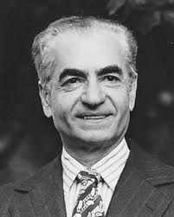
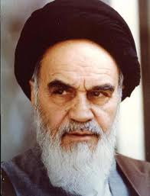

Slide 35
Tensions in the Middle East
Shah westernizes his nation (skyscrapers, wealthier, etc)
Many Iranians still in poverty, supported by ayatollahs (Muslim leaders)
Led by Ayatollah Ruholla Khomeini
Encourages rebellion in 1978
Shah flees rebellions in 1979
Khomeini takes over Iran and lets Iran be a radical Islamic state

Slide 36
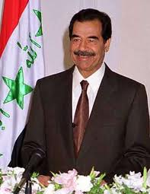
Tensions in the Middle East
Because the US supported the Shah, Khomeini hated the US
Islamic revolutionaries seize US embassy in Tehran, Iran in 1979
Hostage crisis, 60 Americans hostage and demand that Shah be put on trial (hostages released in 1981)
Khomeini encourages radicals to overthrow secular governments everywhere
Leads to tension between Iran and Iraq
Iraq is led by secular Saddam Hussein
War begins between Iran and Iraq (1980)
US gives aid to both, not wanting either side to win
USSR gives aid to Iraq
Cease-fire in 1988

Slide 37
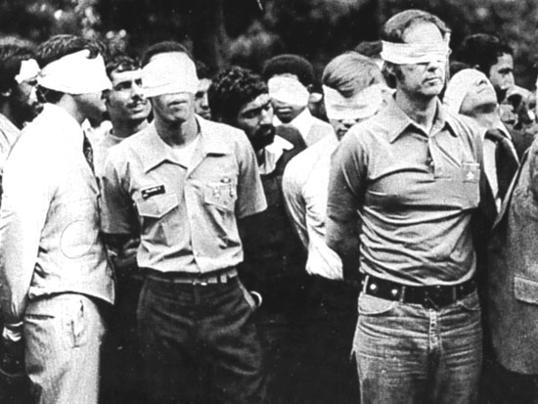

Slide 38
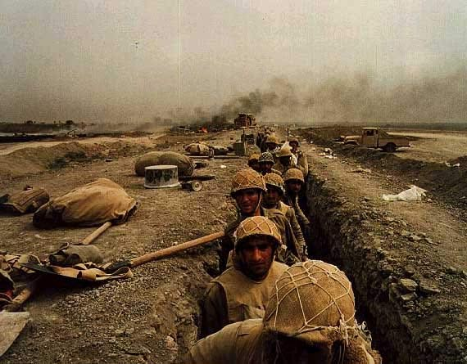

Slide 39
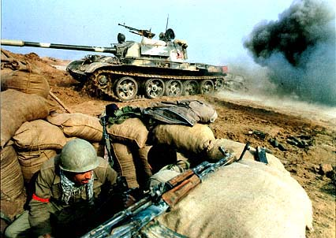

Slide 40
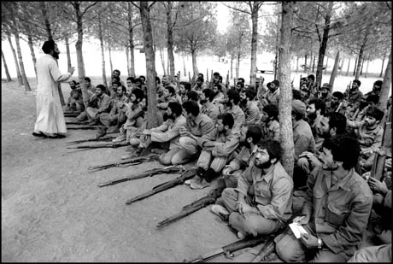

Slide 41
Tensions in the Middle East
Afghanistan maintained independence from the US and USSR
Soviets gain control in 1950s
Nationalists rebel in 1970s
Soviets invade in 1979
Afghans supplied with American weapons against Soviets
Mujahideen (holy warriors)
US supports Afghanistan to protect oil interests
Soviet president, Mikhail Gorbachev withdraws Soviet troops in 1989

