Slide 1
Origins and Early Spread of Islam
Ch. 6

Slide 2
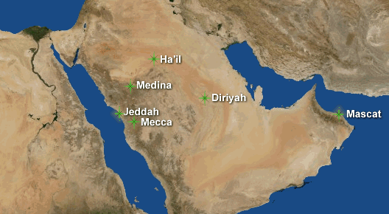
Module 1: Pre-Islamic Arabia

Slide 3
Pre-Islamic Arabia: Geography
Desert, scrub zones
Nomadic bedouins
  Camel and goat herders
  Live along oases
    Towns, villages, merchant activity
Coastal regions
  Extensive agriculture, large cities, regional kingdoms, trading towns

Slide 4
Pre-Islamic Arabia: The Clans
Tribal culture
Kin-related groups
Highly mobile tent encampments
Struggle for subsistence leads to strong dependence and loyalty to one’s clan
Cooperation and support
  Worst punishment: exile
Government
  Clan councils of elders
  Shayks
    Wealthy with large herds, several wives
    Dictates enforced by free warriors
  Slaves

Slide 5
Pre-Islamic Arabia: The Clans
Cohesion reinforced by fierce inter-clan rivalries
  Struggle over control of pastureland and oases
    Why was this such a struggle?
  Turf wars
  Honor and feuds
    Revenge

Slide 6
Pre-Islamic Arabia: Trade
Farmers and towns emerge along west and southern Arabia
Cities develop to participate in transcontinental trade routes
  Mecca
    Founded by Umayyad clan for Quraysh tribe, which dominated politics and commercial economy
    Ka’ba attracts pilgrims on annual basis
      Pilgrims spend money!
  Medina
    Smaller agricultural trade center growing wheat, dates
    Controlled by small bedouin and Jewish tribes

Slide 7
Pre-Islamic Arabia: Marriage and Family
Women
  Greater freedom and higher status
  Key economic roles (milking, weaving, raising kids)
  Matriarchal society
    Men constantly migrating
  Bride price, not dowry
  Unveiled and not secluded
  Not equal to men
    Property, inheritance, divorce favored men
    In cities, men practice polygamy and are patriarchal

Slide 8
Pre-Islamic Arabia: Religion
Culture of Arabia fairly undeveloped
  Isolation, poverty of environment
  Oral history
Animism, polytheism
Supreme god/spirit, Allah
  Rarely worshipped Allah, but rather patronized less abstract spirits that “affected” daily lives
Ethics rooted in tribal customs, not religion

Slide 9
Reflection Questions
How might the trade and caravan culture of Arabia facilitate the spread of Islam?
How do we see evidence of clan mentality in Islamic culture today?
Muhammad will establish Islam in the city of Mecca. How do you think the Umayyad clan will respond? Why?
Why are the roles of women surprising? Why do you think this changes over time?

Slide 10
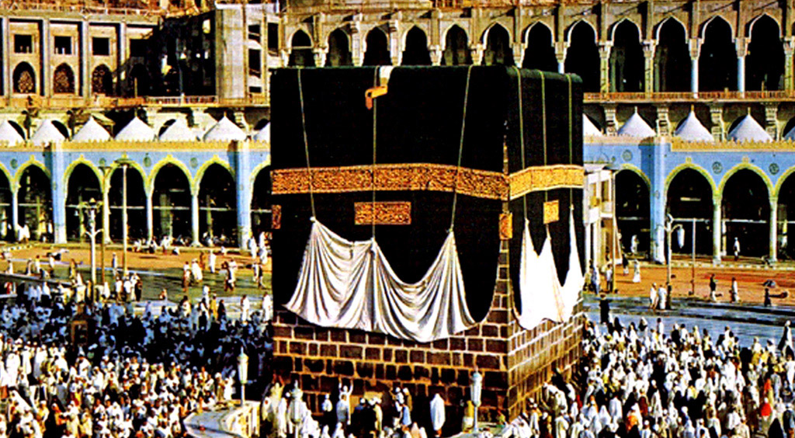
Module 2: Origins of Islam

Slide 11
Islamic Origins
Byzantine and Sassanid empires begin to encroach on Arabia
  Influence of monotheism (Judaism, Christianity)
Muhammad (570-632)
  Orphaned
  Born into respected clan and powerful tribe
  Raised by uncle (Abu Talib) and grandfather
    Becomes a caravan merchant with uncle, traveling into Syria
  Works as a merchant in Mecca for Khadijah (wealthy widow)
  Becomes disenchanted with wealth and power of Umayyads and materialism
  Retreats into hills to meditate
    Visited by Gabriel and given revelations (written as Qur’an)

Slide 12
Establishment of Islam
Umayyad see Muhammad as a threat due to large following
  Why would they see him as a threat in Mecca?
Inter-clan tension in nearby Medina
  Muhammad invited to mediate disputes (hijra)
  Settles quarrels, earning him respect and followers
  Leads to strengthening of Medina
    Angers Umayyads more. Why?
    Attacks by Quraysh on Medina, fails
    Treaty between Muhammad and Quraysh
      Muhammad asks to visit Ka’ba, smashes idols, proclaims authority of Allah
Eventually, Umayyads won over to Islam

Slide 13
Beliefs of Islam
Dignity and equality of all
Ethical code
Compassionate god
Strict legal codes
Accepts earlier revelations of Judeo-Christian beliefs
Five Pillars
  Confession
  Pray 5 times/day facing Mecca
  Fast during Ramadan
  Zakat
  Hajj

Slide 14
Reflection Questions
Why would Islam be so appealing to divided peoples of Arabia?
Why would Islam be so appealing to people in general in a stratified society like those in clans?
How is Islam similar to Christianity and Judaism? Different?
How could Islam change the culture of clan mentality in Arabia?
How do you think Muhammad would feel about the image and perception of Islam today? Why?
134

Slide 15
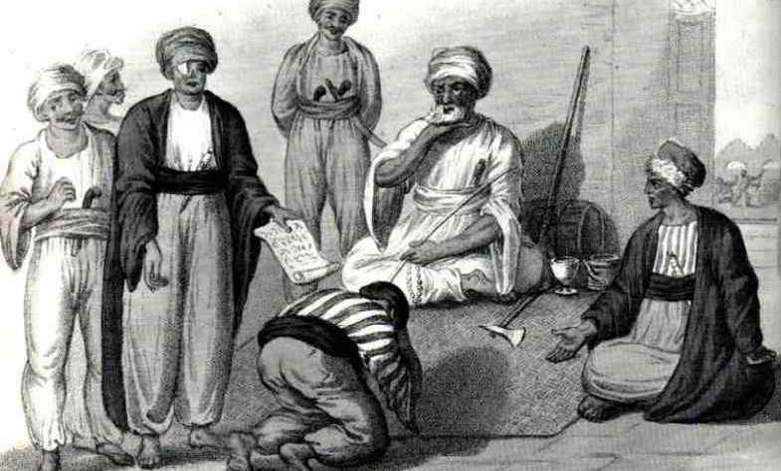
Module 3: The Umayyad Empire

Slide 16
Crisis post-Muhammad
Death of Muhammad (632)
  Did not appoint successor (caliph)
  Ali (cousin/son-in-law), believed too young
  Abu Bakr (632-34)
    Courageous, warmth, wisdom, well-versed in clan rivalries
Many people abandon faith after Muhammad’s death
  Commanders venture across Arabia and beyond to return tribes to Islam (Ridda Wars)
    Reveal vulnerability of Sassanid and Byzantines

Slide 17
Conquest
Use p. 136-37 to identify motives for Arab conquest during the early Umayyad empire
  Unity
  Revenge as backward
  Release pent-up energy
  Share in the booty and tribute
  Glorify religion
    NOT convert! Why?
Expansion
  Conquers Sasanian Empire by capturing capital and destroy armies (651)
  Gain parts of Byzantine Empire
  Absorption of Syria, Iraq, Palestine, Egypt, Libya (capital: Damascus)
  Naval supremacy takes north Africa, Mediterranean islands, Spain/France
  Bureaucracy to rule imperium
  Split between conquerors and conquered
    Conquerors get share of “booty,” receive citizenship
    Warriors set up in garrison towns separate from conquered (why?)

Slide 18
Splits of the Shi’a and Sunni Sects
Murder of Uthman (3rd Umayyad caliph)
  Signals supporters of Ali to proclaim as caliph
Ali refuses to punish Uthman’s murderers, gets on bad side of Umayyads
  Victorious warrior at Battle of the Camel (656)
    Most shift support to Ali against Umayyads
  Battle of Siffin between Umayyads and supporters of Ali (657)
    Ali gives in to requests for mediation
      His supporters renounce him
Umayyads proclaim Mu’awiya as caliph in Jerusalem (660), challenging position of Ali
  Ali assassinated in 661, son Hasan renounces caliphate under Umayyad pressure
Split between Sunni (Umayyad, “anyone”) and Shi’a (Ali, “blood”)
  Ali’s second son, Husayn, killed at battle in Karbala (680) to retake caliphate
    Shi’a begins active resistance to Umayyad
  Leads to split over belief, ritual, law

Slide 19
Muslim Empire Terms
Mawali: converts to Islam
Jizya: head tax
Dhimmi: “people of the book” (Bible)

Slide 20
Women under Early Islam
Muhammad’s high regard for women
  Heavily involved wives and daughters
  Women compiled the Qur’an and hadiths (traditions)
  Fought for Islam (first martyr)
Denounced adultery, forbade infanticide
Right to choose who to marry
Legal rights
  Inheritance
  Divorce
  Bride price given to bride, not her father
  Egalitarianism before Allah
Wide range of careers (scholarship, law, commerce)
Lack of veiling and seclusion

Slide 21
Fall of the Umayyads
What factors led to the decline of the Umayyad empire? (141)
  Addiction to “luxury and soft living”
    Size of royal harem
  Legitimacy disputed
  Alienation of faithful
    Conquest, luxury, abandonment of religious frugality
Tension in Merv (740s)
  50,000 settled warriors intermarried with local women
  Rarely given booty
  See Umayyads as corrupt and decadent
Battle of the River Zav (750)
  Umayyads challenged by Abbasid party (descended from al-Abbas, Muhammad’s uncle)
    Alliance of Abbasids and other tribes who rivaled Umayyads (Shi’a, mawali)
  Abu al-Abbas invited members of Umayyad clan to a peace banquet
    Assassinates most members, hunts the rest
      One escapes to Cordoba, Spain, creating Muslim presence there

Slide 22
Reflection Questions
Why didn’t Islamic leadership have any interest in mass conversions of subject peoples?
What motivated people under the Umayyad empire to convert if it was not forced?
Why did subject peoples prefer the Arabs over the Byzantines or Sassanids?
How might the split between Shi’a and Sunni fuel rivalries in the Middle East today?
Why are the roles of women surprising? Why do you think this changes over time?
How are the factors that led to the collapse of the Umayyads similar and different to those of Rome?

Slide 23
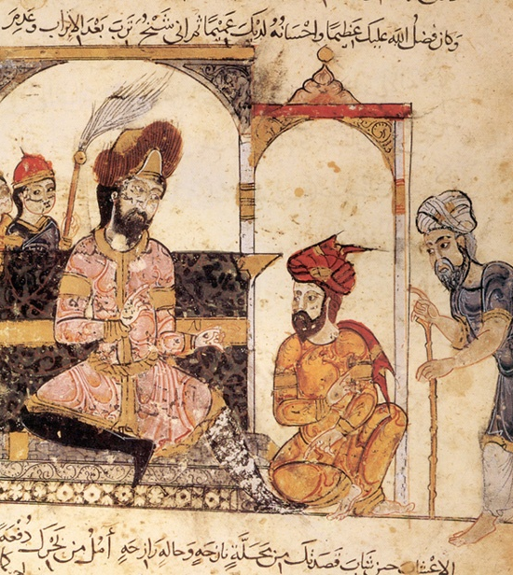
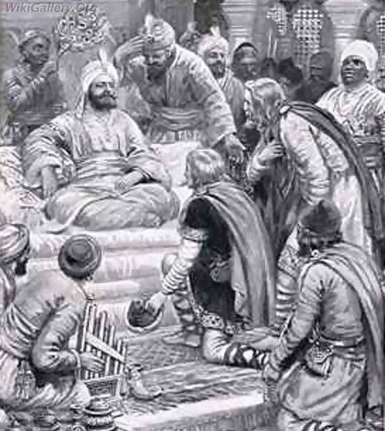
Module 4: The Abbasid Empire

Slide 24
Early Abbasids
Support by Shi’a
Abbasids slowly begin to reject Shi’a and allies once successful
Begin to be more supportive of Sunni, less tolerant of “heretical” Shi’ites
Creation of centralized, absolutist imperium
New capital at Baghdad (near old Persian capital)
  What does this signify?
Bureaucratization
  Wazir (chief administrator, royal executioner, “running the show”)
  Tribute

Slide 25
Conversion
Discarding of “sharing the booty”
  How might this change the view of conversion?
Integration of Arab and non-Arab mawali
  Equal footing as “first generations of believers”

Slide 26
Muslim Commercialism
Growth in wealth and status of merchants
  East: Tang/Song, West: Abbasids
  Dhows: sailing vessels with lateen (triangular) sails
  Joint ventures with Christians and Jews
    Trade business occur everyday (different Sabbaths)
  Trade of provisions, luxury products
  Wealth gets reinvested, given to charity, infrastructure (baths, mosques, schools, rest houses, hospitals)
Artisans (handicraft)
  Furniture, carpets, glassware, jewelry, tapestries
  Lower class (why?)
    Poorly paid, yet own tools and valued for skills
  Guilds

Slide 27
Social Stratification
Slaves
  Originate from east Africa (non-Muslim)
  Unskilled labor, domestic work
  Serve caliphs and advisors
    Rise to positions of power
  Some able to get or purchase freedom
Ayans (landed elite, “landlords”)
  Some long established, others are warriors, merchants or administrators who use booty or new wealth to invest in land and localized power
  Employ sharecropping, tenant, or migrant peasants

Slide 28
Abbasid Politics: Intrigue and Luxury
Imperial luxuries and excesses under al-Mahdi
  Third Abbasid caliph, 775-785
  Monumental buildings, dependent wives and concubines
  Drained imperial treasury
  Did not claim a successor
    Creates rivalry of caliph’s wives and concubines, sons
    Within a year of his death, al-Mahdi’s son is poisoned
Harun al-Rashid (786-809)
  Visited by Charlemagne
  Splendorous mosques, palaces, treasures
  Immortalized in One Thousand and One Nights
    Shows dynastic weaknesses
    Dependent on Persian advisors, making him a pawn
  Does not claim successor
    Creates civil wars
      Some sons begin creating own personal armies and bodyguards (sons of al-Ma’mun, 813-833)
      Creates power behind throne

Slide 29
Fall of the Abbasids
Use pages 153-55 and 160 to explain the factors that led to the fall of the Abbasids
Civil violence between possible successors
  Drains treasury, which alienates subjects
  Some caliphs try to escape violence by creating new capitals (build new palaces, mosques, public works)
    Expenses fall on peasants (labor, taxes, etc)
  Payment of mercenary troops
    Taxation
      Civil wars rather than irrigation canals
        Leads to floods, famine
          Peasants flee to wilderness, which means no taxes
      Uprising by Shi’a

Slide 30
Fall of Abbasids (cont.)
Caliphs focus on civil wars and violence in towns
  Not focuses on borders
    Egypt and Syria break away
Independent kingdoms spring up to try to take over
  Buyids (Persia) capture Baghdad (945)
    Caliphs become puppets as Buyids become sultans
  Buyids overthrown in 1055 by Seljuk Turks
    Turks=Sunni
    Purge Shi’a officials and rid government of Shi’a influences under the Buyids
    Restore land to Abbasids, settling Asia Minor (Anatolia/Turkey)

Slide 31
Fall of Abbasids (cont.)
In 1220s, Mongols invade from east
  Led by Chinggis (Genghis) Khan
  Destroy Turko-Persian kingdoms east of Baghdad
  Grandson, Hulegu, takes Baghdad
    Executes last (37th) caliph in 1258
  Mongols continue west, defeated by Mamluks
    Turkish slaves who ruled Egypt

Slide 32
The Crusades
Knights from Europe decide to take Biblical Holy Land
Divisions within Abbasid empire make empire vulnerable
Eight crusades over 200 years (1096-1291)
  First: 1096-1099, Jerusalem taken, Jews and Muslims massacred
  Muslim leader Salah-ud-Din (Saladin) unites Muslims and reconquers Holy Land
  Last Crusader kingdom falls at Acre in 1291

Slide 33
Impacts of the Crusades
Use pages 155-56 to list and explain the impacts that the Crusades had on the Europeans
  Weaponry
  Fortifications
  Medicine
  Recovery of Greek learning
  Arabic (Indian) numerals, decimal
  Rugs and textiles (tapestries)
  Words, games, chivalry, ballads, foods
Muslims have very little interest in culture of West

Slide 34
Women and Family
Two words: Harem and veil
  WHY???
  Subjugation and seclusion
  Wives and concubines restricted to part of palace
    Slaves freed by bearing healthy sons
Eunuchs
Slave concubines and servants have more freedom than free wives
  Go to market, unveiled
Lower class women
  Married at puberty (age 9)
  Devote lives to household and husband
  Helped family economy (wave, raised silkworms) at home

Slide 35
Islamic Scholarship
Art
  Mosques
Science and Math
  Recovery of Greek learning
    Library at Alexandria burnt, Islamic and Jewish scholars translate and backup texts, apply ideas
  Trigonometry (sin, cosine, tangent)
  Astronomy
  Mapmaking
  Anatomy and ethics
  Indian numbers
Literature
  Persian as official written language of secular society
  Arabic as official written language of religion
  Writing of histories, epics, literature, love, drama, intrigue

Slide 36
Reactions to Scholarship
Ulama (religious scholars)
  Suspicious and hostile to non-Islamic ideas
  Greek scholars were tied to aggressive Crusaders
Sufis
  Islamic mystics
  Sought personal union with Allah
  Healers and miracle workers
  Militant bands to convert
  Union through
    Drugs
    Songs
    Asceticism
    Bodily denial
    Dervishes (ecstatic dancing)

Slide 37
Reflection Questions
What were the benefits of converting to Islam?
Which social class (slave, ayan, artisans, merchants, warrior, bureaucrats, administrators, peasants) do you think was the best group to be part of? Why?
What were some of the prevailing factors that led to the fall of:
  The Abbasids
  The Arab caliphates
  Empires in general
How did succession create issues within the empire?
How does the cultural exchange between the Muslims and Crusaders challenge our ideas of “western society”?
How would Muhammad feel about the treatment of women under the Abbasid dynasty?

