Slide 1
Tang Poetry and Song Art

Slide 2
I am only an old woodsman, whispering a sob, As I steal like a spring-shadow down the Winding River. ...Since the palaces ashore are sealed by a thousand gates – Fine willows, new rushes, for whom are you so green? ...I remember a cloud of flags that came from the South Garden, And ten thousand colours, heightening one another, And the Kingdom's first Lady, from the Palace of the Bright Sun, Attendant on the Emperor in his royal chariot, And the horsemen before them, each with bow and arrows, And the snowy horses, champing at bits of yellow gold, And an archer, breast skyward, shooting through the clouds And felling with one dart a pair of flying birds. ...Where are those perfect eyes, where are those pearly teeth? A blood-stained spirit has no home, has nowhere to return. And clear Wei waters running east, through the cleft on Dagger- Tower Trail, Carry neither there nor here any news of her. People, compassionate, are wishing with tears That she were as eternal as the river and the flowers. ...Mounted Tartars, in the yellow twilight, cloud the town with dust. I am fleeing south, but I linger-gazing northward toward the throne.

Slide 3
Cicadas complain of thin mulberry-trees In the Eighth-month chill at the frontier pass. Through the gate and back again, all along the road, There is nothing anywhere but yellow reeds and grasses And the bones of soldiers from You and from Bing Who have buried their lives in the dusty sand. ...Let never a cavalier stir you to envy With boasts of his horse and his horsemanship

Slide 4
The stars of last night and the wind of last night Are west of the Painted Chamber and east of Cinnamon Hall. ...Though I have for my body no wings like those of the bright- coloured phoenix, Yet I feel the harmonious heart-beat of the Sacred Unicorn. Across the spring-wine, while it warms me, I prompt you how to bet Where, group by group, we are throwing dice in the light of a crimson lamp; Till the rolling of a drum, alas, calls me to my duties And I mount my horse and ride away, like a water-plant cut adrift.

Slide 5
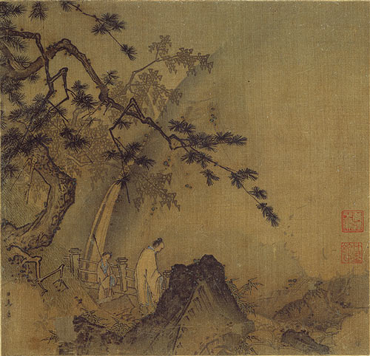

Slide 6
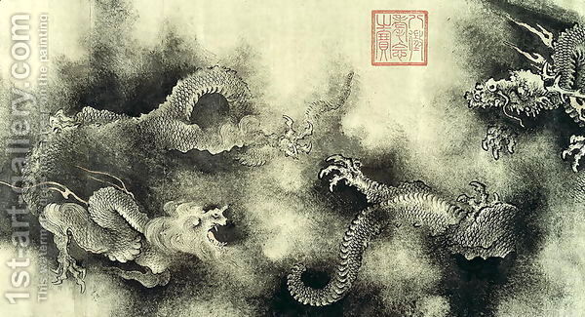

Slide 7
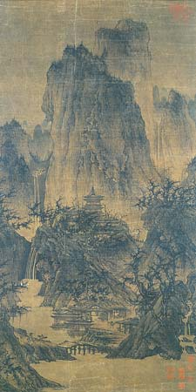

Slide 8
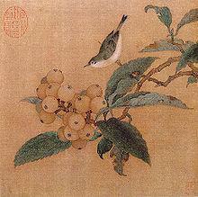

Slide 10
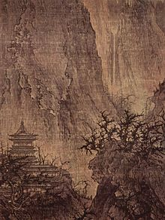

Slide 11
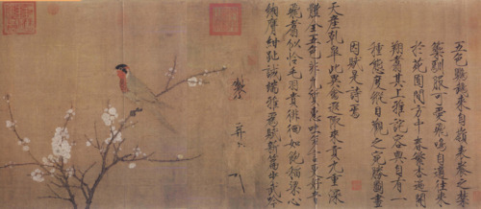

Slide 12
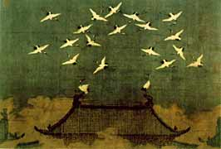

Slide 13
How does art of the Tang and Song dynasties reflect ideas and philosophies of the time?

