Slide 1
The End of the Soviet Union

Slide 2
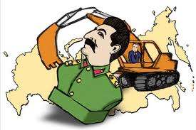
Soviet Policy in E. Europe and China
De-Stalinization
Stalin dies in 1953, replaced by Nikita Khrushchev
Denounces Stalin for jailing and killing loyal citizens
Attempts to purge Stalin from the history of USSR
Destruction of murals, pictures, statues of Stalin
Hungary
Begins revolting against Soviet Union
Cuts hammer and sickle out of Soviet flag
Renounces communism
Imre Nagy promises free elections, demands Soviets leave
Soviet tanks and troops enter Budapest, leads to fighting
Nagy is executed

Slide 3
Soviet Policy in E. Europe and China
Czechoslovakia
Because of Khrushchev’s inability to handle Cuban Missile Crisis, party leaders kick him out and elect Leonid Brezhnev
Brezhnev enacts repressive domestic policies
Limits freedom of speech, worship, secret police
Alexander Dubcek (leader of Czechoslovakia)
Loosens censorship, Prague Spring
Armed forces of Warsaw Pact invade Czechoslovakia
Brezhnev justifies invasion as the right for Soviets to prevent satellites from rejecting communism (Brezhnev Doctrine)

Slide 4
From Brinkmanship to Detente
Brinkmanship
Cuban Missile Crisis
Korea
Vietnam
Protests during Vietnam leads to backing away from confrontation against Soviet Union
Détente: policy of lessening Cold War tensions (Nixon)
Realpolitik: “realistic politics,” dealing with other nations in practical and flexible manner
Nixon begins visiting communist nations
First US president to visit communist China, recognizes as superpower
Nixon visits USSR in 1972, signs Strategic Arms Limitation Talks (SALT I) treaty
Carter strays from détente, leading to buildup of arms
Reagan moves from détente, increasing defense spending

Slide 5
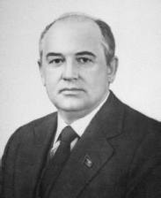
Changes in Soviet Leadership
Brezhnev and Politburo (ruling committee of Communist Party) crush all opposition
Brezhnev dies in 1982
Politburo replaces Brezhnev with Mikhail Gorbachev
Gorbachev realizes economic and social reforms could not occur without free flow of ideas and information
Glasnost (openness)
Glasnost allows churches to open, releases dissidents from prison, allows publication of books by banned authors, allows critical periodicals, and criticism of public officials

Slide 6
Reforming Soviet Economy and Politics
Under glasnost, people complain about economic hardship
Gorbachev blames on direct control of government
Perestroika: economic restructuring (1985)
Managers have more authority over farms and factories
Private ownership of business
Tries to make economy more efficient and productive
Democratization: gradual opening of political system
Soviet communism must loosen grip on society and politics
Voters could choose people to work in government
Foreign policy
Intermediate-Range Nuclear Forces (INF) Treaty bans nuclear missiles with ranges of 300 to 3400 miles

Slide 7
Germany
Tourists leave E. Germany to visit Austria into W. Germany
Thousands of E. Germans leave
Germany completely closes borders, met by protests
Berlin Wall falls on Nov. 9, 1989
Reunification: merging of E. and W. Germany
Oct. 3, 1990
E. Germany is extremely poor and in ruins

Slide 8
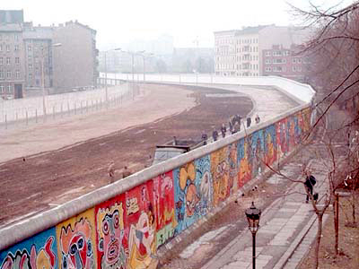

Slide 9
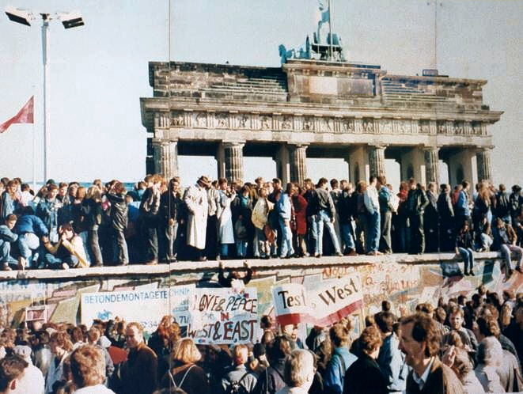

Slide 10
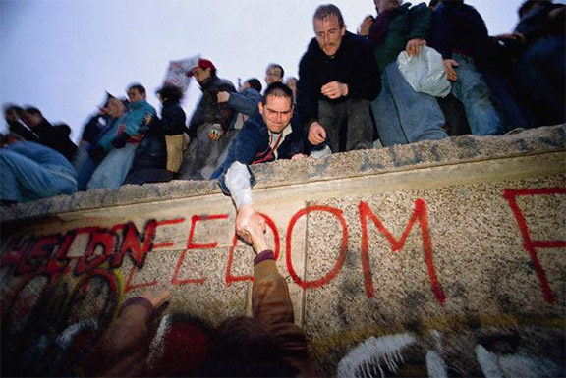

Slide 11
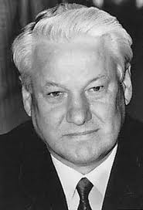
The End of the Soviet Union
Because of Soviet reform (glasnost, Perestroika, democratization), nationalists in Soviet Union begin asking for independence
100+ ethnic groups (Georgia, Ukraine, Moldova)
Lithuania declares independence (1990)
Gorbachev orders economic blockade
Sends Soviet troops to attack in 1991
Hurts Gorbachev’s popularity
Boris Yeltsin becomes first president of Russian Federation
Furious that Gorbachev had given up USSR’s direct rule

Slide 12
The End of the Soviet Union
August Coup
August 18, 1991: Gorbachev is arrested by supporters of Yeltsin
Communist army invades Moscow, Russians want freedom and defend/protest for independence
Military refuses to obey orders from communists
Estonia and Latvia declare independence
By December 15, all republics declared independence
Formation of Commonwealth of Independent States (CIS), loose federation of former Soviet territories
Gorbachev resigns on December 25, 1991

Slide 13
Russia Under New Leadership
Yeltsin
“Shock therapy”: shift to free-market economics, lowering of trade barriers, removal of price controls, ended subsidies to state-owned industry
Leads to 800% inflation, forces people out of work
Legislators oppose Yeltsin and lock themselves inside parliament
Chechnya
Muslim Russian population declares independence (1991)
Yeltsin sends 40,000 troops into republic, destroys capital
Yeltsin resigns in 1999, names Vladimir Putin as president

Slide 14
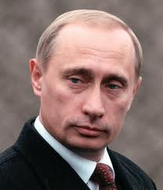
Russia Under New Leadership
Putin
Russia promises to pull out of Chechnya in 2002
Chechen rebels seize theater in Moscow, hold hostages, killing 150 people
Economic problems continue, thousands of homeless children
Will democracy and capitalism continue?
High rates of domestic violence and unemployment, population decline, low life expectancy

