Slide 1
The European Theater

Slide 2
The Soviets and Germany
Nonaggression pact between USSR and Germany
Both agree to split Poland
USSR gets Finland, Lithuania, Latvia, and Estonia
Hitler invades Poland on 9/1/1939
Tanks, bombing raids
France and Britain declare war on Germany on 9/3/1939
Germany annexes w. Poland
Blitzkrieg (“lightning war”)
Fast moving airplanes and tanks, massive infantry forces

Slide 3
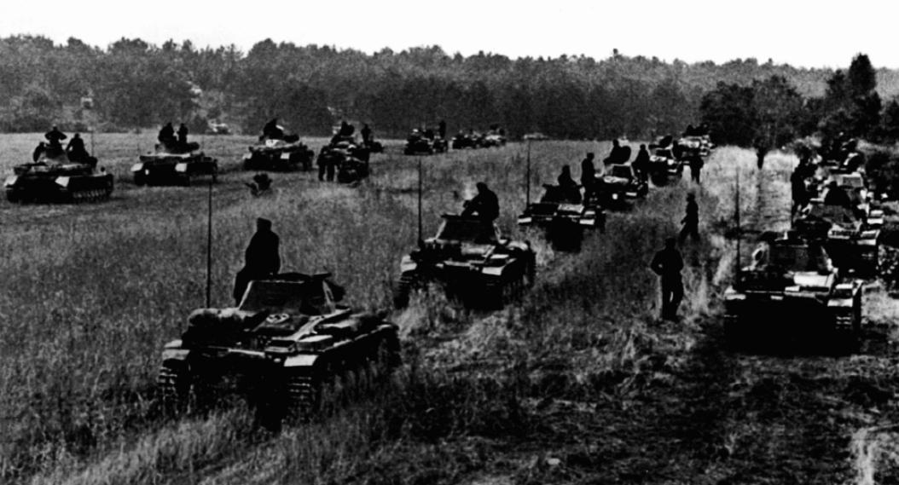

Slide 4
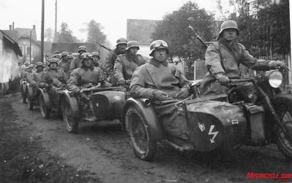

Slide 5
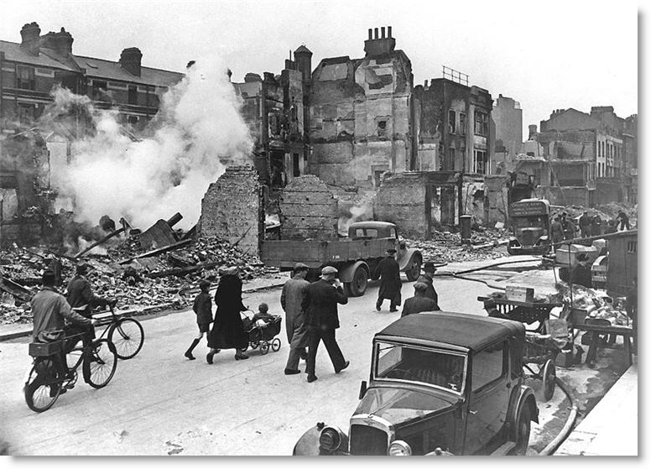

Slide 6
The Soviets and Germany
Stalin sends troops to occupy e. Poland on 9/17/1939
Annexes Lithuania, Latvia, Estonia
Finland fiercely defends themselves
Soldiers on skis
Soviets end up winning, force Finns to surrender
Hitler launches attack on Denmark and Norway on 4/9/1940

Slide 7
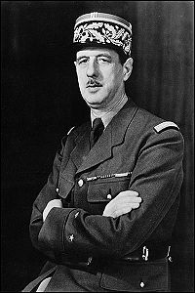
Fall of France
Germans sneak into France
Britain saves French soldiers by picking them up with boats on coast
Germany takes France on 6/22/1940
Charles de Gaulle sets up government in London, determined to reconquer France

Slide 8
Battle of Britain
British Prime Minister Winston Churchill refuses to surrender
Hitler plans to destroy Royal Air Force (RAF) and then land soldiers on shores of England
Germany’s Luftwaffe (air force) begins bombing London (1940)
RAF fights back against Luftwaffe with new technology
Radar
Enigma (code-making machine)
Luftwaffe begins bombing Britain at night
Citizens take shelter in subways, air-raid shelters, basements
Hitler gives up on 5/10/41 to focus on Mediterranean and E. Europe

Slide 9
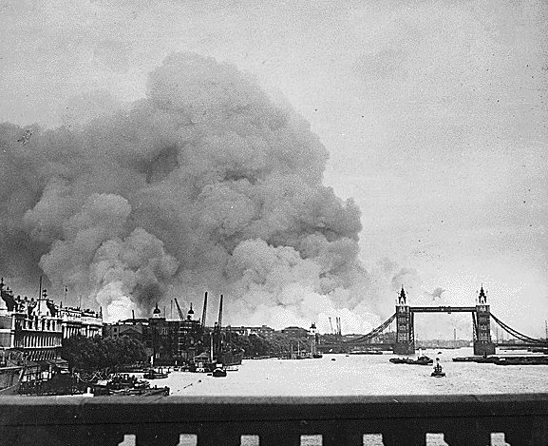

Slide 10
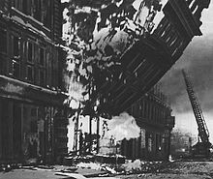

Slide 11
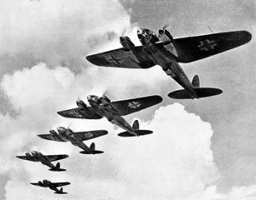

Slide 12
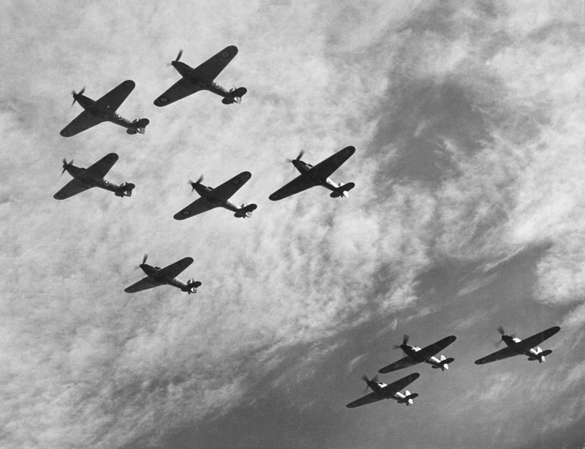

Slide 13
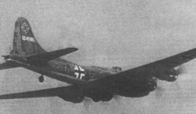

Slide 14
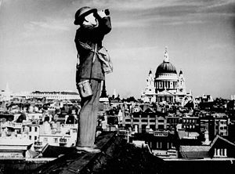

Slide 15
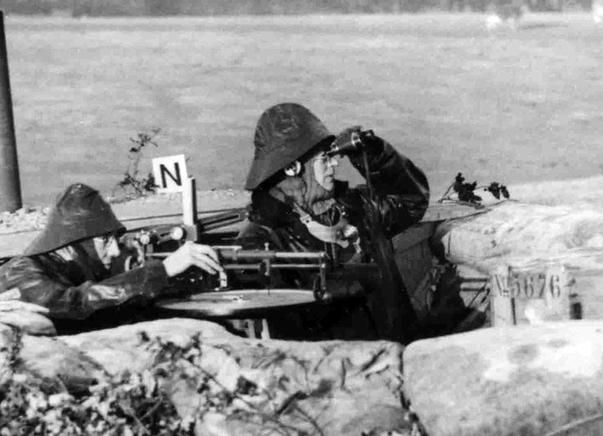

Slide 16
Mediterranean and e. Europe
North Africa
Mussolini attacks British-controlled Egypt
Suez Canal is key to reaching oil fields
In Feb. 1941, British capture 130,000 Italians
Hitler sends tank force (Afrika Korps under Erwin Rommel) to help
Britain retreats, then attacks, driving Rommel back
Rommel ends up pushing back and drives British out (“Desert Fox”)
Rommel eventually gets crushed by Gen. Dwight D. Eisenhower

Slide 17
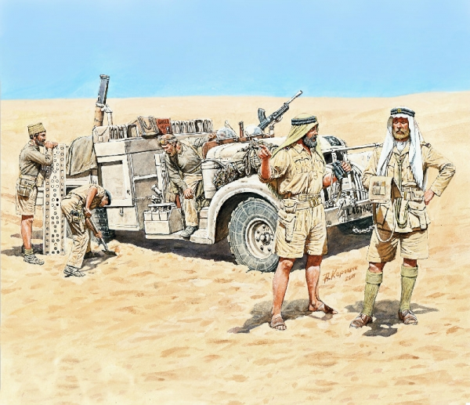

Slide 18
Mediterranean and e. Europe
The Balkans
Hitler decides to invade the Soviets, but first needs to take over Balkan countries
Persuades Bulgaria, Romania, Hungary to join Axis Powers
Greece and Yugoslavia refuse, side with Britain
Hitler invades Greece and Yugoslavia and captures them within 14 days
Flies the swastika from the acropolis

Slide 19
Mediterranean and e. Europe
The Soviet Union
“Operation Barbarossa”
Surprises the Soviets on June 22, 1941
Germans push 500 miles to interior
Scorched-Earth strategy as Soviets flee
Germany destroys storehouses of food
People starve, eat cows, horses, cats, dogs, crows, rats
Soviets resist German advances under Georgi Zhukov
Germans lose 500,000 soldiers between Oct. 2, 1941 and Mar. 1943

Slide 20
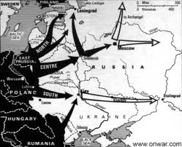

Slide 21
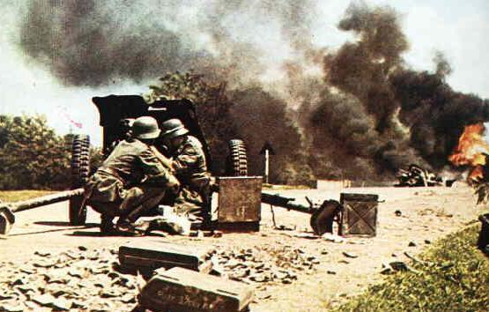

Slide 22
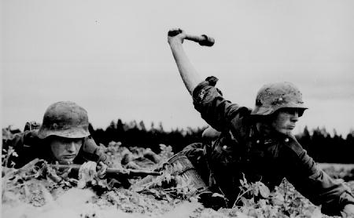

Slide 23
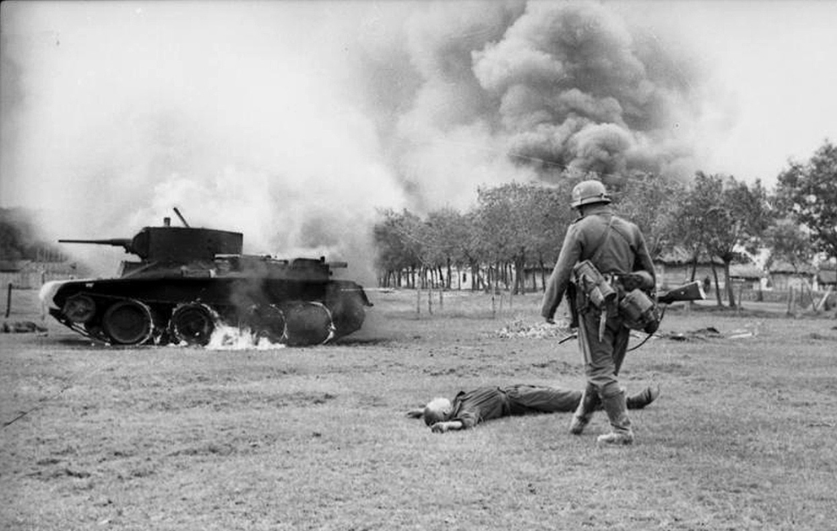

Slide 24
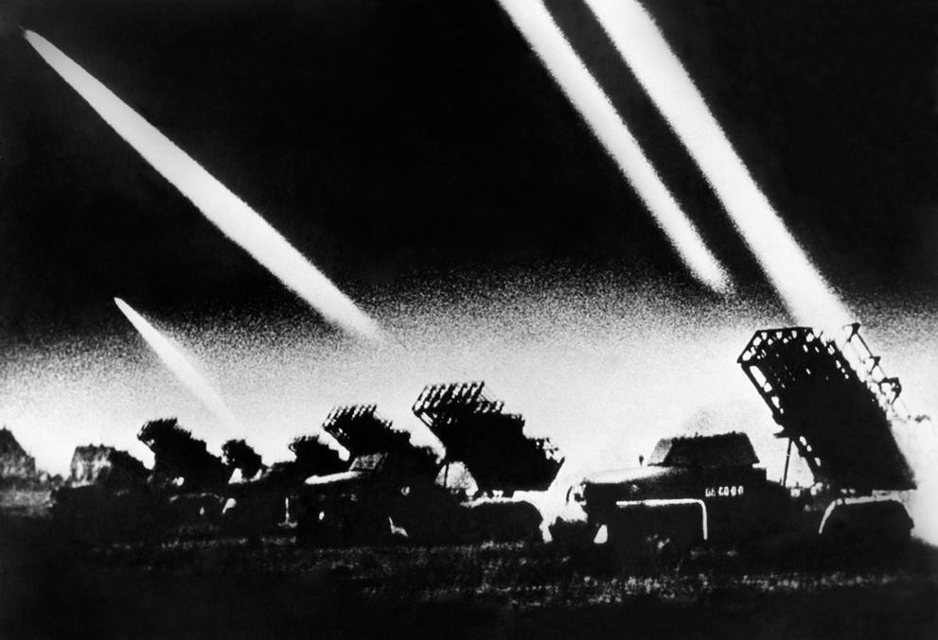

Slide 25
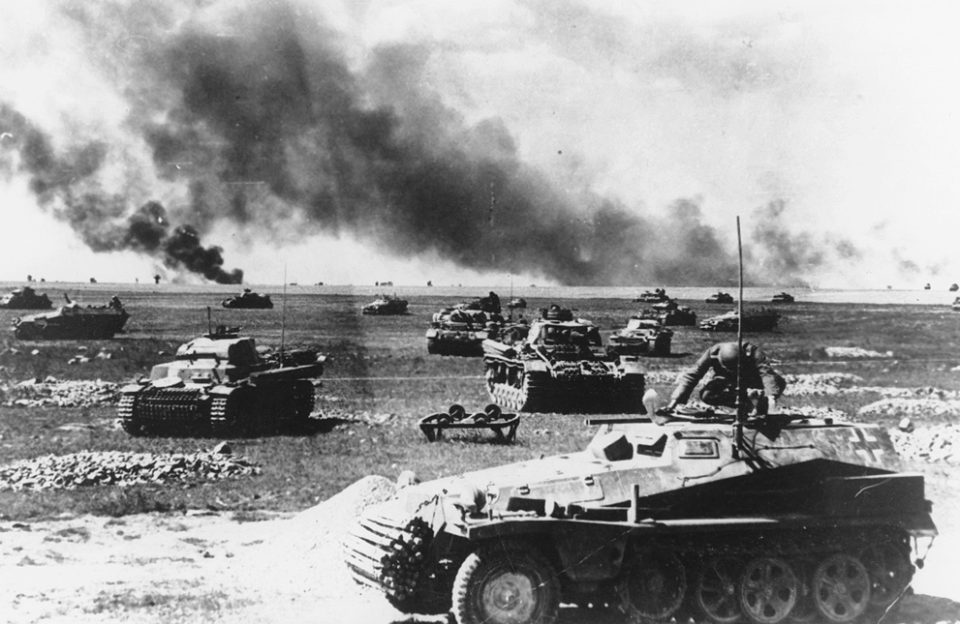

Slide 26
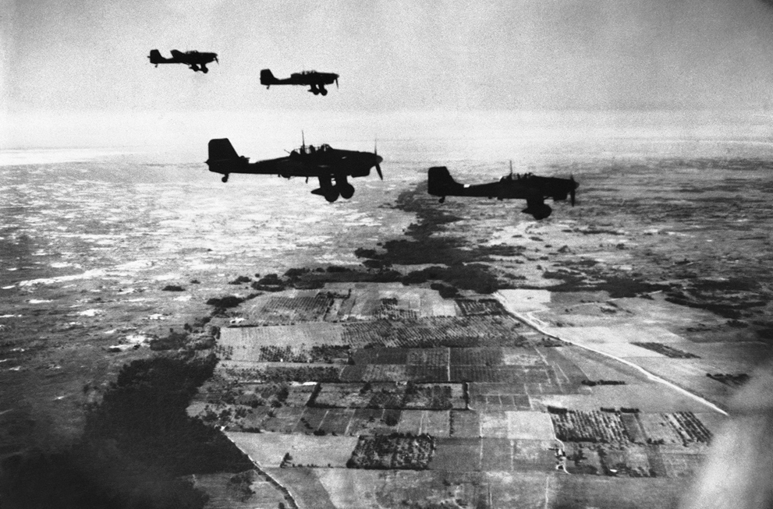

Slide 27
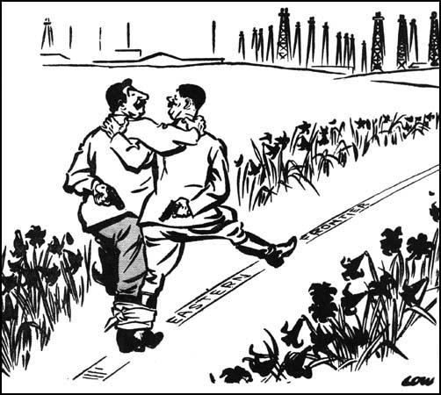

Slide 28
The US ends isolationism
Roosevelt asks Congress to allow the Allies to buy American arms in 1939
Lend-Lease Act (March 1941) allows lending and leasing arms to any nation vital to the US
US Navy escorts British ships carrying US arms in 1941
Atlantic Charter
Allows free trade among nations and right of people to choose their own government
German U-Boat fires on US destroyer, which fires back
Begins a naval war between Germany and the US

Slide 29
Battle for Stalingrad
8/23/42: Luftwaffe begins bombing Stalingrad
By early November, Germany controls 90% of city
Soviet troops capture and surround Stalingrad, trapping Germans
2/2/43: 90,000 German troops surrender
All that was left of 330,000 troops

Slide 30
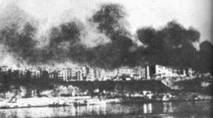

Slide 31
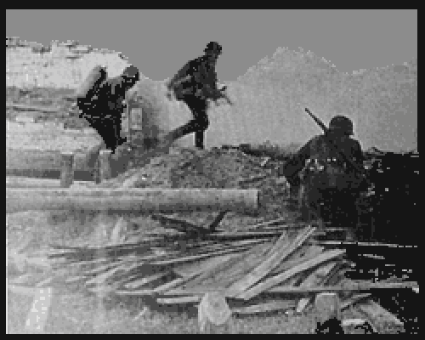

Slide 32
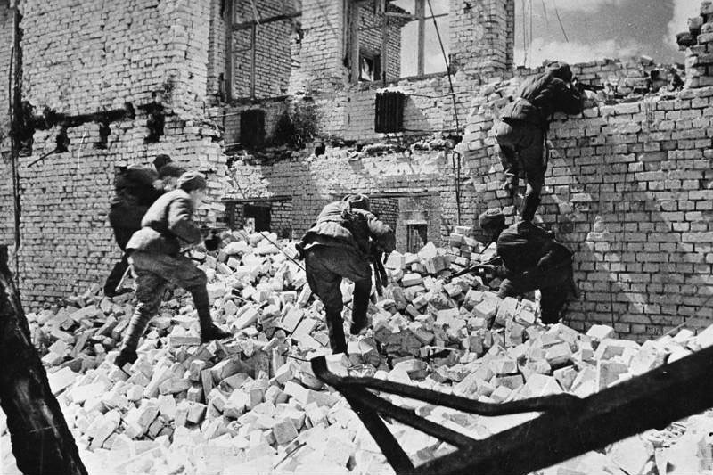

Slide 33
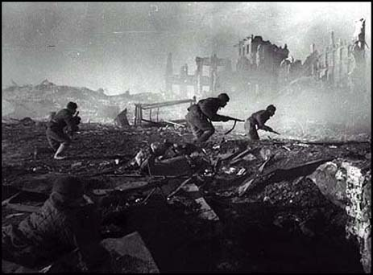

Slide 34
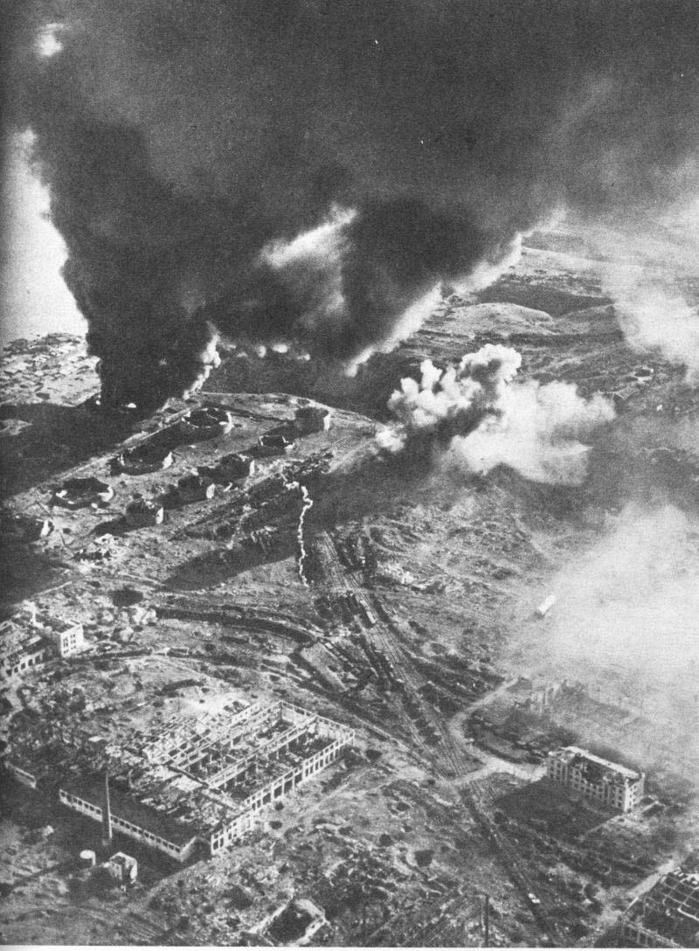

Slide 35
Fall of Italy
King Victor Emmanuel III has Mussolini arrested (7/10/43)
Italy surrenders in war on 9/3/43
Germany tries to help Italy, but retreats
Mussolini is trying to get into Germany
He is shot and killed, his body hung in Milan

Slide 36
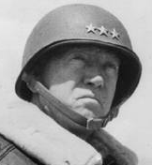
D-Day
Eisenhower plans to lead a force on 6/6/44 to coast of Normandy (NW France)
British, American, French, Canadian troops fight onto 60-mile stretch of beach
Germans dig in with machine guns, rocket launchers, cannons
2700 Americans killed
Allies hold the beachhead led by Gnl. George Patton

Slide 37
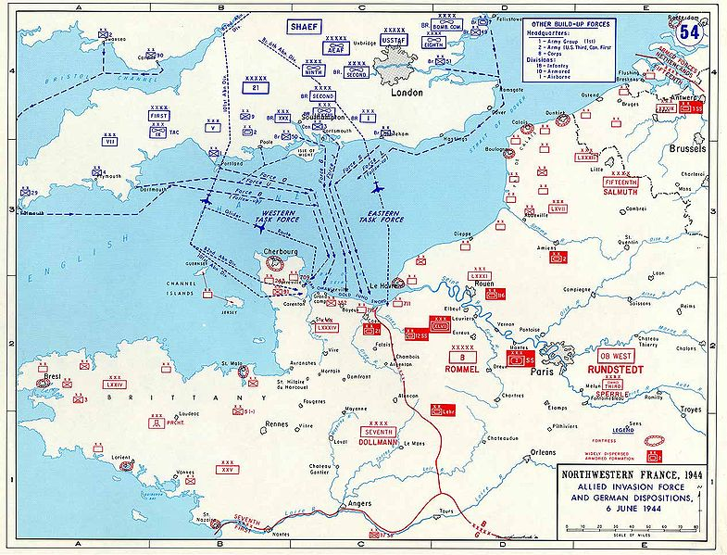

Slide 38
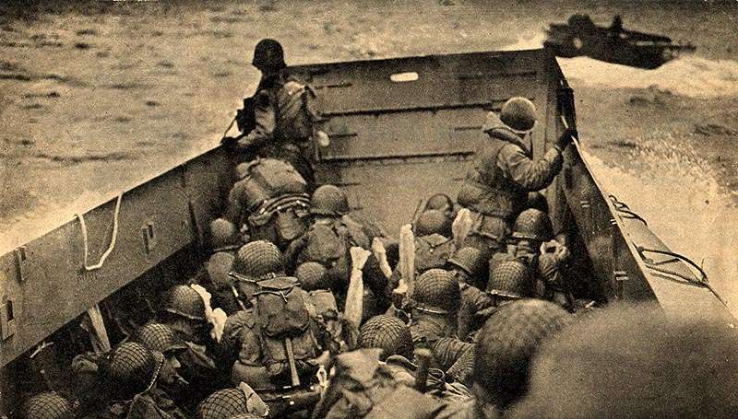

Slide 39
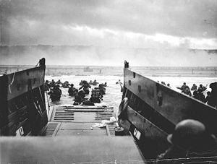

Slide 40
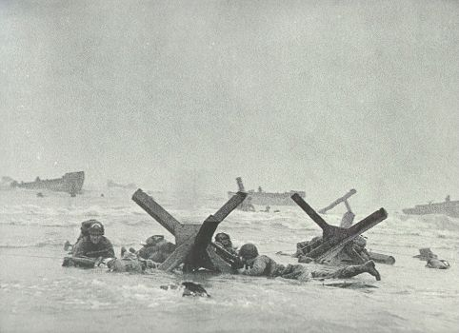

Slide 41
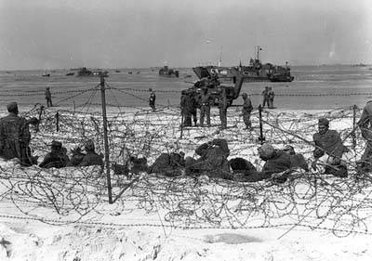

Slide 42
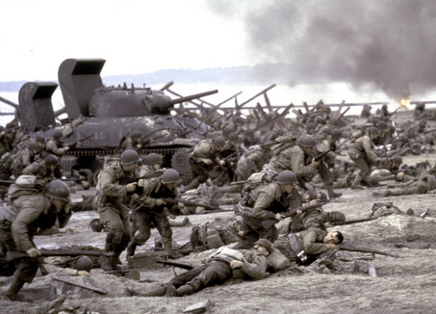

Slide 43
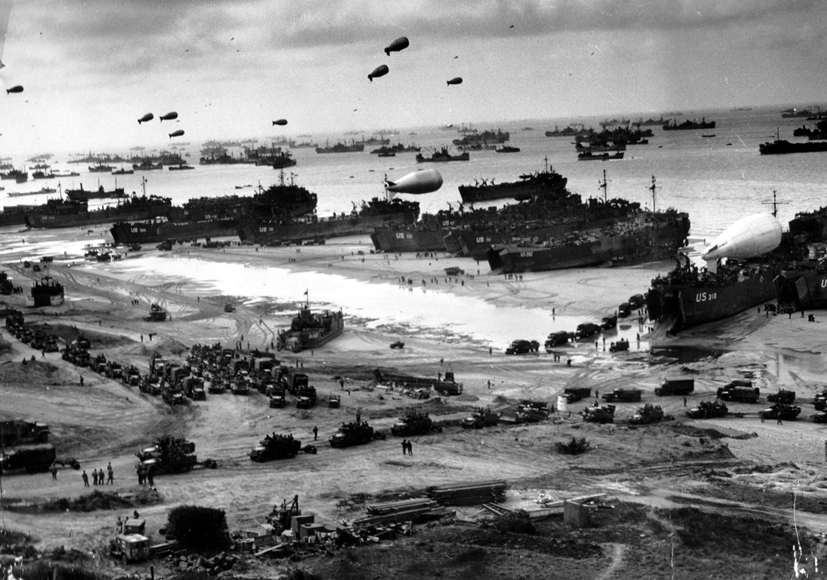

Slide 44
Surrender of Germany
Battle of the Bulge is lost by Germany
Allies roll tanks across Rhine River in March of 1945
Allies approach Berlin from west, Soviets from the east
Soviets begin attacking berlin in April with bombing raids
Hitler commits suicide in a bunker
Third Reich surrenders on May 7, 1945 (VE Day)

Slide 45
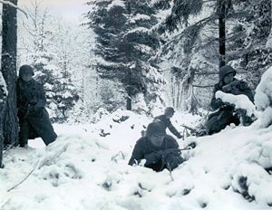

Slide 46
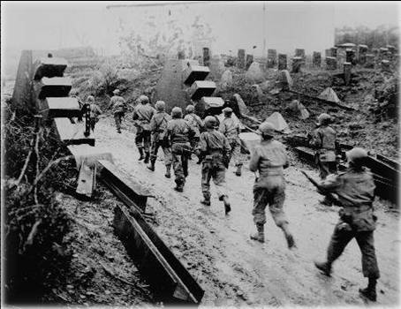

Slide 47
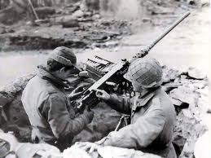

Slide 48
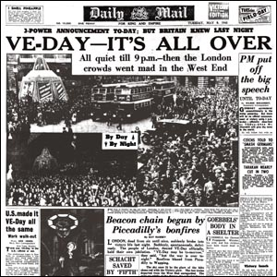

Slide 49
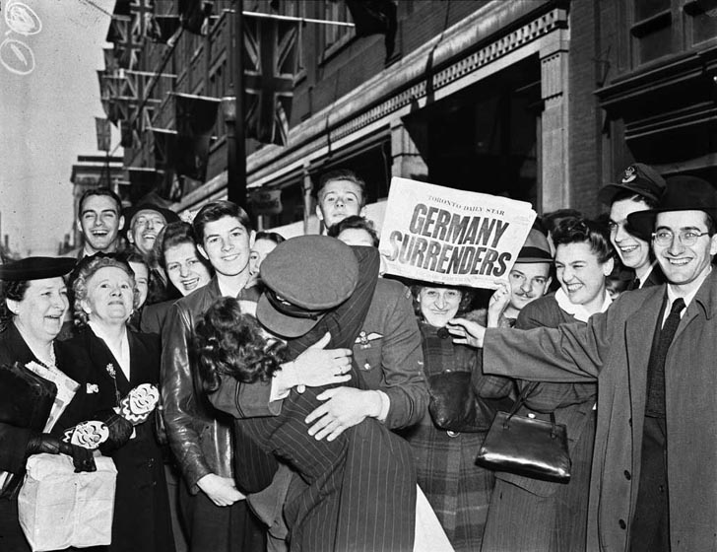

Slide 50
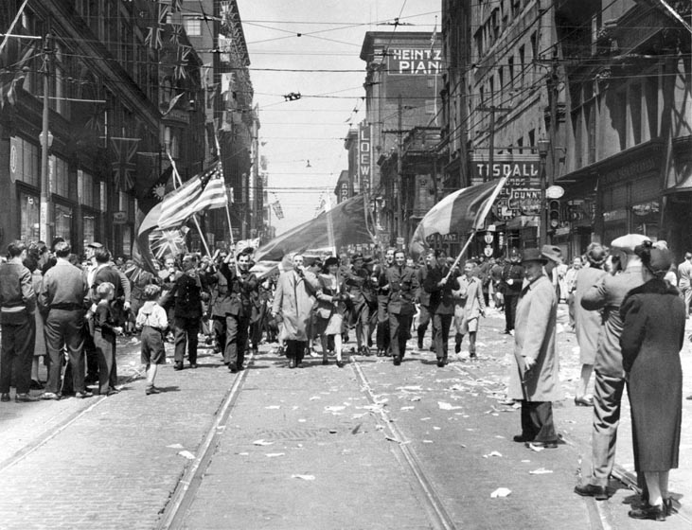

Slide 51
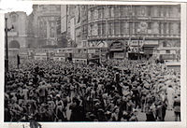

Slide 52
