Slide 1
The Medieval Church

Slide 2
The Byzantine Empire
Rome divided (395)
Justinian (527)
Restores Rome
Absolute power over state and church

Slide 3
Church Divided
Christianity different in E. and W. part of Rome
Due to distance, lack of contact
Eastern Christianity (Orthodox Church)
Early Church fathers
St. Basil (357) preaches lack of material goods, humble
St. John Chrysostom (398-404) is patriarch/leading bishop of east
Emperor Leo III bans use of icons (730)
Western Christianity (Roman Catholic Church)
Pope supports use of icons, excommunicates emperor
Theodora (wife of Justinian) restores icons in 843
Churches compete for converts

Slide 4
Germany and Western Europe
Middle Ages: aka medieval period, 500-1500
Roots in heritage of Rome, beliefs of Roman Catholic Church, customs of Germanic tribes
Germanic invaders overrun Rome
Disrupt trade
Downfall of cities
Population shifts
Decline of learning
Germanic invaders are illiterate
Decline of Greek culture
Loss of Common Language
Latin no longer understood
New languages emerge from Latin (French, Spanish, etc)
Helps the breakup of Roman empire

Slide 5
Germanic Kingdoms
Boundaries shift, government changes
Family ties, personal loyalty rather than to a state
Small communities with unwritten rules/traditions
Chief leads village, provides food, weapons, treasure
Not logical to be allegiant to a king not known
Church converts many Germans
Builds monasteries
Monks, nuns give up private possessions and devote lives to serving God
Monasteries as places of great learning
Pope Gregory I (590)
Broadens power of papacy beyond spiritual role
Secular (worldly), involved in politics
Uses money of church to fund armies, roads, help poor
Believed that region from Italy to England and Spain to Germany was his responsibility

Slide 6
Authority of the Church
State and church have predisposition for a clash
Ruled by authority (priest and king)
Solution: Pope submit to king in politics, king submit to Pope in religion
Church structure
Power based on status
Different ranks of church officials
Pope>>clergy (bishops>>priests)

Slide 7
Unity of the Church
Church as unifying and stable in time of constant warfare
Feeling of security and belonging
Sacraments: important religious ceremonies aiding in salvation (baptism, communion, etc)
Church as religious and social center
Religious festive celebrations/holidays (Easter, Christmas)

Slide 8
Law of the Church
Religious and political authority
Canon (church) law
Covers aspects of life (marriage, religious practice)
Judicial system (may result in excommunication)
Excommunication of ruler/king/emperor
Denial of salvation
Vassals no allegiance to the king
If king continues to disobey pope, interdict
Interdict: sacraments and services not performed in king’s lands
Without sacraments, people “doomed to Hell”

Slide 9
Pope vs. Emperor
Church angry that kings have control over clergy and church
Resents lay investiture (kings/nobles appoint church officials)
Power of church in hands of kings
Pope Gregory VII bans lay investiture (1075)
Emperor (German) Henry IV calls for Greg to quit
Greg excommunicates Henry
Henry begs for Greg’s forgiveness, who forgives
Fighting over lay investiture until 1122
Concordat of Worms: only church can appoint bishop but vetoed by emperor

Slide 10
Age of Faith: Problems
Problems in the church lead to attempted reform
Priests are illiterate, immoral, political (not religious)
Priests marry and have families (against rules)
Bishops sell positions in church (simony/benefice)
Kings appoint bishops, not pope

Slide 11
Theology of the Church
Bible/mass in Latin
Lay not literate in Latin, after Germanic invasions, most people are completely illiterate
Why does this give the Church the upper hand?
Excommunication
“Faith and works”
Sacraments
Indulgences/Purgatory

Slide 12
Medieval Art and Architecture

Slide 13
Romanesque
“Like Roman”
500s-900s
Massive quality, its thick walls, round arches, sturdy, groin vaults, large towers and decorative arcading

Slide 14
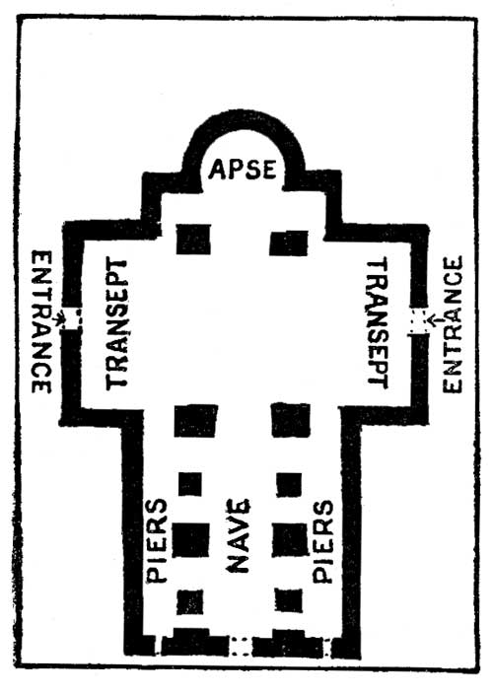

Slide 15
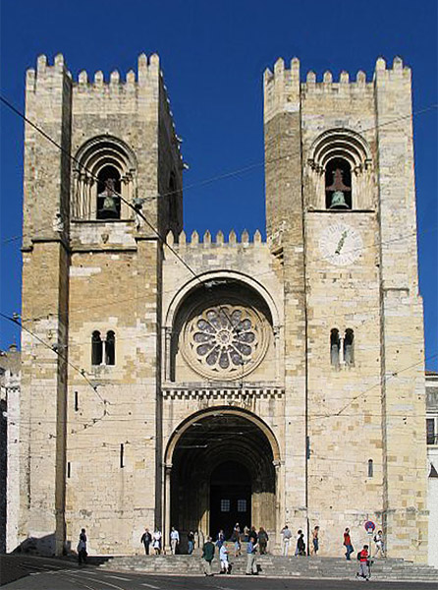

Slide 16
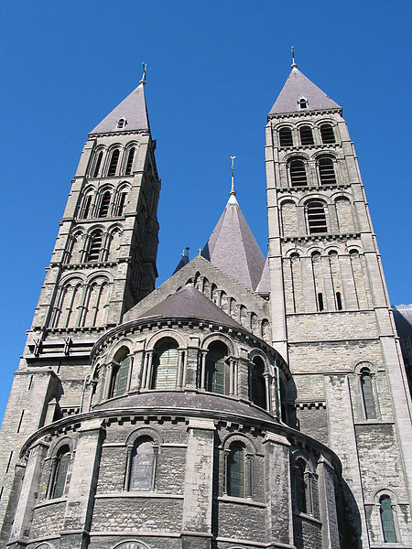

Slide 17
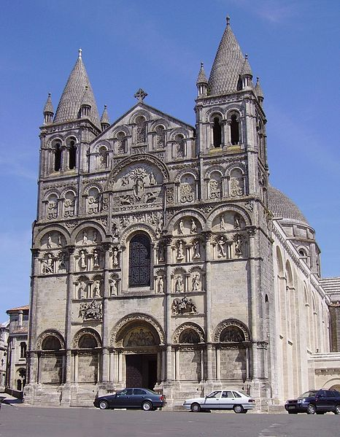

Slide 18
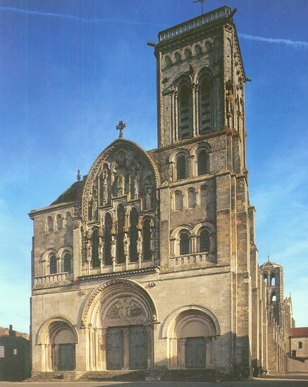

Slide 19
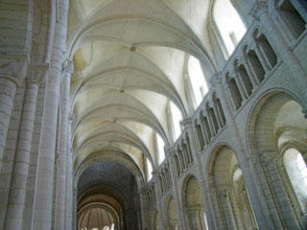

Slide 20
Gothic Architecture
Cathedrals, “cities of God”
800s-1100s
Large churches built in city areas
Filled with riches that Christians could offer
Gothic: from Germanic tribe of Goths
Cathedrals stretch up as if reaching to heaven
Stained glass windows, ribbed vaults, flying buttresses, pointed arches, tall spires
Sculpture, wood carvings, vaulted ceilings
Meant to inspire worshipper with magnificence of God

Slide 21
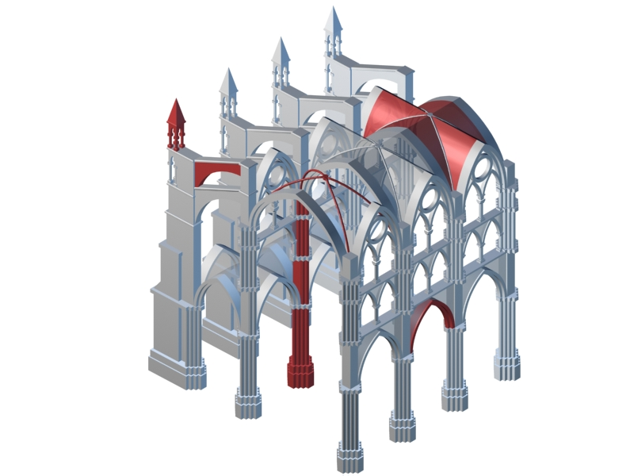

Slide 22
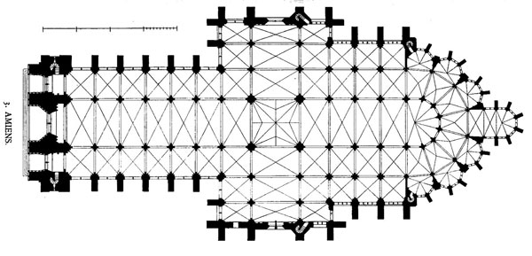

Slide 23
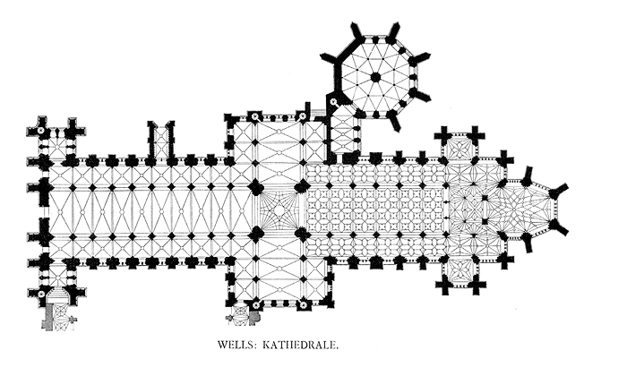

Slide 24
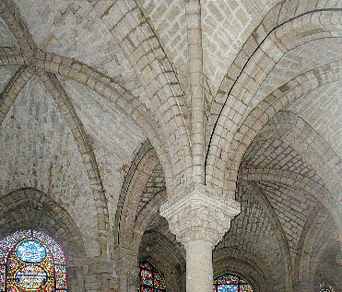

Slide 25
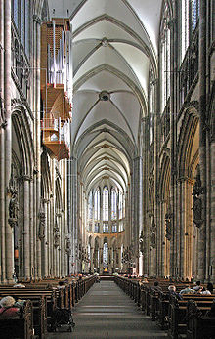

Slide 26
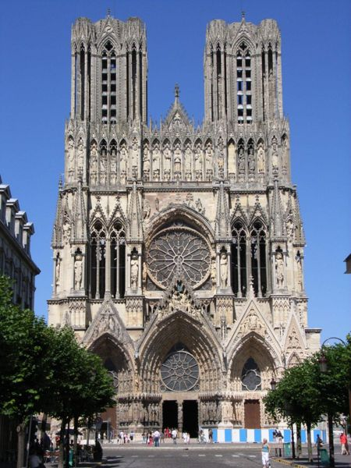

Slide 27
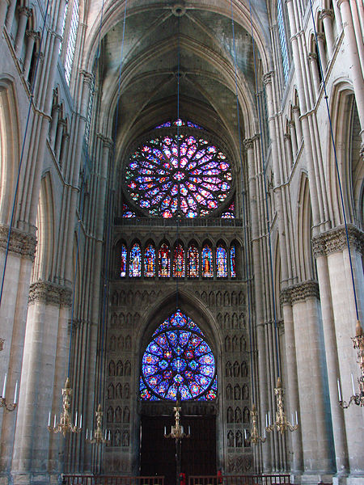

Slide 28
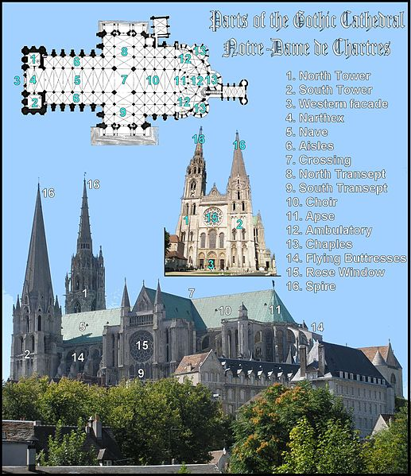

Slide 29
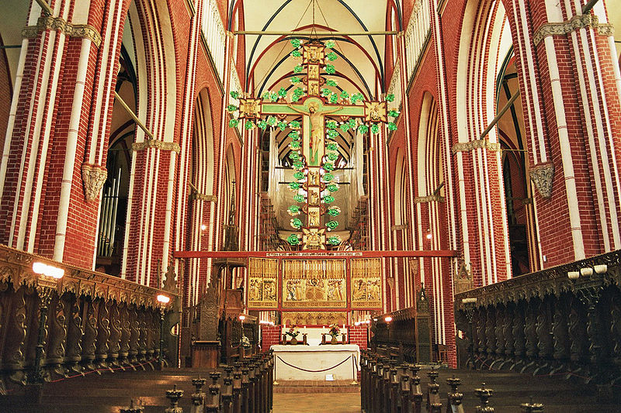

Slide 30
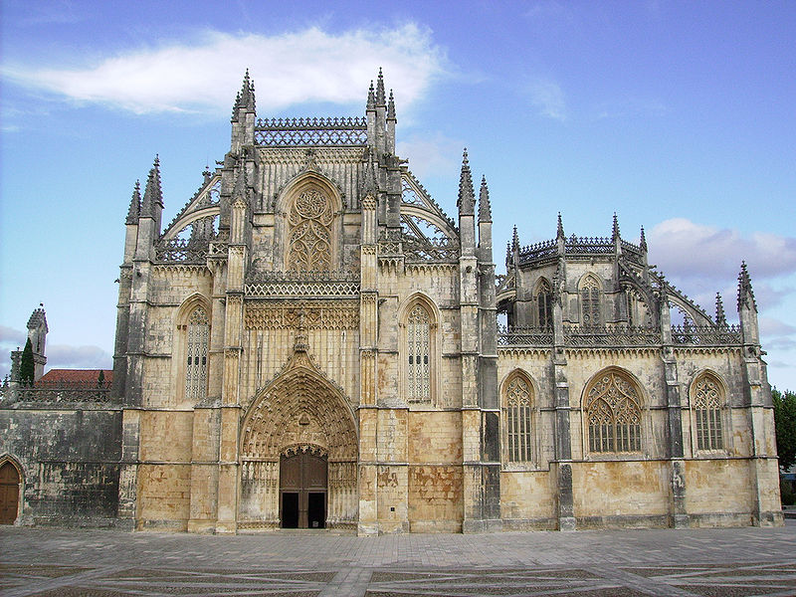

Slide 31
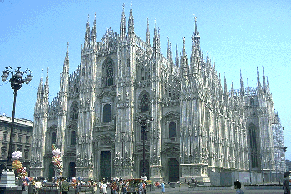

Slide 32
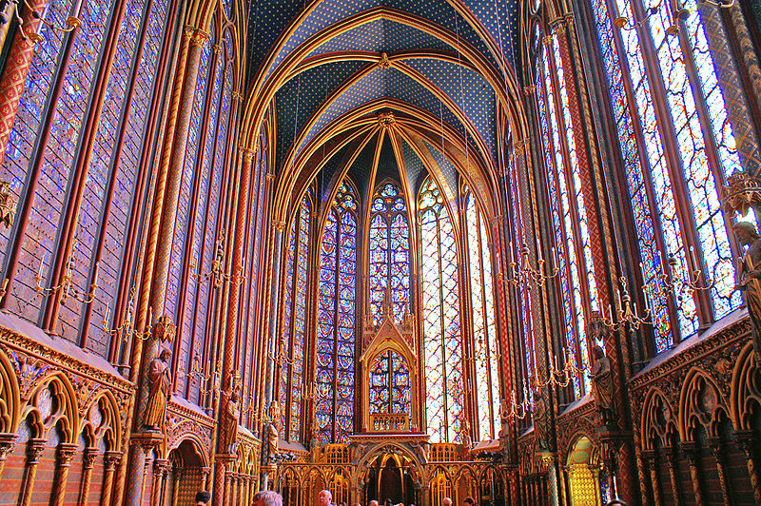

Slide 33
Other forms of Gothic Architecture

Slide 34
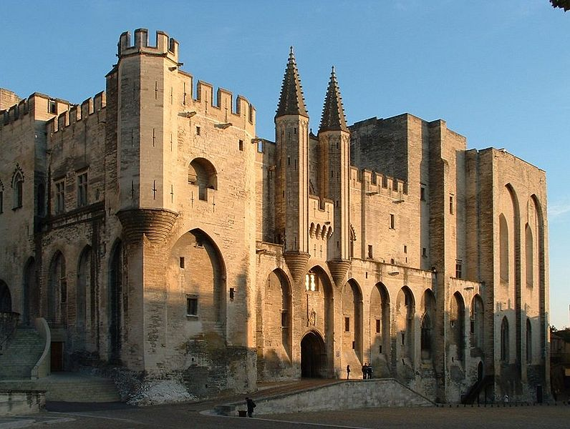

Slide 35
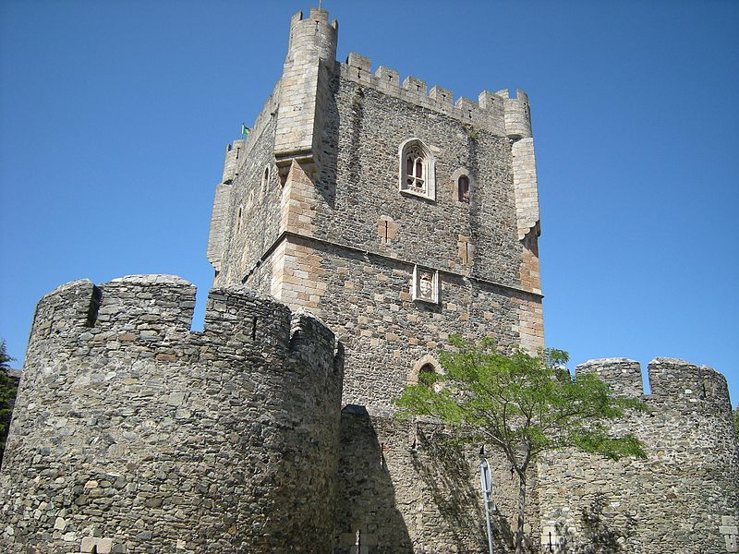

Slide 36
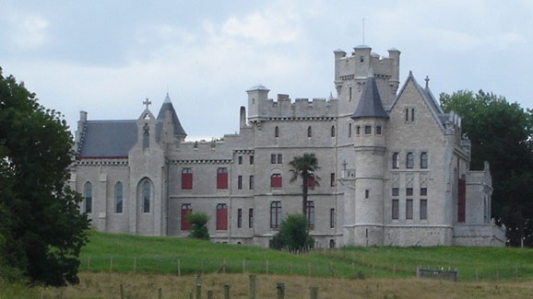

Slide 37
Medieval Art
Classical style
Religious background
2 dimensional
Insular art
Curvy, decorative in writing
Poorly detailed

Slide 38
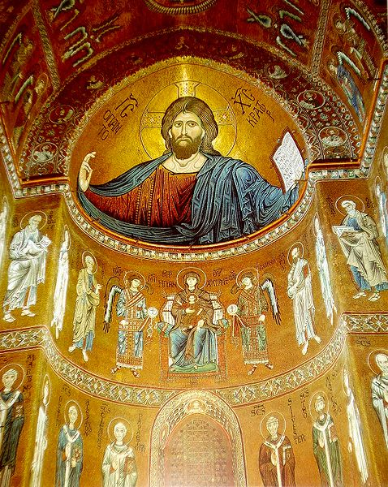

Slide 39
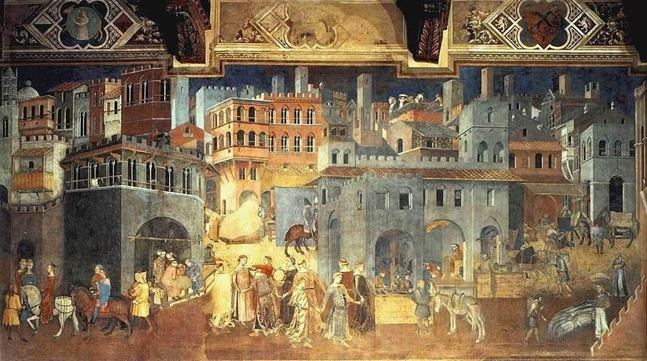

Slide 40
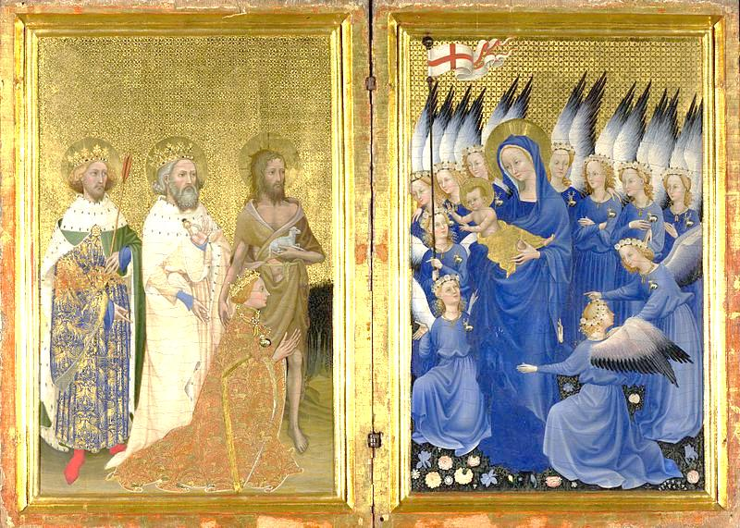

Slide 41
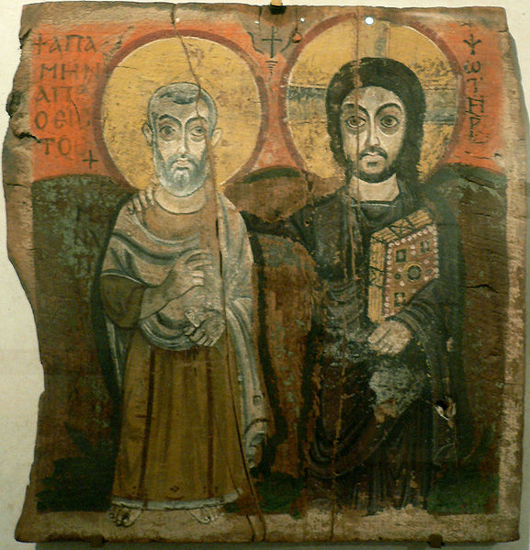

Slide 42
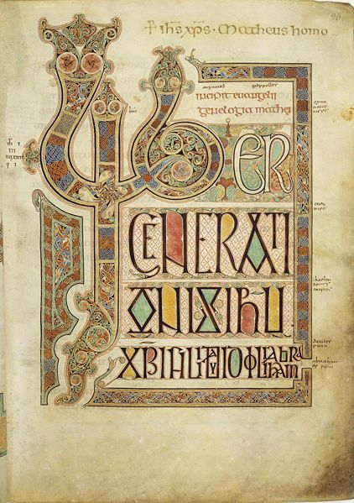

Slide 43
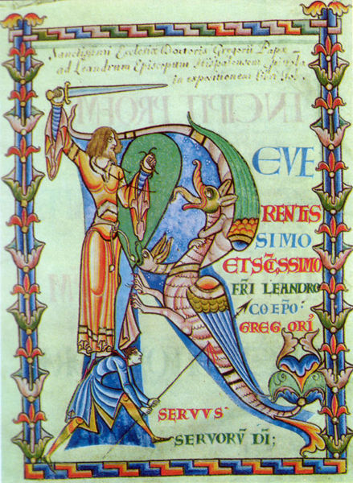

Slide 44
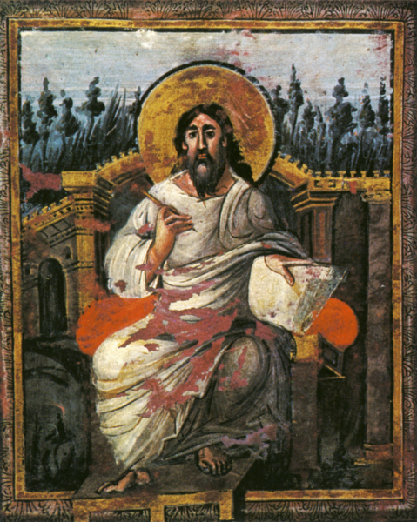

Slide 45
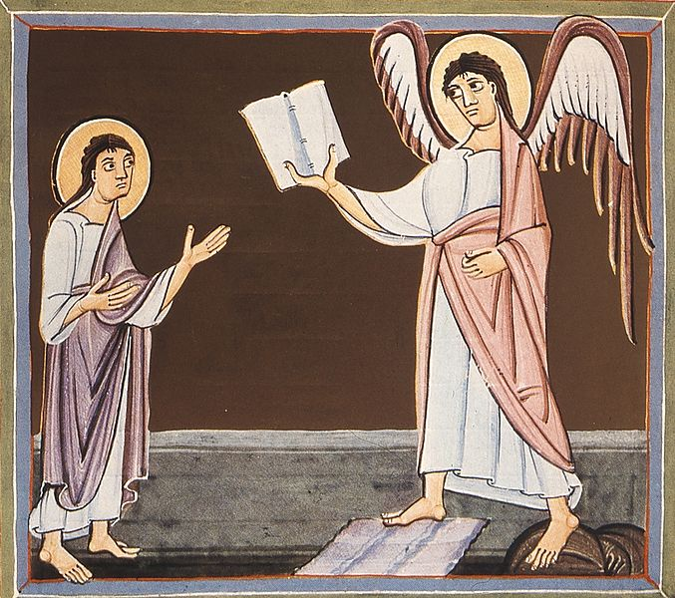

Slide 46
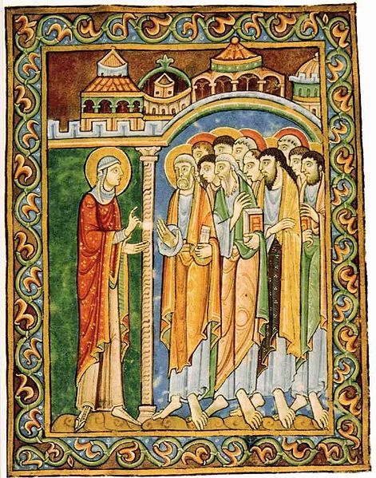

Slide 47
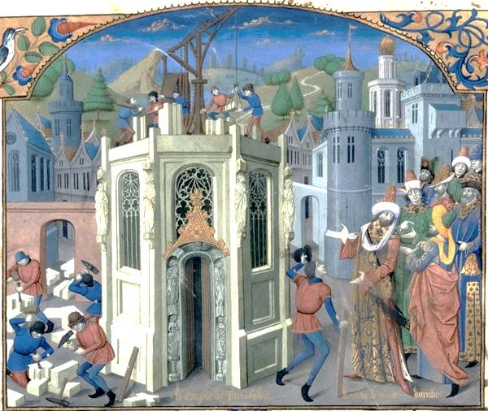

Slide 48
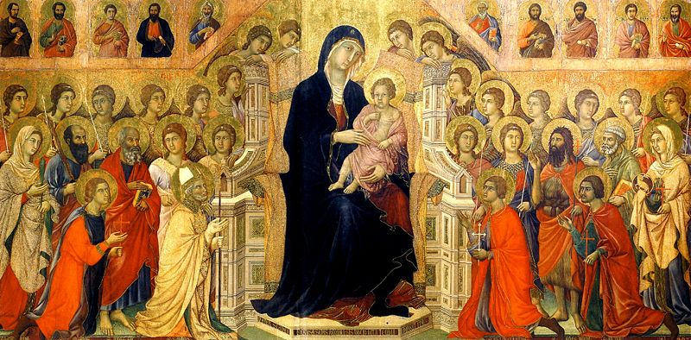

Slide 49
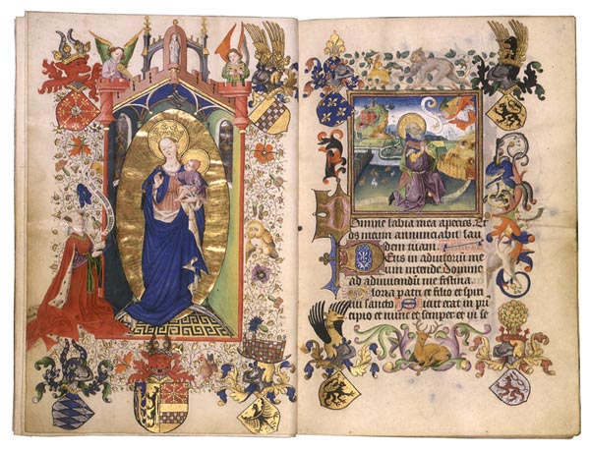

Slide 50
