Slide 1
The Mongols: The Culprit of a Changing World

Slide 2
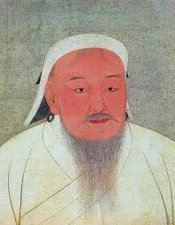
Module 1: Generalizations and Chinggis Khan

Slide 3
Mongol Generalizations
Nomadic, depending on herds of goats and sheep
Migrate due to seasons
Staple foods are meat and milk of herds
Supplemented by grain and vegetables from trade with sedentary peoples
Round tents made of wool and felt
Travel on ponies (begin at young age)
Organization
Tribe>clan
Confederations for defense
Government
Elected by free men
Leadership skills dependent on courage, skill in hunt, ability to forge alliances, attraction of dependents

Slide 4
Temujin
Mongolian-speaking peoples with kingdoms in north China, 900s-1000s
1100s: Kabul Khan leads alliance defeating army by northern Qin
Kabul Khan becomes ill and dies, causing Mongols to become divided over successor
Temujin born in 1170s
Father is poisoned by rival nomads
Temujin rises to power
Other chiefs refuse to follow a boy ruler
Taken as prisoner in 1182, escapes
Joins more powerful Mongol chieftain, avenges insults of clan who had captured him
Gains notoriety of being warrior and commander, gains allies
Defeats rivals
Kuriltai (meeting of chieftains) in 1206 elects Temujin as khagan (supreme ruler) of Mongols
Renames Temujin Chinggis/Genghis Khan

Slide 5
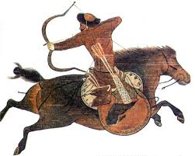
Mongols at War
Advanced weapons
Lances, hatchets, maces, short bows (350 yds), catapults, exploding arrows, cannons
Horses
Cavalry (bow/arrow, leather helmets and armor)
Discipline, unity, organization
Interclan rivalries quenched by loyalty to khagan
Exaction of tribute
Tumens as fighting unit
10,000 warriors, split into units of 1000, 100, and 10
Messenger force
Deliver messages
Spies and informers
Formal code
Immediate execution for desertion
Generosity for brave foes who surrender
Destruction for foes who resist; rape, pillage, enslave people

Slide 6
Expansion of the Mongols
Northern Asia
Tangut kingdom of Xi Xia
Ruler forced as a vassal of Mongols, pay tribute
Jurchen Jin Empire
North China
Attack fortified cities
Capture of Chinese artisans and military commanders

Slide 7
Expansion of the Mongols
Muslim World
Kara Khitai empire
Khwarazm Empire
Flee battle feigning defeat, turn against enemy and defeat
Absorption of Turkic horsemen into armies
By 1227, Mongol empire stretches from Persia to North China Sea

Slide 8
Living under the Mongols
Mongols as astute and tolerant
Open to new ideas
Committed to building a diverse empire where people live together in peace
Interest in arts and learning
Capital established at Karakorum
Chinggis Khan consults with Confucian scholars, Muslim engineers, Daoist holy men
Mongols as tolerant of all religion
They themselves are shamanistic (nature)
Drew on advice of Muslim and Chinese bureaucrats
Development of Mongolian script
Establishment of secure trade routes (Pax Mongolica)

Slide 9
Mongolian Fracture
1226: Chinggis Khan turns east to finish conquest of China
Defeats Xi Xia
Chinggis Khan injured in battle, falls ill and dies 08/1227
Empire divided into four parts between three sons and grandson, Batu
Kuriltai convened in Karakorum to decide successor
Ogedei elected
Directs Mongols to more campaigns and conquests
Russia, eastern Europe, Islamic heartlands, China

Slide 10
Reflection Questions
a.) Why do you think the Mongols get a reputation for being fierce and violent? b.) Are these views historically accurate? Why or why not?
Why do you think the Mongols were so tolerant and interested in the culture of the conquered peoples?
Compare/contrast the Mongols to another society that we have discussed. How are they similar or different from this society?

Slide 11
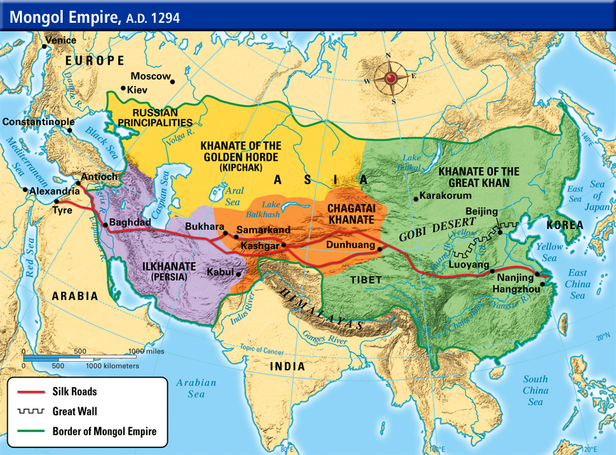
Module 2: Mongols in the West

Slide 12
Mongolian Russia
Golden Horde focuses on expansion, eventually split into four parts of rule (khanates)
Named after golden tents of early khans
1236: Batu’s invasion of Russia
Pawn to take out on the way to western Europe
Easy to conquer, as Russia is divided into several small kingdoms and not united politically/militarily
Known by Russia as Tatars/Tartars
Ryazan, Moscow, Vladimir resist and are destroyed
Mongols return in 1240 to destroy Kiev
Spare Novgorod because they submit to Mongol invasion

Slide 13
Mongolian Russia
Russian princes forced to submit as vassals and pay tribute
Falls heavily on peasants who pay double taxes (lords and Mongols), become serfs
Moscow emerges as trade and economic center of Mongolian Russia
Tribute collector for Russian khanate
Annexes smaller towns who don’t pay tribute
Rise of Moscow’s economy and strength leads to decline of Golden Horde’s power in Russia
Wealth for Russian princes
Moscow as religious center for Eastern Orthodoxy
Lords and princes shift from being tribute collectors to defenders
Unite with other vassals, raise army to defeat Golden Horde at Battle of Kulikova in 1380s
Russian defeat of Mongols lead to change of Russian government and military
Tactics changed to resist division and attack
Centralization of power for princes against nobility, clergy, merchants
Cut off from transformations of the west geographically and by choice
Renaissance, Reformation, etc.

Slide 14
Module 2: Mongols in the West

Slide 15
Europe and the Mongols
Rumors of Prester John
Legendary Christian king in Africa or Asia who was separated from Europe by Muslims
Christian Europe encouraged by Mongolian spread in Asia and Middle East hoping they defeat Muslims
Mongolian envoys arrive in court of Hungarian king
Demand surrender, dismissed by king
Give Mongols reason to invade
Defeat Hungary and pillage from Adriatic to Poland and Germany
Death of Ogedei cause Mongols to pull back to Karakorum for the kuriltai
Mongols never try another incursion into western Europe

Slide 16
Module 2: Mongols in the West

Slide 17
Mongols vs. the Muslims
Mongolian conquest of Muslim empires of Mespotamia and northern Africa
Led by Hulegu, ruler of Ilkhan khanate
1258: Mongols capture and destroy Baghdad
Murder Abbasid caliph and 800,000 people due to resistance
Leaves faithful Muslims without central authority
1260: Muslims defeated by Mamluks
Former Mongolian slaves led by Baibars, from Egypt
Due to cooperation between Muslims and Christians
Causes Hulegu to reconsider conquest of Muslim world
Threatened by cousin, Berke (khan of Golden Horde), who had converted to Islam
Hulegu settles with kingdom from Byzantium to Oxus River in c. Asia

Slide 18
Module 2: Mongols in the West

Slide 19
Reflection Questions
Why did the Mongols focus in on Russia, Europe, and the Muslim lands (in other words, what did each have to offer)?
How do the Muslim and Russian khanates differ?

Slide 20
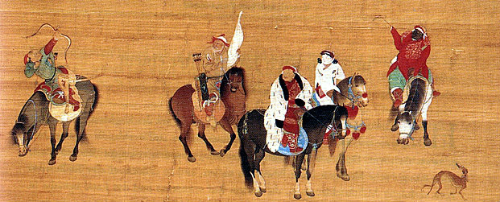
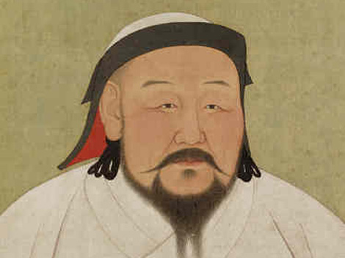
Module 3: Mongolian China

Slide 21
Kubilai Khan’s China
Mongols conquer Xi Xia and Jin empires, then turn to Song dynasty led by Kubilai Khan
Campaign lasts from 1235-1279 against fortified cities
Kubilai becomes great khan in 1260
Renames Mongolian regime the Yuan Dynasty
Passes laws to distinguish between Mongols and Chinese
Forbids scholars to learn Mongol script used for records and governmental documents
Mongols forbidden to marry ethnic Chinese
Friendship between Mongols and Chinese discouraged
Military forces remain separate
Mongol religion and ceremonies retained
Mongol tent cities among Chinese cities
Fascination with Chinese culture
Surrounded by Chinese advisors (Buddhist, Confucian, Daoist)
Use of Chinese rituals, music, and art in Mongol court life
Yuan dynasty on Chinese calendar
Sacrifices to ancestors
Refuses use of civil service exams
New Chinese hierarchy
Mongols
Central Asian nomads and Muslim allies
North Chinese
Ethnic Chinese

Slide 22
Yuan Gender Roles
Mongol women aloof from Chinese culture
Refuse to adopt footbinding
Retain property rights and freedom to move about town
Women aid hunting
Chabi, wife of Kubilai Khan
Advised on political and diplomatic matters
Fostered policies reconciling Chinese to Mongols
Harsh treatment of Song would only anger the people

Slide 23
Tolerance and Cultural Influence
Curiosity of Chinese culture
Patronage of scholars, artists, artisans
Advised by Muslims, Persians, Turks
Building of administration and city
System of more efficient tax/tribute collection
Astronomers fix Chinese calendar and maps
Improve imperial hospitals
Interest and toleration of all religions
Interaction with Europeans
Marco Polo and his family (Venice, Italy)

Slide 24
Fall of the Yuan Dynasty
Measures to preserve Mongolian separateness
Ethnic Chinese never really reconciled to Mongol rule
Scholar-gentry see Mongols as barbarians who endanger Chinese tradition
Refusal of reinstating civil service exams prevent Confucian scholars from dominating politics
Alienation of scholars through Mongol favoritism toward foreign officials
Mongols improve position of artisans and merchants
Elites soon become addicted to urban luxury
Languish of art and poetry
Elevation of actors as minor celebrities
Kubilai Khan favors peasants
Forbids cavalry from pasturing on peasant lands
Reduction of peasant tax and forced-labor
Song loyalist revolts in south
Defeat in Japan in 1274 and 1280, undermining power
Graft and corruption of Chinese and Muslim adminstrators
Angers peasantry even more
Scholar-bureaucrats call on peasants to revolt
Banditry and piracy
Famine
Rise of secret religious sects like White Lotus Society
Dedicated to overthrowing Yuan, leads to peasant resistance
Mongols flee to central Asia
Short power vacuum, ended by Ju Yuanzhang (peasant) to found Ming Dynasty

Slide 25
Timur
Turkish nomads led by Timur-I Lang (1360s-1405)
Noble land-owning clan
Highly cultured in fine arts, gardens, architecture
Ruthless, indifferent to suffering
Conquest of Persia, Fertile Crescent, India, Russia
Prisoners massacred as a warning
Rule brings neither trade or cultural diffusion
After Lang’s death, empire dissipates through power vacuum civil war

Slide 26
Reflection Questions
a.) How did the Mongols influence China? b.) How did China influence the Mongols?
a.) How did the Mongols distinguish themselves from the Chinese? b.) Why do you think this is?
How did the Mongols treat their women differently than the Chinese? Why do you think they were treated this way?
Why do you think the Mongols were so interested in the culture of the conquered peoples? Give an example as evidence to back your argument.
What do you consider to be the main reason for the fall of the Yuan dynasty? Why?
Compare/contrast the Chinese, Russian, and Middle Eastern khanates.

