Slide 1
The World Economy
Exploration and Colonization

Slide 2
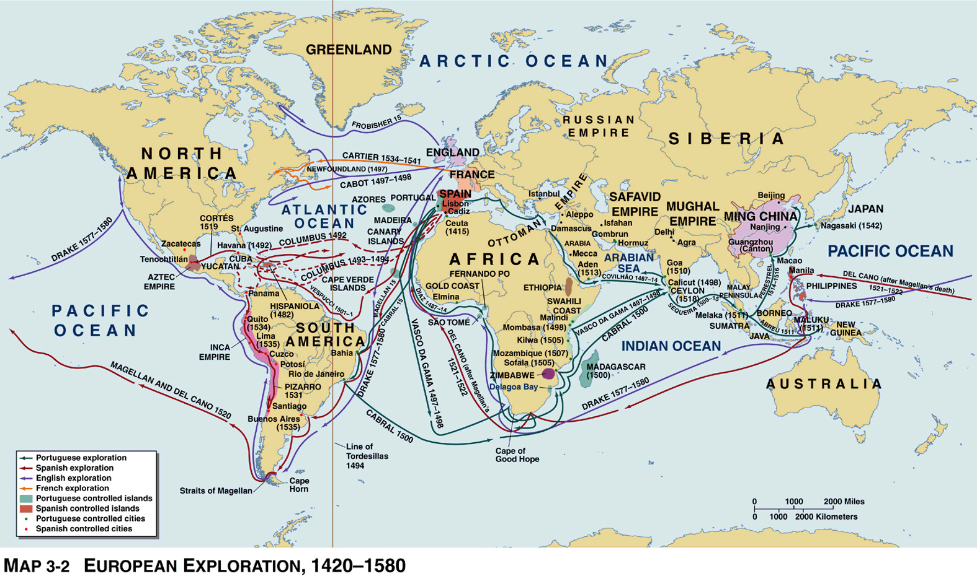
Module 1: Exploration

Slide 3
Early Exploration
Crusades: knowledge of Arab world
Mongols allow for quick and easy exchange between east and west
Fall of Mongols leads to closing of China to outsiders
Vikings in 900s arrive in Greenland and North America
Flat Earth theory
Challenges to expansion and exploration
Technology of boats (oar-propelled)
Navigational techniques
Strength of Ottomans
Lack of gold for trade

Slide 4
New Technology
Deep-drafted sailing ships
Carry heavy armaments
Improvement of compass and maps
Use of explosives for gunnery and cannons
Provides military advantage

Slide 5
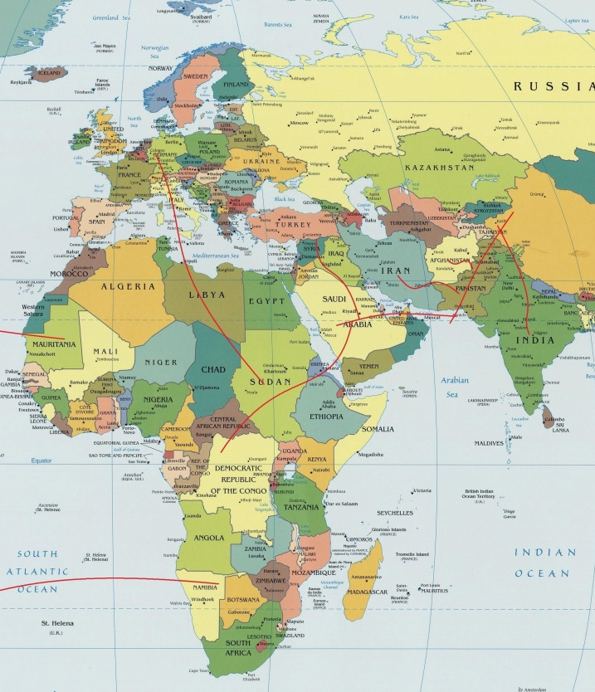
Portuguese Exploration
Portugal’s ideal location
Motives:
Excitement of discovery, harm toward Muslims, thirst for wealth
Henry the Navigator (1434)
Sponsored expeditions along African coast
Sought slaves, spices, and gold
Bartholomew Dias (1488)
Reaches Cape of Good Hope, turns back
Vasco da Gama (1498)
Reaches India
Mistakenly believe Hinduism=Christianity
Hostility of Muslim merchants
Crude goods to trade (iron pots)
Use of force, violence, and intimidation to encourage trade
Expedition blown off course lands on Brazil
Set up missions in Japan

Slide 6
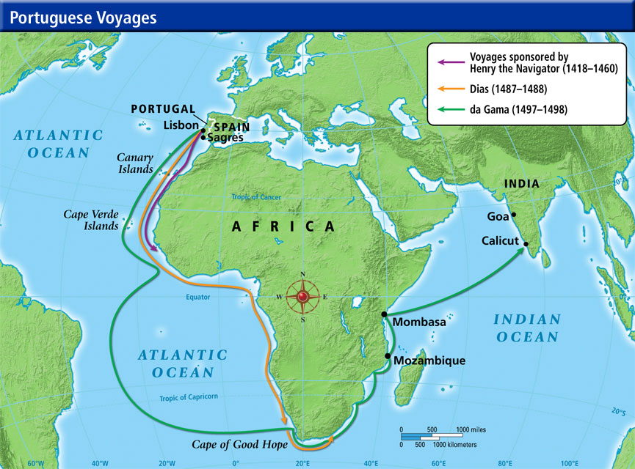

Slide 7
Spanish Exploration
Motives: eliminate Islamic rule, missionary zeal, desire for riches
Columbus (1492)
Sails for westward route to India
Reaches San Salvador (island in Caribbean), believes natives are Indians
Vespucci (names America)
Treaty of Tordesillas/Line of Demarcation
Granted by Pope to settle disputes between Spain and Portugal
Magellan (1519-1521)
Sails west, arriving in Indonesia (killed), crew arrives back to Spain

Slide 8
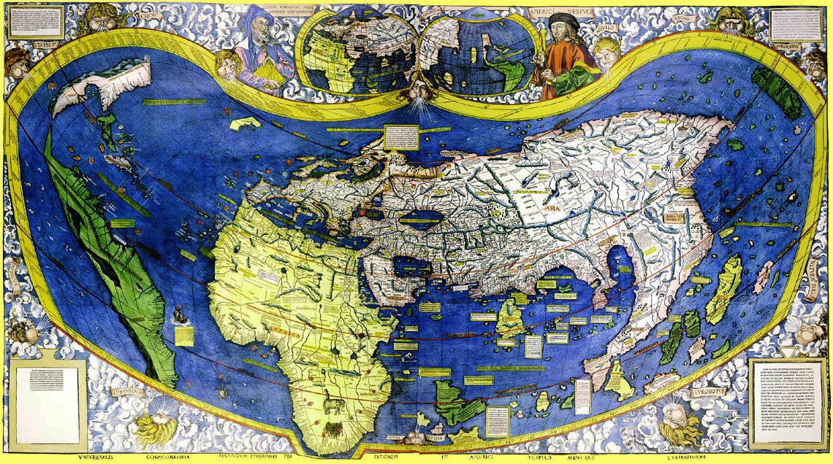

Slide 9
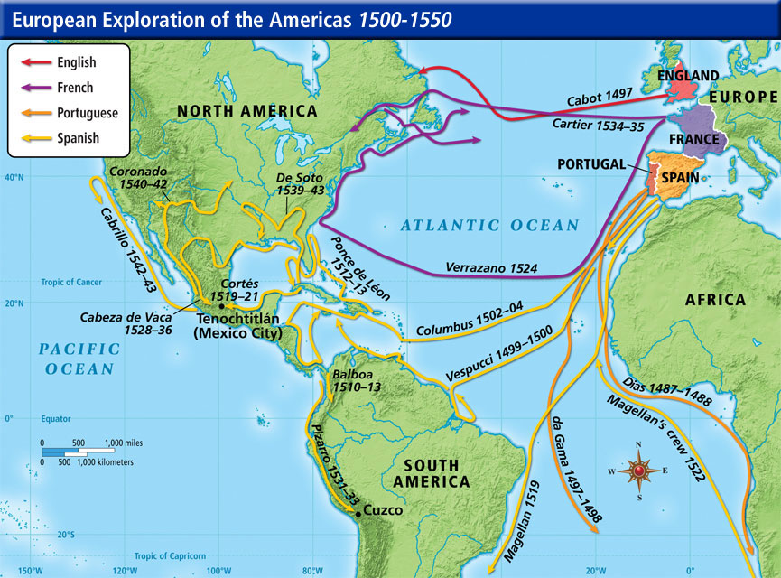

Slide 10
Northern Europe
Motives: Strong monarchies in Britain and France, Protestants in Britain and Holland to rival Catholic gains, PROFIT
Northern European vessels lighter and faster than western European
British and Dutch defeat Spanish Armada (1588), creating dominance of the seas
Settle northern America to avoid conflict w/ Spain

Slide 11
France, Britain, and Holland
France
Reach Canada in 1534
Expeditions into Great Lakes and Mississippi Valley
British attempt to discover NW Passage in 1497
Explore Hudson Bay, colonize Atlantic Coast
Holland settle Indonesia, Australia, Cape of Good Hope

Slide 12
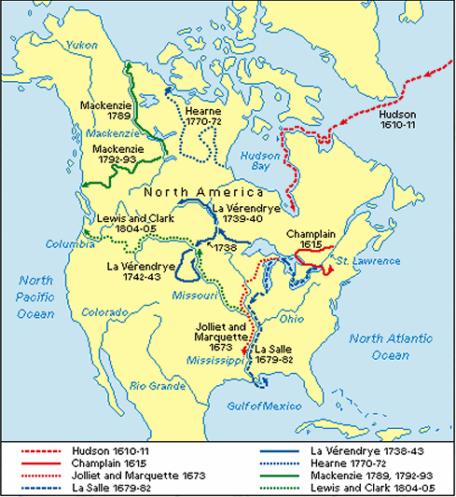

Slide 13
Trading Companies
Provide monopolies of trade in regions, act as government authorities
Rights to raise armies, coin money
Dutch East India Company rules Taiwan
British East India Company rules parts of India

Slide 14
Reflection Questions
What factors led to exploration? What factors hindered early exploration?
Where was the primary focus for Portugal’s exploration? Why?
Explain the overall outcomes of Portuguese exploration.
What was the primary focus for Spain’s exploration? Why?
Why did European exploration shift in power?
Rank the motives for exploration and justify you answers. Pick 3-4 motives.
Why do you think people settled once regions were discovered? Why might this lead to tension? With whom?

Slide 15
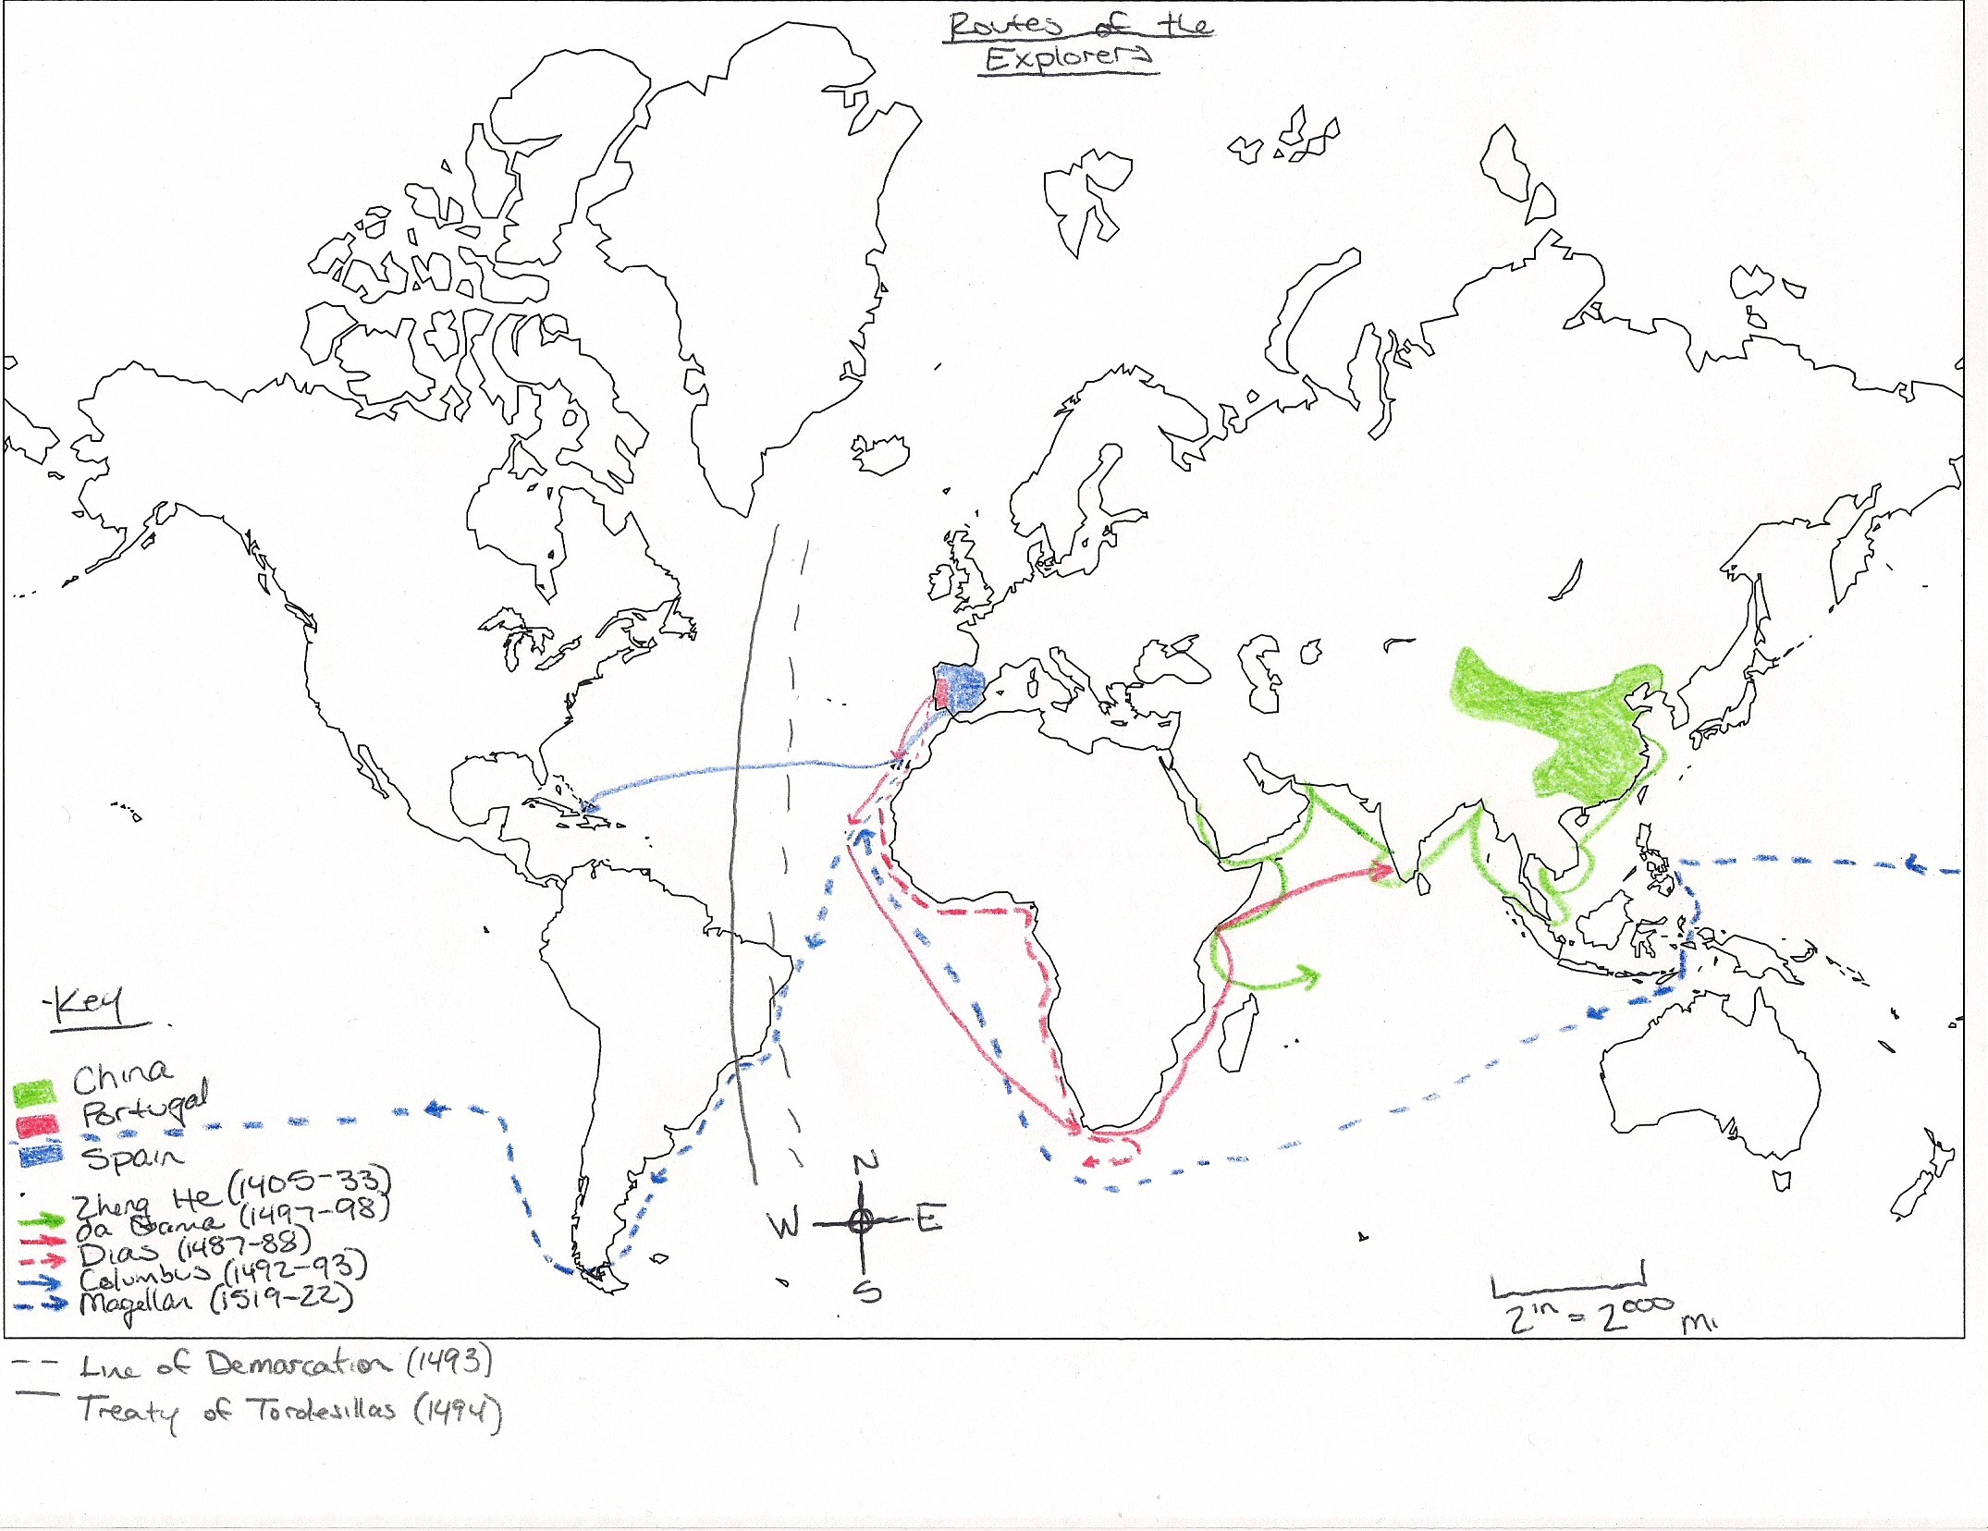

Slide 16
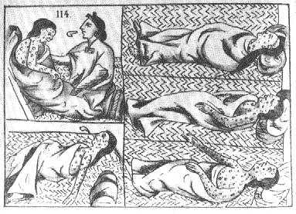
Module 2: Establishing a World Economy

Slide 17
The Columbian Exchange
Spread of disease
Natives have no natural immunity (smallpox, measles)
80% fatality across 150 years
Spread of crops
New World to Eurasia: corn, sweet potatoes, beans, potatoes, squash
Agricultural improvements trigger large-scale population increases
Spread of animals
Horses and cattle

Slide 18
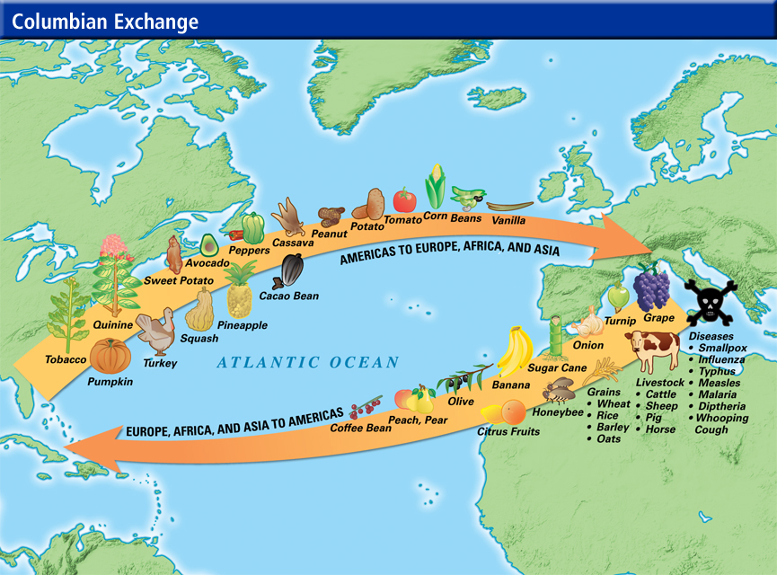

Slide 19
Europe vs. the East
Muslim traders continue to be active in the east
Spanish defeat of Ottoman navy at Lepanto in 1571, displacing authority and power of Arabs
Establishment of European ports along African and Indian coasts
China and Japan self-isolate
While in places without direct control, Europeans establish enclaves with special legal rights

Slide 20
Commercial Imbalance
Spain
Briefly dominant due to imports of American silver
Began to go into downturn economically, lacked banking system to support surge in silver
Western Europe expands manufacturing operations to export (guns, cloth) for raw materials (silver, sugar)
Mercantilism
Dependencies
Produced low-cost goods (precious metals, cash crops) using human labor for “core nations” (Spain, France, England, Netherlands)
Triangular Trade:
Europe receives raw materials from colonies, which they use to create manufactured goods sold to Africa in return for slaves on American plantations
Local rulers and landowners often given independence, but dependent on core nations for income and imports
Forced labor
Begin with encomienda system (using natives). Many die, flee
Turn to African slaves

Slide 21
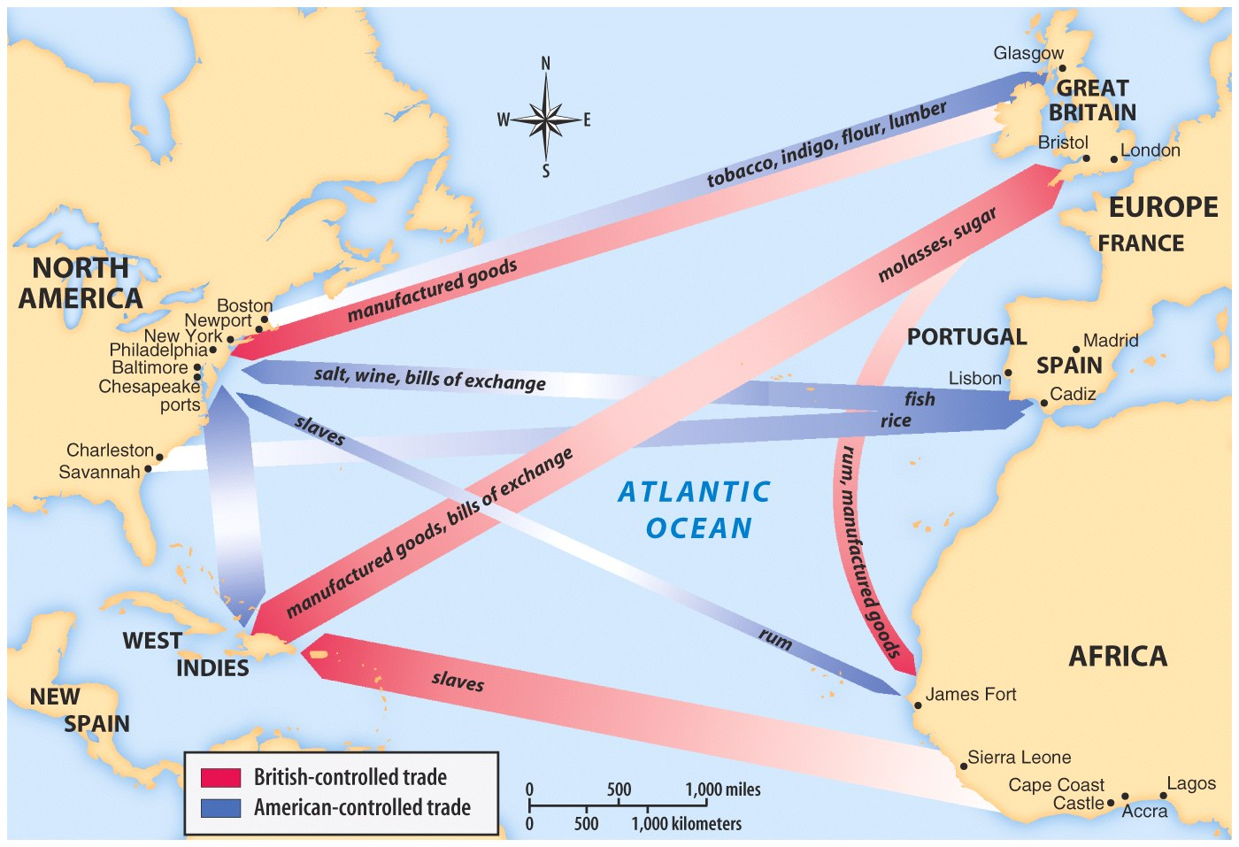

Slide 22
China and Japan
China
Self-isolated after end of Zheng He
Funneled imports/exports through port of Macao
Avoided subservience to Europeans
Chinese had no need for outside goods
Europeans hungered for Chinese goods (“china”)
Japan
Initially open to Christian missionary activity and manufactured goods
Guns used to help keep feudal warlords in check
Eventually fear European influence and power of samurai with guns
Develop internal gun manufacturing, cut selves off from Europe
Suppression of Christian minority
Complete isolation from world trade, save Dutch in Nagasaki

Slide 23
Dependencies and Core Nations
Britain in India
Pass tariffs against import of cotton cloth made in India so consumers have to purchase British-made
Allow Britain to use India as market for British goods in return for Indian gold
Eastern Europe
Used as a source of grain for population increases in the west
Harvested by serfs in Poland, Russia, Prussia

Slide 24
Reflection Questions
List three effects of exploration.
Explain Columbian Exchange. What was exchanged? What were the effects?
What do you think was the most significant aspect of the Columbian Exchange? Why?
Explain Triangular Trade. Who did it benefit the most? What was traded where?
Why did the encomienda system of native slaves fail and African slavery “succeed”?
Why did China and Japan isolate themselves? Is this consistent with their foreign policy previously in world history? Why or why not?

Slide 25
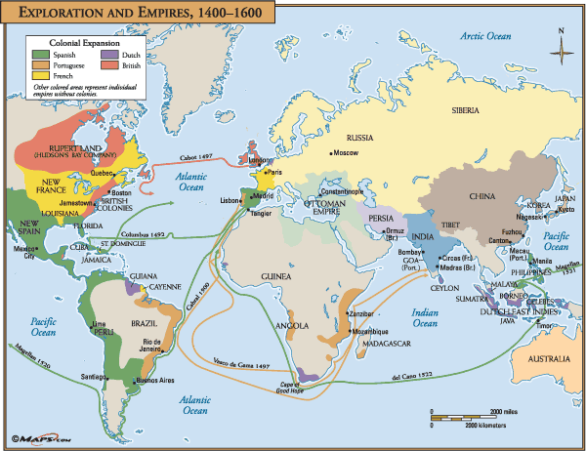
Module 3: Colonialism

Slide 26
The Americas: Conquest and Colonies
European advantages
Guns, horses, iron weapons, localized political disarray, disease
Spanish
Hispaniola, Cuba, Jamaica, Puerto Rico, Panama, central/North/South Americas
Cortez’s conquest of Aztecs
Pizarro’s conquest of Incas
Colonial bureaucracy
Loosely controlled administrations in Europe exact tribute from native populations
Over time, agricultural settlements lead to a more localized administration
French along St. Lawrence River, Quebec, Mississippi
Dutch and English along Atlantic Coast

Slide 27
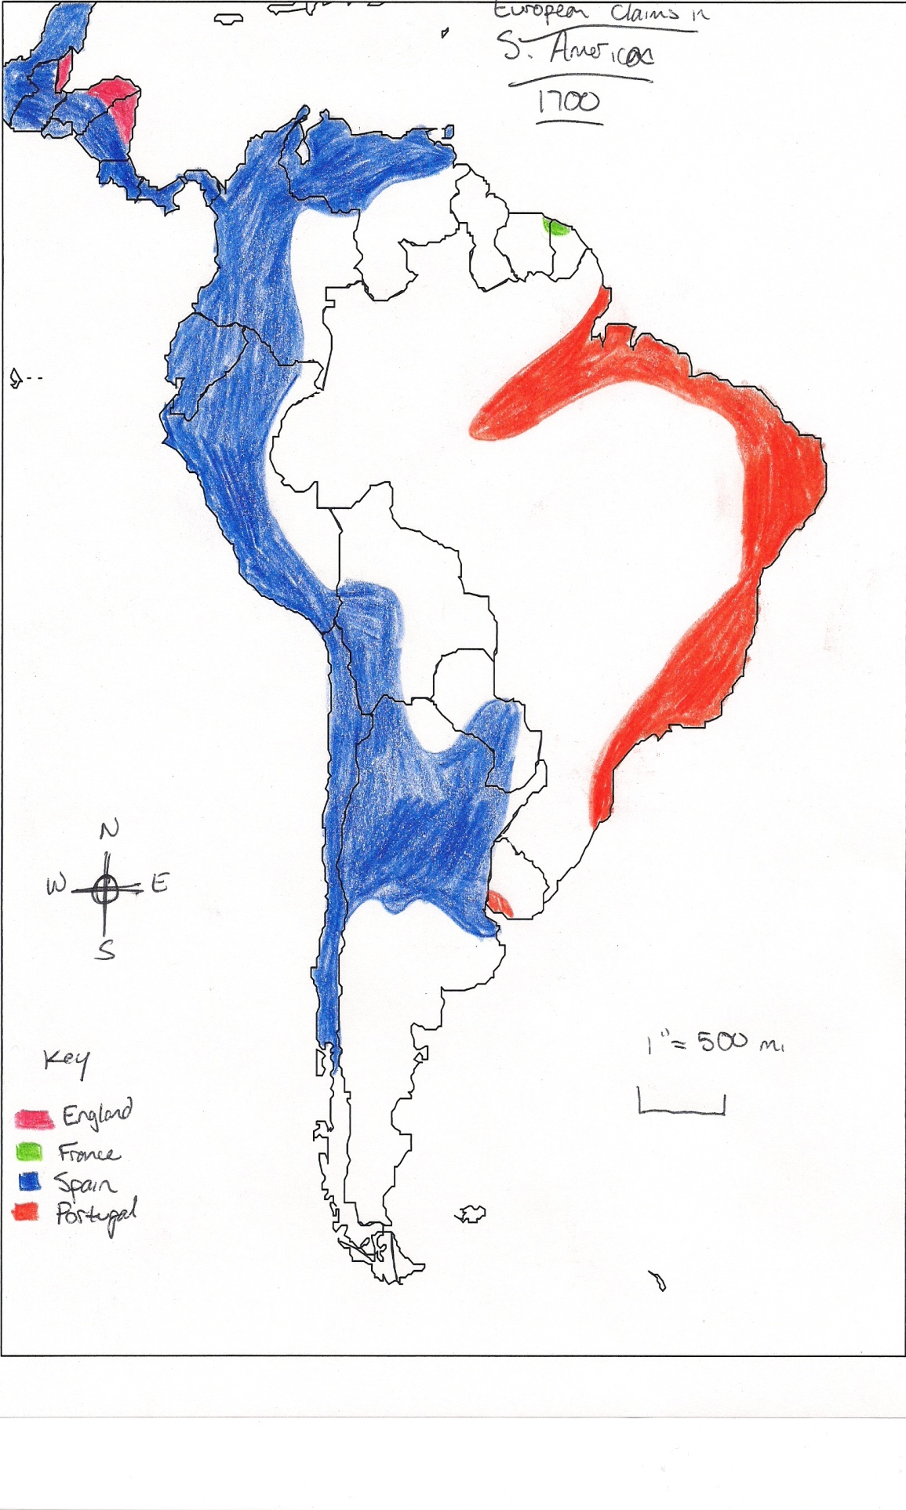

Slide 28
Britain and France in North America
Britain
Religious refugees (Calvinists, “Pilgrims”)
William Penn’s colony actively recruiting settlers
New York being captured from Dutch
Virginia as a penal colony
France
Use of Canada to set up manorial estates
Encouragement of peasants to emigrate
High birth rates in New France, centered around fortressed Quebec
Seven Years’ War
Britain and France fight over Mississippi and parts of Canada
France loses and forfeits land under Treaty of Paris (1763)
North American colonies as poor, backwater supplements to Caribbean and Latin American colonies
Turn to manufacturing industry, later to some southern cash crops (tobacco, cotton)

Slide 29
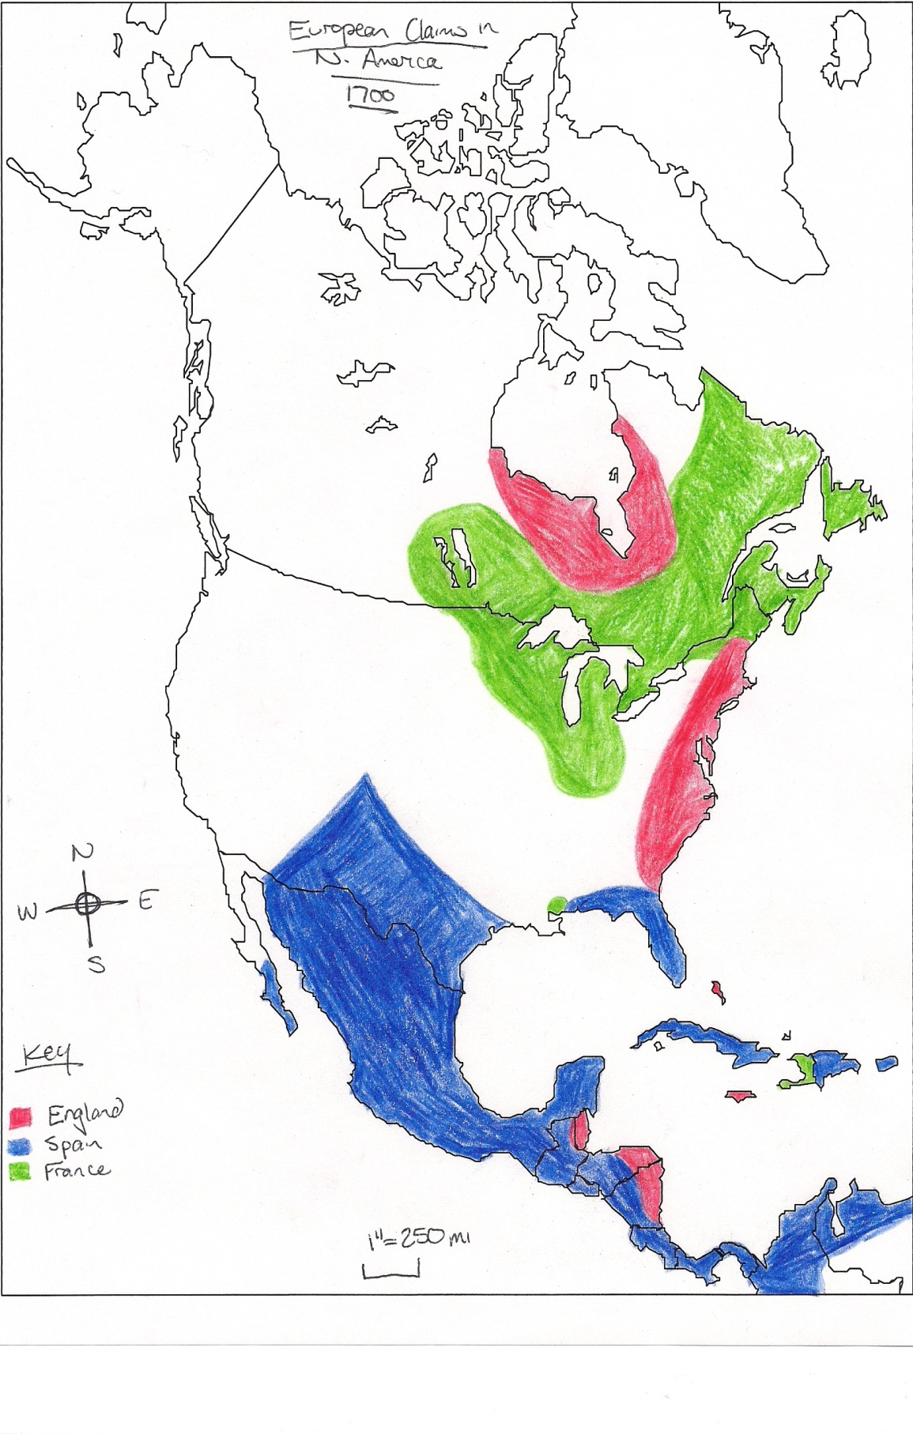

Slide 30
Colonists
Establishment of religious colonies for freedom
Use of local assemblies as governing bodies
Readers of Enlightenment ideas and political philosophies by Locke, etc.
Push natives west by expansion for farmland
Natives practice hunting and slash-burn
Purchase horses for mounted hunting
Importation of African slave labor
Marry earlier, have larger families (farm labor?)
Focus on nuclear unit, familial affection

Slide 31
African Trading Stations
Small coastal fortresses
Negotiation with African kings and merchants
Do not attempt to take over land or establish colonies
Africa as impenetrable
Cape Colony
Dutch establish way station on Cape of Good Hope
Farmers settle (Boers), clashing with and pushing African farmers and Bantu north

Slide 32
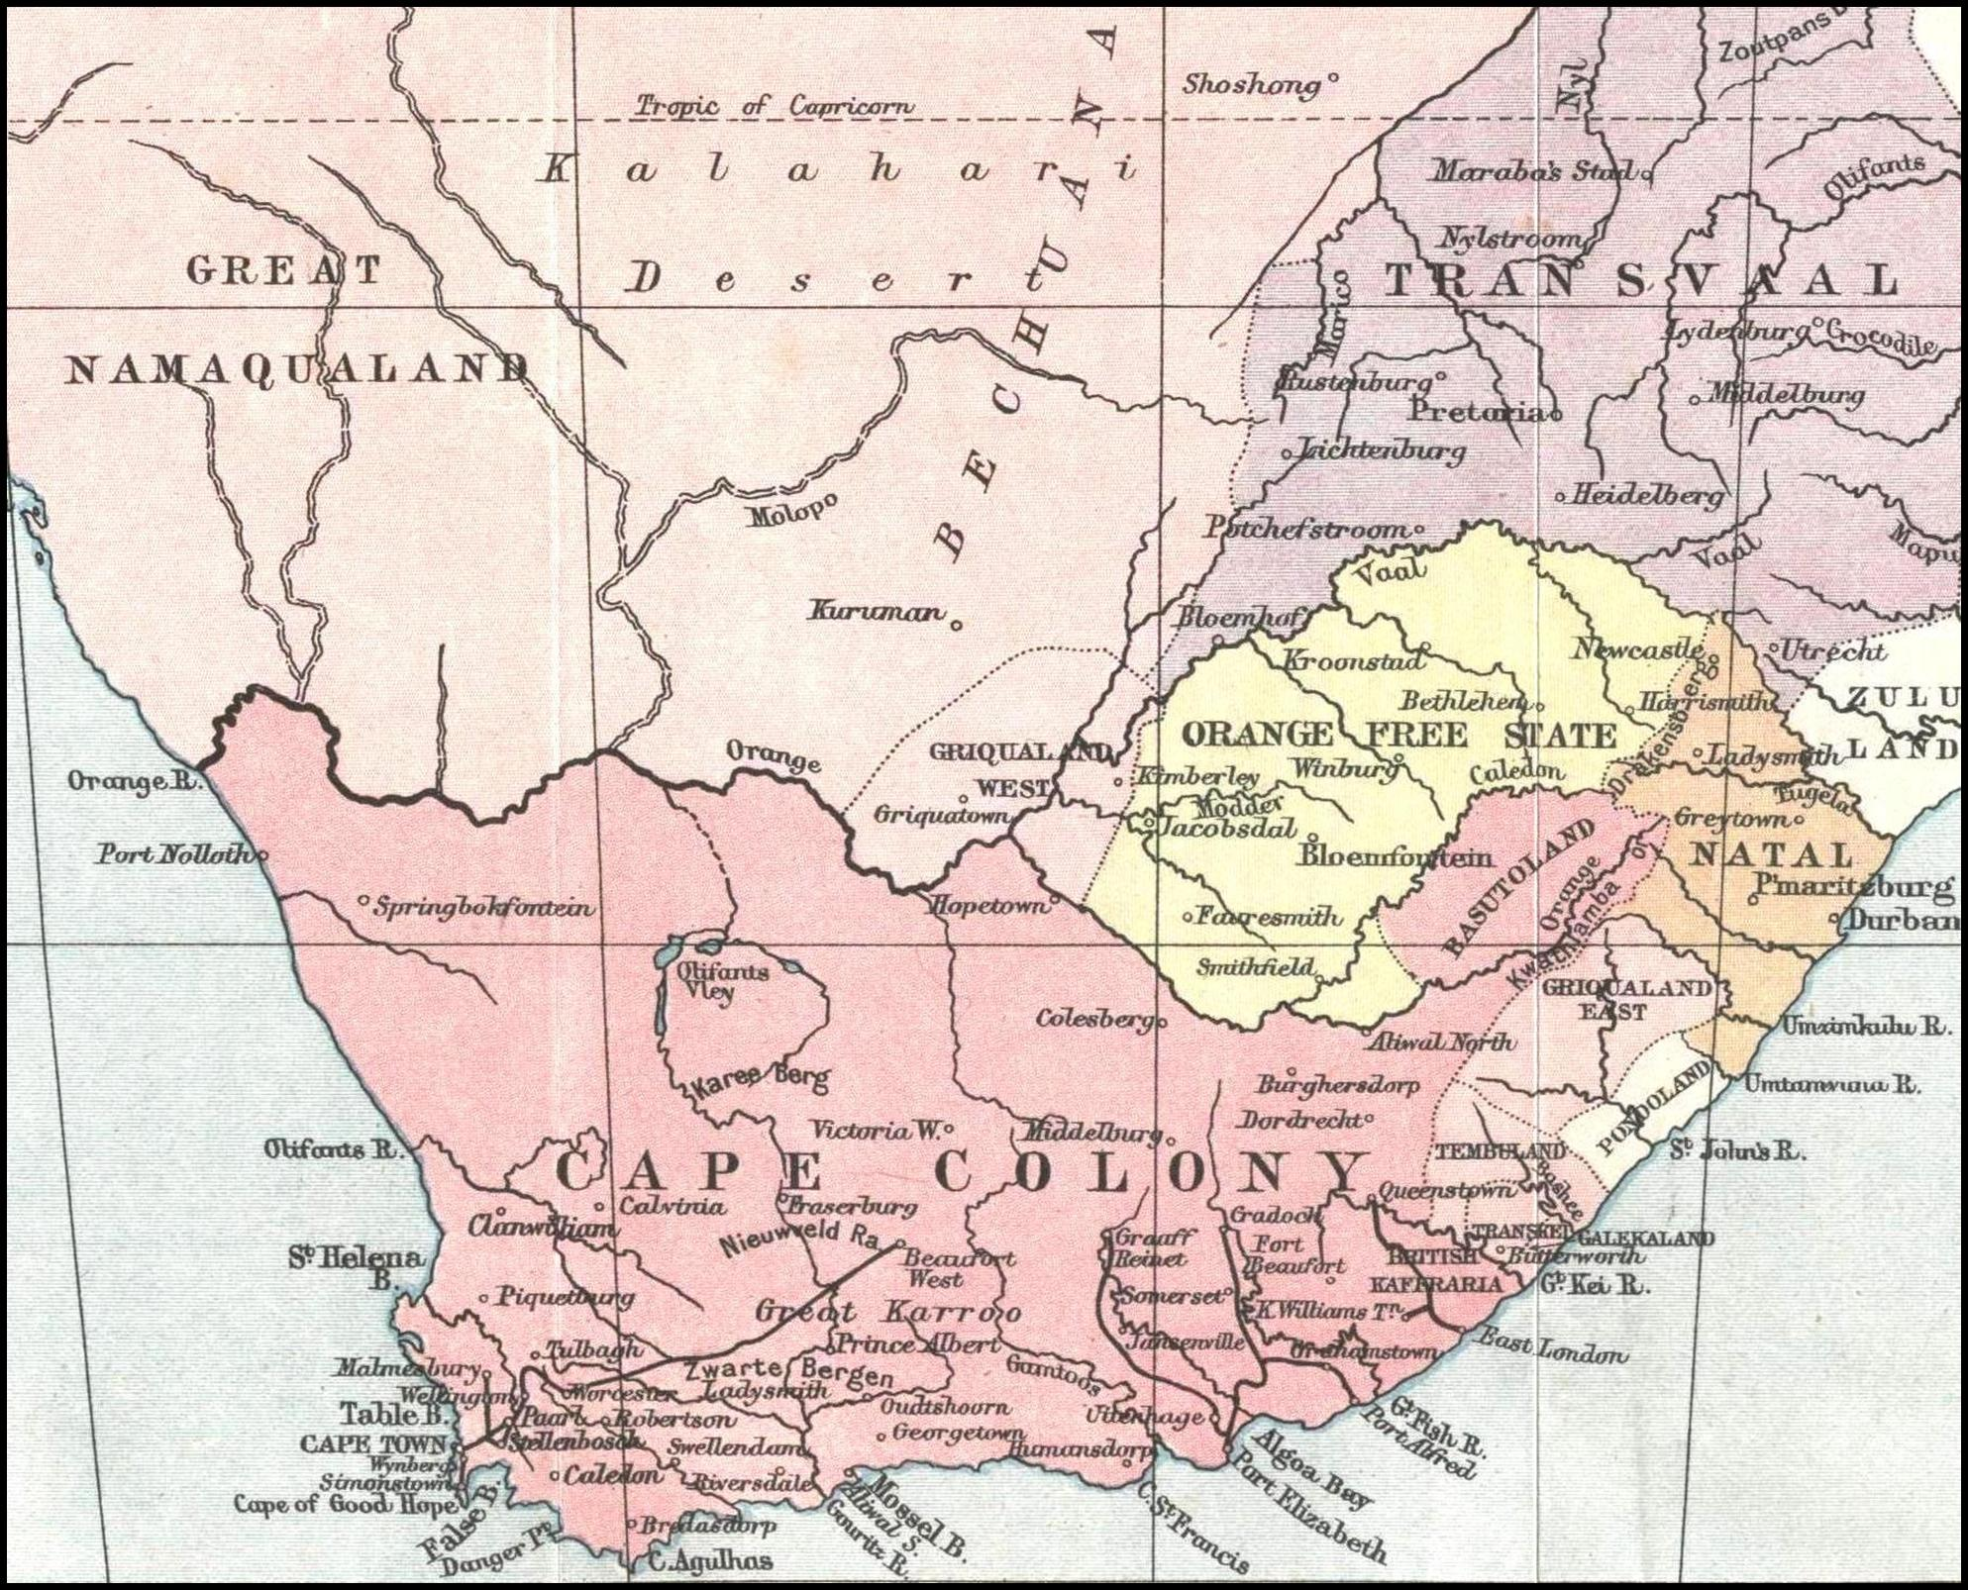

Slide 33
Control of India
British vs. French control of India
Weakening of Mughal empire
Trading posts along east and west coasts
Advantages of British East India Company
Gained station at Calcutta via negotiation with local princes
Access to wealth of Ganges valley
Influence over British government
Content in allowing Hinduism and practices
Disadvantages of French
Less political power
More interested in missions
Seven Years’ War
Recruitment of local princes and warriors
British imprisoned in own jails, “Black Hole of Calcutta” leads to many deaths
East India Company captures Calcutta, seizes additional land including Bengal and Ceylon
British government takes more direct role in India over East India Company
Forms alliances with local rulers rather than just direct rule

Slide 34
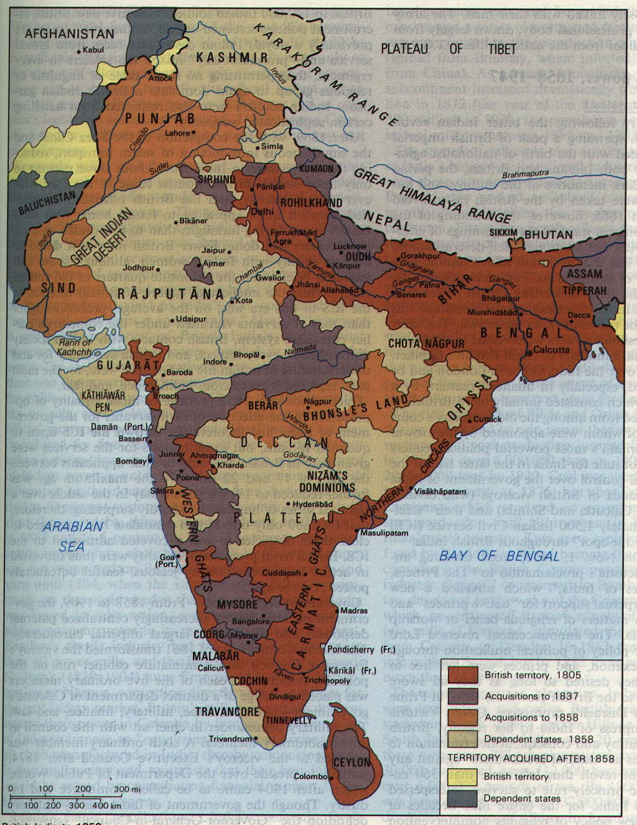
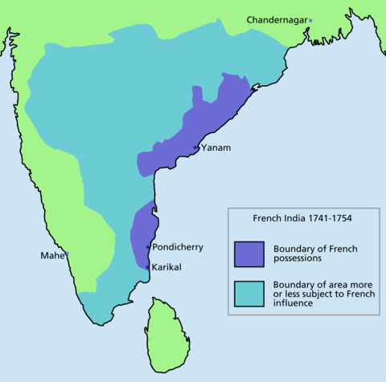

Slide 35
Effects of Colonization on Europe
New rivalries and wars over colonies
England and Holland vs. Spain
England vs. Holland
England vs. France (Seven Years’ War, the REAL WWI)
Growth of consumer societies
Sugar for ordinary people traded over long distance, gives work to dentists
Quick hit of pleasure
Increased manufacturing, reduces dependence on agriculture

Slide 36
Impact on the World
Unfree labor (slavery and serfdom)
Disrupts African societies and lives
New foods and trade patterns
Reduce scarcity
New wealth for individuals and nations
China>silver
Rapid population gains
Profits and compulsion leads more people and regions to become international

Slide 37
Reflection Questions
Why was it so easy for Europeans to establish colonies in the Americas?
How did the form and function of American colonies change over time?
What do you think were the most lucrative colonies for
Spain
England
France
What do you believe to be the most significant impact of colonialism on
Europe
Americas
The World

