Slide 1
War on the homefront

Slide 2
European Home Front
Land and homes destroyed
Battle of Britain
Luftwaffe
Air-raid shelters, “the tube”
Many lose lives and property

Slide 3
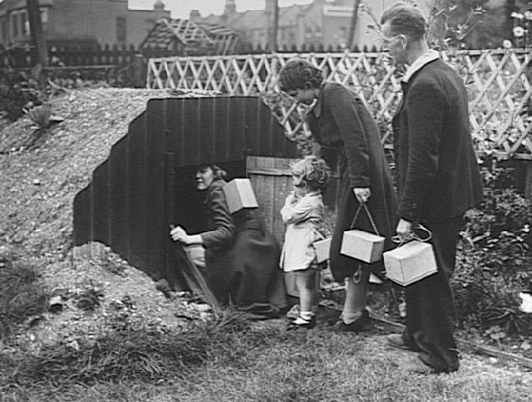

Slide 4
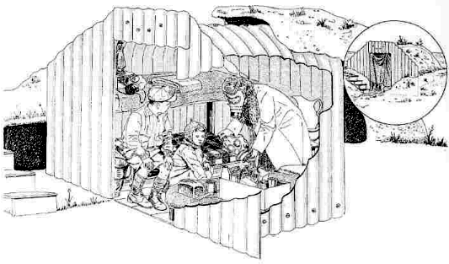

Slide 5
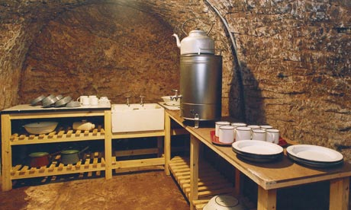

Slide 6
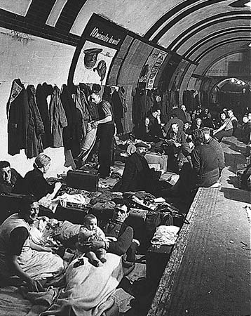

Slide 7
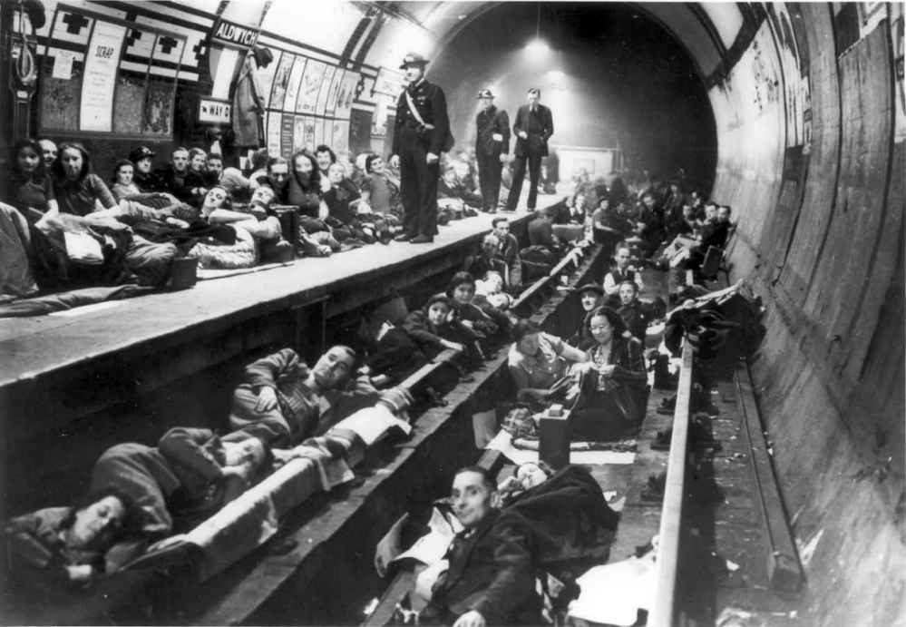

Slide 8
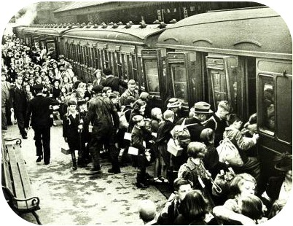

Slide 9
American Home Front
Factory work
Change factories to wartime production
Gibson Refrigerator Factory (Greenville, MI)>>wooden gliders for D-Day
“The Fighting Falcon”
Ford plants (Detroit, MI)>>airplanes and tanks
Enola Gay
17-18 million workers across the US by 1944
“Rosie the Riveter”
Women in medicine

Slide 10
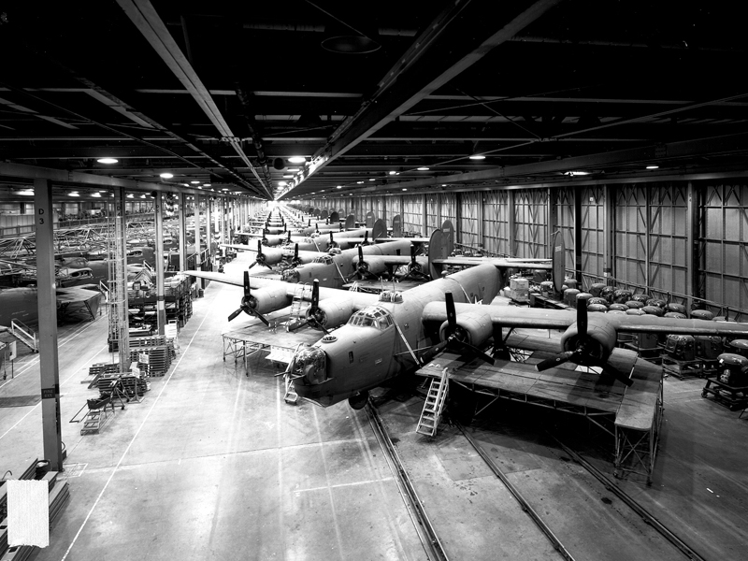

Slide 11
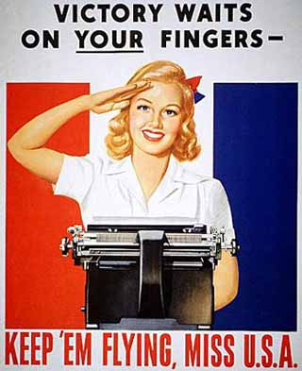

Slide 13
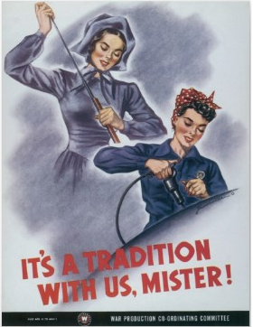

Slide 14
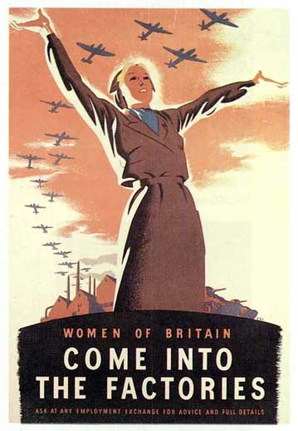

Slide 16
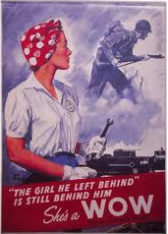

Slide 17
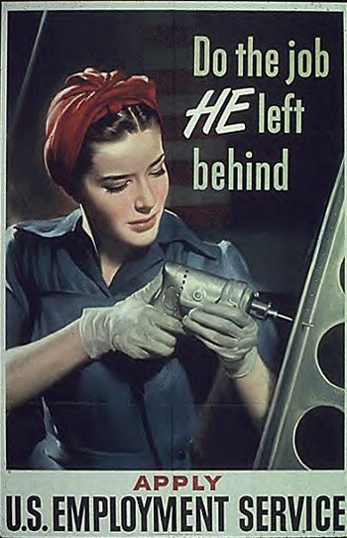

Slide 18
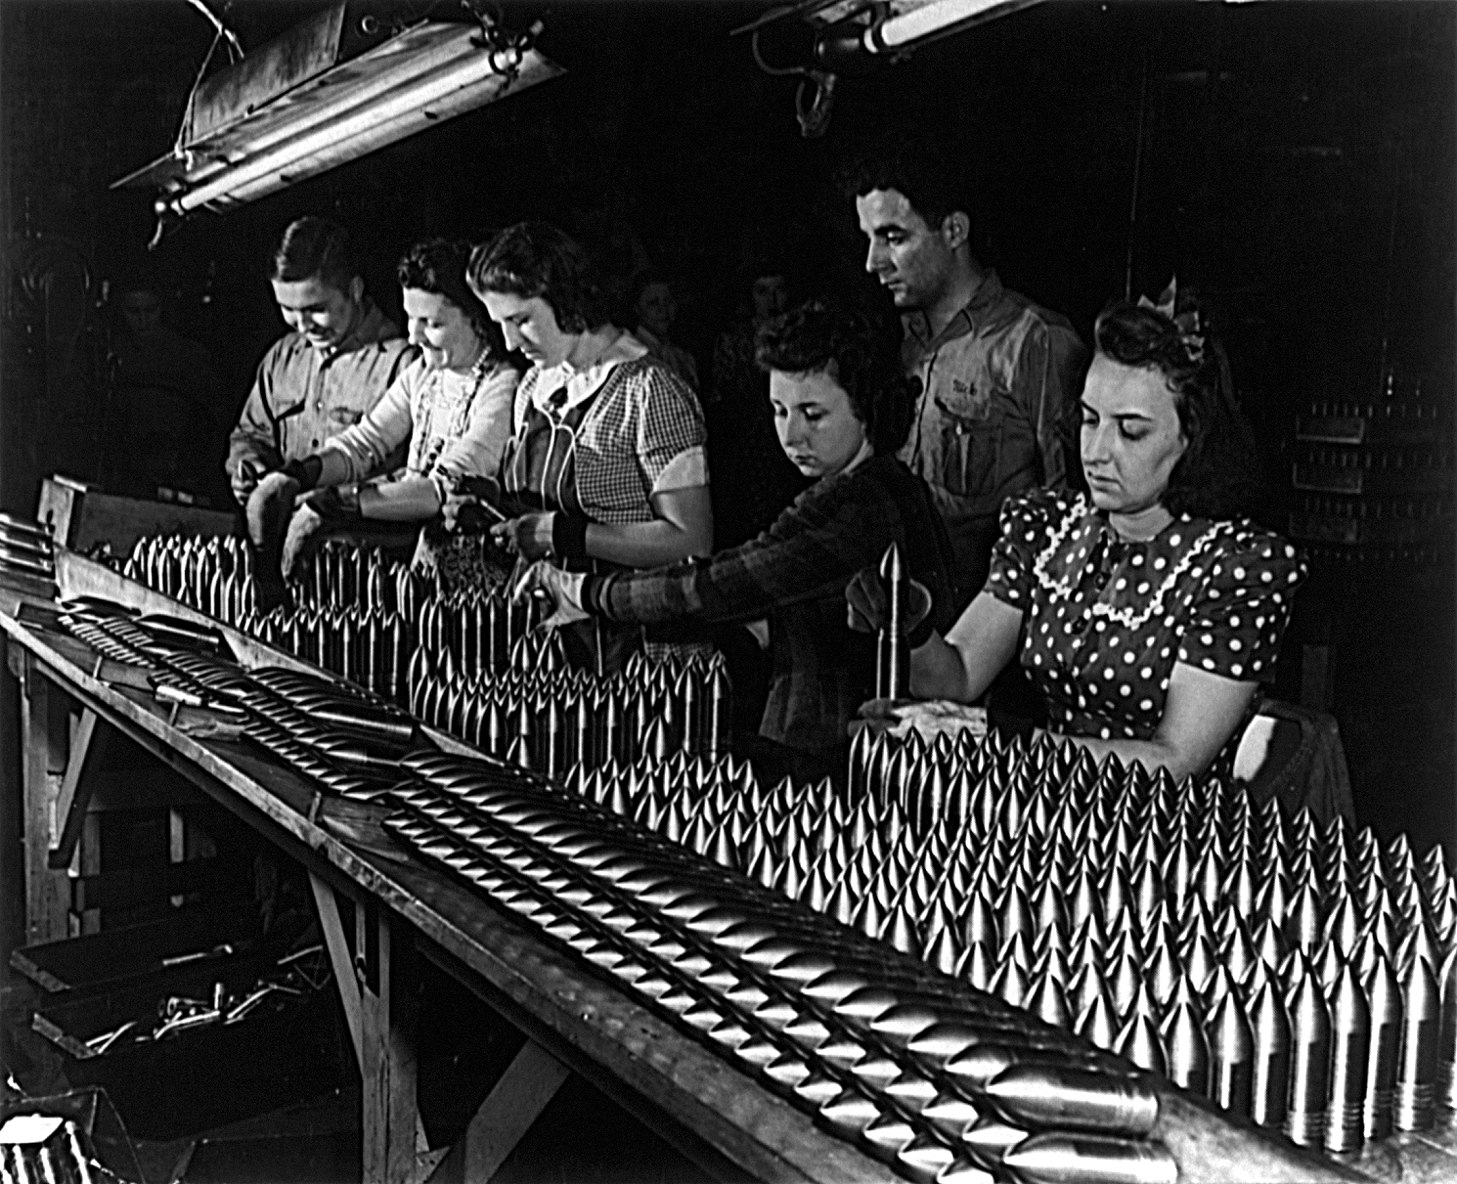

Slide 19
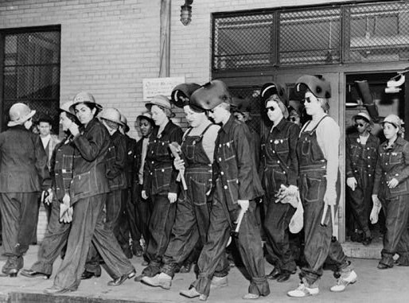

Slide 21
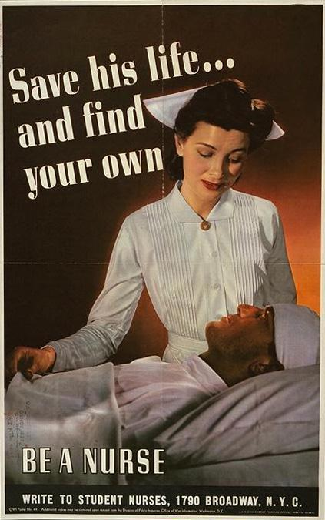

Slide 23
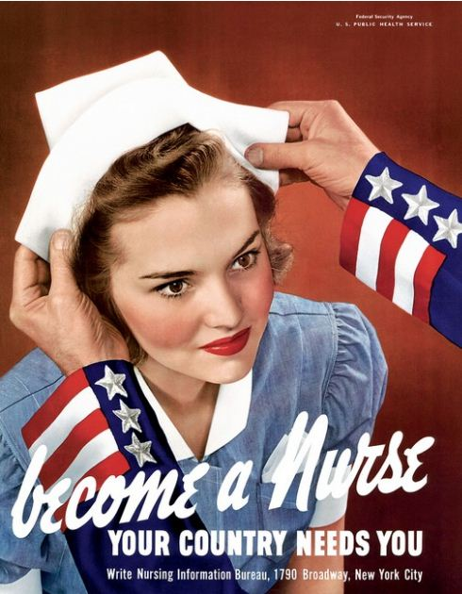

Slide 24
American Home Front
Rationing
Meat, sugar, tires, gasoline, nylon, soap
Fat grease
Gasoline and rubber (35 mph)
Scrap metal collection
Raising money
War bonds
War stamps
Financing airplanes (Fighting Falcon financed by children at an elementary school in Greenville, MI)

Slide 25
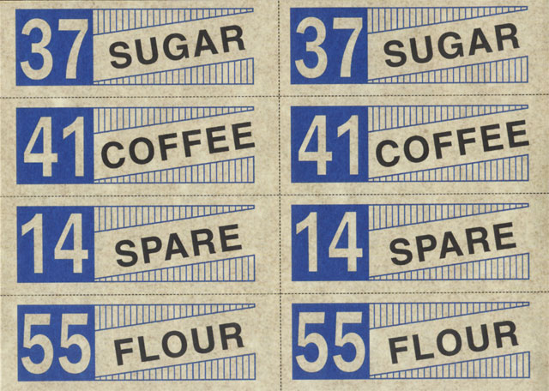

Slide 26
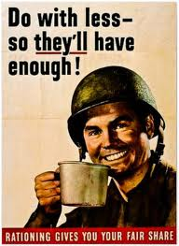

Slide 28
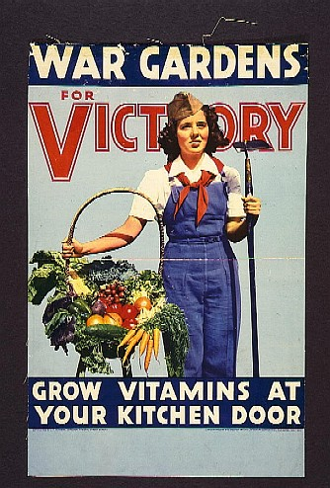

Slide 29
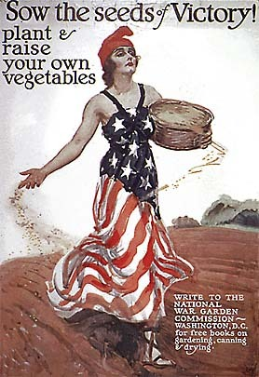

Slide 30
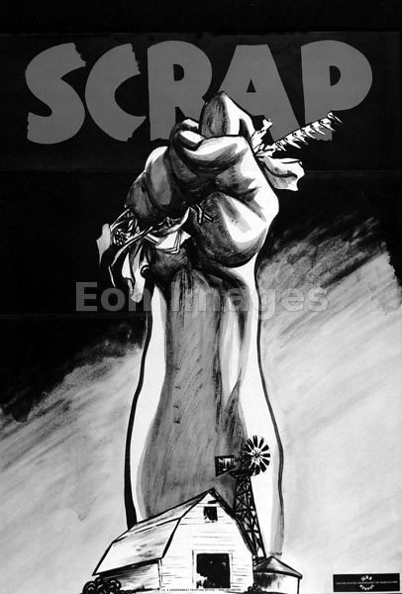

Slide 31
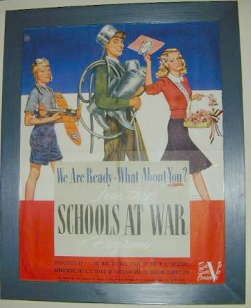

Slide 32
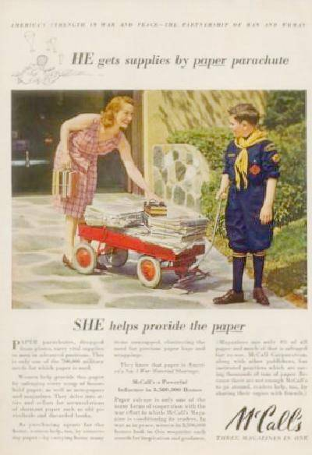

Slide 33
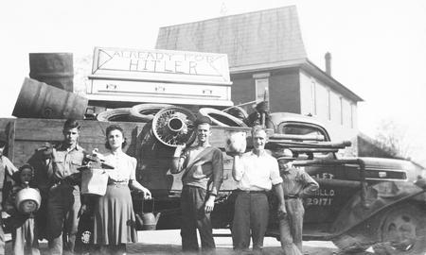

Slide 34
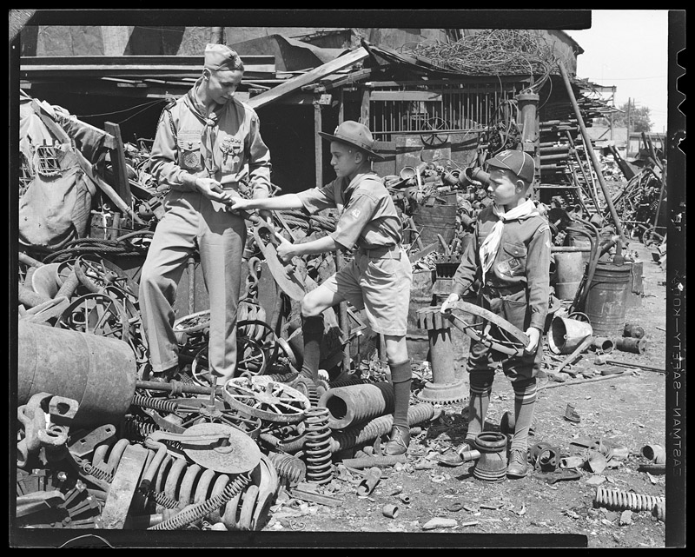

Slide 35
American Home Front
Civil Rights Problems
Prejudice against Japanese
“Relocation (internment) camps”
Poor living conditions, filth, disease, little food
Many were farmers, lose their farms or shops
Many were Nisei (American citizens whose parents were Japanese)
Some Nisei fought for the US bravely
African Americans
Given poor positions in the military (cooks, machinists, etc)
Riots against pay in different parts of the country
Demand equality because they fought and died like the whites did

Slide 36
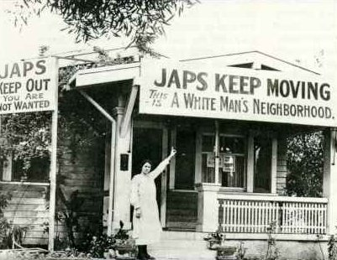

Slide 37
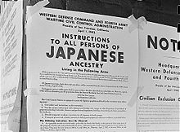

Slide 38
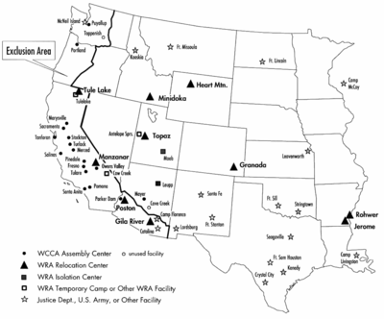

Slide 39
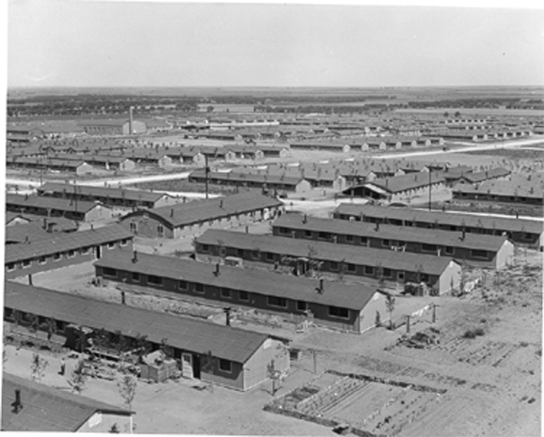

Slide 40
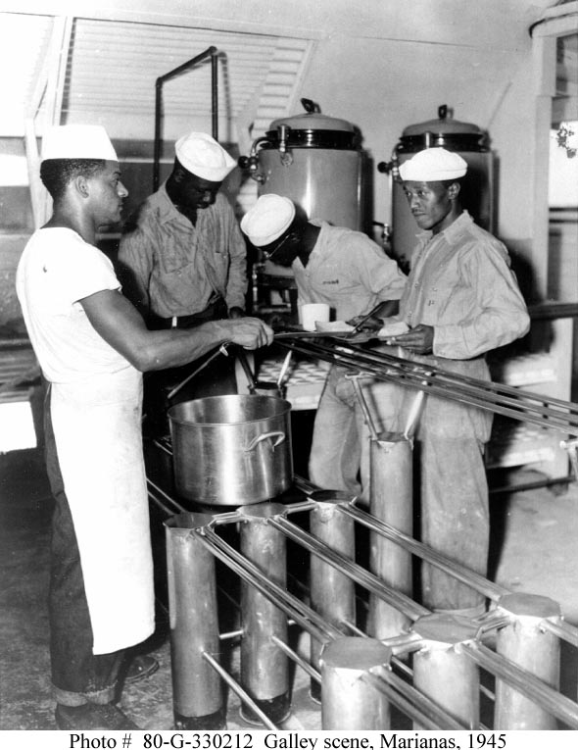

Slide 41
Propaganda

Slide 42
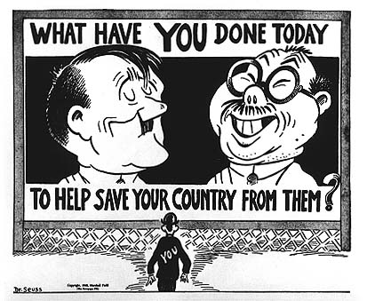

Slide 43
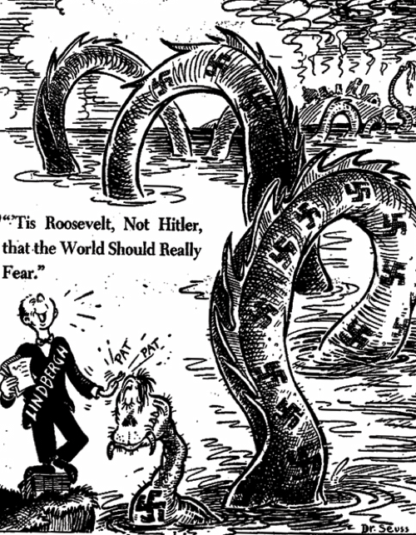

Slide 44
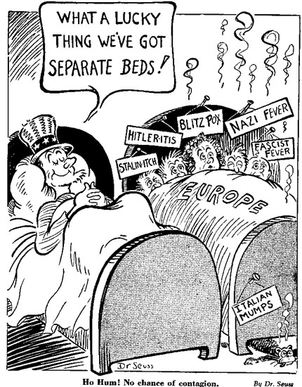

Slide 45
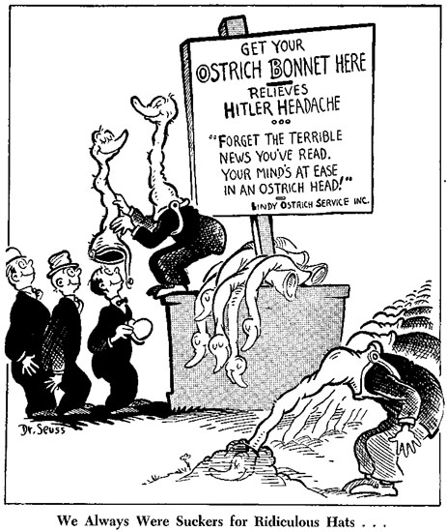

Slide 46
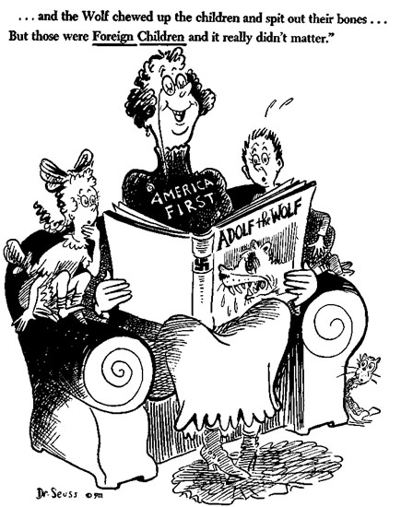

Slide 47
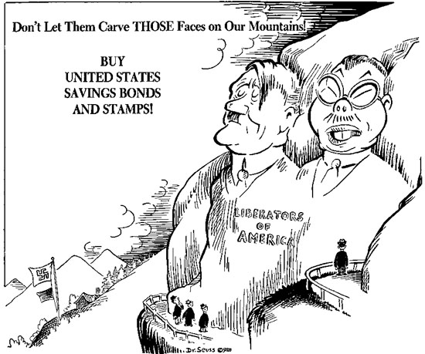

Slide 48
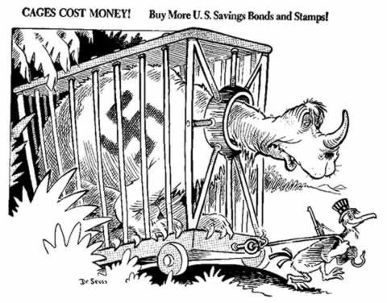

Slide 49
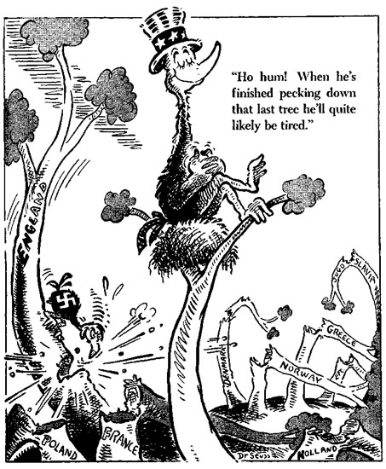

Slide 50
