Slide 1
Life During the Cold War

Slide 2
Life Under Stalin
Police state
Tanks and armored cars to stop riots
Monitored telephone lines, read mail, spies
Children
Midnight arrests, executions
The Great Purge (1937-38)
Campaign of terror directed at eliminating anyone threatening the power of Stalin
Executions, arrests, sent to Gulags
8-13 million deaths

Slide 3
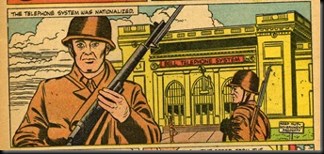

Slide 4
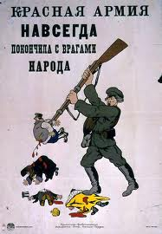

Slide 5
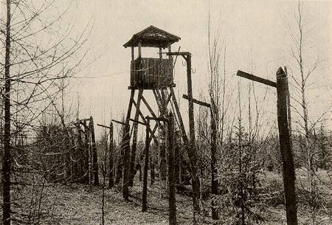

Slide 6
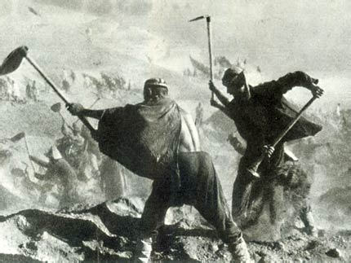

Slide 7
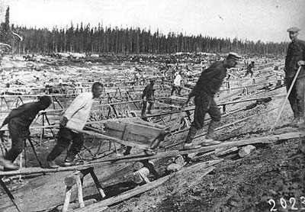

Slide 8
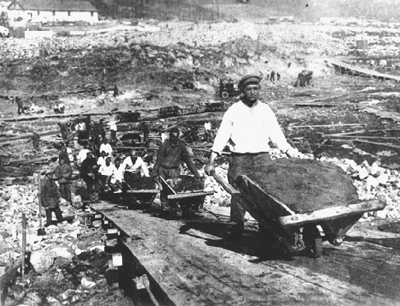

Slide 9
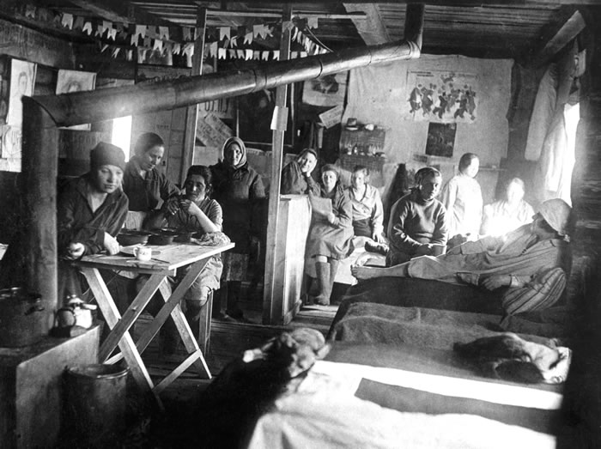

Slide 10
Life Under Stalin
Propaganda
Government control of all newspapers, films, radio
Writers, composers, artists victim to censorship
No creativity that does not help the state
Newspaper, radio, news glorify achievements of communism and Stalin
Pravda, communist party newspaper
Purpose of art: “Literature, the cinema, the arts are levers in the hands of the proletariat which must be used to show the masses positive models of initiative and heroic labor”

Slide 11
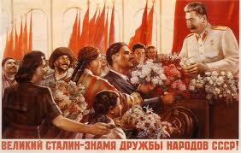

Slide 12
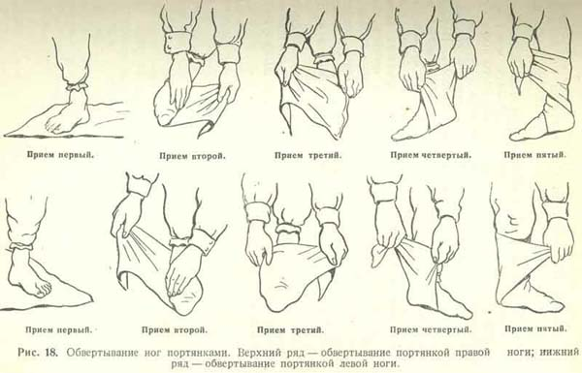

Slide 13
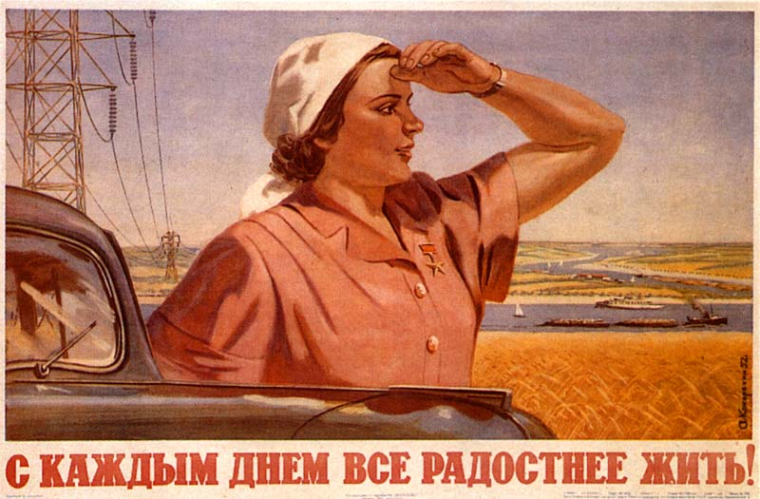

Slide 14
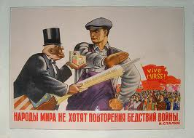

Slide 15
Life Under Stalin
Education and Indoctrination
Government control of all schooling
Preschool to universities
Learn virtues of the Communist Party
Professors and students that questioned Communist Party’s interpretation of history or science risk loss of jobs and/or imprisonment
Stress importance of sacrifice and hard-work to build communist state

Slide 16
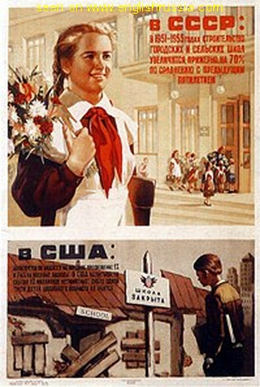

Slide 17
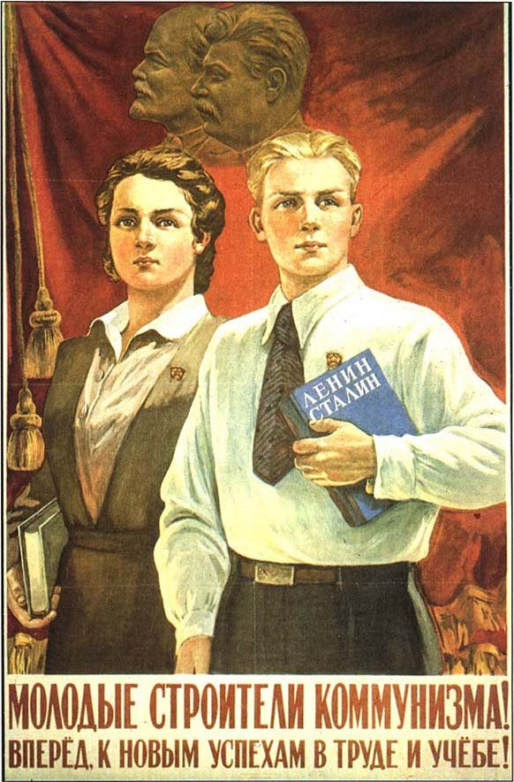

Slide 18
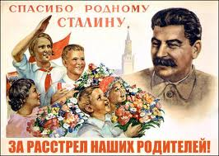

Slide 19
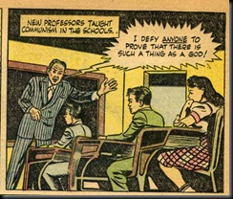

Slide 20
Life Under Stalin
Religious persecution
Replace religious views with ideas of communism
League of the Militant Godless
Government-sponsored group of atheists
Museums of Atheism
Shows religion as superstition
Russian Orthodox Church is persecuted
Police destroy churches and synagogues
Religious leaders killed or sent to Gulags

Slide 21
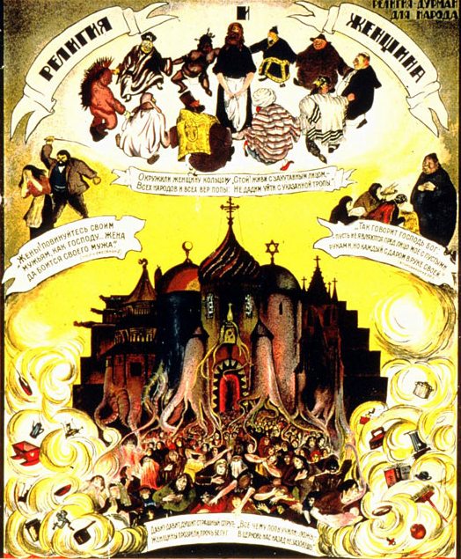

Slide 22
Life Under Stalin
Command economy: system where government made all economic decisions
Stalin realizes USSR is behind the rest of the world by about 100 years
Five-Year Plans (1928-1937)
Economic plans to improve USSR
Set high quotas to increase output of steel, coal, oil, electricity
Limits production of consumer goods, resulting in shortages of housing, food, clothing, etc

Slide 23
Life Under Stalin
Agricultural Revolution
Government seizes 25 million privately owned farms across USSR (1928)
Combines farms into large government owned farms (collective farms)
Production of food for the state
Use of modern machinery on farms to reduce workers
Leads to peasant rebellions (Kulaks)
Killed livestock, destroyed crops
Kills 5-10 million peasants
90% of all peasants in USSR live on collective farms
Leads to doubling of wheat production

Slide 24
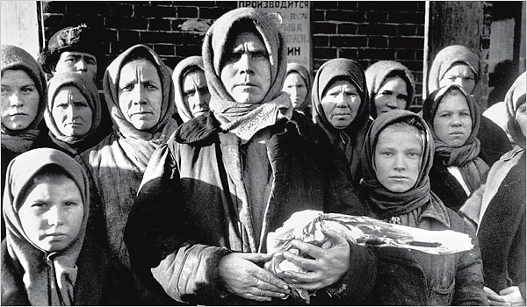

Slide 25
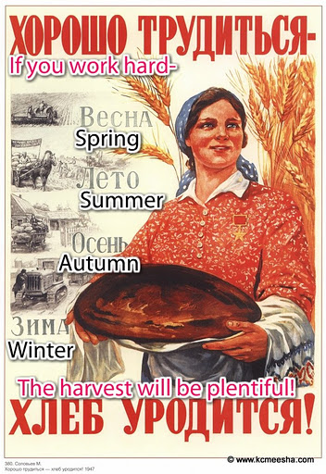

Slide 26
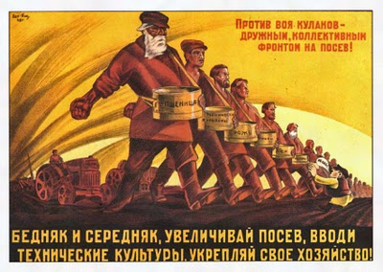

Slide 27
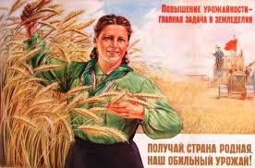

Slide 28
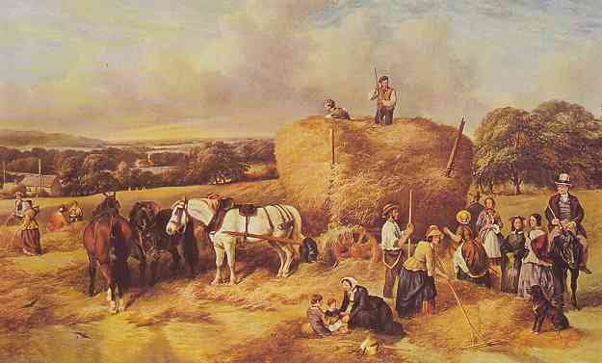

Slide 29
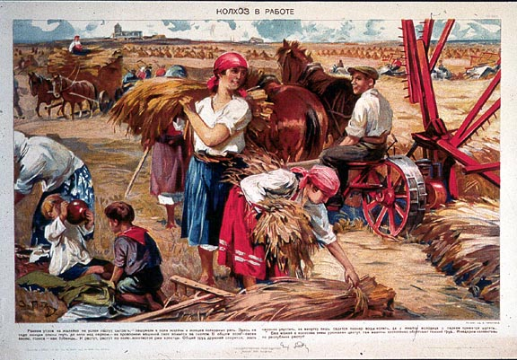

Slide 30
Life Under Stalin
Women’s roles improve
Women equal to men
Women work in jobs, childcare provided by state
Factories, construction
Educated women leads to jobs in engineering and science (75% of doctors were women by 1950)
Also responsible for housework, produce future generations of loyal communists
Better educated, new technical skills
Personal freedoms limited, lack of consumer goods
High demand for skilled workers
“Americanization”

Slide 31
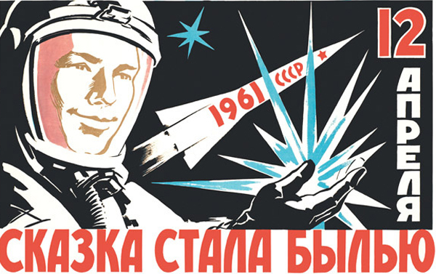

Slide 32
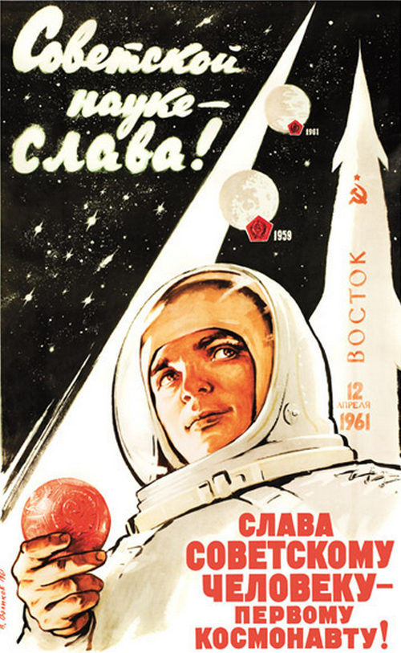

Slide 33
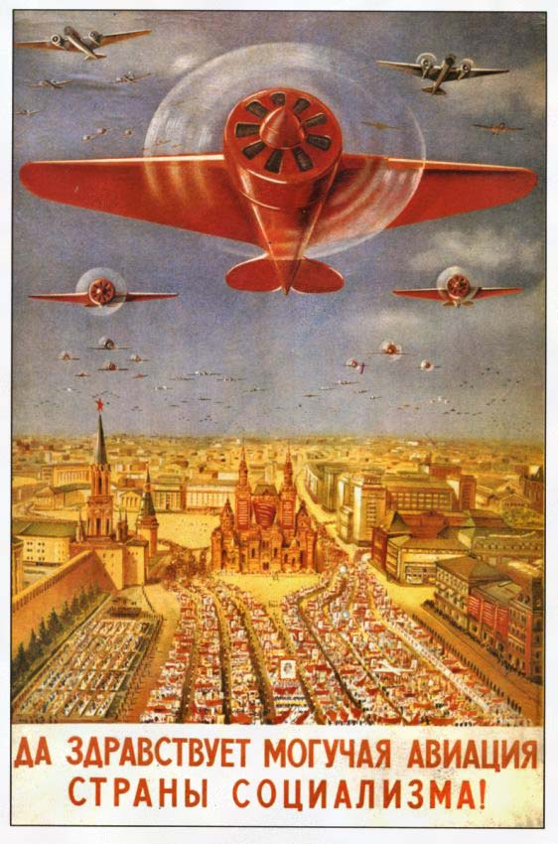

Slide 34
Life in the US
Anti-Communist Propaganda
Nationwide hatred of communism
James Bond, films, comics, etc
“Duck and Cover”
JFK’s “New Frontier”
Pours government money into space program (NASA)
Education of America’s youth in math and science to compete with USSR
Fear of communism
Red Scare/McCarthyism
Julian and Ethel Rosenberg

Slide 35
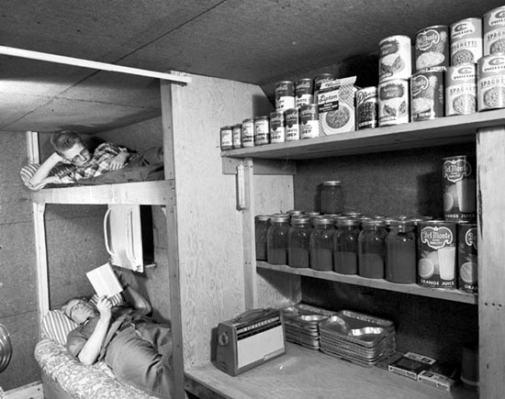

Slide 37
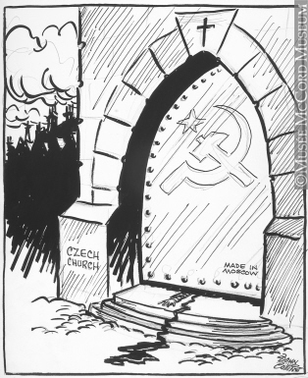

Slide 38
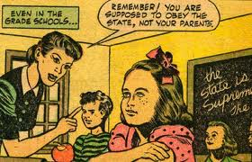

Slide 39
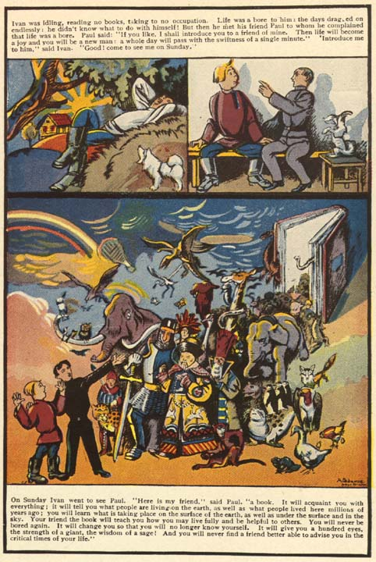

Slide 40
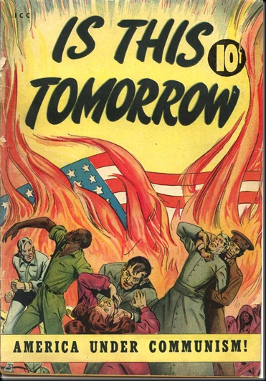

Slide 41
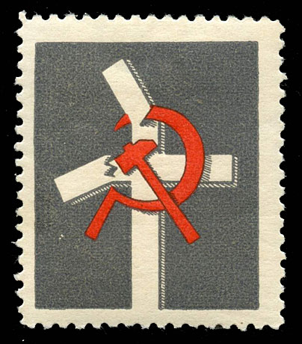

Slide 42
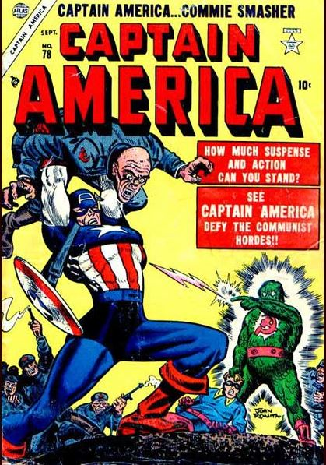

Slide 43
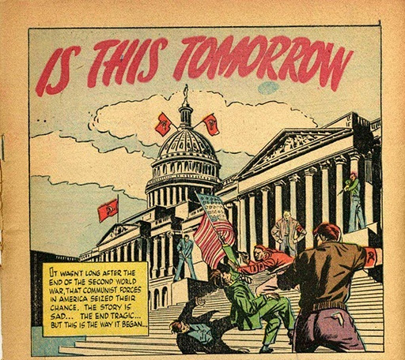

Slide 45
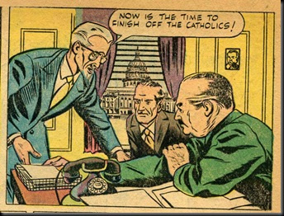

Slide 46
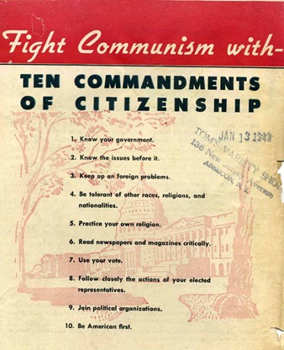

Slide 47
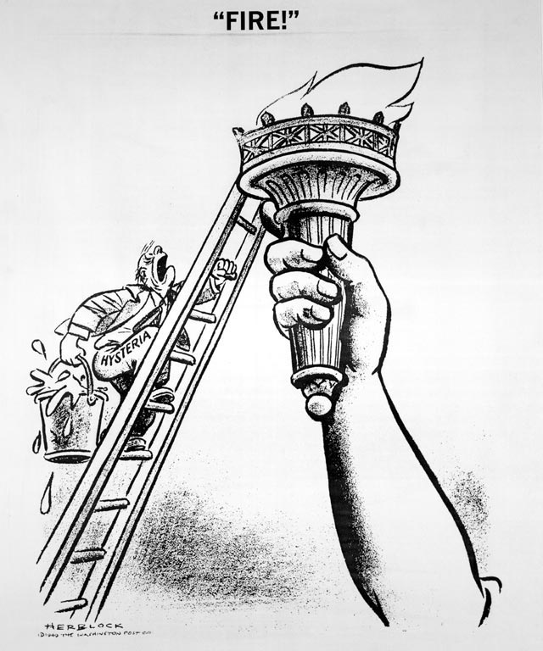

Slide 48
