Slide 1
Medieval Europe
Aka “The Middle Ages”
Ch. 10

Slide 2
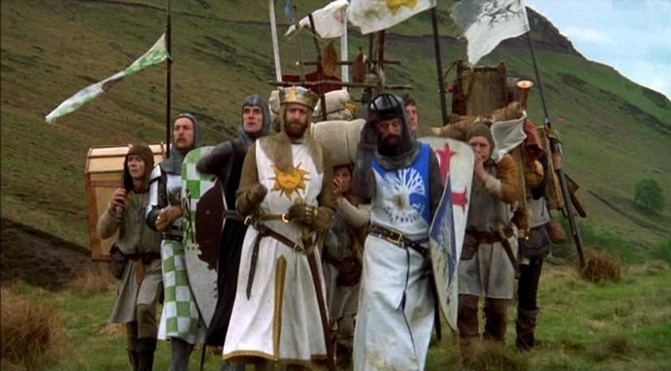
Module 1: Development of the West

Slide 3
THE DARK AGES
Huns overthrow Roman Empire (476)
Nomadic peoples made up of different groups
Huns, Visigoths, Normans, Gauls, Saxons, Anglos, Vikings
Most nomads not literate (why?)
Loss of literacy, hence “Dark Ages”
Most learning concentrated in monasteries
Regional kingdoms, politically divided
Weak rulers, subsistence agriculture
Political and religious rule of the Catholic church

Slide 4
Manorial System
Government and economic system, post-Rome (476-900s)
Manorialism: system of economic and political relations between landlords and peasant laborers
Most people are serfs
Farmers with very few rights and owe allegiance to regional ruler
Live on self-sufficient agricultural estates (manor)
Receive protection from landlords
Obligated to give part of goods to landlord, remain on land
Taxed through harvest or labor on castle repairs
NOT SLAVES, but treated as such
Right to own land and home, pass property through inheritance
Strengthened by decline of trade and lack of political structure
Causes greater dependency between serfs and landlords

Slide 5
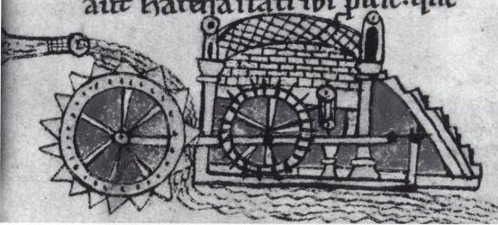
Agricultural Revolution
End of ice age, retreat of glaciers
Warmer, drier climate
Invention of moldboard (9th century)
Curved blade that allows for deeper turning of soil
Three field system
One field fallow, one spring crop, one winter crop
Fallow field used for grazing and restoration of nutrients using sheep manure (“Golden Hoof”)
Mills
Tidal mills, windmills, water mills for grinding of grain
Owned by landed aristocracy (landlords)
Taxed part of crop in return for using mill
Horse collar and stirrups

Slide 6
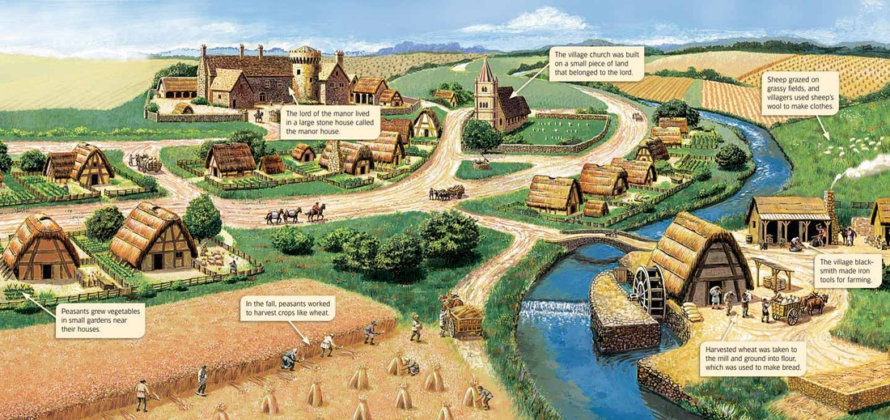

Slide 7
The Church
Church as only solid organization in medieval Europe during early Middle Ages
Copied governmental hierarchy of Roman Empire
Pope
Sometimes appointed bishops, often held by local lords
Regulated doctrine, defeat heresies
Sponsored missionary activity
Bishop
Priest
Establishment of monasteries
Discipline intense spirituality of Christians
Devotion of prayer and religious discipline to escape material life
Benedectines and Franciscans
Promotion of Christian unity, examples of holy life
Many help improve cultivation of land, education, and literacy

Slide 8
The Carolingians
Grow out of royal house of Franks (8th c)
Based in northern France, Belgium, western Germany
Early ruler, Charles Martel, beats Muslims in Tours (732)
Helps contain Muslims to Spain

Slide 9
Charlemagne
Establishes empire in France and Germany (r. c. 800-814)
Helps restore church-based education, causing intellectualism to slowly revive
After his death, empire split into three parts
Roughly modern-day France, Germany, Low Countries/Switzerland/n. Italy

Slide 10
Politics post-Charlemagne
Emergence of regional monarchies
Empire is impossible due to competing loyalties and absence of strong bureaucracy
Cultural unity (?)
Centered around Catholicism
Diversity of languages
Political division
Use of Latin by intellectuals and church officials
Later merged with Germanic elements (French, English)

Slide 11
Holy (?) Roman (?) Empire (?)
After Charlemagne’s death, kingdom in charge of Germany and n. Italy strongest
Claim title emperor around 10th century
Establishment of the Holy Roman Empire
Merge Christian and classical claims
Hollow, false rule
Rely too much on imperial claims
No solid monarchy, but regional foundations
Local lords do their own thing in Germany (360 semi-autonomous regional princes)
City states in Italy

Slide 12
From Agriculture to Urbanization
Regional governments become stronger as nomadic incursions (Vikings) taper off
Political stability and improved agriculture promotes population growth
Population growth encourages innovation
New markets, growing trade, expansion of towns
Colonization of new lands for agriculture
More rights for serfs to encourage them to move to new farms for landed elite
Require less labor service, instead charging money rent
Some serfs flee to cities, and if they live there 366 days, become “free”
New crops (durum wheat, alfalfa)
Growth of towns
Italy and Low countries have population soar due to trade and manufacturing
Causes spread of literacy and growth of popular languages
Schools forming around churches, training future priests
Beginning of universities for medicine, law, clergy, philosophy
Paris, Italy, England (Oxford, Cambridge), Germany

Slide 13
Feudalism
Feudalism: link wealth, political power, and military relationships to ownership of land
Linked military elites (landlords) who can afford horses and weapons to fight
Greater lords provide protection and aid to lesser lords (vassals)
Vassals given a fief to run exchange for providing lords with military service, goods or payments, and advice
Greater lords slowly morph into regional kings
Use feudalism to build power
Form feudal links with other lords via marriage alliances
Brings more territory under their control
Use of bureaucracy
Kings begin using power to force church to pay taxes, mint money, and employ professional soldiers

Slide 14
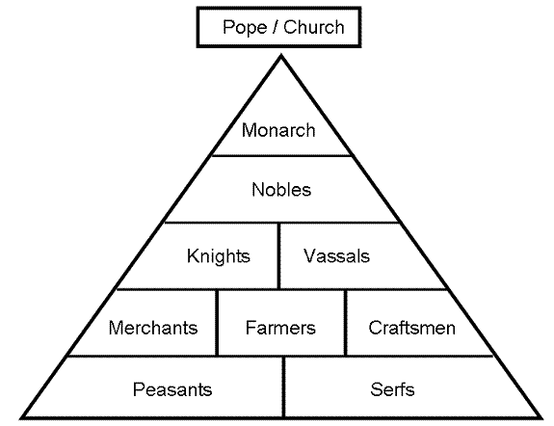

Slide 15
Europe under Feudalism
Germany and Italy (controlled by HRE) split into regional states run by lords and city states
Pope rules central Italy
Low Countries remain divided into regional units
Duke of Normandy (Viking descent from France) invaders England (1066)
Aka William the Conqueror
Use of great lords as vassals who owe him loyalty
Use of sheriffs who supervise justice throughout kingdom
Centralized version of feudalism

Slide 16
Limited Government
Church limits political claims
Aristocrats hold independent voice and own military
Growing power of monarchies limited by nobles
Magna Carta (Great Charter, 1215)
King John must observe restraint in dealing with nobles and church
Agree not to institute new taxes without lords’ permission
Agree not to appoint bishops without church permission
Creation of the Parliament
Legislative bodies that represented privileged groups (nobles and church)
English Parliament (1265)
House of Lords represents nobles and church hierarchy
House of Commons had elected representatives from wealthy citizens of towns
Reinforces idea that monarchs should consult with vassals
Represent three estates: church, nobles, urban leaders
People have rights based on their estate (born into), but no democracy or citizenship
Still more of a central administration
War as a key purpose (Hundred Years’ War)

Slide 17
Expansionism
Population growth=expansionism
Into east central Europe (11th c-13th c)
East Germany and Poland
Into Spain (10th c-14th c)
Christian kingdoms begin to increasingly attack Muslims
Reconquista (reconquest) conquers Toledo in 11th c
Full expulsion of Muslim leaders in 1492 (Ferd and Izzy fuse kingdoms of Aragon and Castile)
Vikings push west across Atlantic
Iceland, Greenland, Hudson Bay (Canada)
Glacier pushes south in Iceland, so head to Greenland and America
Crusades
Begin under Urban II (1095)
Grants crusaders full forgiveness if die in battle
Sacking of Constantinople in 1097
Gain Jerusalem after first crusade, lose it from Saladin, who holds it for Islam
Show western aggressiveness
Begin thirst for international trade

Slide 18
Religious Reform
Church slowly becomes more focused on land holdings and political interests
Some monks retreat from society to resist temptation
Franciscans (13th c), devoted to poverty and service
Some popes try to purge power of feudal lords from church
Pope Gregory VII (1073-1085)
Purification of church and free from interference
Insistence on holy character of priesthood, celibacy, quarrel over lay investiture
Creation of religious courts to rule on religious law and bring heretics to trial and execution

Slide 19
Reflection Questions
Why did the manor system “work”?
Overall, how would you judge the lives of the common people to be? Why? Provide evidence.
Why were monasteries important to the development of Europe during the Middle Ages?
Why were no major European empires developed during the Middle Ages?
How did the Agricultural Revolution improve the European economies?

Slide 20
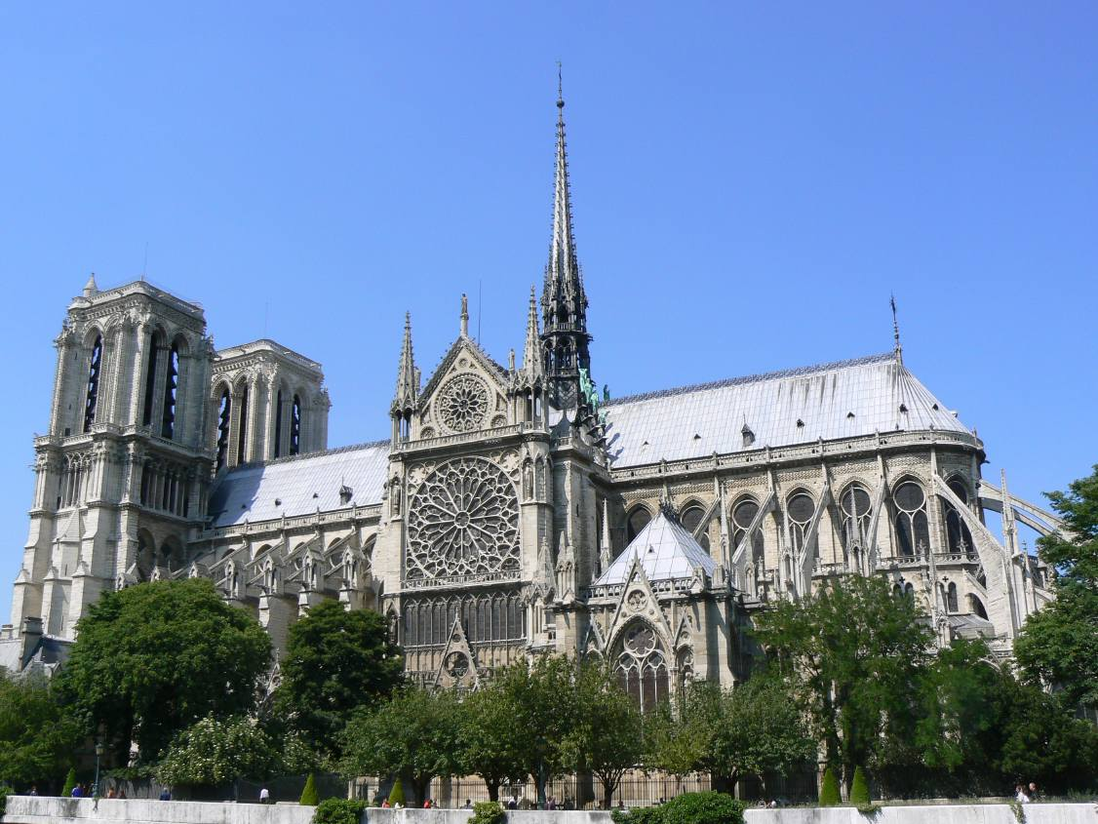
Module 2: Western Culture in Middle Age Europe

Slide 21
Faith and Reason
Clergy focuses on preserving and interpreting past wisdom (non-Christian, Latin authors)
Rhetoric and logic, wisdom
Aristotle for clear exposition of rational thought
Religious leaders stress absolute faith in God’s word
Human reason can move toward understanding of aspects of religion and natural order
Possible to prove natural existence of God
Some oppose this logic
Bernard of Clairvaux stresses importance of mystical union with God, but believed reason was dangerous and God’s truth should be through faith alone
Thomas Aquinas (13th c)
Faith came first, but reason alone can prove natural order, moral law, and nature of God
Leads to scholasticism (reason about religion as discussed in universities)
Reason, logic, and scholasticism leads to early experimentation and science

Slide 22
Popular Religion
Christianity increases among ordinary people
Many follow Christian rituals, but still contradict Christian morality
Development of lay groups
Develop spirituality and express love of God
Veneration of Mary and saints
Stress God’s mercy, assistance for salvation, intermediaries
Combine pagan festivals and magic rituals
May Day, Christmas

Slide 23
Art, Architecture, and Literature
Religious themes
Meant to serve the glory of God
Paintings depict Christ’s birth and suffering, lives of saints
Stiff, stylized figures
Use of tempura (egg-based) paints and gold leafing
Stained glass
Architecture is Romanesque
Gothic architecture emerges in 11th c.
Soaring church spires like reaching up to heaven, tall arched windows
Cathedrals, “cities of God” take decades-hundreds of years to build
Literature focuses on philosophy, law, political theory
Sometimes written in vernacular
Secular literature focuses on oral sagas, deeds of knights or mythic figures
Canterbury Tales (Chaucer) looks at tension between Christian values and hypocritical behavior
Troubadours sing about love, courtly ceremony, chivalric (polite) behavior

Slide 24
Medieval Art and Architecture

Slide 25
Romanesque
“Like Roman”
500s-900s
Massive quality, its thick walls, round arches, sturdy, groin vaults, large towers and decorative arcading

Slide 26
Gothic Architecture
Cathedrals, “cities of God”
800s-1100s
Large churches built in city areas
Filled with riches that Christians could offer
Gothic: from Germanic tribe of Goths
Cathedrals stretch up as if reaching to heaven
Stained glass windows, ribbed vaults, flying buttresses, pointed arches, tall spires
Sculpture, wood carvings, vaulted ceilings
Meant to inspire worshipper with magnificence of God

Slide 27
Medieval Art
Classical style
Religious background
2 dimensional
Insular art
Curvy, decorative in writing
Poorly detailed

Slide 28
Reflection Questions
Do you think it is important to understand religion and God with reason and logic? Why or why not?
Why do you think Europeans combined their paganistic beliefs, practices, and festivals with Christianity? Why do you think church officials allowed this?
Why do you think that artwork changes over time to less religious?

Slide 29
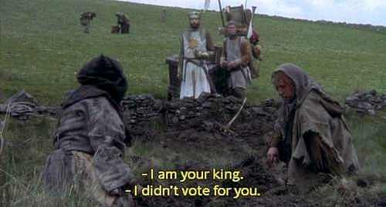
Module 3: Medieval Economics and Society

Slide 30
Rural Life
Some peasants become freer to shake off constraints of manorialism
Landlords continue military functions
Trade used to improve standards of living
Battles between peasants and landlords
Peasants claim natural, traditional right to land
Christian equality

Slide 31
Trade
Economy emerges as early capitalism
Merchants invest funds in trading ships and their goods, hoping to make large profit
Trade between Italy, Low Countries (Belgium and Netherlands), England, Scandinavia, Baltic, France, the Orient
Low Countries: cloth
England: wool
Scandinavia/Baltic: timber/furs
China/Middle East (Orient): Luxury goods and spices
Spices used for food preservation or medicine, not flavor
Exchanges within Europe and other parts of world
Italian merchants dominate
Hanseatic League (Germany, Scandinavia) for encouraging trade
European traders less adventurous and less wealthy than Muslim
Western society less tolerant of merchants
Gain some political power from kings who counterbalance aristocrats

Slide 32
Guilds
Guild: organization of people in same business or occupation working to improve economic/social conditions of its members
Merchant guilds band together to control number of goods traded to keep prices up, provide security in trading, reduce losses
Craft guilds (wheelwrights, glassmakers, winemakers, tailors, druggists)
Guilds set quality of work, wages, working conditions
Bakers required to sell loaves of standard size and weight
Training for new workers
Increases and improves goods being produced
Wealth gained from crafts allow influence over government and economy

Slide 33
Guilds
3 stages
Apprentice
Parents pay for training
Live with master and family
Required to obey master
Trained 2-7 years
Not allowed to marry during training
Journeyman
Worked for master to earn salary
Work 6 days/week
Produce a masterpiece to become master
Needs to be accepted by guild to become master

Slide 34
Guilds
Master
Own own shop
Work with other masters to protect trade
Served in civic government
Guild services
To members
Set working conditions, provided health insurance, funeral expenses, dowries
To community
Almshouses for victims of misfortune, guaranteed quality work, police streets, donated windows to church

Slide 35
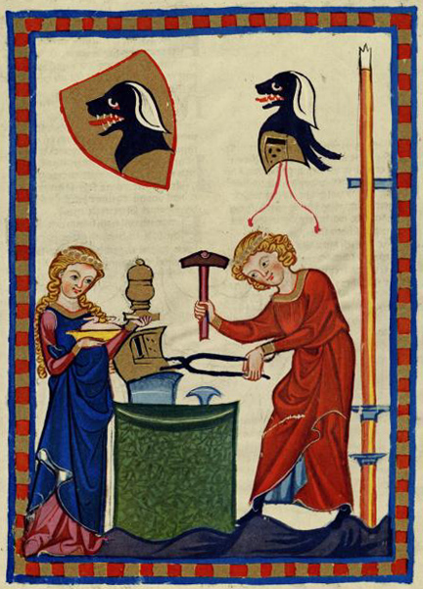
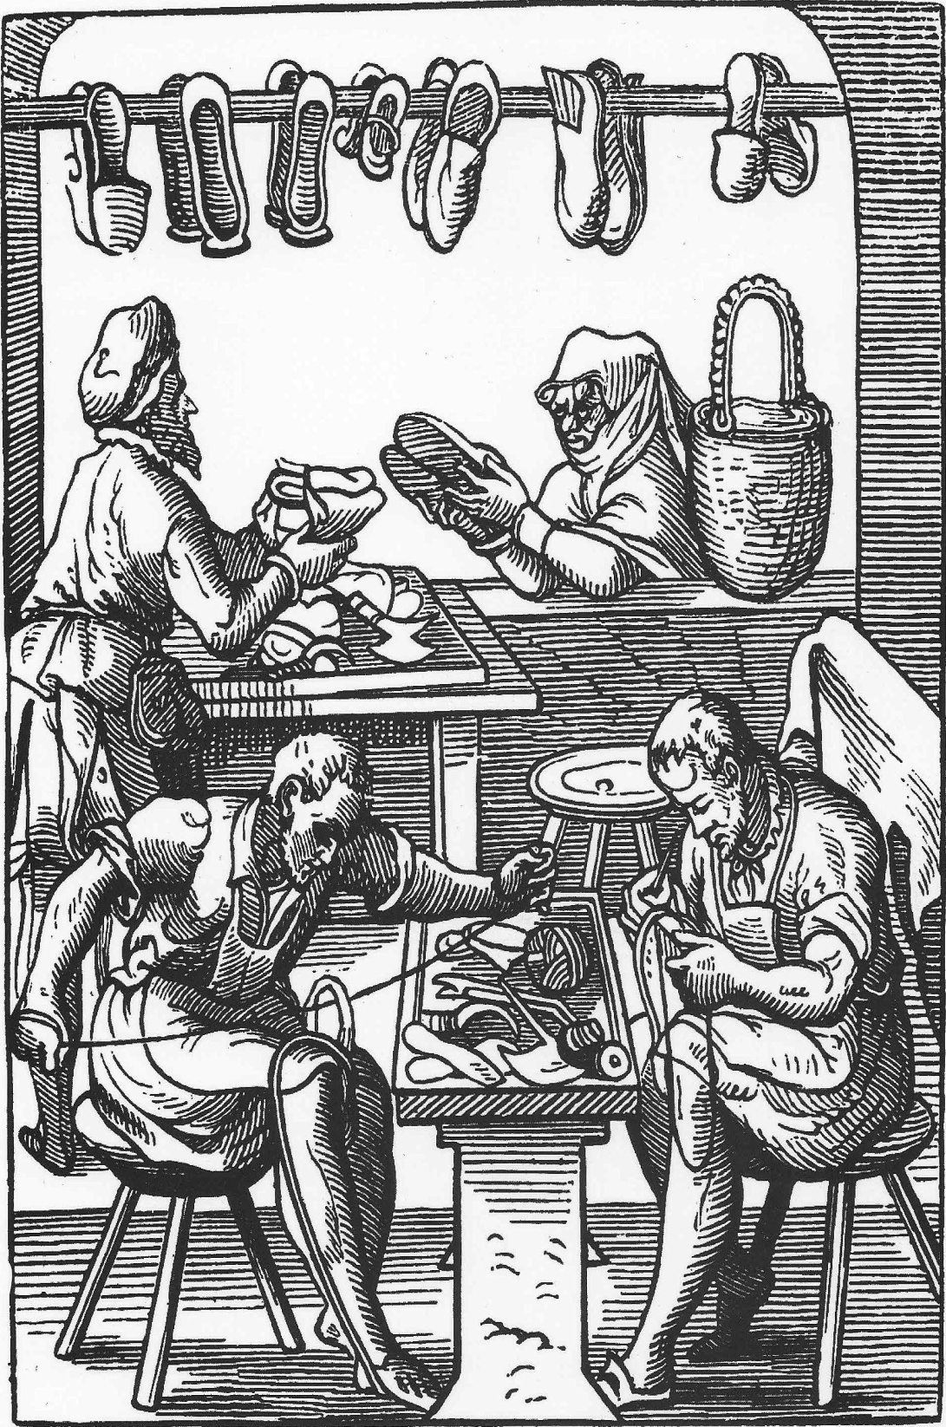

Slide 36
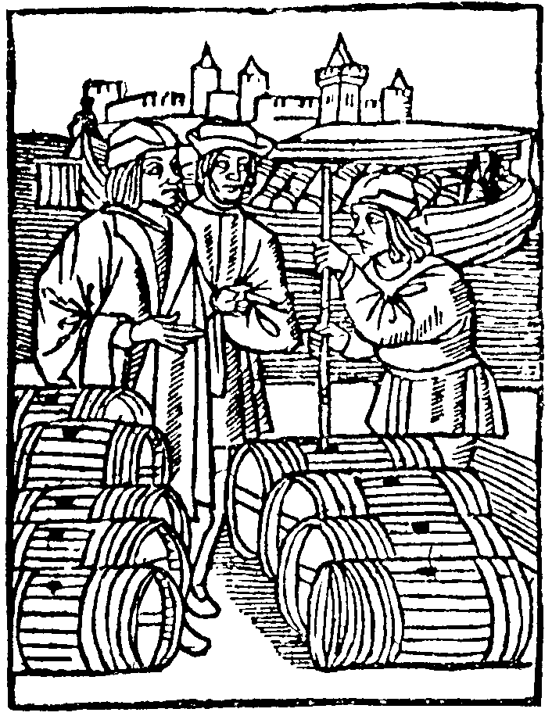
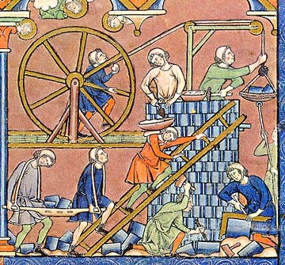

Slide 37
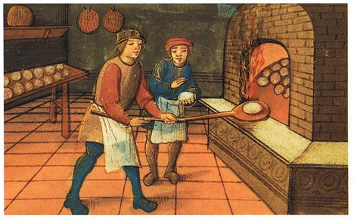

Slide 38
Manufacturing and Commercialism
Clock making
Allows for precise time linked to schedule of church services
Solar clock
Becomes 24-hour day based on sunlight starting at noon with hours divided into length of time of sun, divided by 12=length of daylight hour (an hour could be 95 minutes during the day and 35 minutes at night)
“Perpetual motion” clocks wound using weights and counterweights
Cottage industry

Slide 39
Women
Limits on women’s lives
Work is vital for families
Women participate in cottage industry
Create/sell manufactured goods
Christianity stresses equality of all souls
Women participate in monastic groups
Veneration of Mary and other female saints
Less segregated in religious services
Less confined to the household
No property rights
Women as assistant and comforters to men
Household tasks, docile virtues
Patriarchal society

Slide 40
Reflection Questions
Were the lives of peasants in Europe comparable to those of other low class people in other societies? Explain.
What social class would you like to be in? Why?
What role did trade play in European society?
Why do you think the roles of women changed in Medieval Europe?

Slide 41
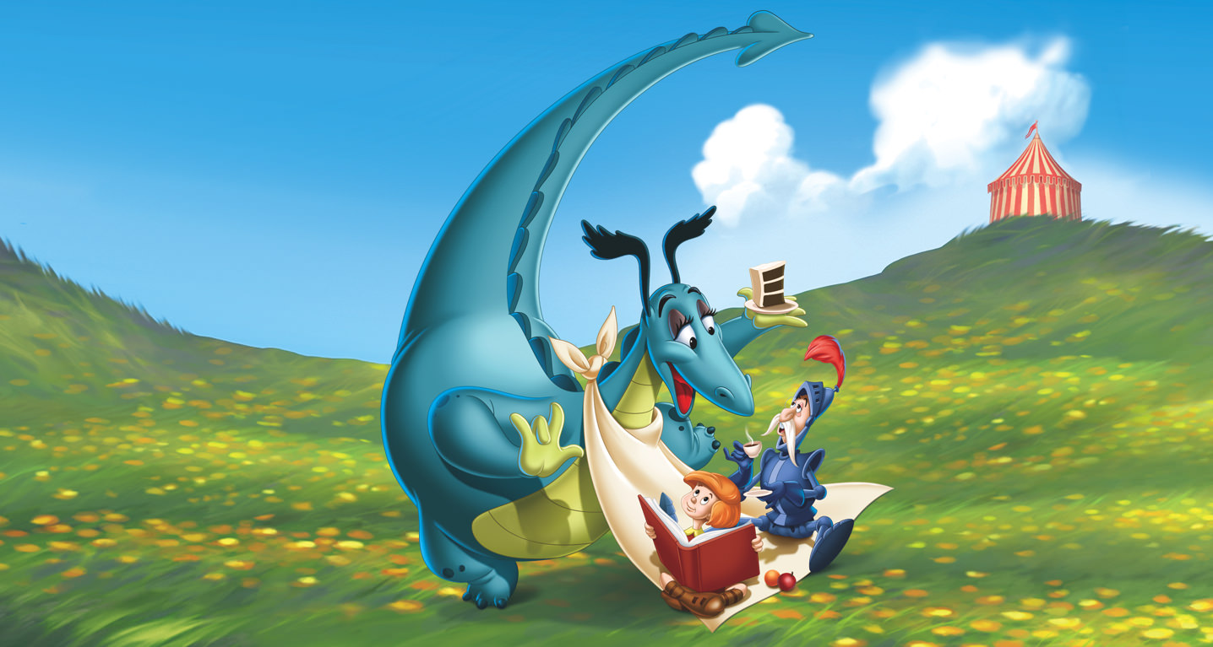
Module 4: Decline of Medieval Europe and the Advent of the Modern Era

Slide 42
Outline of the War
When king of France dies and his son is assassinated, Henry VI (infant) of Eng. is declared king of Fr.
Joan of Arc claims to hear God’s voice telling her to lead Fr. (13-20)
King of Fr. “what do we have to lose?”
Joan leads Fr. to victory at battle of Orleans
Eng. captures her, kills her, Fr. does nothing

Slide 43
Effects of the War
Devastated France
Awakened French nationalism
Transition from feudal monarchy to centralized state in Fr.
Encouraged English to develop own clothing industry and foreign markets
Peasantry forced to support war with taxes and services
English fight internally for throne (War of Roses)

Slide 44
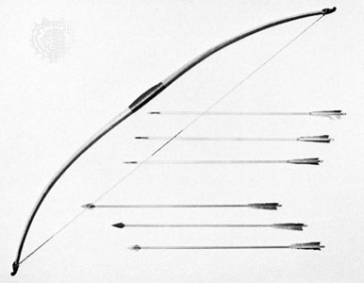
Effects of the War
Longbow
England with longbow outnumbered 3 Fr. per 1 Eng.
Fr. have knights and crossbows
English beat French

Slide 45
The Black Death
Aka Bubonic Plague
“This scourge had implanted so great a terror in the hearts of men and women that brothers abandoned brothers, uncles their nephews, sisters their brothers, and in many cases, wives deserted their husbands. But even worse…fathers and mothers refused to nurse and assist their own children.”~ Boccaccio
AP 295

Slide 46
How the Plague Spread
Began in Asia
Merchant ships carrying rats with infected fleas
“Your Friend the Rat” film clip
Some communities were unharmed
Why?
67-75% of those who caught disease died
Killed 25 million Europeans (1/3 population)

Slide 47
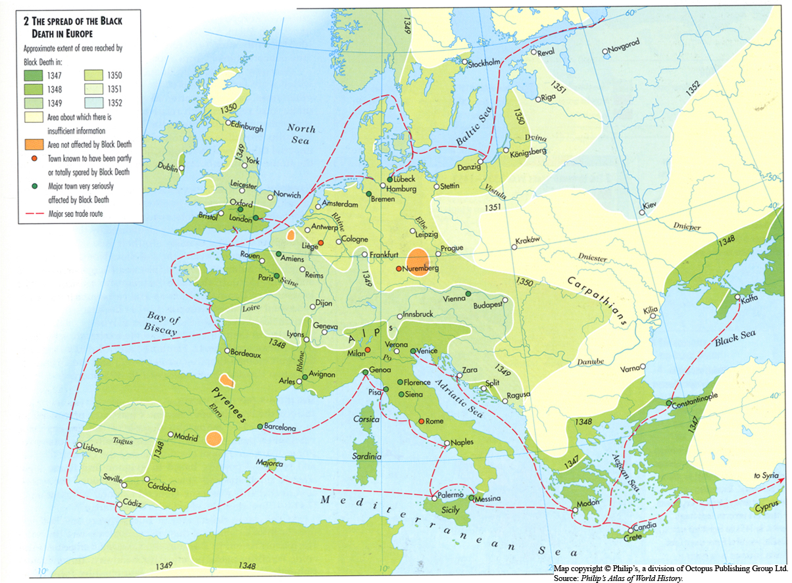

Slide 48
Symptoms and Remedies
Symptoms
Black/purple sores
Coughing, wheezing, sneezing
Death
Superstitious Causes
Witchery
Fumes released by earthquakes
“Remedies”
Aromatic amulets
Moderation and temperate
Give over to pleasures (“live for the day”)
Flight and seclusion
Flagellants

Slide 49
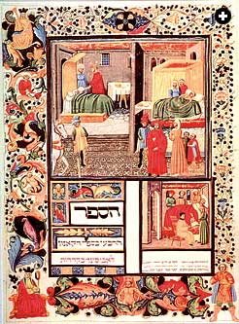

Slide 50
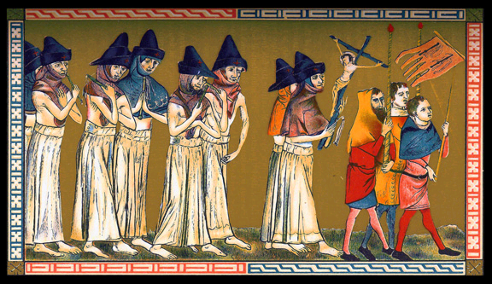

Slide 51
Effects of the Plague
Town populations fell
Trade declined, prices rose
Serfs leave work to find better wages
Nobles refuse to increase wages for peasants, causing peasant revolts
Jews, witches blamed
Church loses prestige because prayers “don’t work”

Slide 52
Decline of Noble Power
Use of professional armies and new weapons (cannons and gunpowder) calls usefulness of nobility into question
Fighting styles of nobility, castles useless
Instead, nobility focuses on ceremonial style of life
Tournaments
Chivalry
Maintaining honor

Slide 53
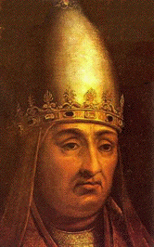
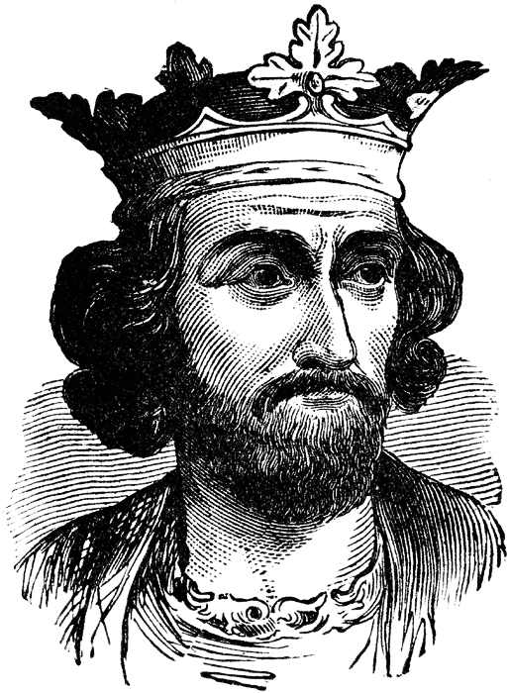
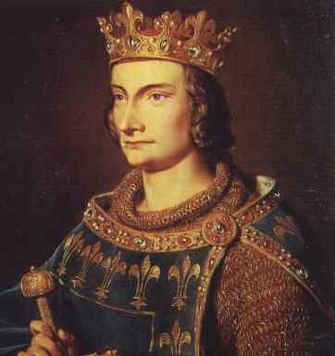
Church Politics
Plentitude of Power
Benefices
Political power of the church
Sequestering of bishops
Boniface vs. Phil and Ed
Clerical Laicos: no taxation of clergy
No court hearing or money exportation
Unam Sanctam: temporal authority
subject to power of church
Death of Boniface

Slide 54
Avignon
Clement V moves the papacy to Avignon (Fr.)
Annates (first year’s revenue) and indulgences (“pay your way out of purgatory”)
Opposition to Avignon

Slide 55
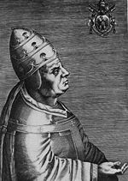
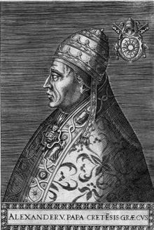
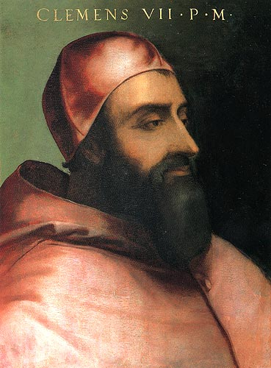
The Great Schism/Conciliar Movement
“Babylonian Captivity”
Urban VI (It.) and Clement VII (Fr.)
Solutions
Cession of both
Resignation of one
Conciliar Theory
Council of Pisa
Alex V
Council of Constance
Sacrosancta and Martin V

Slide 56
Reflection Questions
Which factor do you think was most important in leading to the end of the middle ages and the beginning of the modern era? Why?

