Slide 1
“Modernization” of Japan
Ch. 27.2

Slide 2
Before Reform
Shogun still in power
Bureaucratic government ruling through semi-feudal alliances with daimyo and samurai
Financial instability
Taxes by agriculture, not currency
Stipends paid to samurai for loyalty
Neo-Confucianism of the elite
Decline of Buddhism
Increasingly secular among upper classes
Expansion of education
Terakoya (common schools) teach reading, writing, and Confucianism
Literacy: 40% men, 15% women
Tension
Between traditionalists (conservatives) and reformists (liberals)
Ultranationalists
Shintoism and Buddhism
Goddess as originator of Japan, all other lands spring from Japan
Japanese studies vs. Dutch studies
Interest in western science, medicine, stray from Chinese science and medicine
Commerce
Manufacturing, consumer goods
Technological limitations due to isolation
Limited agricultural output
Rural riots
Protests against wealthy, merchants, landlords

Slide 3
The End of Isolation
1853: Commodore Matthew Perry from US arrives in Edo Bay
Threatens bombardment of Tokyo if ports not opened to America
Ultimatum of one year
Returns in 1854 with flotilla of ships
Establishment of American consul in Japan in 1856
Opening of two pots to America, more to Britain, Russia and Holland
Representatives of the west governed by own laws, not Japanese laws

Slide 4
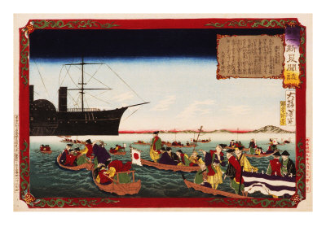

Slide 5
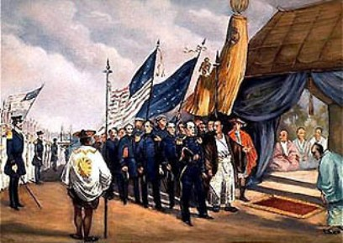

Slide 6
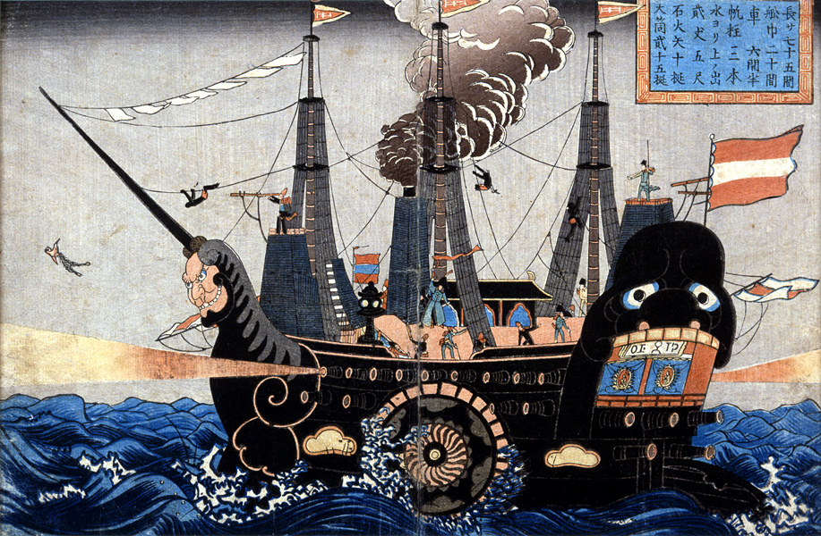

Slide 7
Reactions to Opening Borders
Bureaucrats insist on opening borders to protect Japan from destruction
Daimyos and samurai oppose concessions (conservative)
Some samurai support reform, giving them opportunity to overthrow shogunate
Civil war in 1866
Samurai armed with American weapons
Defeat shogunate military, reestablishing power of emperor

Slide 8
Meiji Restoration
New emperor seated in 1868
Mutsuhito (Meiji, “enlightened one”)
Samurai reformists put down shogunate troops
Abolition of feudalism in 1871
Replaced daimyos with prefects (regional administrators)
Centralized power in the emperor
Effect social and economic change
Samurai sent abroad to West to observe political, economic and technological institutions
Economic reforms
Abolition of samurai and stipends
Tax payable in money, not agricultural goods
Army developed based on national conscription
Samurai focus on political and business opportunities
Iwasaki Yataro (Mitsubishi) invests in railroad and steamship lines
Development of political parties
House of Peers (conservatives) held by nobles and Meiji leaders
Bureaucracy by civil service exams
Constitution creates new form of government
Diet passes laws agreed upon by both houses, budgetary issues, advise emperor (but not control it)
Emperor commands military
High property qualifications for voting rights

Slide 9
Japan’s Industrialization
Improvement of military technology, modern navy
Requirements for industrialization
Government banks
Trade
Movement of capital
State-sponsored steamships and railroads
Abolition of guilds and road tariffs to create national market for goods
Individual ownership of farms, new fertilizers and equipment
State operation of mines, shipyards, and metallurgical plants
Ministry of Industry
Technical training and education
Importation of western techniques and equipment, raw materials
Japan as a resource-poor nation (coal, etc)
Low paid workers, cheap labor
Labor organization met by repression

Slide 10
Effects of Industrialization
Massive population growth
Better nutrition
New medical technology and techniques
Strains Japanese resources
Constant supply of low-cost labor
Universal education
Stress science, technology, loyalty to nation and emperor
Moral education: loyalty, love, filial piety, respect, faith, charity, respect
Westernization
Haircuts
Hygiene
Calendar and metric system
Mixture of western and Japanese values and customs
Family life
Divorce rate increases
Inferiority of women
Fall of Buddhism, rise of Shintoism

Slide 11
Expansion and Foreign Policy
New foreign policy tied back to industrialization
Necessitated access to raw materials
Sino-Japanese War
Japan wins control in Korea
Demonstrates superiority over rest of Asia
Confidence leads to Russo-Japanese War
Strength leads to alliance with Britain, seen as equal nation in the world

Slide 12
Strain
Poor living standards
Crowded cities
Conservative tension
Clinging to traditional standards vs. new Western styles
Tension between liberals and emperor
Dissolution of the Diet
Political assassination
Japanese scholars
Western literature/science/philosophy or Japanese?
Confusion and pessimism over identity loss
Renewed nationalism

