Slide 1
Representations of the Buddha
Strayer, pp. 225-235

Slide 2
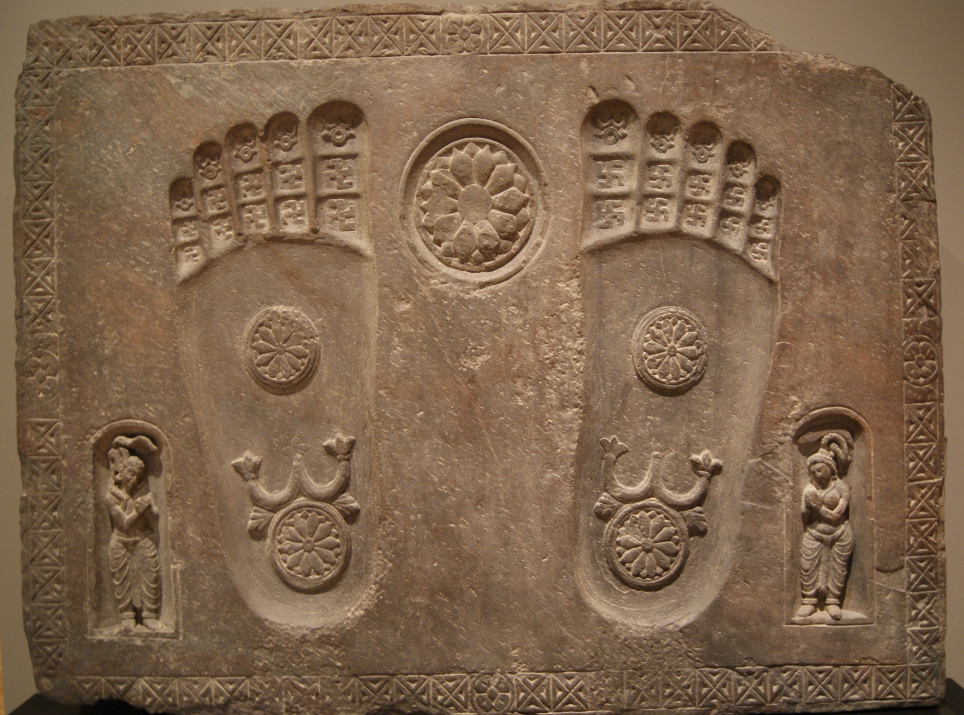

Slide 3
Why might the wheel serve as an effective symbol of the Buddha’s message?
What does the inclusion of the yukshis add to the message of this image?
What overall religious message might this footprint convey to those who gazed upon it?

Slide 4
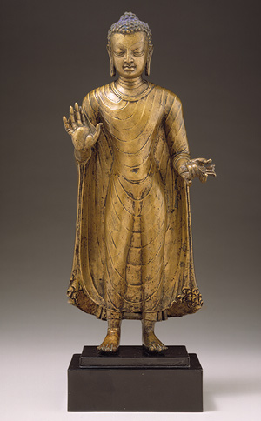

Slide 5
What might account for the emergence of human images of the Buddha?
What overall impression or religious meaning is this statue intended to convey?
The elongated earlobes remind the viewer that, earlier in his life, they prince Siddhartha had worn heavy and luxurious earrings. What does their absence suggest about his transformation as the Buddha?
Notice the partially closed and downcast eyes of the Buddha as well as his bare feet. What might these features suggest?

Slide 6
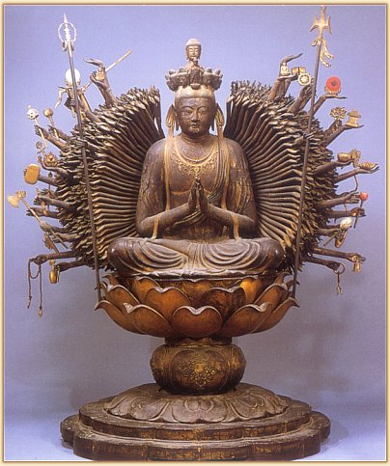

Slide 7
What elements of Buddhist imagery can you identify in this statue?
To whom might such an image appeal? Why?
Notice the lotus flower, for centuries a rich Buddhist symbol, on which the bodhisattva is resting. With its roots in the mud, the lotus emerges on the surface of the water as a pure, beautiful, and fragrant flower. Why would the artist choose to place the bodhisattva atop such a flower?
Some scholars have identified similarities between the Bodhisattva of Compassion and the Virgin Mary in the Christian tradition. What common elements and what differences can you identify?

Slide 8
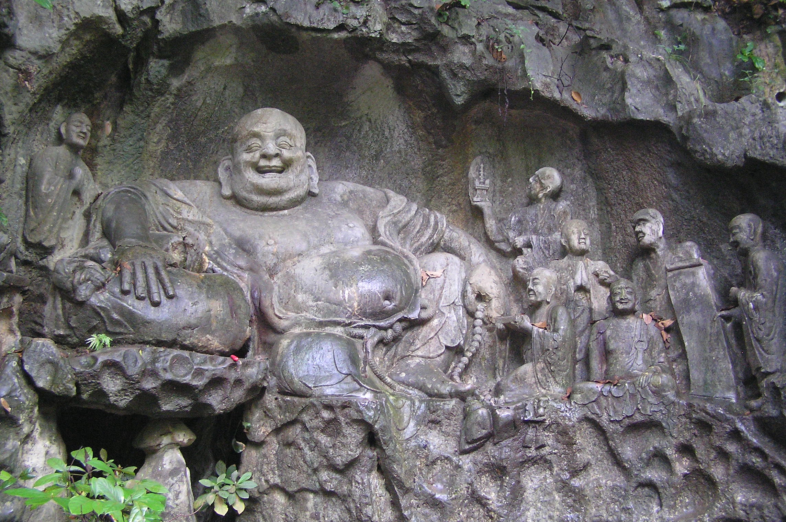

Slide 9
How does this Buddha image differ, both physically and in its religious implications, from the Buddhas in the previous images?
Why might this image be appealing to some Buddhists, and why might others take exception to it?
In what ways does this figure represent an adaptation of Buddhist imagery to Chinese culture? Consider what you know about Confucian and Daoist postures to the world.

Slide 10
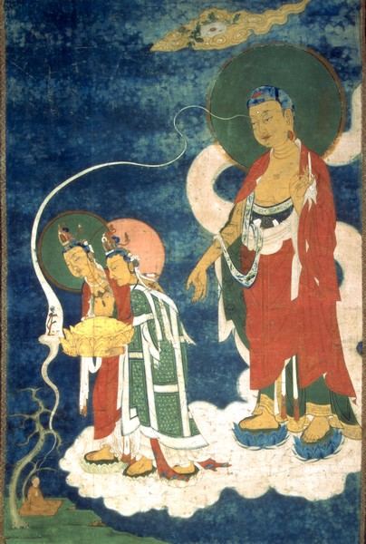

Slide 11
Why do you think the practice of Pure Land Buddhism became so widely popular in China by the mid-seventh century? What features of this image might help to explain its appeal?
What details from this painting support the sacred character of the Buddha and bodhisattva figures?
What is the significance of the small figure sitting in meditation under a tree at the bottom left of this painting?

Slide 12
What transformations in Buddhist belief and practice are disclosed in these images?
What evidence do these images provide about the blending of Buddhism into a variety of cultural settings?
What do these images suggest about the appeal of Buddhism to growing numbers of people across Asia?
To what extent are these images meaningful to people outside of the Buddhist tradition? In what ways do they speak to universal human needs or desires? What is specifically Buddhist or Asian about them?

