Slide 1
Post-Classical China
220-1279 CE

Slide 2
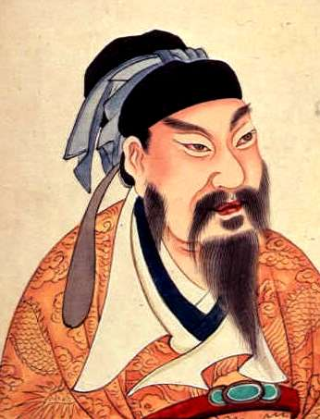
Module 1: The Sui Dynasty

Slide 3
The Rise of the Sui Dynasty
Fall of Han (220)
Era of Division (220-589)
Sui Dynasty (589-618)
Nobleman, Wendi, creates marriage alliance between his daughter and ruler of N. Zhou
Wendi seizes throne from son-in-law, proclaimed emperor
Wins support of nomadic militaries, strengthens power by limiting power of scholar-gentry
Expands and reunites empire by conquering rival kingdoms
Gains support by lowering taxes and establishing granaries

Slide 4
The Fall of the Sui Dynasty
Son of Wendi, Yangdi (through assassination)
Expands empire, drives back nomads
Establishes milder legal code
Devoted resources to upgrading Confucian education
Restores civil service exams
Factors leading to fall of Sui
Yangdi’s love of luxury on behalf of peasants
Attempts to expand through unsuccessful wars
Provincial governors declare independence
Bandit gangs
Nomads seize parts of northern China plain
Yangdi assassinated in 618

Slide 5
Reflection Questions
What strategies did Wendi use to establish his rule?
Do you think it was possible for Wendi to be successful or was his reign doomed from the start? Why?
How did Yangdi rule differently from his father?
Were the factors that led to the fall of the Sui similar or different to the factors that led to the fall of other societies? Explain.

Slide 6
Module 2: The Tang Dynasty

Slide 7
Rise of the Tang
Noble of Yangdi, Li Yuan (Duke of Tang)
Fights civil war during power vacuum, wins
Tang armies conquer central Asia
Force nomads to submit to Tang rule
Sons of nomadic chiefs sent to capital as hostages to ensure good behavior of tribes
Educated in Chinese culture
Conquer Manchuria, Vietnam, Korea, Tibet
Establish vassal kingdom (Silla)

Slide 8
Rebuilding the Bureaucratic System
Reasons for the bureaucracy
Emperors needed loyal provincial governors
Scholar-gentry offset power of aristocracy
Staffed most parts of secretariats and executive department
Three levels of bureaucracy: imperial, provincial, local
Six ministries to run imperial bureaucracy
War, justice, public works, Censors, rites

Slide 9
Civil Service Exams
Emperors patronize academies to train officials and educate in Confucianism
Exam system expanded
Different types of exams based on job desired
Highest offices given to those who pass exams on philosophical, legal classics, Chinese literature (“jinshi”)
When one passed an exam, families positions secured by high office of student
Wins better social status
Right to wear certain types of clothing
Exempt from corporal punishment
Higher level of material comfort
Birth and family connections still important for exams
Even allows for failed candidates to get jobs
Some positions reserved for old aristocracy and children of imperial concubines

Slide 10
Religion and Government
Increasing state patronage of Confucian learning
Threatens Buddhism
Pre-Tang rulers patronize Buddhism
Mahayana Buddhism (Pure Land)
Zen Buddhism
Taizong builds monasteries
Empress Wu tries to make Buddhism state religion
Builds paintings and sculptures in caves and cliffs

Slide 11
Anti-Buddhist Backlash
Success of Buddhism angers Confucians and Daoists
Daoist monks stress own magical and protective power
Confucians convince rulers that Buddhist monasteries are economic drain on empire
Monasteries not taxed or used for labor
Wuzong (r. 841-847) limits flow of land and resources to monasteries
Becomes open persecution
Shrines and monasteries destroyed
Monks and nuns forced to return to civilian lives, subject to taxes
Monastery lands given to landlords
Confucianism becomes main philosophy of China from 800s-1940s

Slide 12
Fall of the Tang
Empress Wu tries to establish new dynasty
Son is poisoned by wife, Empress Wei
Revolt forces Wei and her son from power
Xuanzong (r. 713-756) establishes reign
Devoted to patronizing arts and pleasures
Concubine Yang Guifei
Packs government with relatives, enjoys luxuries
Xuanzong focuses on Yang Guifei, neglecting state and economy
Fuels discontent, military weakness
Revolt in 755 to establish new dynasty, put down but hurts empire
Troops revolt, assassinate Yang Guifei
To defeat rebels, Tang allied with nomads
Use political division to gain control over north
Allows provincial governors to become independent
Collect own taxes, raise own armies, etc
Last Tang emperor forced to resign in 907

Slide 13
Reflection Questions
How does the rise of the Tang differ from the rise of the Sui?
Why did the new Tang dynastic empire need a bureaucracy? How did the government establish the bureaucracy?
Do civil service exams allow for a more egalitarian bureaucracy? Why or why not?
Why do you think Buddhists were attacked so severely by Daoists and Confucianists? What was the result?

Slide 14
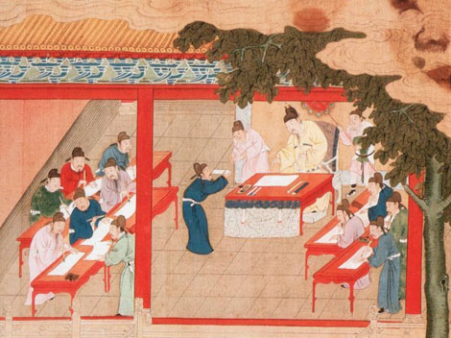
Module 3: The Song Dynasty

Slide 15
Rise of the Song
Zhao Kuangyin reunites China (military commander) in 960
Renamed Emperor Taizu
Defeats all rivals except northern Liao dynasty
Founded by northern Khitan nomads
After being defeated, Taizu forced to sign treaties with Khitan, forcing Song to pay tribute to Khitan to keep them from raiding
Sets precedent for other Song rulers’ appeasement of nomads

Slide 16
Song Politics
Taizu establishes political reforms to prevent the factors that led to the downfall of the Tang
Military subordinate to scholar-gentry
Commanders rotated to prevent establishment of power base
Song promoted Confucian scholar-gentry
Salaries of officials increased, provided with servants and luxury goods
Reforms of civil service exams
Three tested levels: imperial, provincial, district (county)
Higher percentage pass rate
Bureaucracy becomes bloated

Slide 17
Neo-Confucianism
Scholars try to recover Confucian texts and decipher ancient texts
Establishment of academies to study classical texts
Sought to prove superiority of indigenous philosophies (Confucianism/Daoism) against imported (Buddhism)
Neo-Confucianism: revival of ancient Confucian teachings
Cultivating personal morality was highest goal
Virtue attained through knowledge by book learning and personal observation
Emphasis on rank, obligation, deference, rituals reinforcing class, age, gender
Authority of the patriarch

Slide 18
Fall of the Song
Weakness of Song handling of Khitans encourages other nomads to carve out land
Tangut tribes establish Xi Xia kingdom
Song also pay tribute, causing large drain on resources
Cost of army to hold back nomads enormous
Disdain for military by scholar-gentry
Funds needed to upgrade weapons diverted to scholasticism of gentry
Wang Anshi (chief minister, 1070-80) introduces reforms
Legalistic rule
Cheap loans
Government-assisted irrigation projects to encourage agriculture
Taxed landlords and scholars (previously exempted)
Use of taxes to pay mercenaries
Reorganizes civil service exams to analytical thinking rather than rote memorization
Less scholar-gentry passage
New emperor established (1085) favoring neo-Confucians
Eliminate Wang’s reforms, causing economics to deteriorate
Leads to peasant revolts
Jurchen nomadic tribe overthrows Lio dynasty, establishes Jin kingdom
Annexes most of Yellow River basin, forcing Song to flee south
Establishment of Southern Song dynasty (1167-1279)

Slide 19
Reflection Questions
Compare and contrast the Tang and Song.
Why are they similar or different?
Why was Neo-Confucianism so against Buddhism and foreign ideas?
How was Neo-Confucianism alike and different from the initial ideas of Confucius?
Compare and contrast the fall of the Sui, Tang, and Song.
Are they more alike or different? Give evidence to back your claim.

Slide 20
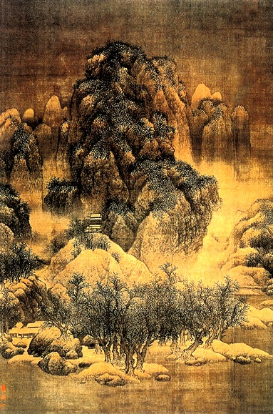
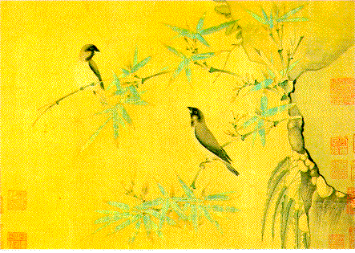
Module 4: The Golden Age of Chinese Economics and Culture

Slide 21
The Grand Canal
Built by Yangdi (589-618)
Linked Chinese civilization in north China plain with Yangtze 500 miles south
Built to accommodate cheaper, quicker trade north-south as opposed to predominant east-west
Makes it easier to facilitate control over southern regions by courts, bureaucracy, and armies
Transportation of grain south during times of drought or famine
More than one million forced laborers

Slide 22
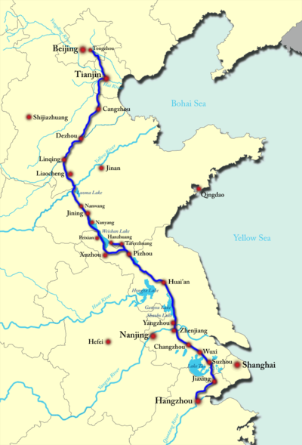
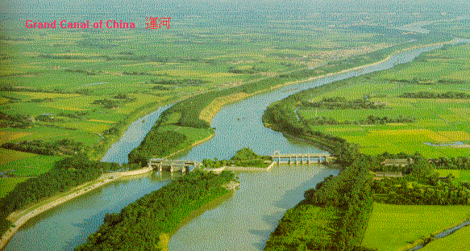

Slide 23
Commercialism
Reopening of old Silk Road routes to trade with Persia and Arabs
Horses, Persian rigs, tapestries to China, silk, porcelain, paper from China
Transport of goods overseas rather than foreign merchants to China
Use of Chinese junks
Watertight bulkheads, sternpost rudders, oars, sails, compasses, fenders, rockets for self-defense
Allows China to become formidable force in Asian seas

Slide 24
Urban Growth
Import trade allows for growth of cities and towns
Shops, farmers markets, artisanship, guilds
Beginning of credit and paper money
Credit vouchers, aka “flying money” reduced robbery
With more people moving to towns for trade and artisanship, cities grow exponentially
City luxuries for aristocrats and emperor
Gardens, hunting parks

Slide 25
Rural Life
Encouragement of peasants to migrate to uncultivated areas
Send military garrisons to protect new settlements
Agricultural improvements
State-regulated irrigation and embankments
Introduction of new seeds
Better use of manures
Soil preparation and weeding
Multiple cropping
Improved water control
Wheelbarrow
Rulers of Sui and Tang aim to break up estates of aristocracy and redistribute to free peasants
Reduce power of aristocracy, give more power to peasants
Extended family households increase in number and size
Curved roofs with upturned corners, painted roof tiles
Reserved for people of high rank
Still use natural elements to tie back to nature

Slide 26
Family and Society
Women
Improve in status during Tang and early Song
Decrease in status during late Song
Male-dominated hierarchy
Upper-class women practicing personal expression
Divorce by mutual consent, protection of wife
Authority of elders improved by laws allowing for beheading
Marriage as alliance
Use of matchmakers
Use of dowries
Similar age range marriages

Slide 27
Neo-Confucianism and Men
During late Song
Stress women’s role as homemaker and mother, bearer of sons
Confinement of women
Stress virginity for brides, fidelity for wives, chastity for widows (discouraged from remarrying)
Double standards for men
Permitted to have premarital sex, concubinage, remarry, polygamy
Laws favoring men in inheritance, divorce, education
Footbinding
As early as ages 5-6
Foot shaped as “lotus petal” or “golden lily” that was “preferred” by upper-class husbands
Limited mobility, making women “trophy wives”
Slow to adopt by lower classes (women needed for family economy)

Slide 28
Innovation
Tang poetry, Song painting
Banks and paper money
Engineering (Grand Canal, irrigation, embankments, dikes, dams)
Bridge building
Explosive powder
Grenades, bombs, flamethrowers, poison gas, rocket launchers
Chairs
Tea
Coal
Kites
Compasses
Abacus
Movable type
Paper

Slide 29
Scholarly Refinement
Scholar-administrators and Confucian teachers write literature of Tang and painted landscapes of Song
Educated people expected to practice arts
Well-educated man expected to be versed in many fields
Tang literature
Devotional objects and religious homilies
Lives of common people, witchcraft, romance, detective stories
Song paintings
Focus on nature and landscapes
Symbolism intended to teach moral lessons or explore philosophical ideas
Crane or pine: longevity
Abstract
Personal vision of natural beauty
Sometimes accompanied by poem
Painted on a scroll that is unrolled bit-by-bit to tell story

Slide 30
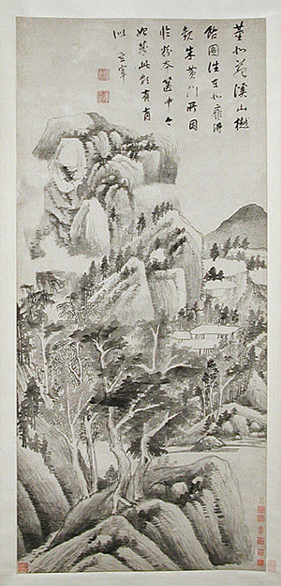
Dong Qichang, the foremost landscape painter and theorist of the early seventeenth century, pursued artistic reform. Reacting against what he perceived as the decadent, perverse trends of contemporary landscape painting, Dong, following in the literati tradition, sought a creative reconstruction of the past through the critical study of ancient styles. In an attempt to restore simplicity and vitality to painting, Dong advocated a spiritual correspondence with the art of the old masters rather than a literal imitation of them and underscored the importance of self-expression. Approaching painting as though it were calligraphy, Dong alternated positive and negative patterns in his landscapes, which resulted in a radical new kinesthetic style.
Shaded Dwellings among Streams and Mountains, based on a work by the early master Dong Yuan (active 930s–60s), is a complex calligraphic study of rock and tree forms conceived as an integration of abstract, cubic, and dynamically expressive masses that embody and are unified by the kinetic energy of the artist's physical movements.

Slide 31
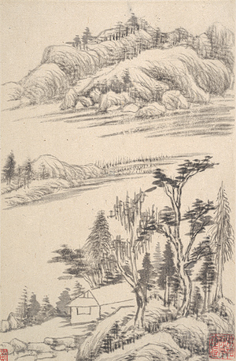
This album demonstrates Dong Qichang's interpretation of the entire spectrum of Song and Yuan styles using a set of contrasting brushstroke methods, which could also be used for depicting actual landscapes. The great theorist and painter took as his point of departure the works of the Yuan master Ni Zan (1306–1374), whose paintings were regarded as calligraphic abstractions of earlier Song styles. In the first two leaves, Dong contrasts—in what he regards as the early and late styles of Ni Zan's art—an "earthen" landscape (round, parallel, "hemp-fiber" brushstrokes) with a "rocky" one (angular, oblique, "folded-ribbon" brushstrokes). In successive leaves, Dong juxtaposes various "earthen" and "rocky" themes in order to evoke different paradigmatic styles of the Northern Song period.

Slide 32
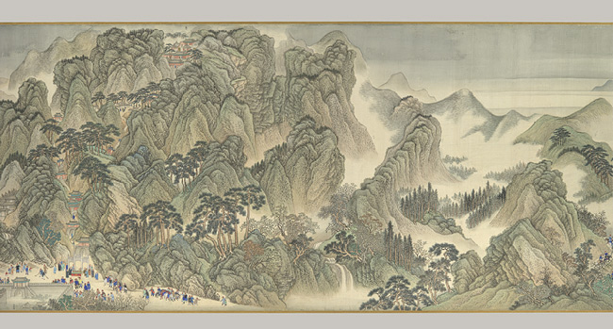
To consolidate Manchu authority over China, the Kangxi emperor (r. 1662–1722) made a second tour of inspection in 1689, traveling from Beijing to the commercial and cultural centers of the Yangzi delta region. In 1692, Wang Hui was commissioned to commemorate this epic journey. Breaking down the tour into episodes, the artist designed a series of twelve massive handscrolls, each one measuring from forty to eighty feet in length and focusing on one important event. It took a team of assistants six years to complete the project.
This scroll highlights the route of the emperor and his entourage from the city of Ji'nan to Mount Tai, in Shandong Province, a distance of about thirty miles that the party covered between February 5 and 6 in 1689. Throughout the scroll, which is more than forty-five feet long, soldiers, porters, and officials in the advance party wend their way through the countryside on their way to Mount Tai, the "cosmic peak of the East." A sacred site where Chinese rulers worshipped heaven and reported on the state of the empire below, Kangxi's visit here held tremendous symbolic importance, identifying him as a traditional Confucian monarch.
Wang Hui did not accompany the emperor on his tour and had not seen this portion of the route. Instead, he relied on maps and the imperial diary to label key sites and lay out rivers and towns. Cities are indicated by walled compounds and Mount Tai is schematically presented with its fabled path to the summit—not visible in reality—clearly depicted. Scale is fluid, distances are not measurable—the route frequently disappears behind a mountain or below the scroll's lower margin—and the stylized "blue-green" color scheme imitates a classical landscape style to suggest that Kangxi's reign would revive a golden age of rulership.

Slide 33
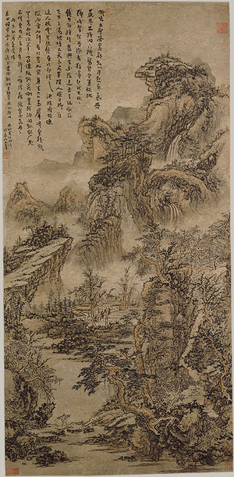
Born on the Buddha's birthday, Kuncan took Buddhist monastic vows at the age of twenty-six and became an ardent follower of Chan (Zen) Buddhism. After the establishment of the Qing dynasty, he lived in Nanjing, where his circle of friends included a number of poet-painters who considered themselves loyal yimin ("leftover subjects") of the vanquished Ming dynasty. In 1659, he visited Mount Huang, the scenic "Yellow Mountain" in southern Anhui Province, and, inspired by the beauty of the site, decided to devote himself entirely to painting. For Kuncan, painting was a path to the self, and he brought to his art the importance of selfhood espoused by later Chan practitioners.
Kuncan's landscapes, painted in the densely textured style of the Yuan master Wang Meng (ca. 1308–1385), are often accompanied by inscriptions that describe a physical, as well as spiritual, journey through mountains and over waters. In Wooded Mountains at Dusk, the artist depicted himself as a wandering pilgrim seated beneath a natural rock bridge:
I want to go further, But my legs are bruised and scratched. The bony rocks appear chiseled, The pines look as if they had been dyed. Sitting down, I feel like a small bird, As I look out at the crowd of peaks gathered before me. Having ascended the heights to the brink of the abyss, I hold fast and ponder the need to sincerely face criticism. Wherever a road ends, I will set myself down, Wherever a source opens, I will build a temple. All this suffices to nourish my eyes, And rest my feet.

Slide 34
Reflection Questions
Why do emperors try to weaken the power of the aristocracy?
How do they attempt this?
Are they successful? Why or why not?
Compare footbinding to subjugating practices toward women in other societies.
How does neo-Confucianism reinforce traditional expectations for age and gender in Chinese society?
Why is it significant that the Chinese state poured so much capital into the lives of rural peasants?
Who is creating art? Why?
What do the types and themes of Tang/Song art tell us about society? Give examples.

