Slide 1
The Causes of WWII

Slide 2
Fascism
Def.: A new political movement that emphasized loyalty to the state and obedience to its leader.

Slide 3
What is fascism?
No clearly defined theory or program
Extreme form of nationalism
Nations must struggle
Loyalty to an authoritarian leader who guided and brought order to the state
Uniforms, special salutes, mass rallies
Believes each class has its own place and function
Made up of aristocrats and industrialists, war vets, and lower middle class

Slide 4
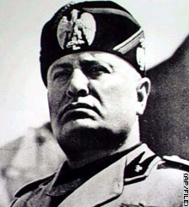
Fascism in Italy
Social unrest
Anger over failure to win territorial gains post-WWI
Rising inflation and unemployment
Newspaper editor/politician named Benito Mussolini
Promises to rescue Italy by:
Reviving economy
Rebuild Armed forces
Give Italy strong leadership
Mussolini gains support of middle classes, aristocracy, industrial leaders
Attacks socialists and communists
Coup d'état gives Mussolini (Il Duce) power, dethrones king
Abolishes democracy, outlaws all political parties except Fascists
Jailed opponents
Forces radio, publications to censor, publish Fascist doctrine
Outlaws strikes

Slide 5
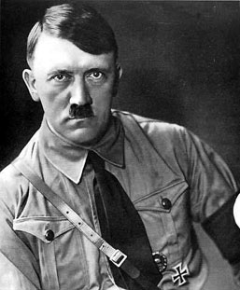
Fascism in Germany
Ex-artist, political leader Adolf Hitler
Joins National Socialist German Workers Party (Nazi)
Overturn Treaty of Versailles, battle communism
Adopts hooked cross (swastika) as symbol
Private militia (Storm Troopers)
Becomes “der Fuhrer” (leader) of Nazi party
Writes Mein Kampf (“My Struggle”) while in jail
Aryans as master race
Other races (Jews, Slavs, Gypsies) inferior
Calls for lebensraum (living space) to reduce crowding
Wants to conquer E. Europe and Russia
Germany looks to Hitler to restore economy during Depression

Slide 6
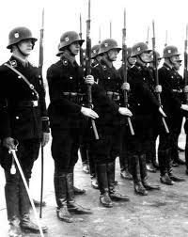
Hitler Takes Over Germany
Hitler is named Chancellor of Germany
Calls for elections but Parliament building burnt down
Communists blamed, letting Nazis take over
Becomes totalitarian ruler
Outlaws parties other than Nazism
Arrests opponents
Creates the SS (Schutzstaffel “protection squad”), loyal to Hitler
Arrests and murders Hitler’s opponents
Creates the Gestapo (secret police), ruling through terror
Bans strikes, dissolves labor unions, gov’t has total power over business
Puts Germans to work, creating highways, weapons, military
From 6 million unemployed to 1.5 million unemployed

Slide 7
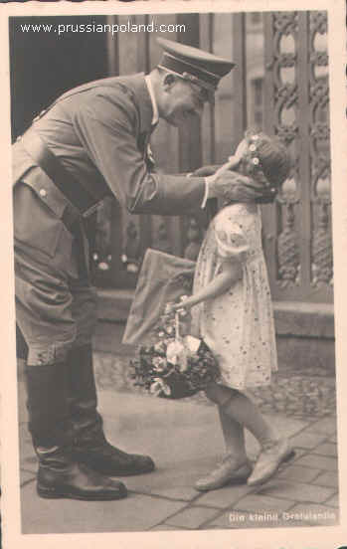
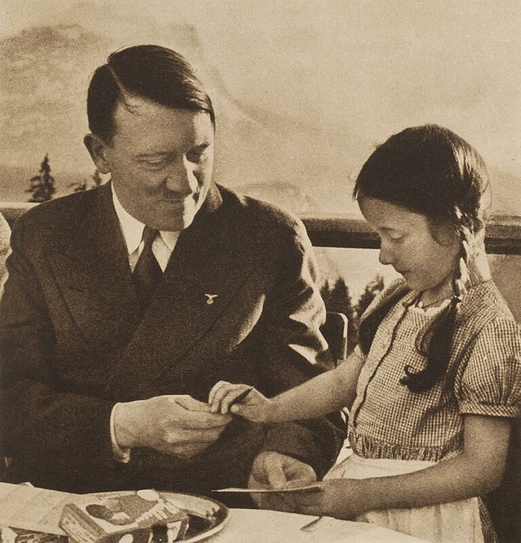
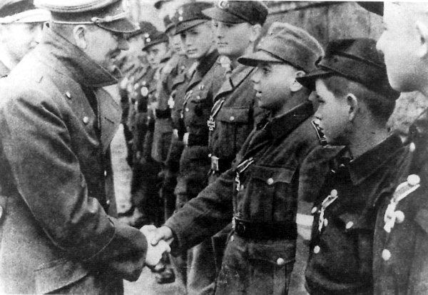
Hitler as Fuhrer
Absolute ruler
Propaganda
Burning of books
Hitler Youth and League of German Girls

Slide 8
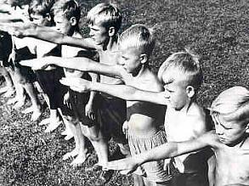
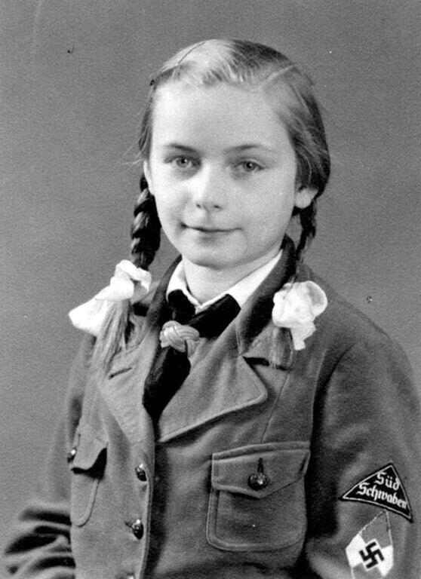
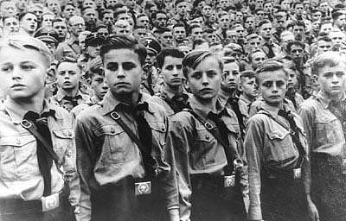

Slide 9
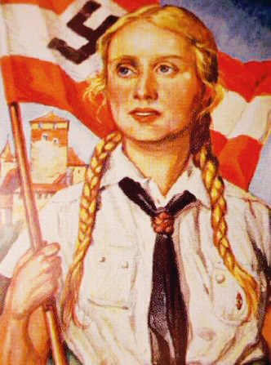
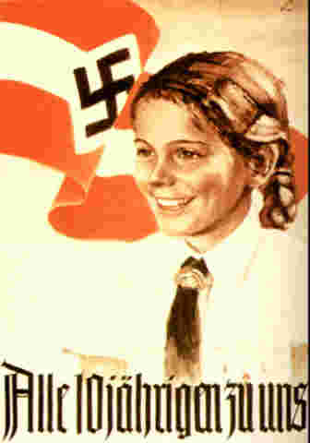
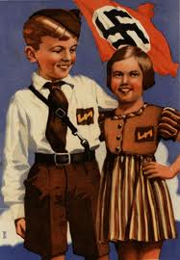

Slide 10
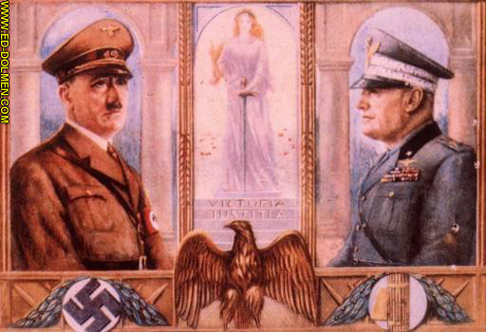

Slide 11
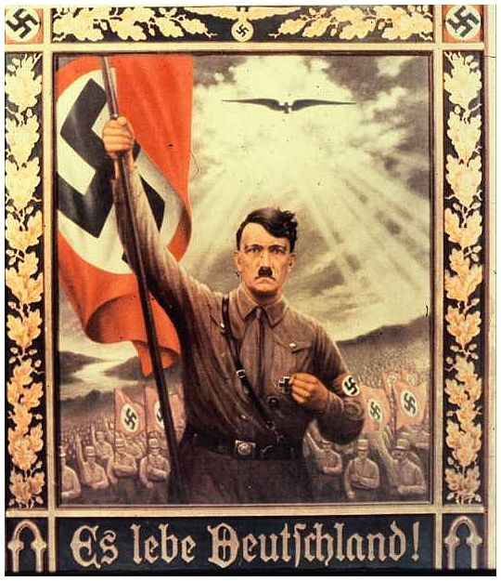

Slide 12
The Beginnings of WWII

Slide 13
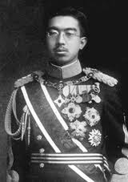
Japan
When Depression begins, civilians blame the government
Military leaders dispose of government, take over
Keep Emperor Hirohito as the head of government
Wins popular support to allow military ruling
Military want to improve economy by expanding, get raw materials, and sell manufactured goods
Japan invades Manchuria (1931)
Establishes factories and mines
Protested by League of Nations, Japan withdraws in 1933
Japan invades China, takes over
China defended by Mao and Chiang Kai-Shek

Slide 14
Mussolini Attacks Ethiopia
Ethiopia is one of three independent nations in Africa
Italy invades in 1935, defeats Ethiopians
Italy: airplanes, tanks, guns, poison gas
Ethiopians: spears and swords
Ethiopian emperor asks League of Nations for help
League does not respond
By allowing Mussolini to attack Ethiopia, keep peace in Europe

Slide 15
Hitler Defies the Versailles Treaty
Hitler vows to expand military, limited by treaty (1935)
League does nothing
German invasion of land surrounding Rhine River (Rhineland) in 1936
Britain urges appeasement (giving in to aggressor to keep peace)
Invasion of Rhineland strengthens Hitler’s power and prestige within Germany
France and Belgium open to attack by German troops
Weak response from France and Britain encourages Hitler to continue expanding
Hitler convinces Mussolini to create alliance (10/1936)
Known as Rome-Berlin Axis
Japan joins in November, becomes Axis Powers

Slide 16
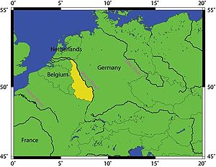

Slide 17
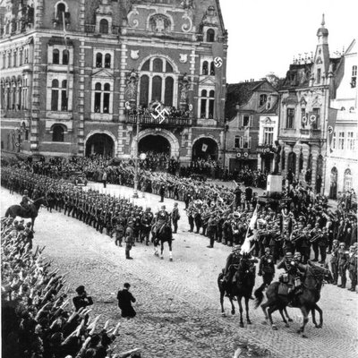

Slide 18
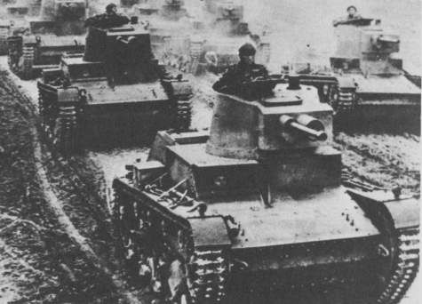
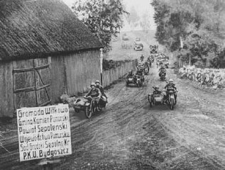

Slide 19
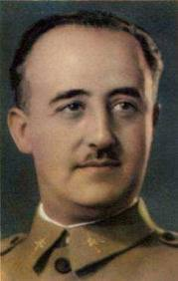
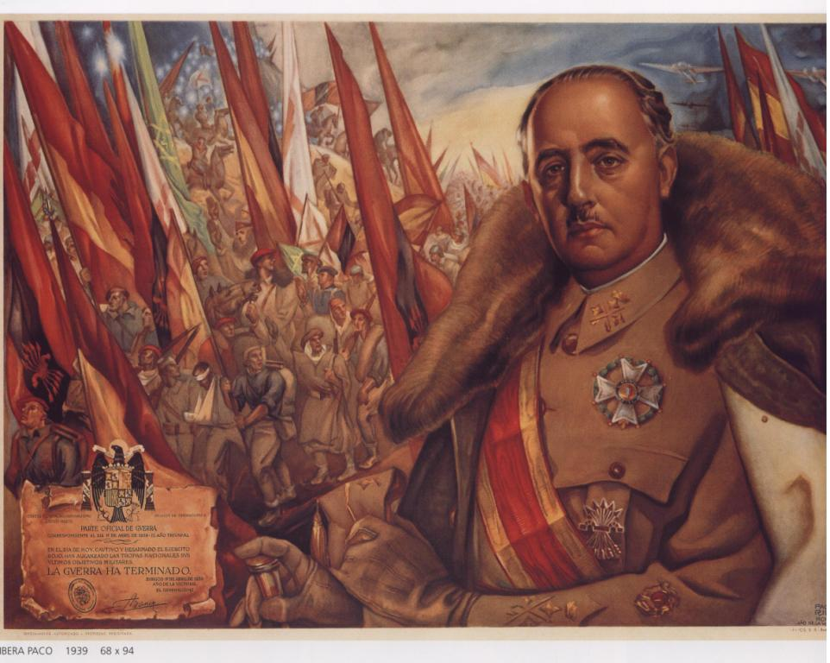
Spanish Civil War
Rebels declare Spain republic against Spanish monarch
Led by Francisco Franco
Hitler and Mussolini send troops and supplies to aid Franco
Franco becomes a Fascist dictator in 1939

Slide 20
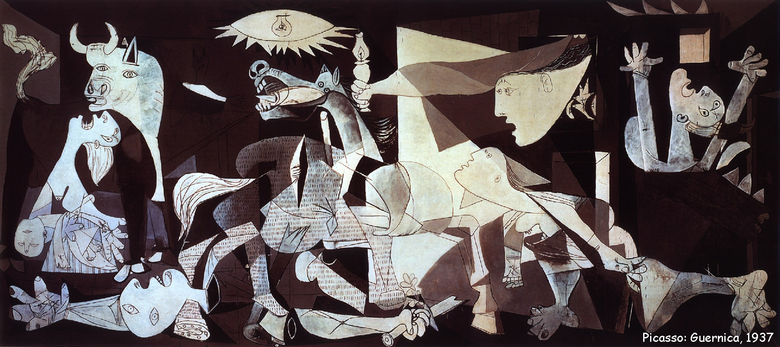

Slide 21
The Preservation of Peace
Europe fears another war, too poor from Depression
United States
Joining WWI was a bad move, call for isolationism
Neutrality Acts passed in 1935
Banned loans and sale of arms to nations at war

Slide 22
Germany Gains Power
Hitler wants to absorb Austria and Czechoslovakia into Third Reich (German Empire)
Versailles prevented Anschluss (union between Austria & Germany)
Hitler annexes Germany in 1938, Britain and France ignore
Region of Czechoslovakia called Sudetenland
Hitler demands to annex Sudetenland, Czechoslovakia refuses
Munich Conference
Meeting of Germany, France, Britain, Italy
To preserve peace, Britain and France give in to Hitler’s demands
Give Germany control of the Sudetenland, Hitler respects Czechoslovakia
Hitler takes over Czechoslovakia, Mussolini takes Albania
Britain and France ask Soviet Union for help
Stalin makes pact with Hitler, create non-aggression pact

Slide 23
