Slide 1
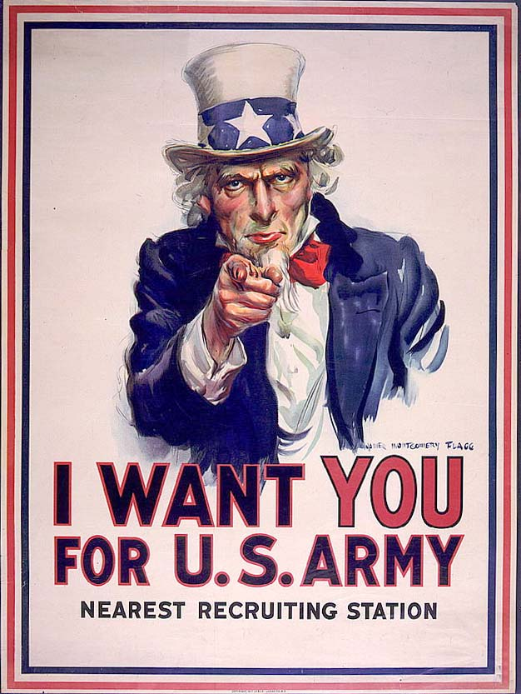
World War One Propaganda

Slide 3
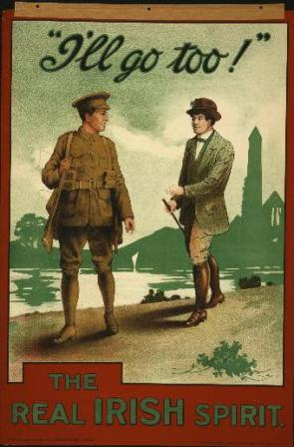

Slide 4
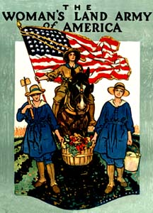

Slide 6
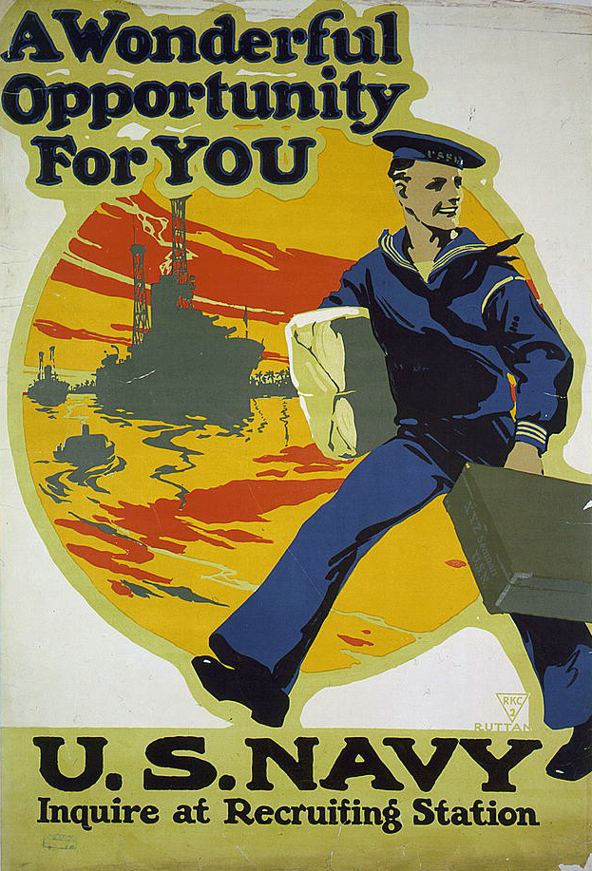

Slide 7
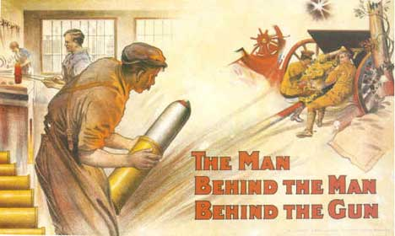

Slide 8
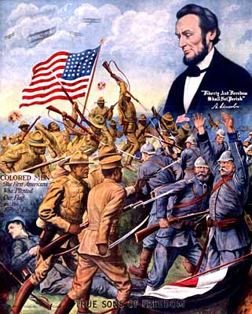

Slide 10
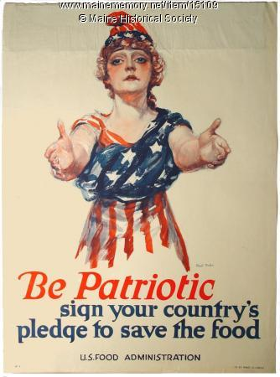

Slide 11
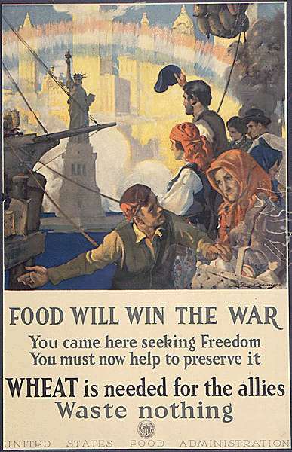

Slide 13
WWI Propaganda Posters
Partner Work
Posters must be creative, colorful and genuine (don’t copy ideas)
War posters must promote patriotism or instill fear
Topics include:
Food Conservation
Working in war industries
Recruitment
Demonizing the enemy
Poking fun at the enemy
Women/African Americans
Staying Neutral
Etc. (clear with me first)
War Posters are…
Not wordy
Use symbolism
Have a clear message (do this or don’t do this)
Promoting the war effort
Uniting Americans

