Slide 1
After WWII: Immediate Effects

Slide 2
Devastation of Europe
Casualties:
Europe: 40 million (2/3 civilians)
American: 310,000
USSR: 14 million
Japan: 1.14 million
Destroyed towns and landscape
Warsaw, Berlin
Destroyed agricultural land
Leads to famine and disease
Displaced peoples
Jews, survivors, refugees, POWs

Slide 3
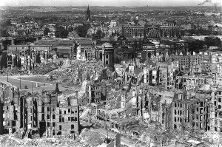

Slide 4
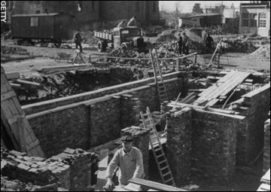

Slide 5
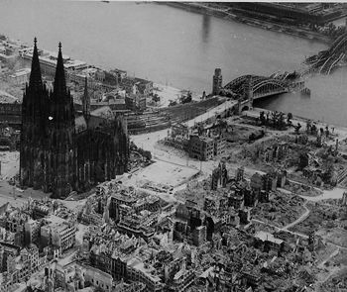

Slide 6
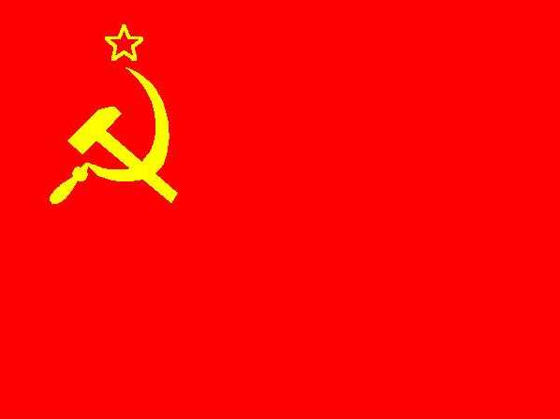
Postwar Government and Politics
Communist Party
Promises change in nations with fractured governments
France, Italy
Leads to violent protests
People begin to vote against communists

Slide 7
Nuremberg Trials
1945-46: 23 nations (International Military Tribunal) put war criminals on trial
22 Nazi leaders charged with waging war of aggression and committing crimes against humanity
Murder of 11 million people (Holocaust)
Hitler, Himmler (SS Chief), Goebbels (Propaganda) had committed suicide prior to trials
Goring (Luftwaffe), Hess, etc still alive for trials
Hess sentenced to life in prison, Goring gets death sentence but commits suicide
Executed bodies burned at Dachau

Slide 8
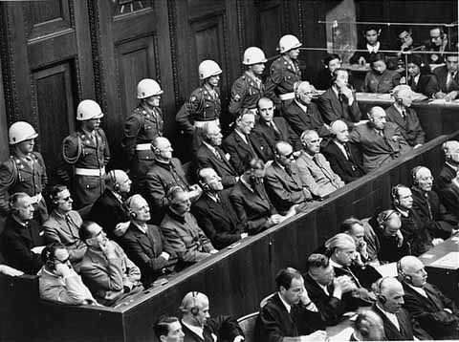

Slide 9
Postwar Japan
Tokyo, Nagasaki, Hiroshima are wastelands
General Douglas MacArthur
Demilitarization (disband Japanese military)
War trials
Democratization (create government elected by people)
Accepted by Japanese on 5/3/47
Emperor no longer divine, now a figurehead
2 house parliament (Diet), led by prime minister
All people over 20 have right to vote
Redistributes land to poor peasants from large landowners
Peace Treaty between Japan, US, and 47 nations (9/51)
Because Japan cannot have army, the US stays to protect
Creates alliance between US and Japan

