Slide 1
Religious Wars

Slide 2
Religious Struggle
1500-1550s, struggle between Lutherans and Zwinglians (c. Europe)
1550s-1600s, struggle by Calvinists for recognition
Peace of Augsburg
Cuius regio, eius religio
Does not apply to non-Lutheran protestants
Anabaptists, Calvinists as heretics
Religious struggle of Jesuits against Protestants
Protestants have presbyters (boards of elders) in charge of church
Catholics have distinct hierarchy (pope>bishops>priests)

Slide 3
Religious Art
Baroque
Grandiose
3D
Raw energy
Ornamental
Typically Catholic
“Plain Church”
Restrained
Gentle
Typically protestant
Why??

Slide 4
Baroque
Marries advanced techniques and grand scale of Renaissance to emotion and drama of mannerism
Evokes classical antiquity
Mastery of light to achieve maximum emotional impact
Elaborate furnishings, gardens, art
Sometimes religious

Slide 5
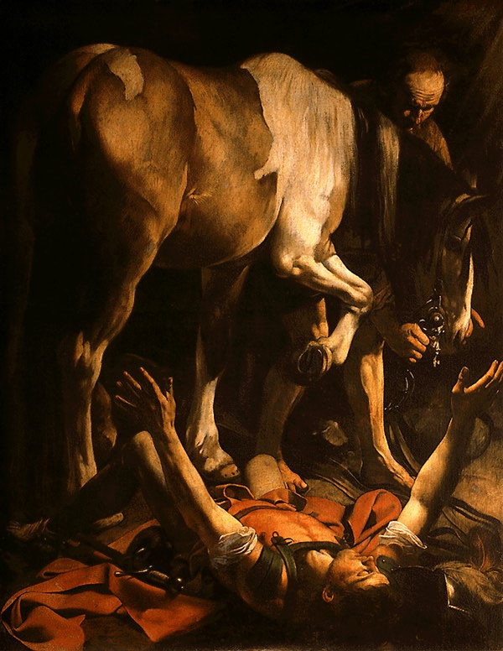

Slide 6
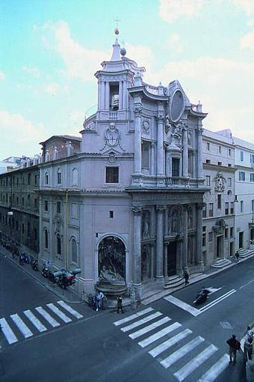

Slide 7
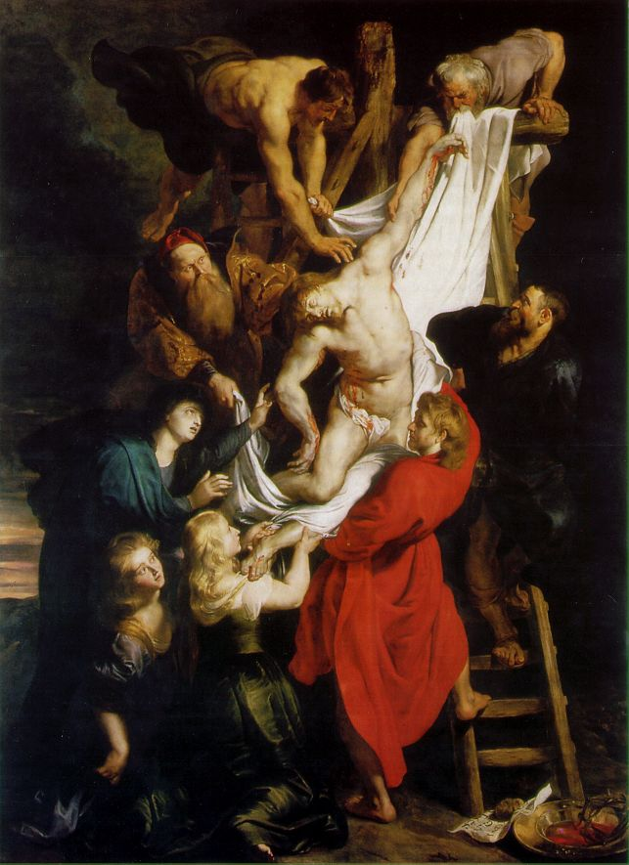

Slide 8
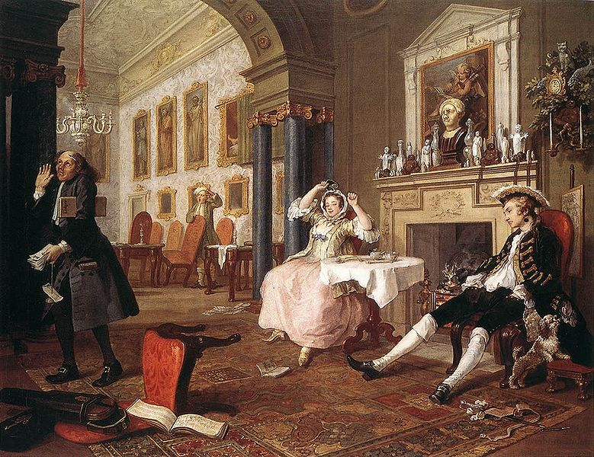

Slide 9
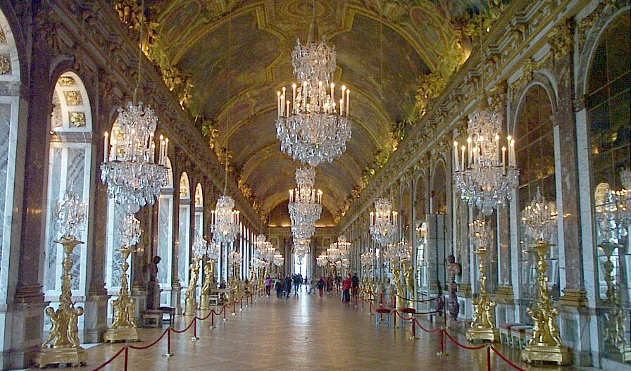

Slide 10
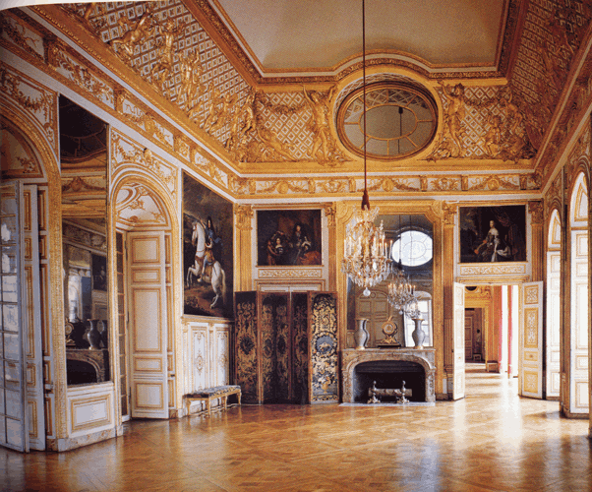

Slide 11
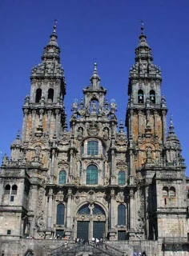

Slide 12
“Plain Church”
Restrained
Gentle
Less grandiose, more realistic to life
Calm
Rembrandt van Rijn

Slide 13
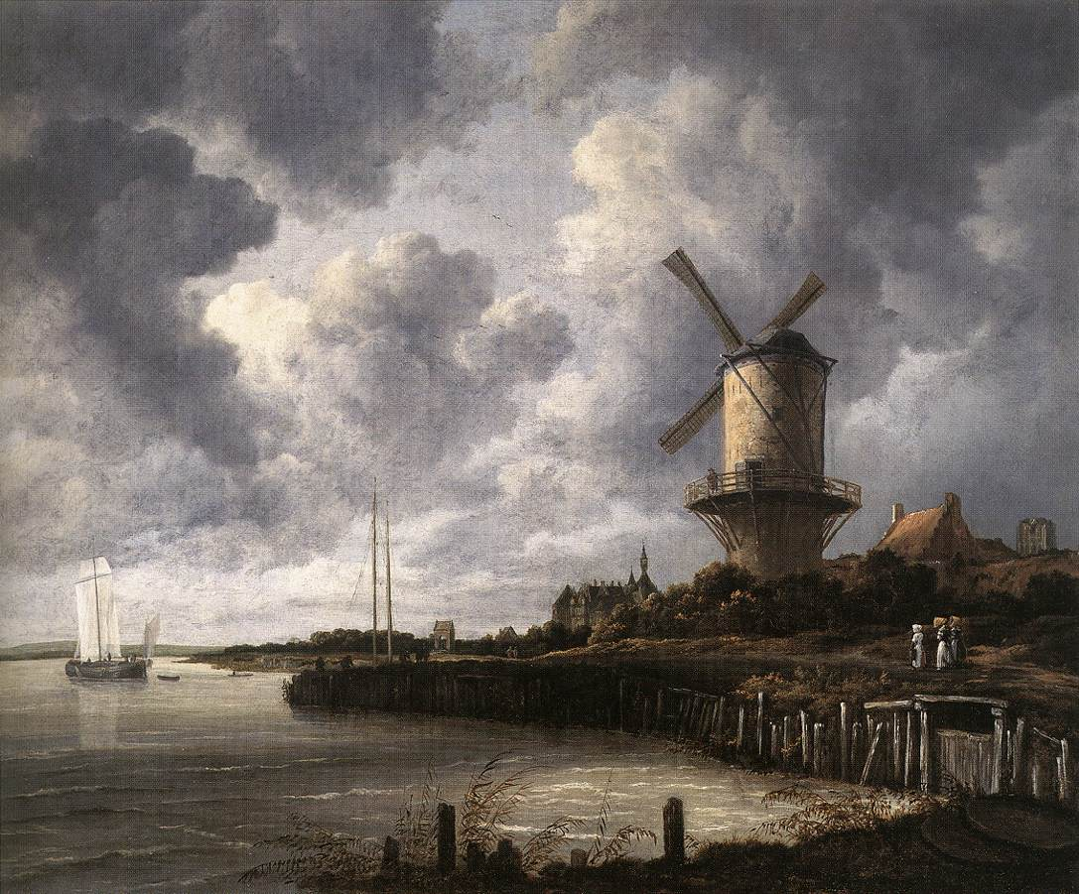

Slide 14
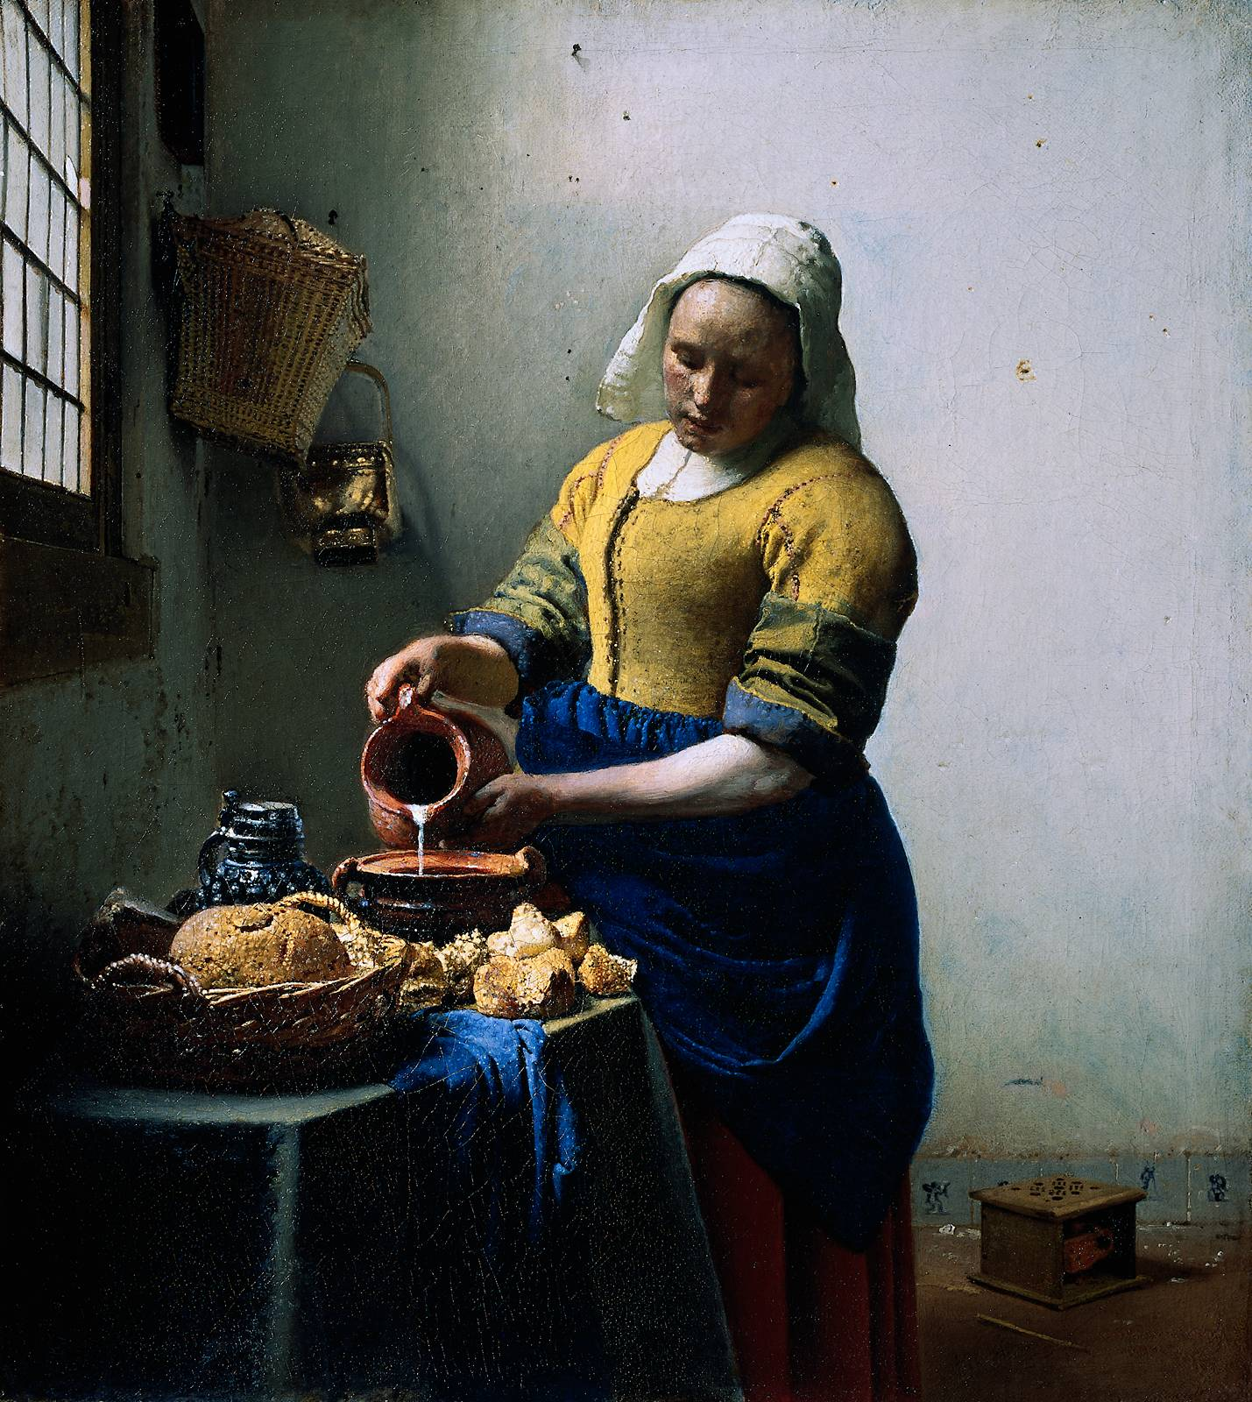

Slide 15
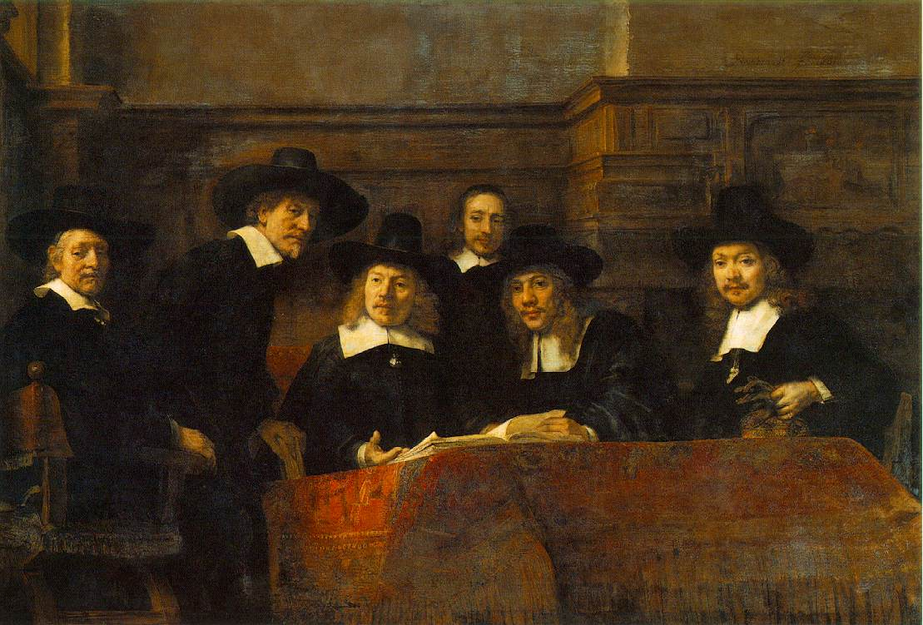
Syndics of the Draper’s Guild

Slide 16
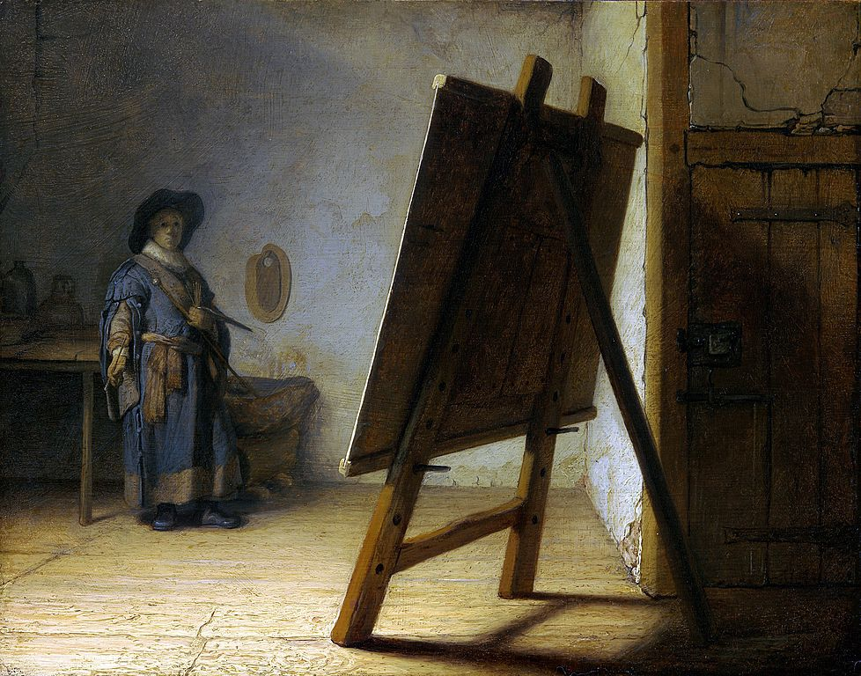

Slide 17
Politiques
Rulers that subordinate theology to political unity
Religious tolerance
Moderation
Compromise
Indifference
Elizabeth I
Those who stress religion over political unity had persecution toward those of different denominations, including wars
Did not achieve political goals

Slide 18
Struggle for the Crown
Rulers try to impose religion on their own and other nations
Catholic France and Spain declare war on Protestant England and Netherlands (30 Yrs War)

Slide 19
Early French Persecution
Huguenots: French protestants
Protestants in France capture French king and plaster anti-Catholic placards around Paris
Leads to mass persecution
Edict of Fontainebleau subjects Huguenots to Inquisition
When Henry II of Fr. is killed, 3 families vie for power: Bourbons, Montomrency-Chatillons, and Guises (Guises gain power)
Guises=militant, reactionary Catholic family (cardinals)

Slide 20
Appeal of Calvinism in France
40% of Fr. Aristocracy became Huguenots
Aristocracy wants Huguenots to gain power to declare religion of their areas
Thus, political decentralization
To gain political and religious power, Huguenots had to fight back, becoming militant against Catholic church

Slide 21
de Medici and Guises
Catherine de Medici becomes regent for son, Charles IX
Tries to reconcile protestants and Catholics
January Edict: protestants can worship publicly outside/privately inside towns
Duke of Guise massacres worshippers at Vassy, ending royal toleration
Fearing the power of the Guises, Medici submits to them, ending religious toleration
Duke of Guise is assassinated, Medici gives freedoms to Huguenots

Slide 22
St. Bartholomew’s Day Massacre
Medici assists Guises in assassinating Coligny, the head of Huguenots (he survives)
Afraid, Medici convinces king that Protestants are planning a coup under Coligny and that leaders should be killed
August 24, 1572: 3,000 Huguenots (including Coligny) are killed in Paris
20,000 more hunted/killed in France in 3 days
Catholic church celebrates killings
Now a struggle for survival of protestants, not just internal struggle between factions or royal houses
Calvin had taught non-violent submission
Knox encourages it as a Christian duty to depose an unjust, heathen (Catholic) tyrant

Slide 23
Henry III and Henry of Navarre
Henry III
Politique, tries to appease both sides
Peace of Beaulieu (1576): grants Huguenots religious and civil freedom
Forced to repeal Peace in 1577
Protestants led by Henry of Navarre
Catholic League (Spanish support) wants to take France
Henry III tries to attack League, fails, flees
Assassinates duke and cardinal of Guise
League responds furiously
Henry III allies with Henry of Navarre against Guises
Catholic friar kills Henry III; Henry of Navarre (Henry IV)

Slide 24
Henry IV
Now that Henry IV is in power, many fear protestant France
Spain rushes troops in to help Catholic League
Philip II had wanted to place daughter Isabella on French throne
French people support Henry IV in keeping bloodline pure over restoring Catholic France
Wanting to encourage religious tolerance toward Huguenots in France to keep political unity (politique), Henry IV converts to Catholicism
Unites French even more under his rule

Slide 25
Edict of Nantes
Formal religious settlement
Ends hostilities between France and Spain (Treaty of Vervins)
Recognized minority religious rights within officially Catholic country
Grants Huguenots freedom of public worship, right of assembly, admission to public offices and universities, permission to maintain fortified towns
Henry IV assassinated by Catholic radical
Edict is repealed by Louis XIV in 1685

Slide 26
Pillars of Spanish Power
Spain led by Philip II (Catholic), also heir to Habsburg empire
New World Riches
Silver from Bolivia and Mexico
Used to pay mercenaries
Unable to eliminate national debts
Increased Population
^ population= ^ wealth=inflation
Inflation=less food and fewer jobs
Efficient Bureaucracy and Military
Supremacy in Mediterranean
Catholic champion against Islam
Armada destroys Turkish fleet
Spanish military suppresses resistance in Portugal
Philip II inherits Portuguese throne
Enhances Spanish sea power, allows Spain to acquire Portugal’s empire

Slide 27
Revolt in the Netherlands
Netherlands part of Philip’s Habsburg empire
Cardinal Granvelle tries to take power from protestants by making them answer to Spanish royalty
Rather than submit, Protestants want independence and Calvinism/toleration
William of Orange wants political unity in Netherlands over religious creeds (politique)
Granvelle tries to reorganize Catholic power over Netherlands
Orange gains support of Dutch in removing Granvelle from power
Aristocrats are unable to hold control over the Netherlands
Compromise written to resist Council of Trent and Inquisition
Riots, Dutch Calvinists call for help from Huguenots and Lutherans

Slide 28
Revolt in the Netherlands
Philip II sends Duke of Alba to Netherlands to suppress revolt (10,000 strong)
Thousands of suspected heretics are publicly executed
Spanish force Netherlands to pay taxes to pay for their revolt
William of Orange emerges as leader for Dutch independence against Spain
Hires anti-Spanish exiles and pirates to fight
Fighting occurs, Dutch open dikes and flood land
Spain retaliates, killing thousands (“Spanish Fury”)
Catholic and Protestant provinces unite against Spain
“Pacification of Ghent”: internal regional sovereignty in matters of religion
Leads to Perpetual Edict, withdrawal of Spanish troops within 20 days

Slide 29
Dutch Independence
Philip II declares Orange an outlaw and places a bounty on his head
Strengthens resistance against Spain
Orange responds with the Apology: Philip as a heathen tyrant who Netherlands should not obey
Provinces meet in the Hague and declare independence from Philip II
Netherlands would later assist English in defeating Spanish Armada in English Channel
Spain leaves Netherlands to focus on French and English

Slide 30
Mary I of England
Mary weds Philip II of Spain
Symbol of militant Catholicism to English protestants
Mary returns official religion from Protestantism of Edward to Catholicism of Henry VIII
Protestant leaders executed
People flee persecution to Germany, and Switzerland, “Marian Exiles”
Become more “indoctrinated” in Protestantism

Slide 31
Elizabeth I
Wanted a religious settlement to be able to unify England politically (Politique)
Act of Supremacy makes Elizabeth “supreme governor” of Anglican Church (protestant doctrine, traditional Catholic ritual)
Thirty-Nine Articles makes Protestantism official religion within Church of England
Remains unmarried to allow for the possibility of marriage as a diplomatic advantage

Slide 32
Elizabeth and Her Enemies
Catholic radicals want to get rid of Elizabeth and replace her with Mary Stuart (of Scots)
Elizabeth as illegitimate, Stuart as rightful heir
Liz executes fewer Catholics than Mary Tudor had executed protestants
Wary of Puritans who want to rid Protestantism of any “popery,” seeing Liz as a threat under Act of Supremacy
Want to create a church that will be governed by peers (presbyteries/Presbyterians)
Elizabeth finds Puritans/Presbyterians as subversive
Conventicle Act of 1593: conform to Church of England or face exile/death

Slide 33
England vs. Spain
Duke of Alba invades Netherlands to persecute protestants + Pope Pius V excommunicates Elizabeth= internal resistance by Catholics to protestant Elizabeth
England and France sign mutual defense pact
John Hawkins and Sir Francis Drake begin attacking Spanish shipping in Americas
Liz signs Treaty of Nonsuch: English troops to Netherlands to protect protestants

Slide 34
Mary Queen of Scots
Catholic, French queen from Scotland
John Knox resists Mary’s Catholic practices in Scotland
Mary has claim to English throne, threatening religion in England
Various conspiracies against Elizabeth by Spain, supposedly led by Mary
Mary is executed
Spain prepares Armada for attack

Slide 35
Destruction of the Armada
Sir Francis Drake attacks Cadiz, destroys ships, and raids Portugal
England destroys Spanish Armada with the help of Dutch ships
Gives hope to Protestants against Catholic Spain
Spain begins losing power and credibility
England takes over as dominant power in Americas, France takes over as dominant power in Europe

Slide 36
Thirty Years War: The Causes
Catholics vs. Protestants and Calvinists vs. Lutherans
Fragmented Germany
360 autonomous political entities (secular and religious)
Peace of Augsburg allows each sovereignty to choose its own religion, control its borders and currency
German princes want to expand outside principality and national borders
Religious Divisions
Lutherans take Catholic lands and vise versa, going against Peace of Augsburg
Each deprives the others of rights, forces clergy to convert or step down
Conflict between Calvinists and Lutherans

Slide 37
Thirty Years War: The Causes
Calvinism and the Palatinate
Under Peace of Augsburg, Calvinism is not a recognized religion
Frederick III becomes Elector Palatine of Holy Roman Empire, making Calvinism official religion
Encourages resistance to Lutherans, Protestants, and Catholics
Calvinists are upset about Lutheran doctrine of the literal Eucharist/transubstantiation
Maximilian of Bavaria and Catholic League
Bavarian Catholics launch successful missions throughout Holy Roman Empire to take land from Lutherans
Now Maximilian (Catholic) vs. Frederick III (Calvinist) within Holy Roman Empire

Slide 38
The Thirty Years War: Four Periods
Bohemian Period (1618-1625)
Ferdinand takes the Habsburg throne, wants to restore e. Habsburg lands to Catholicism
Revokes rights/religious freedoms of Bohemian protestants
Protestants throw king’s regents out windows (“defenestration of Prague”)
Protestants proclaim Frederick V as king of Holy Roman Empire
Spain sends troops to assist Ferdinand
Lutheran John George assists Ferdinand, wanting trade routes
Ferdinand/Catholic forces victorious over Frederick

Slide 39
The Thirty Years War: Four Periods
The Danish Period (1625-1629)
Fears of re-Catholicization of Holy Roman Empire
Lutheran king Christian IV of Denmark wants to extend Danish influence over parts of Empire
Christian is defeated by Maximilian
Ferdinand responds by invading Denmark
Edict of Restitution: reaffirms illegality of Calvinism, orders return of lands Lutherans had acquired to Catholic Church

Slide 40
The Thirty Years War: Four Periods
The Swedish Period (1630-1635)
Gustavus Adolphus II as Lutheran king of Sweden, leads Protestant forces in Holy Roman Empire
Two supporters:
Cardinal Richelieu wants to protect French interests by keeping Habsburg armies tied down in Germany
Dutch want revenge against Spanish Habsburgs
Adolphus is victorious, but later dies in battle
Peace of Prague: German protestant states reach compromise with Ferdinand (Netherlands and France continue to support Sweden)

Slide 41
The Thirty Years War: Four Periods
The Swedish-French Period (1635-1648)
French, Swedish, and Spanish send soldiers in, looting Germany
Germany unable to fight back, exhausted
War kills 1/3 German population

Slide 42
Treaty of Westphalia
Ends all hostilities within Holy Roman Empire
Reasserts Peace of Augsburg
Ruler of land determines official religion
Gave Calvinists legal recognition
Establishes independence of Swiss Confederacy and United Provinces of Netherlands
France wants to gain more territory
Opposed by Pope b/c it gives power to protestants
Confirms territorial sovereignty of Germany’s political entities, perpetuating German division and political weakness into modern period

