Slide 1
The Pacific Theater

Slide 2
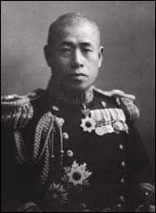
Stepping In
Oct. 1940: US cracks codes that Japan is planning to invade European colonies in SE Asia
Possible threat to American-controlled Philippines and Guam
US sends troops to assist China in resisting Japan
Japan takes French Indochina, FDR cuts off oil shipments
Japan begins planning surprise attacks on British, Dutch, and the US
Led by Admiral Isoroku Yamamoto

Slide 3
“December 7th, 1941…A Date which will live in infamy…”
Pearl Harbor, Oahu, Hawaii
Japanese air raid sunk/damaged 19 ships (inc. 8 battleships)
Kills 2300 Americans, 1100 wounded
Congress accepts the FDR’s declaration of war
Japan also launches attacks on British Hong Kong and American Guam and Wake Island
Guam and Wake fall to Japan, as do Philippines and other colonial islands
Japanese are brutal to their prisoners
Bataan Death March: Japan forces POWs to brutal march of 50+ miles
Japanese bury people alive, chop off heads with swords
54000 of 70000 survive

Slide 4
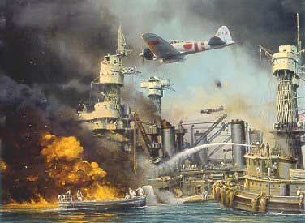

Slide 5
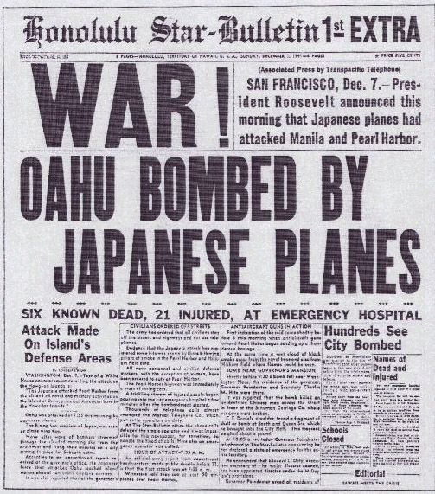

Slide 6
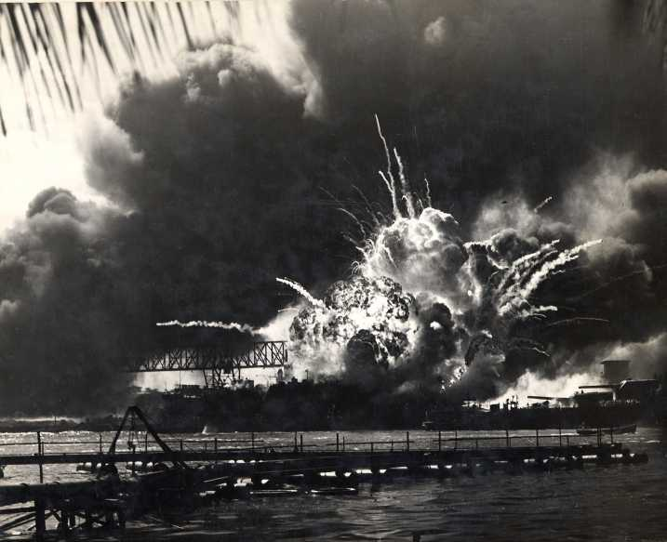

Slide 7
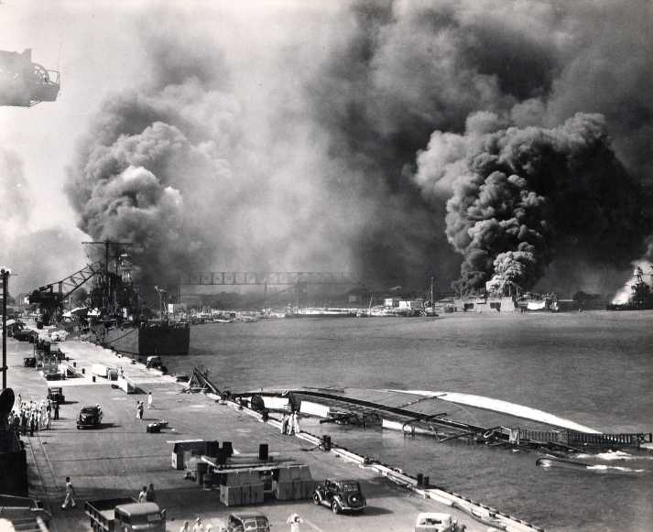

Slide 8
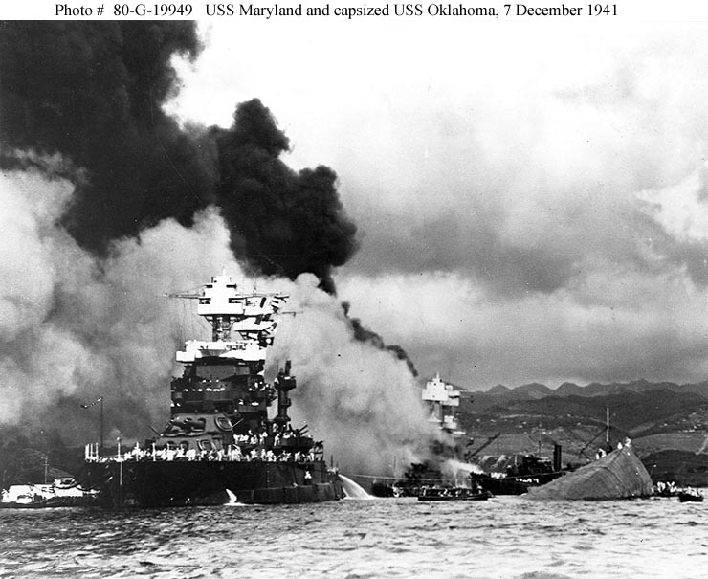

Slide 9
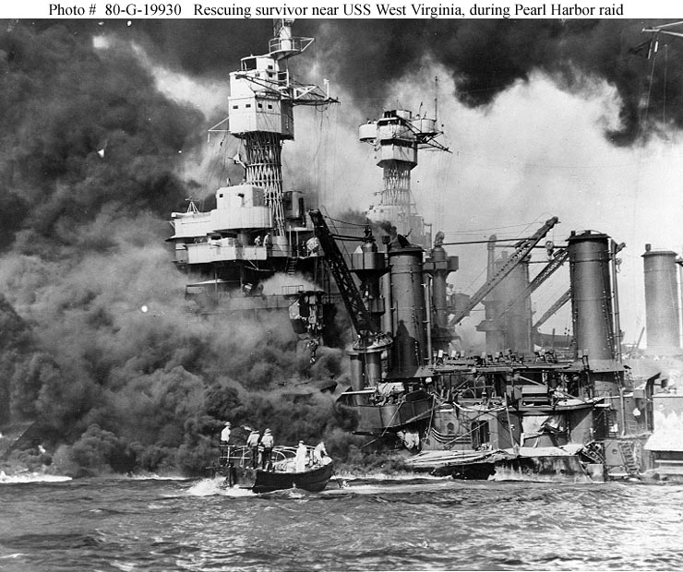

Slide 10
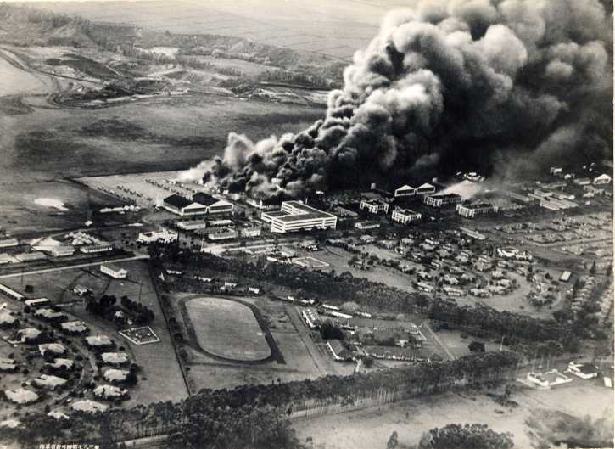

Slide 11
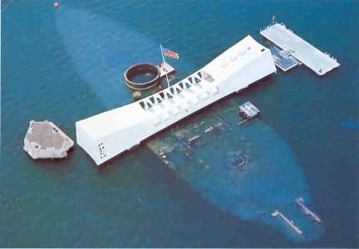

Slide 12
Allies Strike Back
April 1942: 16 B-25 bombers attack Tokyo
Raises America morale, shakes confidence of Japan
Battle of Midway
Midway is key American airfield
Code-breakers learn that Japan is headed to Midway (led by Yamamoto)
Americans allow Japan to begin attacking island
American planes swoop in and attack Japanese fleet
Destroys 332 Japanese plans, all 4 aircraft carriers, one support ship
Yamamoto flees, turning tide of Pacific campaigns

Slide 13
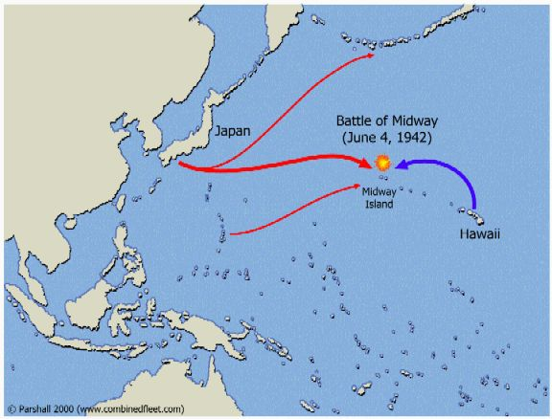

Slide 14
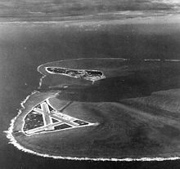

Slide 15
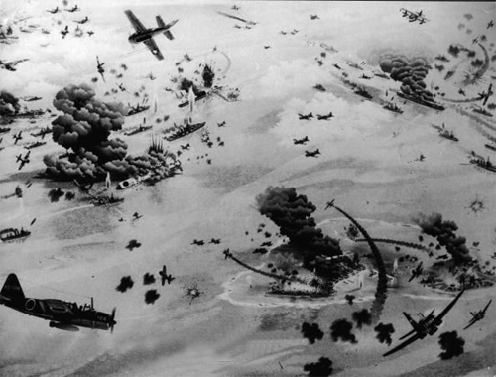

Slide 16
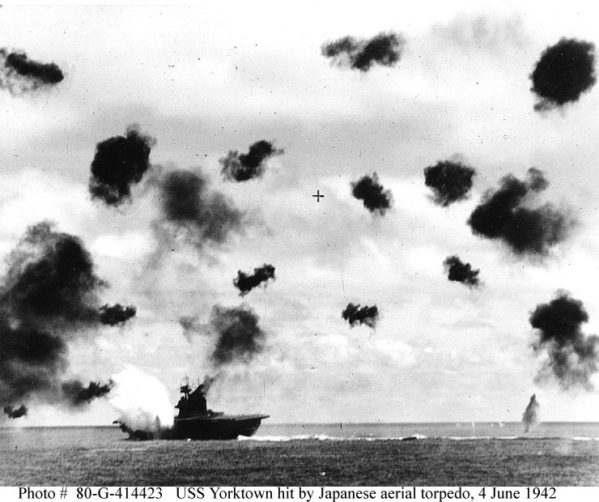

Slide 17
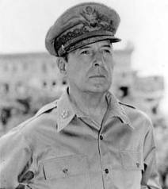
The Allied Offensive
General Douglas MacArthur: Commander of Allied Forces in the Pacific
Instead of storming each island, Allies should island-hop past Japanese strongholds
Seizing islands not well defended but close to Japan
Japan is building stronghold on island of Guadalcanal
Allies want to strike before airbase is completed (8/7/42)
Battle ends in 2/43
Japan loses 24000 of 36000 troops, abandon the island

Slide 18
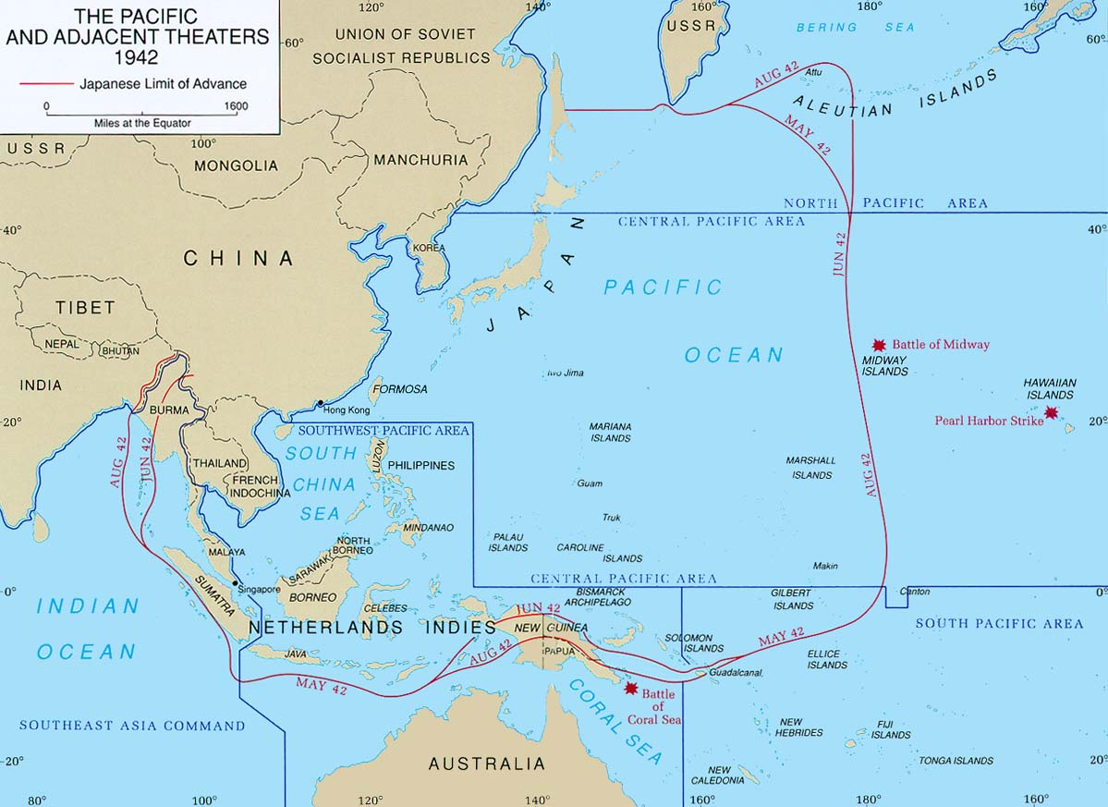

Slide 19
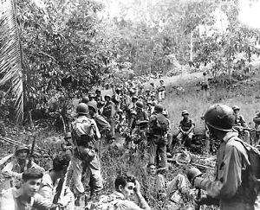

Slide 20
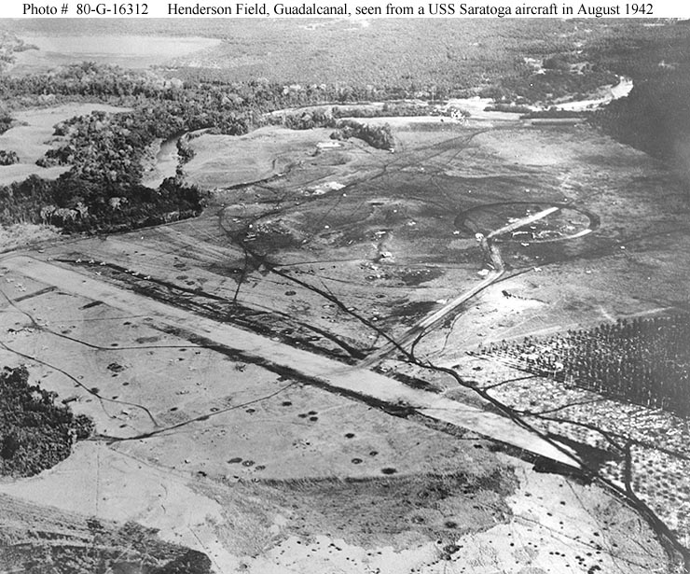

Slide 21
Japan in Retreat
Japanese navy is destroyed in battles of Philippines
Kamikaze pilots
Iwo Jima
Island with large rocky mountain
Japanese have hidden tunnels, attack
Thousands of men die on shores
Americans charge up mountain, use a pipe and flag to raise a flag
No one takes a picture, so flag is taken down, a rough flag is put back up and a picture is taken with different men
Japanese land wars end on June 21
Japan loses 100,000 troops, Americans lose 12000

Slide 22
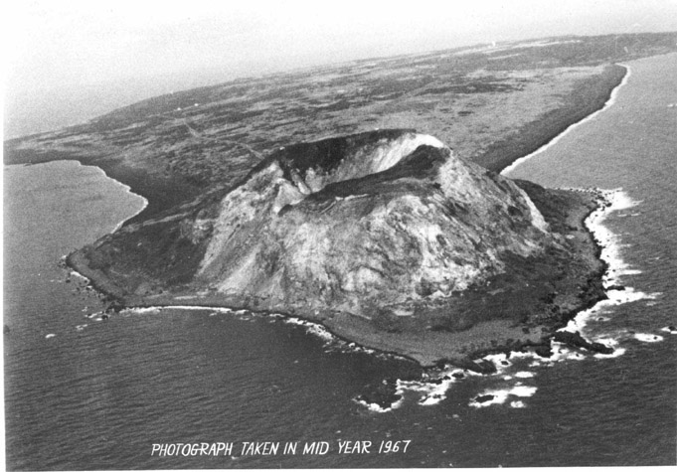

Slide 23
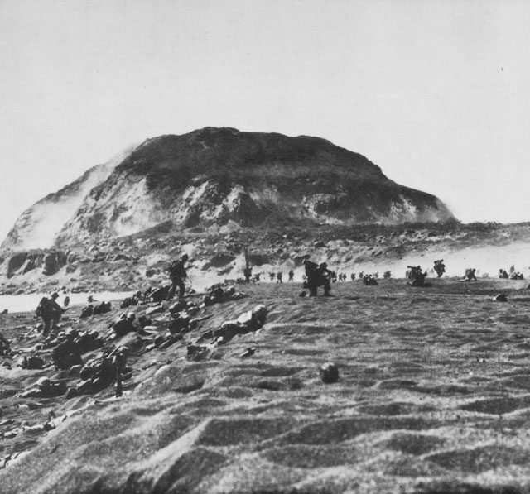

Slide 24
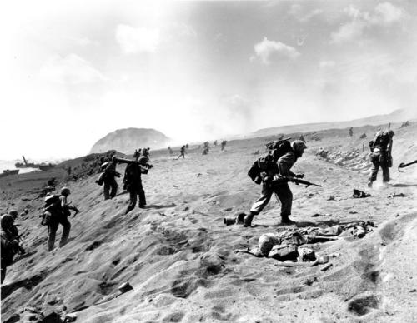

Slide 25
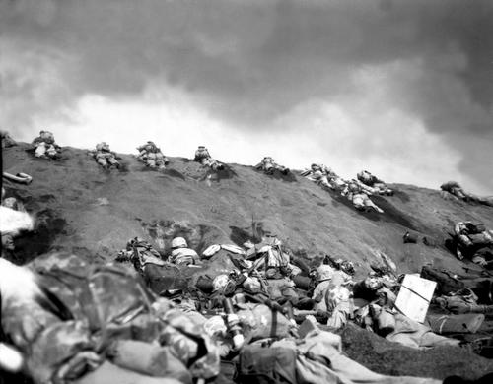

Slide 26
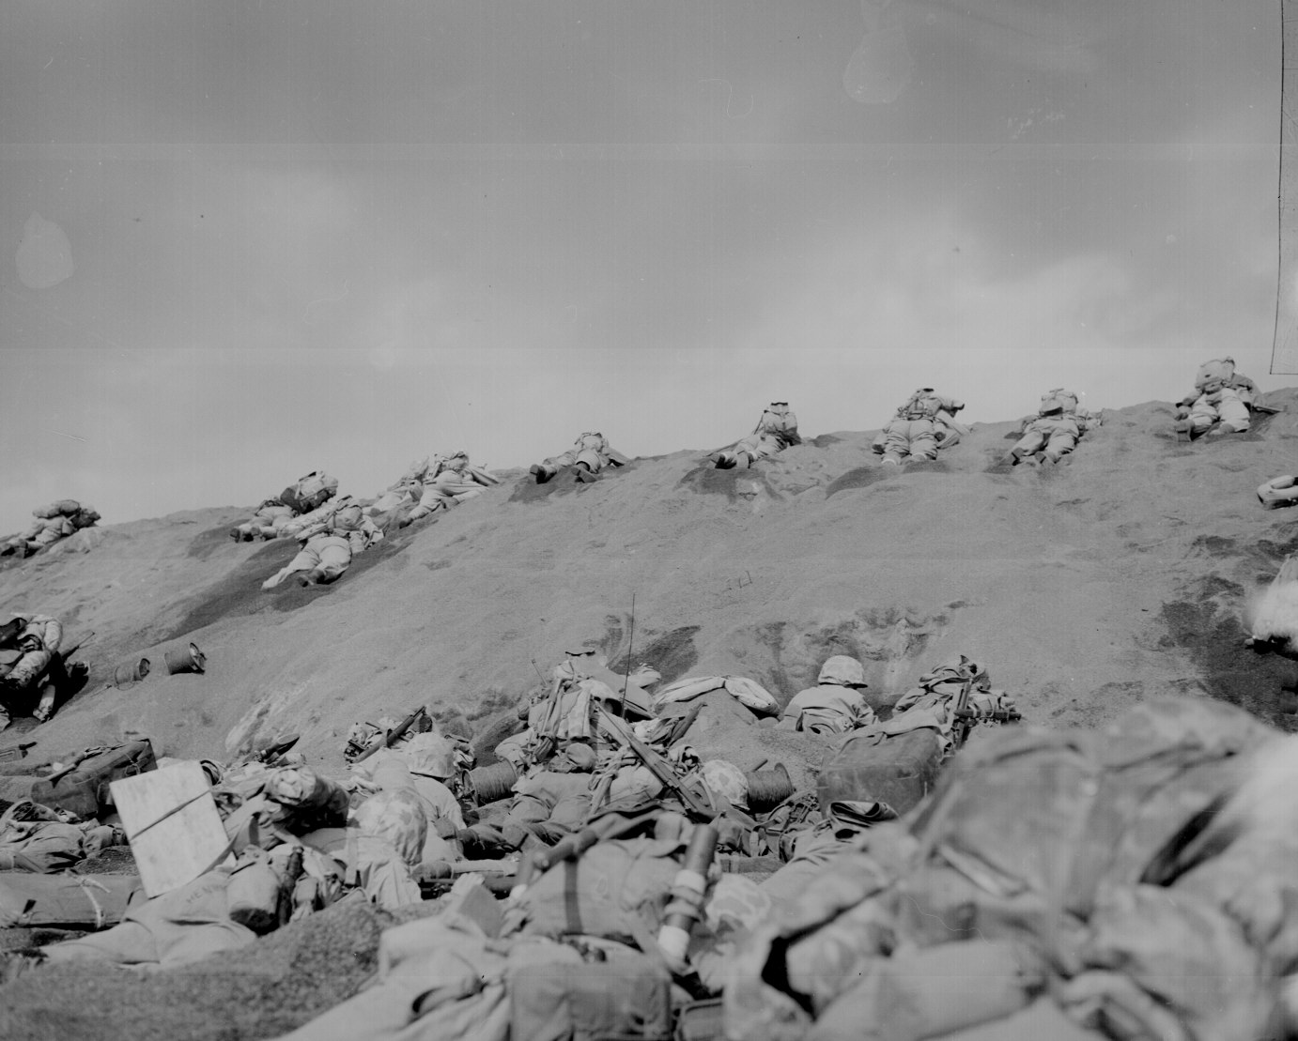

Slide 27
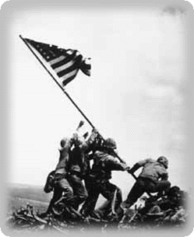

Slide 28
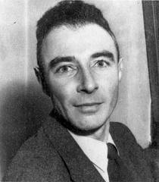
Japan Surrenders
Invading Japan could cost Allies 500,000 soldiers
Truman debates whether or not to use the atomic/A-bomb (Manhattan Project)
Bring war to quickest possible end
August 6, 1945: US drops A-bomb on Hiroshima
70-80,000 people killed
August 9, 1945: US drops A-bomb on Nagasaki
70,000 people killed
Radiation
VJ Day on 9/2/45

Slide 29
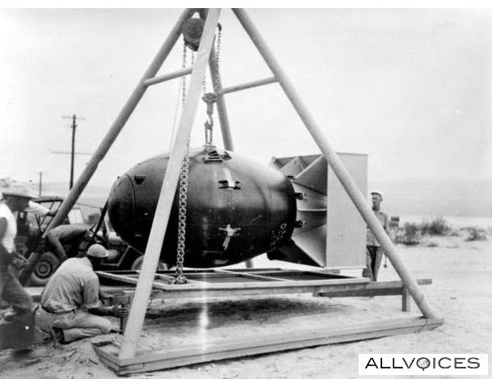

Slide 30
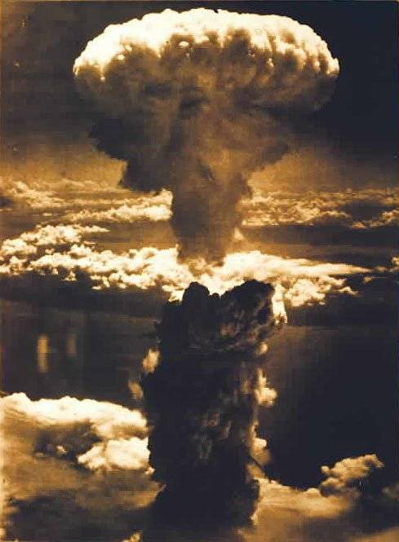

Slide 31
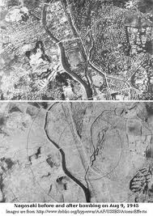

Slide 32
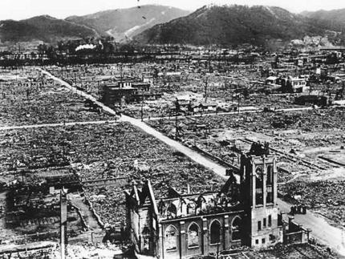

Slide 33
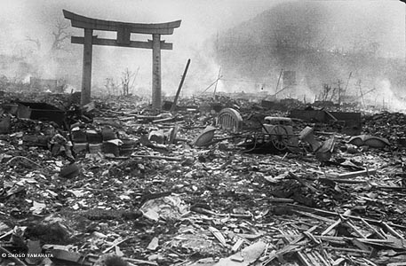

Slide 34
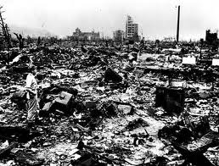

Slide 35
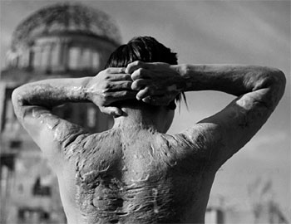

Slide 36
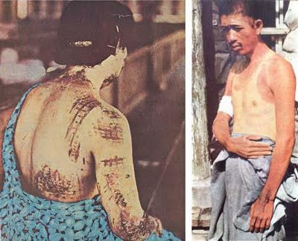

Slide 37
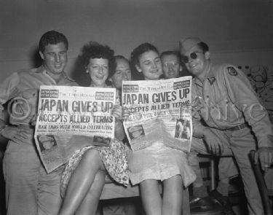

Slide 38
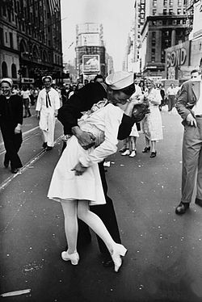

Slide 39
