Slide 1
Transition to a Westernized World

Slide 2
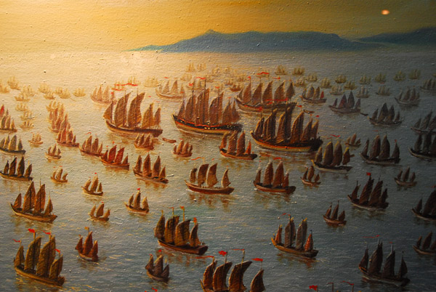
Module 1: The East

Slide 3
Decline of the Middle East
1200: still dominated by Byzantines and caliphate
1400: Byzantines in decline by Ottoman Turks (1453), caliphate fallen by Mongols
Authority of caliphate declined as landlords seize power over peasants
Peasants lose freedom, becoming serfs
Agricultural productivity suffered
Tax revenues declined
European merchants begin to challenge Arab merchants
Piety of Sufist movement leads to new emphasis on religious and rationalistic ideas
Mongols displace caliphate
Mongols encouraged interregional trade and exchange
With the fall of the Mongols, trade vacuums developed
Filled by Europeans

Slide 4
Ming China
Revolution drives out Mongols in 1368
Led by peasants, establish Ming dynasty (“brilliant), lasting until 1644
Ming focus on expansionism
Early emperors press to secure borders of Middle Kingdom
Push Mongols far north to Mongolia
Reestablish influence over Korea, Vietnam, Tibet
Receiving tribute
State-sponsored expeditions (treasure fleet)
First fleet in 1405 to India (62 ships, 28,000 men), later to Middle East and Africa
Zhenghe leads expeditions from 1405-1433
Eunuch Muslim, travels to collect tribute and exotic items for emperor
Resented by bureaucrats
Costs of expeditions unacceptable
See Zhenghe as a rival
Preference for tradition rather than international expenditures and foreign involvement
Consolidation of Chinese rule
Colonies established in Philippines, Malaysia, Indonesia
Internal economic development continues with focus on domestic, isolated economies
Clears the way for Europeans to emerge as stronghold in international trade

Slide 5
Module 1 Reflection Questions
How did the declining role of the caliphate affect politics, religion, and culture?
How did the decline of the caliphate affect the economics of the Middle East?
Why does Chinese internationalism suddenly stop?
What factors led to the emergence of western Europe as a strong force in internationalism?

Slide 6
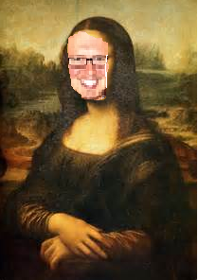
Module 2: The Rise of Western Europe

Slide 7
The Fall of Feudal Europe
Interaction with the East
Mongols, China, Middle East, etc.
Awed by bureaucracies
Fall of feudal culture
Church under attack
Aristocratic lifestyle falters (jousting, rituals, etc)
Famine
No new agricultural technology
Population greater than food supply
Reduced disease resistance (1/3 population due to Black Death)

Slide 8
Rise of Modern Europe
Strengthening of feudal monarchy
Leads to more effective national/regional gov’ts
Portugal and Spain
Improvements in military technology (100-Yr War)
Non-aristocratic, professional soldiers
Growth of cities and urban society
Commercialism
Church and capitalism make peace
Improvements in day-to-day technology
Ironwork, timekeeping, etc.
Imitation from the east
Printing, compass, explosive powder

Slide 9
The West in the World
Hunger for Asian luxuries
Spices, silks, sugar, perfumes, jewels, precious metals
Europe only has crude goods to offer (wool, tin, copper, honey, salt) leading to unfavorable balance of trade
Europe with limited gold supply, threatens collapse
Fears of threat from Muslim traders (esp. Egypt)
Muslims act as intermediaries between Europeans and Asia
No western-controlled ports in eastern Mediterranean
Begin searching for a bypass to the east

Slide 10
The Renaissance
Centered in Italy
Direct influence of old Roman empire
Central between east and west
Secular focus in literature and art, heavy focus in religion
Realistic portrayals of people and nature
Focus on doings of human beings for own sake rather than as a divine plan (humanism)
Innovation in art
Move toward art, people, cityscapes
Departure from stiffness to fluidity and realism
Perspective, color, classical architecture
Petrarch
Focused on personal ethics and behavior, personal achievement
Generally geared towards and felt by upper classes (high culture)
Commerce and shipping
City-state governments try for more tax money and commerce

Slide 11
Renaissance Art
“Medieval Christian values adjusted to a more this-worldly spirit”
High Renaissance
Embraced natural world and human emotions
Rational/mathematical order
Perfect symmetry and proportionality (harmony of universe)
New technical skills
Oil paints
Shading to enhance naturalness (chiaroscuro)
Adjusting size of figure to create continuity with painting (linear perspective)
Portraying space realistically
Paint more natural world
3D canvas filled w/ energy and life

Slide 12
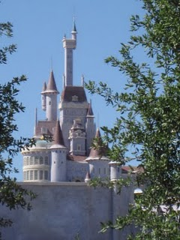
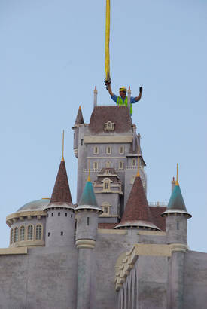

Slide 14
Leonardo da Vinci
Ideal of universal person
Jack of all Trades
Inner moods through complex facial expression

Slide 15
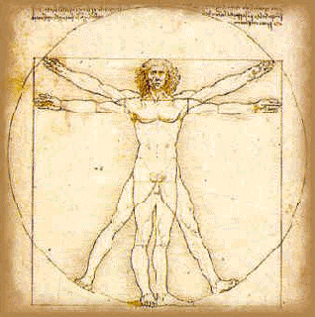

Slide 16
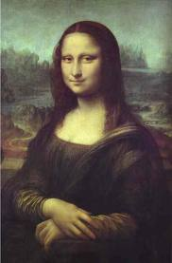
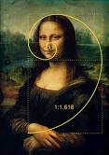

Slide 17
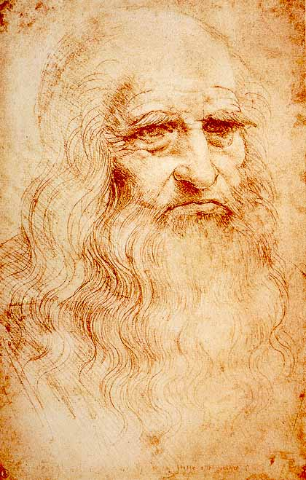

Slide 18
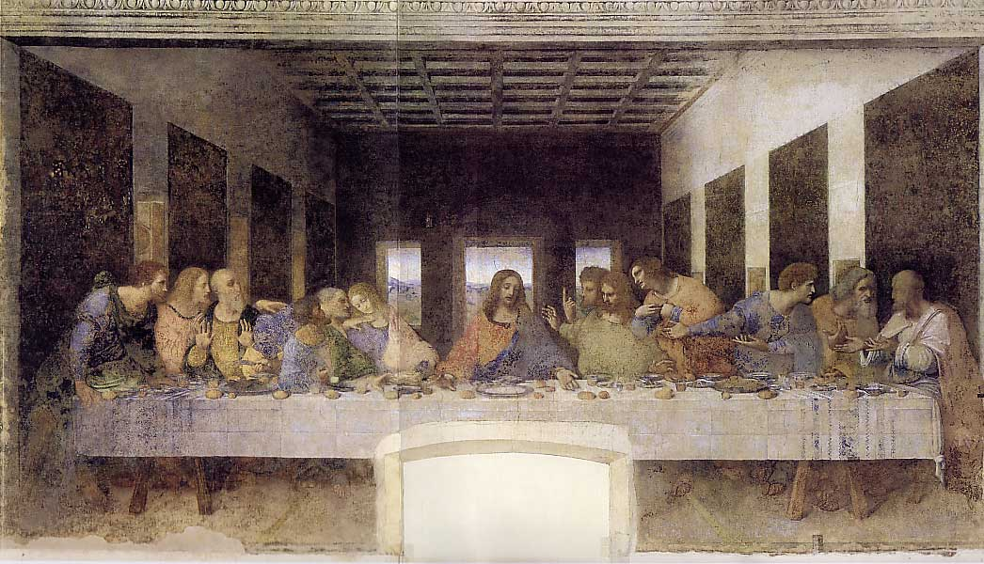

Slide 19
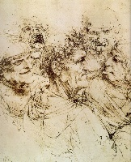

Slide 20
Raphael
Famous for madonnas
“School of Athens”

Slide 21
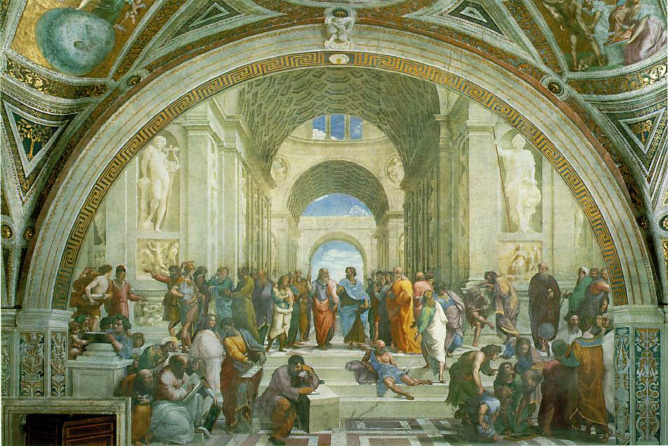

Slide 22
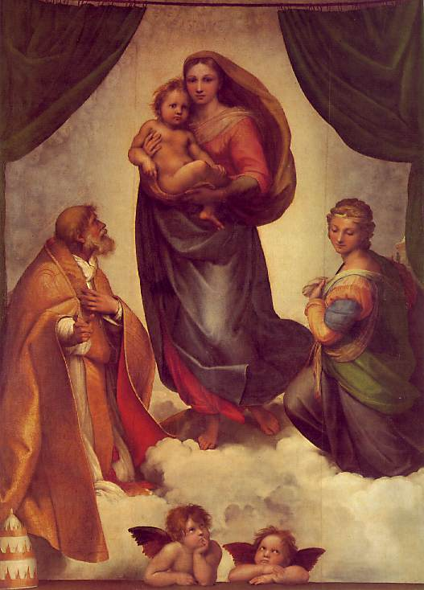

Slide 23
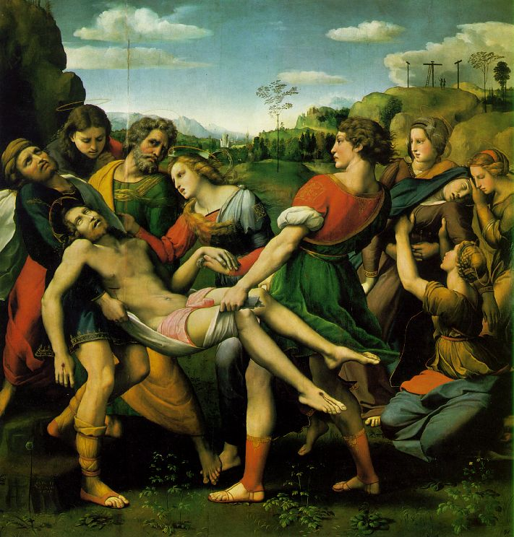

Slide 24
Michelangelo
“David”
Harmony, symmetry, proportion
Glorification of human form
Sistine Chapel (Julius II)
Mannerism
Strange and abnormal, freer reign to individual perceptions and feelings of artist

Slide 25
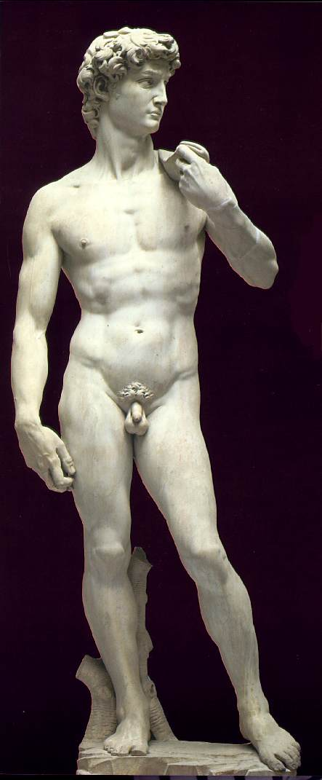

Slide 26
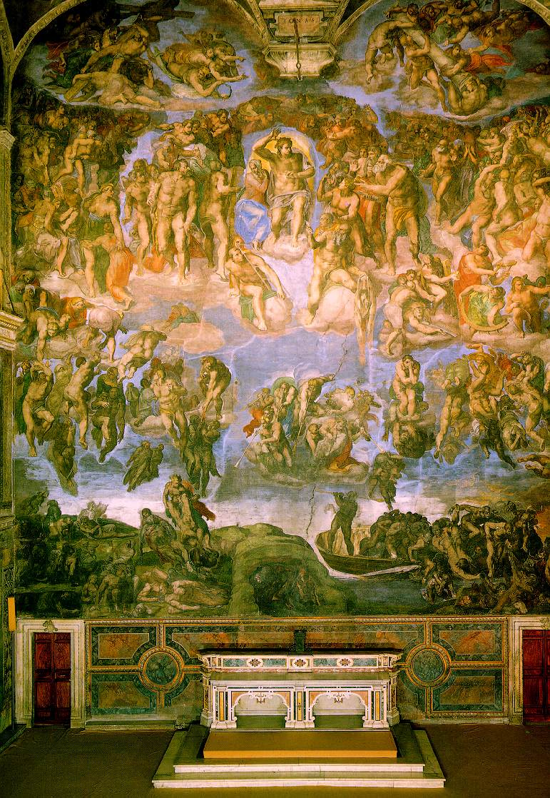

Slide 27
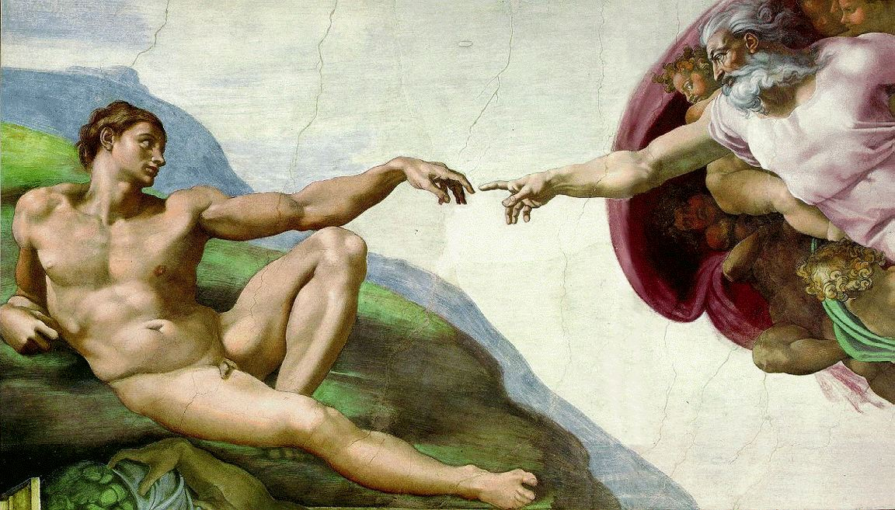

Slide 28
Northern Renaissance
What brought the Renaissance north?
Differences between the Italian and Northern Renaissance
Significance of the printing press
Erasmus
How did Erasmus’ teachings relate to religion and what did religion think about it?
Humanism and Reform
How did Humanism appear in Germany?
How did Humanism get into Ger, Fr, Eng, and Spa?
Art
Durer
Bruegel
Van Eyck

Slide 29
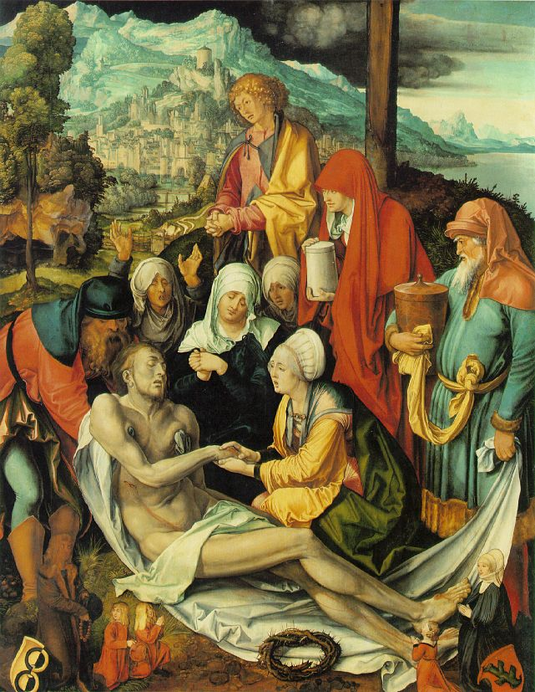

Slide 30
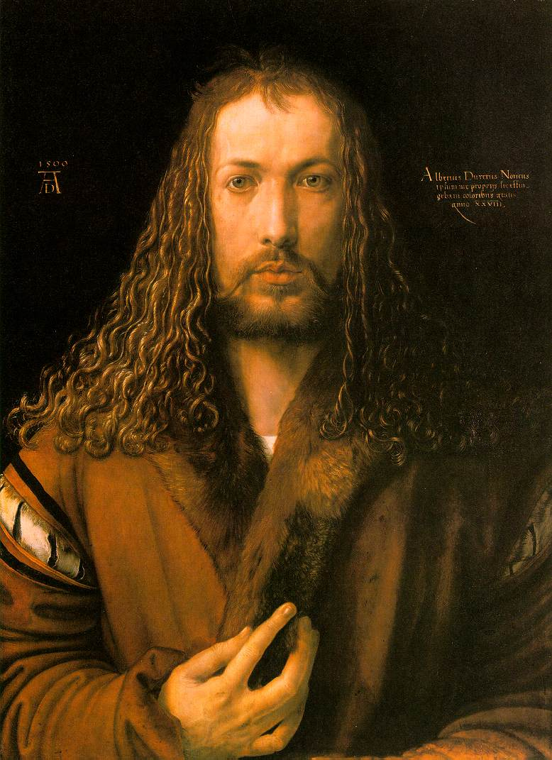

Slide 31
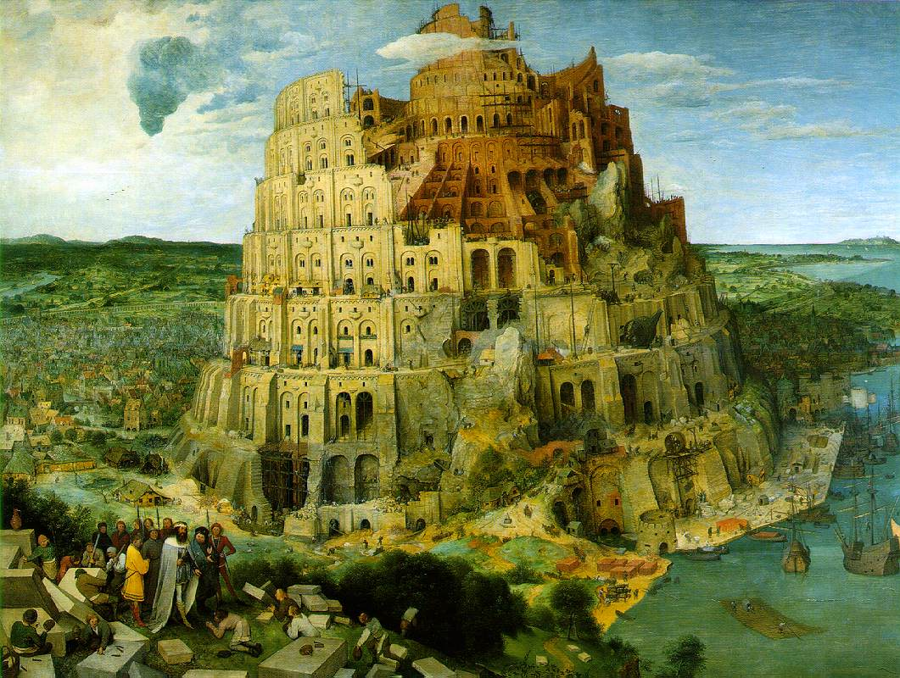

Slide 32
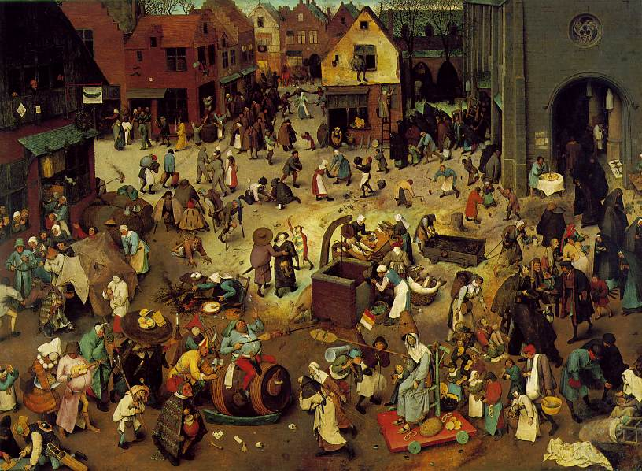

Slide 33
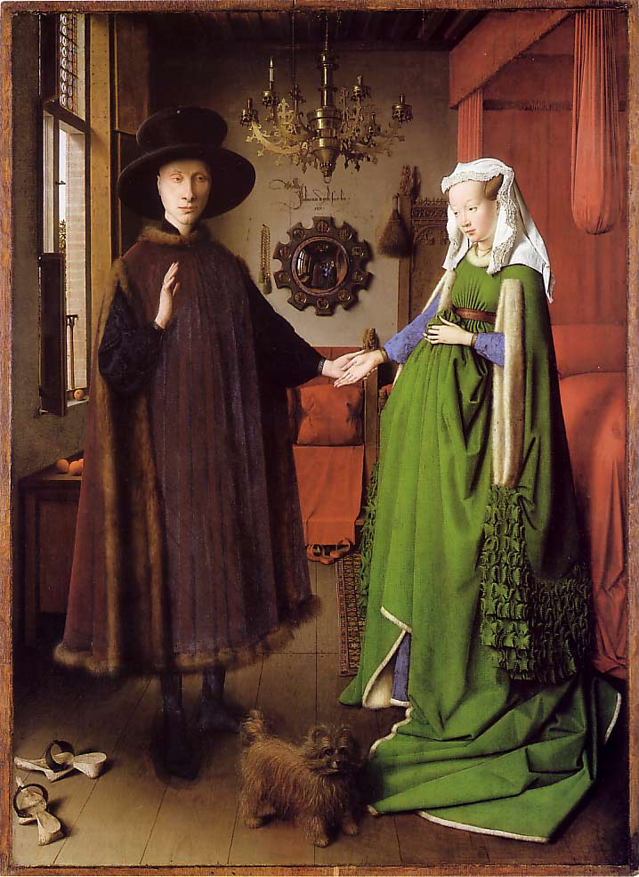

Slide 34
Theocratic Spain
Iberian Peninsula (Spain and Portugal)
Christian military leaders push back boundaries of Muslim states
Two large regional monarchies emerge, Castile and Aragon (Ferdinand and Isabella)
Unite in marriage, 1469
Belief that government had mission to promote Christianity
Expulsion of Jews and Muslims who refuse to convert (reconquista), maintain doctrinal purity within church
Government supported church courts, enforcing moral and doctrinal purity
Reestablishment of Inquisition, enforcing religious orthodoxy

Slide 35
Module 2 Reflection Questions
Why did western Europe imitate the east? What did they copy?
Why might the unfavorable balance of trade and the gold famine lead to expansion and exploration?
How did the ideas of Renaissance (rebirth) manifest themselves in art?
Why was the Renaissance in Italy?
What was the relationship between church and state in Spain? Explain.

Slide 36
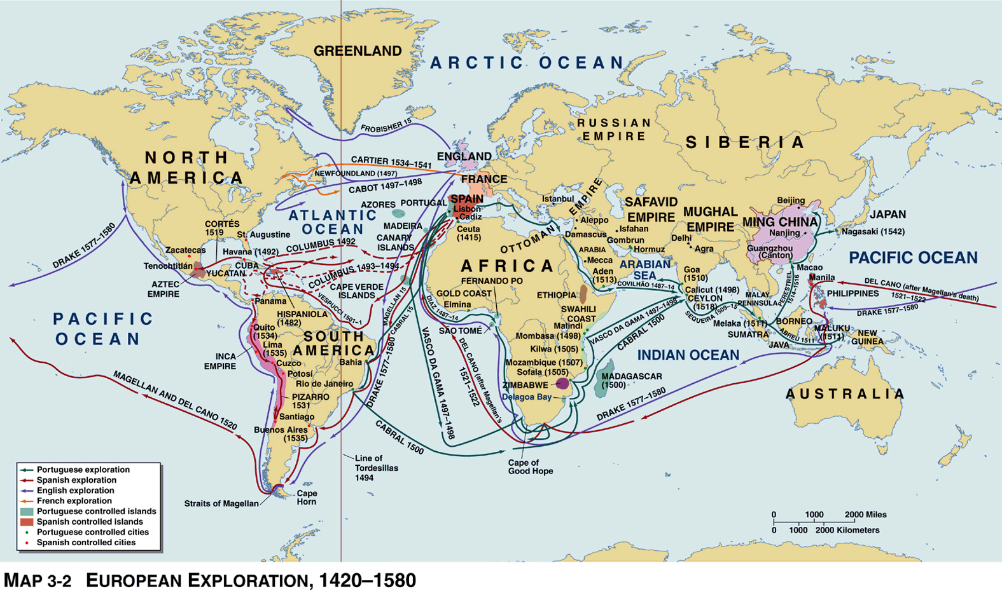
Module 3: Early Expansion

Slide 37
Early Exploration
1291: Vivaldis (Genoa, Italy) search for western route to Indies, disappear
Spice producing regions of s./SE Asia
1300s: Genoese explorers “discover” Canary Islands, Madeiras, Azores
However, barriers prevent full-scale exploration
Lack of navigation instruments
Poor shipping (shallow, oar propelled)
Poor mapmaking techniques
Learn skills and strategies from Chinese and Arabs
Compass, astrolabe, sailing vessel
1498: Vasco da Gama reaches India

Slide 38
Colonization and Imperialism
Exploration led by Spain and Portugal
New lands with potential for economic benefit
Henry the Navigator sponsors 1/3 Portuguese voyages
Motivated by science, curiosity, religion, economics
Portuguese and Spanish colonization
Azores (1439), grant land to colonists
Canaries, Madeiras
Bring western plants, animals, weapons, diseases
Columbian Exchange
Establishment of agricultural estates providing cash crops
Sugar, cotton, tobacco
Use of slave labor

Slide 39
Module 3 Reflection Questions
What were the barriers to exploration?
What are the goals of Europeans in terms of exploration? Why?
What do new lands have to offer Europe?
a. How can you foresee the game of imperialism and colonization expanding for Spain and Portugal?
b. How might Spanish and Portuguese colonies motivate other European nations?

Slide 40
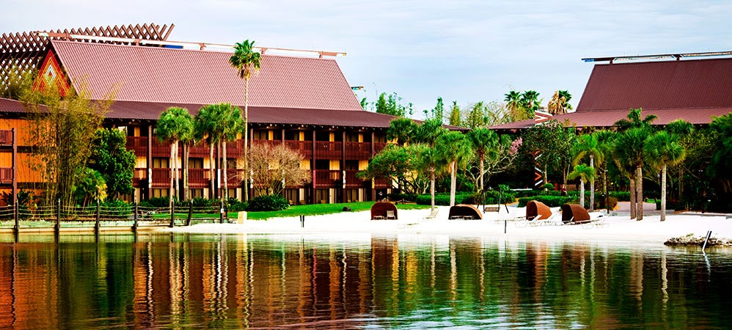
Module 4: Outside of the East and West

Slide 41
The Americas on the Eve of Invasion
Political fragmentation
Aztec exploitation of subject peoples for gold, slaves, sacrifice
Leads to great resentment
Inca imperial leadership causes frustration at the local level

Slide 42
Hawai’i
Expansion from 7th-14th centuries
Originated in Society Islands (Tahiti, Samoa, Fiji)
Circa 7th c: spread to Hawai'i in great war canoes
Contact continues between Hawai’i and Society Islands until around 1300s
Cut off from Polynesia between 1400 and 1778 (Euro arrival)
Agricultural clusters and fishing villages
Utilized local vegetation, create implements using vegetation
Importation of pigs from Society Islands
No use of metals or written language
Regional kingdoms
Caste system: priests/nobles>commoners
Highly warlike

Slide 43
New Zealand and the Maori
Migration from Society Islands to New Zealand around 8th century
Original migrants small in numbers, grow over time with additional migrations
Maori adapt to environment (colder and harsher than Society Islands)
Tribal military and priests hold power
Slaves and prisoners of war
Total isolation from the rest of Polynesia and the world

Slide 44
Module 4 Reflection Questions
How could the political fragmentation of the Inca and Aztecs lead to an ease for European invasion?
Why did the societies of Hawai’i and the Maori develop so differently even though they originated in the same place?
What were the factors that led to the transition from the post-classical to modern eras of world history?

